Slide 1
Year: 3
Term: 2
Objective: We are learning to use ‘ing’ verbs at the start of our sentences.
Author: Penny Blomfield, Wiehann Nel & Stephanie Le Lievre

Slide 2
Multiple Choice
Pair Share
Track with me
Pick a Stick/Answer (non-volunteer)
Whiteboards
Vote
Read with me
In Your Workbook

Slide 3
Learning Objective
We are learning to use ‘ing’ verbs at the start of our sentences

Slide 4
Concept Development
Action verb
An action verb is a verb that describes an action, like run, jump, kick, eat, break, cry, smile, or think.
Speaking verb:
Speaking verbs give the reader information about the thoughts and feelings of the characters who are speaking-e.g. yelled, screamed, whispered, muttered.
CFU:
What is an action verb?

Slide 5
Concept Development
‘ing’ is a suffix. It is used to make verbs in the present tense (happening now).
CFU:
What is an action verb?
Running
Laughing
Walking
Swimming
Singing

Slide 6
Concept Development
We can improve our writing by varying our sentence types.
We can start sentences using an ‘ing’ verb.
We don’t want to overuse this technique, but it can be useful when used purposefully.
CFU:
There are two verbs in each of these sentences. What are they?
Examples:
Sighing, the boy walked to his bedroom.
Yelling, mum called everyone to dinner.
Smiling from ear to ear, the boy handed the parcel to the family.
Crying her eyes out, Lucy clutched her grazed knee.

Slide 7
Concept Development
We can improve our writing by varying our sentence types.
We can start sentences using an ‘ing’ verb.
We don’t want to overuse this technique, but it can be useful when used purposefully.
CFU:
What is the verb in the sentence opener?
Running like the wind,…
Looking out the window,…
Laughing out loud,….
Treading carefully,…
Scanning the horizon,…

Slide 8
Concept Development
We can improve our writing by varying our sentence types.
We can start sentences using an ‘ing’ verb.
We don’t want to overuse this technique, but it can be useful when used purposefully.
CFU:
Why isn’t this an example?
Non-examples
Quietly, the boy crept to his bedroom.
Suspiciously, he peered into the Principal’s office.
Although these are great sentences, they both begin with an adverb. They are not examples of sentences that begin with –ing verbs.

Slide 9
Hinge Point Question
Which sentences begin with a –ing verb?
CFU:
Why is it/ isn’t it a an example of an –ing sentence starter?
Gazing out the window, Tom thought about what High School would be like .
Screaming in pain, Samantha clutched her broken ankle.
They were smiling with delight.
Sneakily, he crept out the door.

Slide 10
Skill development: I do
Read the clause
Identify the main verb in the clause
Add an appropriate –ing verb to the beginning of the sentence.
CFU:
Which verb sentence opener matches the clause?
________________, Mel headed towards the safe house.
Running as fast as she could
Walking at pace
Singing at the top of her lungs
Running as fast as she could, Mel headed towards the safe house.

Slide 11
Skill development: We do
Read the clause
Identify the main verb in the clause
Add an appropriate –ing verb to the beginning of the sentence.
CFU:
Which verb sentence opener matches the clause?
________________, Penny avoided the older children in the park.
Laughing out loud
Looking towards the ground
Singing at the top of her lungs
Looking towards the ground, Penny avoided the older children in the park.

Slide 12
Skill development: We do
Read the clause
Identify the main verb in the clause
Add an appropriate –ing verb to the beginning of the sentence.
CFU:
Which verb sentence opener matches the clause?
________________, Ben wondered when it was going to rain.
Clicking his fingers
Looking towards the ground
Gazing out of the window
Gazing out of the window, Ben wondered when it was going to rain.

Slide 13
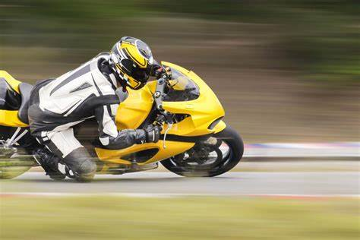
Skill development: I do
Finish the sentence:
Speeding the whole way,
the man rode along the freeway.

Slide 14
Skill development: We do
Finish the sentence:
Smiling,

Slide 15
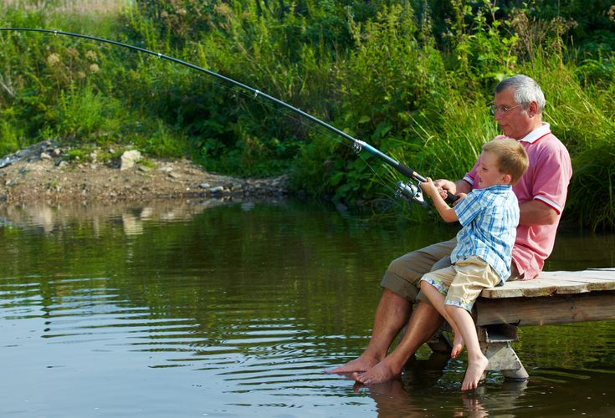
Skill development: We do
Finish the sentence:
Cheering loudly,

Slide 16
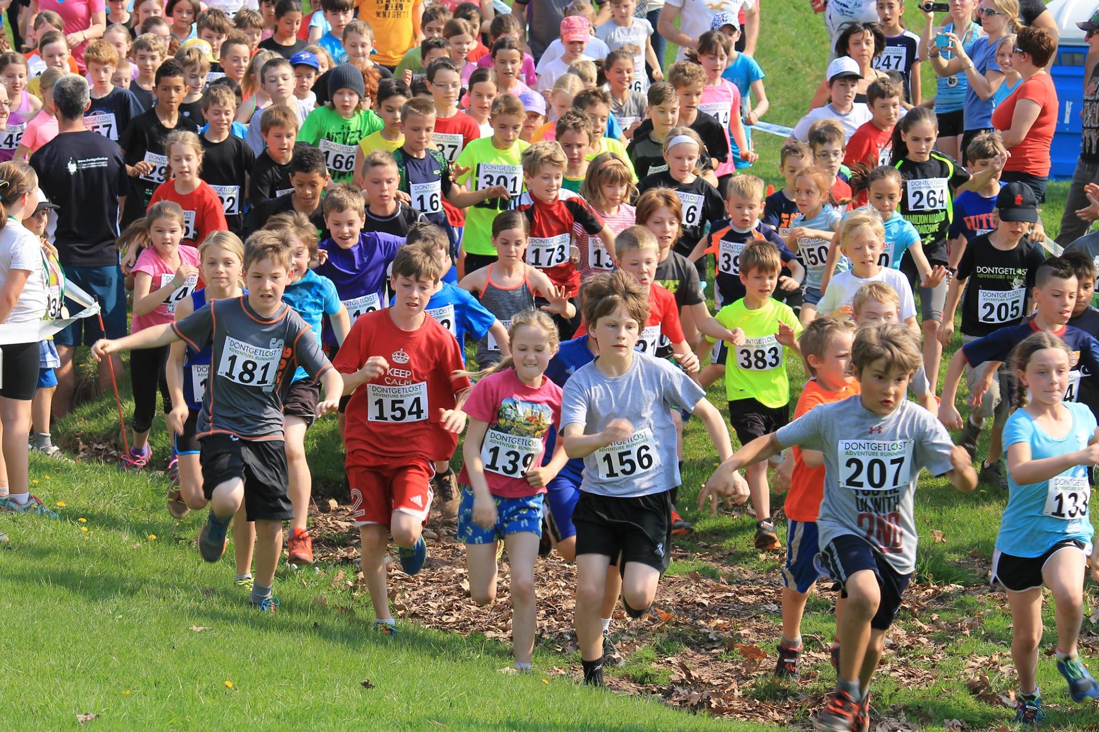
Skill development: We do
Finish the sentence:
Trying their best,

Slide 17
Skill development: I do
Write a sentence for this picture using an –ing starter

Slide 18
Skill development: I do
Write a sentence for this picture using an –ing starter

Slide 19
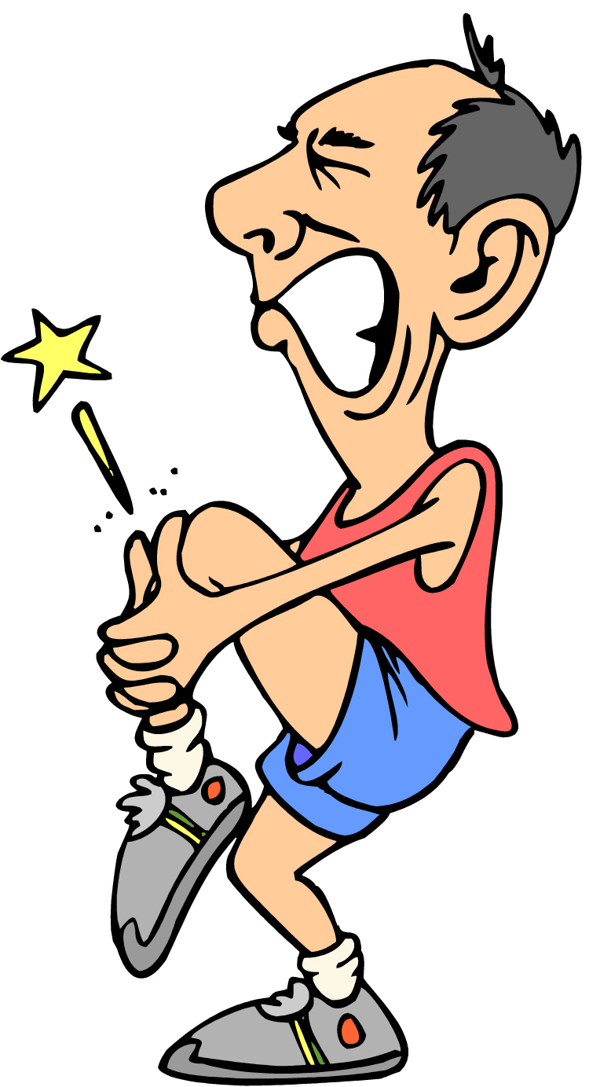
Skill development: I do
Write a sentence for this picture using an –ing starter

