Slide 1
Year: 5/6
Term: 1
Objective: Use apostrophes to show possession in a singular word and plural word (e.g. the cat's biscuits, the horses' paddock)
Author: Michelle Thomas, Hayley Howard and Nicole Page

Slide 2
Multiple Choice
Pair Share
Track with me
Pick a Stick/Answer (non-volunteer)
Whiteboards
Vote
Read with me
In Your Workbook

Slide 3
Learning Objective
We are learning to use apostrophes to show possession in singular words or plural words.

Slide 4
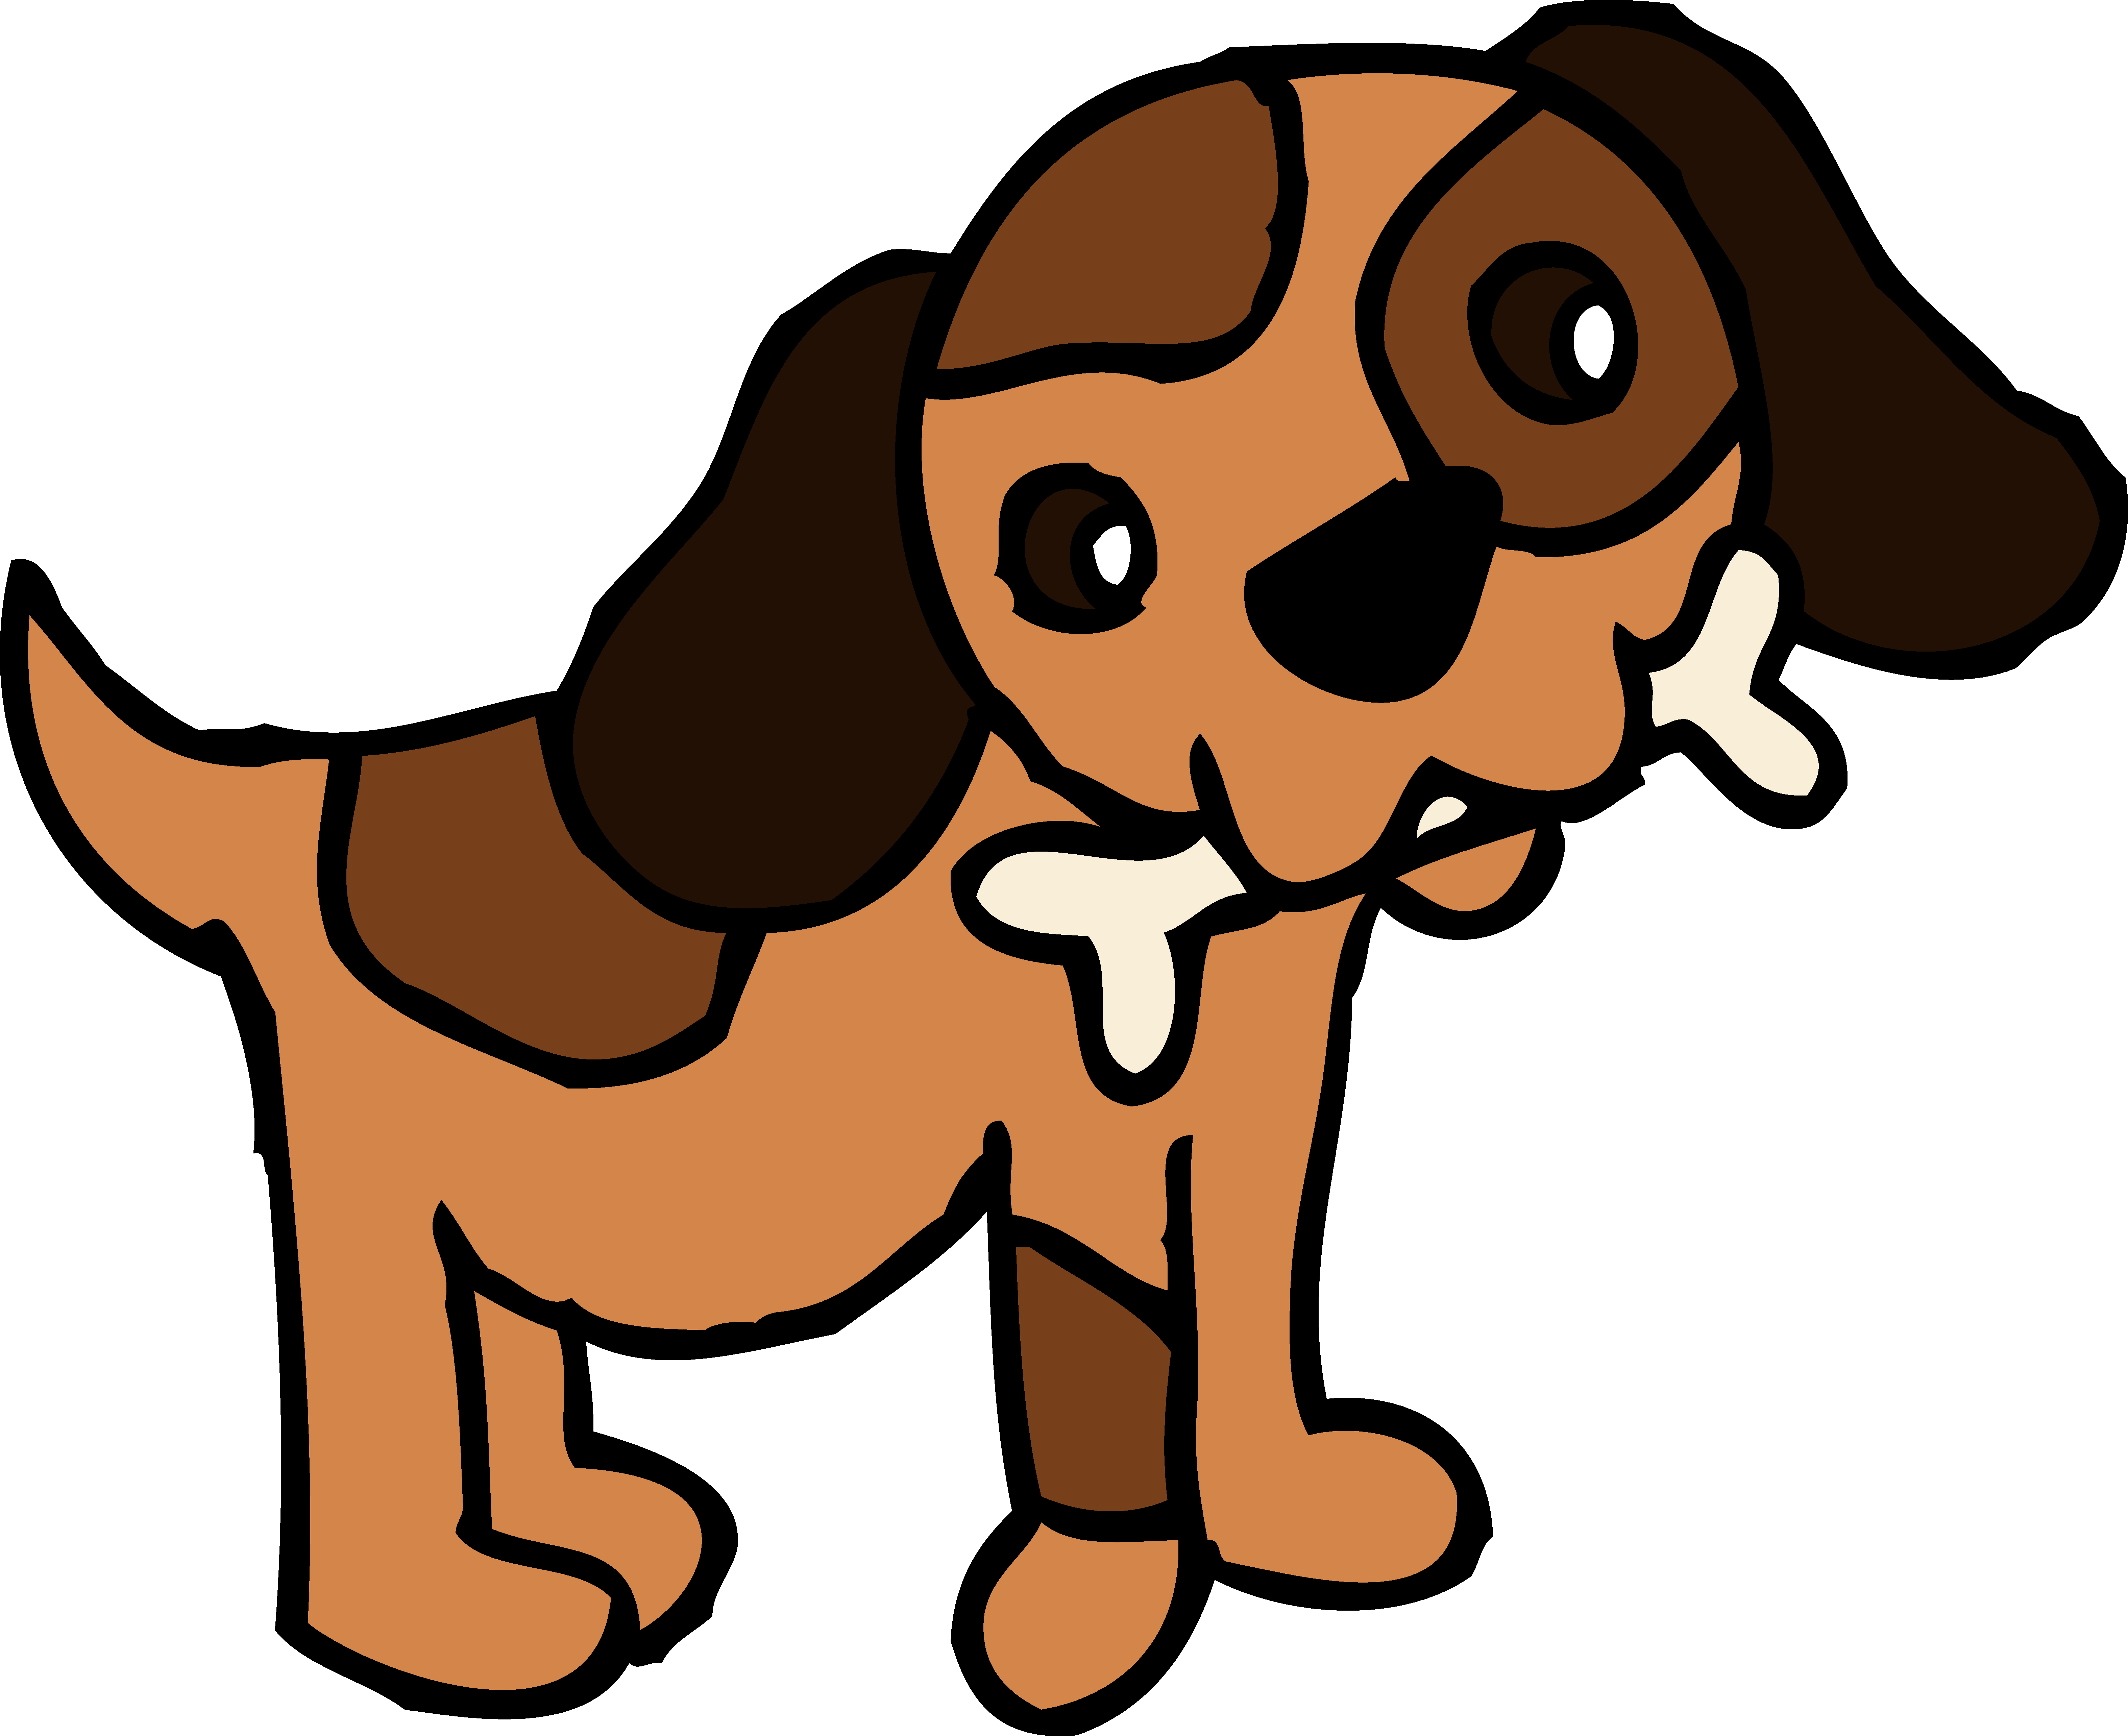
Concept Development
Singular noun- refers to one
Plural noun- refers to more than one
Regular plurals are shown with an ‘s’, ‘es’ or ‘ies’ on the end (suffix)
CFU:
What does singular mean?
What does plural mean? How is a plural noun usually represented?
One dog
Singular noun
Two dogs
Plural noun

Slide 5
Concept Development
Singular noun- refers to one
Plural noun- refers to more than one
Regular plurals are shown with an ‘s’, ‘es’ or ‘ies’ on the end (suffix)
CFU:
What does singular mean?
What does plural mean? How is a plural noun usually represented?
One puppy
Singular noun
Two puppies
Plural noun

Slide 6
Concept Development
Singular noun- refers to one
Plural noun- refers to more than one
Regular plurals are shown with an ‘s’, ‘es’ or ‘ies’ on the end (suffix)
CFU:
What does singular mean?
What does plural mean? How is a plural noun usually represented?
One bus
Singular noun
Two buses
Plural noun

Slide 7
Concept Development
Apostrophes show possession in a singular word before before the s
Apostrophes show possession in a plural word after the s
Many plural words already end with an s
CFU:
What is the purpose of an apostrophe?
Where do we position an apostrophe?
What indicates possession in a singular word?
Examples:
The apostrophe indicates possession in a singular word before the s.
This is Mike’s car.
The woman’s book.
The apostrophe indicates possession in a singular word before the s.

Slide 8
Concept Development
Apostrophes show possession in a singular word before before the s
Apostrophes show possession in a plural word after the s
Many plural words already end with an s
CFU:
Why is this not an example of an apostrophe to indicate possession in a singular word?
Non-Examples:
The apostrophe indicates possession in a singular word after the s. This is grammatically incorrect when showing possession of a singular word.
This is Mikes’ car.
The dog’s are playing.
There is no need for an apostrophe here as there is no possession/ownership. The ‘s’ is a plural marker.
Notes:
Same singular example - change apostrophe

Slide 9
Concept Development
Apostrophes show possession in a singular word before before the s
Apostrophes show possession in a plural word after the s
Many plural words already end with an s
CFU:
What is the purpose of an apostrophe?
Where do we position an apostrophe?
What indicates possession in a plural word?
Examples:
The apostrophe indicates possession in a plural word after the s.
In Australia, the states’ capital cities have large populations.
The apostrophe indicates possession in a plural word after the s.
The markers’ tops were fluro yellow.

Slide 10
Concept Development
Apostrophes show possession in a singular word before before the s
Apostrophes show possession in a plural word after the s
Many plural words already end with an s
CFU:
Why is this not an example of an apostrophe to indicate possession in a plural word?
Non Examples:
In Australia, the state’s capital cities have large populations.
The apostrophe indicates possession in a plural word before the s. The apostrophe comes after the s to indicate possession in the plural word.
The markers tops were fluro yellow.
There is no apostrophe to indicate possession in a plural word. An apostrophe indicates possession in a plural word after s.

Slide 11
Concept Development
Apostrophes show possession in a singular word before before the s
Apostrophes show possession in a plural word after the s
Many plural words already end with an s
CFU:
What is a singular noun?
Where do we position the apostrophe in a singular noun?
Identify the correct responses to fill in the blanks below.
The football went missing. (boys/boy’s)
(This sentence is referring to one boy)
This is favourite pencil (Ella’s/Ellas’)
The shop is busy. (butcher’s/butchers)
That is the assistant. (teachers’/teacher’s)
(This sentence is referring to one teacher)
Notes:
Matching or fill in the blanks

Slide 12
Concept Development
Apostrophes show possession in a singular word before before the s
Apostrophes show possession in a plural word after the s
Many plural words already end with an s
CFU:
What is a plural noun?
Where do we position the apostrophe in a plural noun?
Identify the correct responses to fill in the blanks below.
My house is big. (friends’/friends)
(This sentence is referring to one friend)
You need your permission. (parent’s/parents’)
Notes:
Matching or fill in the blanks

Slide 13
Concept Development
Apostrophes show possession in a singular word before before the s
Apostrophes show possession in a plural word after the s
Many plural words already end with an s
CFU:
What is a plural noun?
Where do we position the apostrophe in a plural noun?
Identify the correct responses to fill in the blanks below.
Where are the bones? (dogs’/dog’s)
(This sentence is referring to two dogs)
The wings are repaired. (airplanes/airplanes’)
(This sentence is referring to one aeroplane)
Notes:
Matching or fill in the blanks

Slide 14
Hinge Point Question
What sentences correctly show an apostrophe indicating possession in a singular or plural form?
Has anyone seen Nandika’s pencil case?
Many of this countrys children and adults misuse apostrophes.
The flood destroyed the beavers’ dam.
The carparks’ at school are always overcrowded.
CFU:
Why is it/ isn’t it a an example of a sentence containing an apostrophe indicating possession in a singular word before the s.
To indicate possession with a singular noun, add s at the end of the word. This also applies to names and other proper nouns.
Most plural nouns already end in s. In this case, to indicate possession, add only an apostrophe to the end of the word.
Notes:
Keep layout

Slide 15
Concept Development- re-explanation
Possessive apostrophes with singular nouns are used to indicate that something belongs to something or someone else.
To indicate possession with a singular noun, add s at the end of the word. This also applies to names and other proper nouns.
CFU:
What is a singular noun?
Does the apostrophe go before or after the s?
Circle the apostrophe of possession.
Underline the singular noun.
Rome’s backstreets are charming.
A series of actions led to Captain Cook’s demise.

Slide 16
Concept Development- re-explanation
Possessive apostrophes with plural nouns mostly already end in s. In this case, to indicate possession, add only an apostrophe to the end of the word.
This also applies to words where the singular and the plural take the same form.
CFU:
What is a plural noun?
Does the apostrophe go before or after the s?
Circle the apostrophe of possession.
Underline the plural noun.
We present new evidence of the pirates’ intentions.
The two species’ habitats are very different.

Slide 17
Skill development: I do
Identify the singular or plural noun to fill in the blank.
Insert the apostrophe of possession before or after the s
Write the sentence with boundary punctuation.
CFU:
Is it a singular or plural noun?
Does the apostrophe of possession go before or after the s?
I highly recommend salon.
Sharons
Sharon’s
Sharons’
I highly recommend Sharon’s salon.

Slide 18
Skill development: I do
Identify the singular or plural noun to fill in the blank.
Insert the apostrophe of possession before or after the s
Write the sentence with boundary punctuation.
CFU:
Is it a singular or plural noun?
Does the apostrophe of possession go before or after the s?
The hay it wet. (referring to 3 rabbits)
rabbits
rabbits’
rabbit’s
The two rabbits’ hay is wet.

Slide 19
Skill development: We do
Identify the singular or plural noun to fill in the blank.
Insert the apostrophe of possession before or after the s
Write the sentence with boundary punctuation.
We recovered three fingerprints at the crime scene.
suspects’
suspects
suspect’s
We recovered three suspects’ fingerprints at the crime scene.

Slide 20
Skill development: We do
Identify the singular or plural noun to fill in the blank.
Insert the apostrophe of possession before or after the s
Write the sentence with boundary punctuation.
Is that your bike over there?
friends
friends’
friend’s
Is that your friend’s bike over there?

Slide 21
Skill development: You do
Identify the singular or plural noun to fill in the blank.
Insert the apostrophe of possession before or after the s
Write the sentence with boundary punctuation.
If you’re late you will miss ballet concert.
Amys
Amy’s
Amys’
If you’re late you will miss Amy’s ballet concert.

Slide 22
Skill development: You do
Identify the singular or plural noun to fill in the blank.
Insert the apostrophe of possession before or after the s
Write the sentence with boundary punctuation.
Don’t give the treats to the dog! (referring to 2 cats)
.
cat’s
cats
cats’
Don’t give the two cats’ treats to the dog!

Slide 23
Skill development: You do
Identify the singular or plural noun to fill in the blank.
Insert the apostrophe of possession before or after the s
Write the sentence with boundary punctuation.
What is in lunchbox today?
Michelles
Michelle’s
Michelles’
What is in Michelle’s lunchbox today?

Slide 24
Skill development: You do
Identify the singular or plural noun to fill in the blank.
Insert the apostrophe of possession before or after the s
Write the sentence with boundary punctuation.
We will vote for higher salaries.
Teacher’s
Teachers’
Teachers
We will vote for higher teachers’ salaries.

