Slide 1
Year: 2
Term: 2
Objective: Complete a sentence when provided with a sentence stem beginning with a subordinating conjunction.
(Even though, although)
Author: Rebecca Glasson

Slide 2
Multiple Choice
Pair Share
Track with me
Pick a Stick/Answer (non-volunteer)
Whiteboards
Vote
Read with me
In Your Workbook

Slide 3
Learning Objective
We are learning to finish sentences when given a sentence stem (starting with a subordinating conjunction).
although and even though

Slide 4
Concept Development
When we are writing, we can use ‘even though’ and ‘although’ at the beginning of a sentence.
A special name for these words is ‘subordinating conjunctions’.
The subordinating conjunctions of ‘even though’ and ‘although’ tell us something has happened even though it should not have.
They have a similar meaning to the conjunction ‘but’
Notes:
*Teacher note – it is not necessary to teach the children specifically what subordinating conjunctions do or are in any detail. The reason the terminology is used is to give students the language needed for discussion about the topic and to begin to familiarise them with the terminology for future years.

Slide 5
Concept Development
‘Even though’ and ‘Although’ are subordinating conjunctions that tell us something happened even if it should not have.
When a sentence begins with ‘even though’ or ‘although’ and one action (what happens), we need to complete the sentence by adding a turn around or contrasting action.
Their meaning is similar, but ‘even though’ gives more emphasis.
CFU:
What do sentences beginning with even though and although show us?
These sentence stems are not ... (a complete thought)
Sentence stems:
Even though he ate breakfast,
Although he ate breakfast,
Even though we clean our teeth,
Although we clean our teeth,
These sentence stems are not complete thoughts. They tell us when something has happened or will happen, but they are not a complete thought.

Slide 6
Concept Development
‘Even though’ and ‘Although’ are subordinating conjunctions that tell us something happened even if it should not have.
When a sentence begins with ‘even though’ or ‘although’ and one action (what happens), we need to complete the sentence by adding a turn around or contrasting action.
Their meaning is similar, but ‘even though’ is slightly stronger, giving more emphasis.
CFU:
What do sentences beginning with even though and although show us?
How do the sentences show a turn around or contrast?
Examples:
Although he ate breakfast, Billy wanted a snack 10 minutes later.
Even though he ate breakfast, Billy was still really hungry.
Although it was late at night, Bella was not in bed.
Even though it was late at night, Bella was not tired.

Slide 7
Concept Development
‘Even though’ and ‘Although’ are subordinating conjunctions that tell us something happened even if it should not have.
When a sentence begins with ‘even though’ or ‘although’ and one action (what happens), we need to complete the sentence by adding a turn around or contrasting action.
Their meaning is similar, but ‘even though’ is slightly stronger, giving more emphasis.
CFU:
Why are these non examples?
How can we fix the non-examples?
Non-Examples:
Even though Mike was hungry, he ate all his vegetables.
This sentences does begin with even though, but the information matches. There is no contrast or turn around information.
Although Sam was not feeling well, finished race.
This sentences does begin with although, but it is not a complete thought. There is no subject or verb after the sentence stem.

Slide 8
Concept Development
‘Even though’ and ‘Although’ are subordinating conjunctions that tell us something happened even if it should not have.
When a sentence begins with ‘even though’ or ‘although’ and one action (what happens), we need to complete the sentence by adding a turn around or contrasting action.
Their meaning is similar, but ‘even though’ is slightly stronger, giving more emphasis.
CFU:
Why are these non examples?
How can we fix the non-examples?
Non-Examples:
Examples:
Even though Mike was hungry, he ate all his vegetables.
Even though Mike was hungry, he would not eat all his vegetables.
This sentences does begin with even though, but the information matches. There is no contrast or turn around information.
Although Sam was not feeling well, she still managed to finish the race.
Although Sam was not feeling well, finished race.
This sentences does begin with after, but it is not a complete thought. There is no subject or verb after the sentence stem.
Notes:
Option 2 for non-examples to demonstrate how they can be fixed.

Slide 9
Concept Development – I do
‘Even though’ and ‘Although’ are subordinating conjunctions that tell us something happened even if it should not have.
When a sentence begins with ‘even though’ or ‘although’ and one action (what happens), we need to complete the sentence by adding a turn around or contrasting action.
Their meaning is similar, but ‘even though’ is slightly stronger, giving more emphasis.
CFU:
Does the part after the comma have a subject and a verb?
What are they?
Are the two actions contrasting?
Is the new sentence a complete thought?
Read the sentence stem. Circle the subordinating conjunction ‘even though’ or ‘although’.
Underline the important information.
Now read the action/ verb (what they are doing) after the comma.
Are the actions contrasting?
Even though it is winter,
I will still eat ice cream.
Although Sam is only five,
she can read the Harry Potter books by herself.

Slide 10
Concept Development – We do
‘Even though’ and ‘Although’ are subordinating conjunctions that tell us something happened even if it should not have.
When a sentence begins with ‘even though’ or ‘although’ and one action (what happens), we need to complete the sentence by adding a turn around or contrasting action.
Their meaning is similar, but ‘even though’ is slightly stronger, giving more emphasis.
CFU:
Does the part after the comma have a subject and a verb?
What are they?
Are the two actions contrasting?
Is the new sentence a complete thought?
Read the sentence stem. Circle the subordinating conjunction ‘even though’ or ‘although’.
Underline the important information.
Now read the action/ verb (what they are doing) after the comma.
Are the actions contrasting?
Although Mrs G is a nice person,
she still made the children work hard.
Even though it was pouring with rain,
Mr S made the students run around the oval.

Slide 11
Hinge Point Question
‘Even though’ and ‘Although’ are subordinating conjunctions that tell us something happened even if it should not have.
When a sentence begins with ‘even though’ or ‘although’ and one action (what happens), we need to complete the sentence by adding a turn around or contrasting action.
Their meaning is similar, but ‘even though’ is slightly stronger, giving more emphasis.
CFU:
Are the actions before and after the comma contrasting?
Is the sentence a complete though?
Which sentence show the correct usage of ‘even though’ and ‘although’?
1. Although it was dark outside, the children were playing on the road.
2. Although it was morning, Michael got out of bed.
3. Even though it rained a lot, I still enjoyed the holidays.
4. Even though he had just ran a long way, Jack was red, hot and tired.

Slide 12
Skill development: I do
Read the sentence stem. Circle the subordinating conjunction ‘even though’ or ‘although’.
Underline the action/ predicate (what they are doing) that is being described before the comma.
Use this information to orally complete the sentence with a who and an action/ verb (what they are doing).
Write the sentence stem, followed by a comma, then who and an action/ verb (what they are doing).
CFU:
What is action/verb before the comma?
Does this contrast with the action after the comma?
Does the sentence make sense?
Even though Bob was tired,
Even though Bob was tired, he could not go to sleep.
Although Bob was tired,
Although Bob was tired, there was still lots of work to be done.
Notes:
https://www.publicdomainpictures.net/pictures/160000/velka/uitgeput.jpg

Slide 13
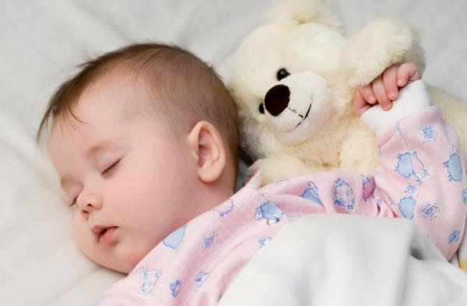
Skill development: We do
Read the sentence stem. Circle the subordinating conjunction ‘even though’ or ‘although’.
Underline the action/ predicate (what they are doing) that is being described before the comma.
Use this information to orally complete the sentence with a who and an action/ verb (what they are doing).
Write the sentence stem, followed by a comma, then who and an action/ verb (what they are doing).
CFU:
What is action/verb before the comma?
Does this contrast with the action after the comma?
Does the sentence make sense?
What is something that is a contrast or turn around?
Even though the baby slept,
the mum did not get to rest.
What is something that is a contrast or turn around?
Although the baby slept for a long time,
she was still cranky.
This Photo by Unknown Author is licensed under CC BY

Slide 14
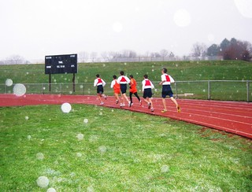
Skill development: We do
Read the sentence stem. Circle the subordinating conjunction ‘even though’ or ‘although’.
Underline the action/ predicate (what they are doing) that is being described before the comma.
Use this information to orally complete the sentence with a who and an action/ verb (what they are doing).
Write the sentence stem, followed by a comma, then who and an action/ verb (what they are doing).
CFU:
What is action/verb before the comma?
Does this contrast with the action after the comma?
Does the sentence make sense?
What is something that is a contrast or turn around?
Even though it was raining,
they watched tv inside.
they ran around the track.
This Photo by Unknown Author is licensed under CC BY-SA-NC
they stayed inside where it was warm.
they ran around the track.
Even though it was raining,

Slide 15
Skill development: We do
Read the sentence stem. Circle the subordinating conjunction ‘even though’ or ‘although’.
Underline the action/ predicate (what they are doing) that is being described before the comma.
Use this information to orally complete the sentence with a who and an action/ verb (what they are doing).
Write the sentence stem, followed by a comma, then who and an action/ verb (what they are doing).
CFU:
What is action/verb before the comma?
Does this contrast with the action after the comma?
Does the sentence make sense?
What is something that is a contrast or turn around?
Even though it was a windy day,
What is something that is a contrast or turn around?
Although the wind was blowing hard,
This Photo by Unknown Author is licensed under CC BY

Slide 16
Skill development: You do
Read the sentence stem. Circle the subordinating conjunction ‘even though’ or ‘although’.
Underline the action/ predicate (what they are doing) that is being described before the comma.
Use this information to orally complete the sentence with a who and an action/ verb (what they are doing).
Write the sentence stem, followed by a comma, then who and an action/ verb (what they are doing).
CFU:
What is action/verb before the comma?
Does this contrast with the action before the comma?
Does the sentence make sense?
Although it snowed heavily,
Even though it was very cold,
This Photo by Unknown Author is licensed under CC BY-SA
Although it was a hot day,
Even though they were at the beach,
This Photo by Unknown Author is licensed under CC BY-NC-ND

