Slide 1
Year: 1
Term: 2
Objective: Complete a sentence when provided with a sentence stem beginning with a subordinating conjunction. (Before, After, When, If)
Author: Rebecca Glasson

Slide 2
Multiple Choice
Pair Share
Track with me
Pick a Stick/Answer (non-volunteer)
Whiteboards
Vote
Read with me
In Your Workbook

Slide 3
Learning Objective
We are learning to finish sentences when given a sentence stem starting with the conjunctions ‘before’, ‘after’, ‘if’ or ‘when’.
(Starting with a subordinating conjunction).

Slide 4
Concept Development
When we are writing, we can use ‘if’, ‘when’, ‘before’ and ‘after’ at the beginning of a sentence.
A special name for these words is ‘subordinating conjunctions’.
The subordinating conjunctions of ‘if’, ‘when’, ‘before’ and ‘after’ show how actions are linked together or related.
Notes:
*Teacher note – it is not necessary to teach the children specifically what subordinating conjunctions do or are in any detail. The reason the terminology is used is to give students the language needed for discussion about the topic and to begin to familiarise them with the terminology for future years.

Slide 5
Concept Development
‘If’, “when’, ‘before’ and ‘after’ are subordinating conjunctions that show how to two actions are linked together or related.
When a sentence begins with ‘if’, when’, ‘before’ or ‘after’ and one action (what happens), we need to complete the sentence by adding a related action in the correct order.
CFU:
Subordinating conjunctions show how actions are …
These sentence stems are not ... (a complete thought)
Sentence stems:
When he gets on the bus,
If he gets on the bus,
After he gets on the bus,
Before he gets on the bus,
These sentence stems are not complete thoughts. They tell us when something has happened or will happen but they are not a complete thought.

Slide 6
Concept Development
‘If’, “when’, ‘before’ and ‘after’ are subordinating conjunctions that show how to two actions are linked together or related.
When a sentence begins with ‘if’, when’, ‘before’ or ‘after’ and one action (what happens), we need to complete the sentence by adding a related action in the correct order.
CFU:
Subordinating conjunctions show how actions are …
How does starting with before and after change the sentence?
Examples:
When he gets on the bus, Billy finds a seat.
If he gets on the bus, Billy will make it to school on time.
After he gets on the bus, the bus driver takes off.
Before he gets on the bus, Billy races to the bus stop.

Slide 7
Concept Development
‘If’, “when’, ‘before’ and ‘after’ are subordinating conjunctions that show how to two actions are linked together or related.
When a sentence begins with ‘if’, when’, ‘before’ or ‘after’ and one action (what happens), we need to complete the sentence by adding a related action in the correct order.
CFU:
Why are these non examples?
How can we fix the non-examples?
Non-Examples:
When he gets on the bus, Billy crawls under the seat.
This sentences does begin with when, but Billy would not normally crawl under the seat.
If he gets on the bus, makes it to school on time.
This sentences does begin with if, but it is not a complete thought. There is no subject after the comma. We do not know ’who’ makes it to school.
After he gets on the bus, the bus driver stops the bus.
This sentences does begin with after, but does not match the first part of the sentence. The bus would already be stopped.
Before he gets on the bus, to the bus stop.
This sentences does begin with before, but it is not a complete thought. There is no subject or verb after the comma. We do not know ’who’ or ‘what’.

Slide 8
Concept Development
‘If’, “when’, ‘before’ and ‘after’ are subordinating conjunctions that show how to two actions are linked together or related.
When a sentence begins with ‘if’, when’, ‘before’ or ‘after’ and one action (what happens), we need to complete the sentence by adding a related action in the correct order.
CFU:
Why are these non examples?
How can we fix the non-examples?
Non-Examples:
Examples:
When he gets on the bus, Billy jumps into the pool.
When he gets on the bus, Billy sits on a seat.
This sentences does begin with when, but it does not make sense.
If he gets on the bus, makes it to school on time.
If he gets on the bus, Billy makes it to school on time.
This sentences does begin with if, but it is not a complete thought. There is no subject after the comma. We do not know ’who’ makes it to school.
Notes:
Option 2 for non-examples to demonstrate how they can be fixed.

Slide 9
Concept Development
‘If’, “when’, ‘before’ and ‘after’ are subordinating conjunctions that show how to two actions are linked together or related.
When a sentence begins with ‘if’, when’, ‘before’ or ‘after’ and one action (what happens), we need to complete the sentence by adding a related action in the correct order.
CFU:
Why are these non examples?
How can we fix the non-examples?
Non-Examples:
Examples:
After he gets on the bus, the bus driver stops the bus.
After he gets on the bus, the bus driver starts the bus.
This sentences does begin with after, but does not match the first part of the sentence. The bus would already be stopped.
Before he gets on the bus, to the bus stop.
Before he gets on the bus, Billy walks to the bus stop.
This sentences does begin with before, but it is not a complete thought. There is no subject or verb after the comma. We do not know ’who’ or ‘what’.
Notes:
Option 2 for non-examples to demonstrate how they can be fixed.

Slide 10
Concept Development – I do
‘If’, “when’, ‘before’ and ‘after’ are subordinating conjunctions that show how to two actions are linked together or related.
When a sentence begins with ‘if’, when’, ‘before’ or ‘after’ and one action (what happens), we need to complete the sentence by adding a related action in the correct order.
CFU:
Does the part after the comma have a subject and a verb?
What are they?
Are the two actions related?
Is the new sentence a complete thought?
Read the sentence stem. Circle the subordinating conjunction ‘if’, ‘when’, ‘before’, or ‘after’.
Underline the action/ verb (what they are doing) that is being described before the comma.
Now read the action/ verb (what they are doing) after the comma.
Are the actions related to each other?
If Beryl was sick,
she would rest in bed.
When Beryl was sick,
she rested in bed.
Before Beryl was sick,
she had lots of energy.
After Beryl was sick,
she felt very tired.

Slide 11
Concept Development – We do
‘If’, “when’, ‘before’ and ‘after’ are subordinating conjunctions that show how to two actions are linked together or related.
When a sentence begins with ‘if’, when’, ‘before’ or ‘after’ and one action (what happens), we need to complete the sentence by adding a related action in the correct order.
CFU:
Does the part after the comma have a subject and a verb?
What are they?
Are the two actions related?
Is the new sentence a complete thought?
Read the sentence stem. Circle the subordinating conjunction ‘if’, ‘when’, ‘before’, or ‘after’.
Underline the action/ verb (what they are doing) that is being described before the comma.
Now read the action/ verb (what they are doing) after the comma.
Are the actions related to each other?
If Joe came to school,
he could learn about wombats.
When Joe came to school,
he learnt about wombats.
Before Joe came to school,
didn’t know much about wombats.
After Joe came to school,
he knew lots about wombats.

Slide 12
Hinge Point Question
‘If’, “when’, ‘before’ and ‘after’ are subordinating conjunctions that show how to two actions are linked together or related.
When a sentence begins with ‘if’, when’, ‘before’ or ‘after’ and one action (what happens), we need to complete the sentence by adding a related action in the correct order.
CFU:
Do the actions before and after the comma match?
Are they in the correct order?
How are they related?
1. Before I leave the house, I put on my shoes.
2. When he set up his desk for the day, Sam left to go home.
3. If he climbed on the playground, Jack felt hot and tired.
4. After Mia ate her lunch, she got out her lunch.

Slide 13
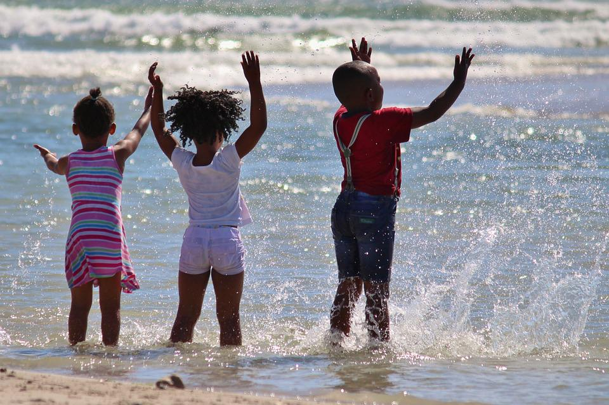
Skill development: I do
Read the sentence stem. Circle the subordinating conjunction ‘if’, ‘when’, ‘after’ or ‘before’.
Underline the action/ verb (what they are doing) that is being described before the comma.
Use this information to orally complete the sentence with a who and an action/ verb (what they are doing).
Write the sentence stem, followed by a comma, then who and an action/ verb (what they are doing).
CFU:
What is subordinating conjunction?
How do the sentences change?
Why do the sentences change?
What will the result/ effect be?
When we go to the beach,
we can swim in the water.
What will the result/ effect be?
If we go to the beach,
we can swim in the water.
What might happen next?
After we go to the beach,
we will have a shower.
What might happen before we go to the beach?
Before we go to the beach,
we will put on our bathers.
Notes:
https://get.pxhere.com/photo/beach-sea-water-sand-people-vacation-africa-child-black-children-fun-african-south-africa-inject-afro-american-1332004.jpg

Slide 14
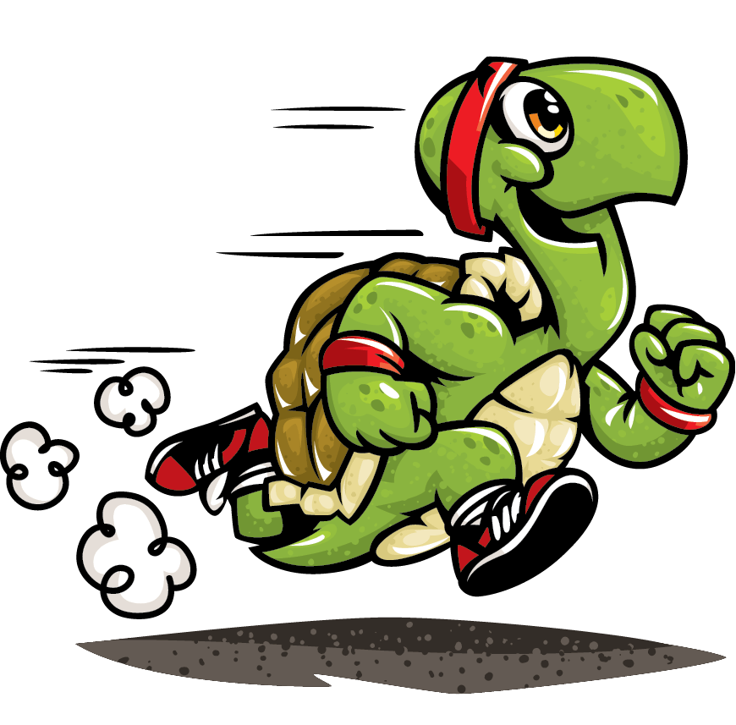
Skill development: We do
Read the sentence stem. Circle the subordinating conjunction ‘if’, ‘when’, ‘after’ or ‘before’.
Underline the action/ verb (what they are doing) that is being described before the comma.
Use this information to orally complete the sentence with a who and an action/ verb (what they are doing).
Write the sentence stem, followed by a comma, then who and an action/ verb (what they are doing).
CFU:
What is subordinating conjunction?
How do the sentences change?
Why do the sentences change?
What will the result/ effect be?
When the turtle crosses the finish line,
the turtle gets to rest.
What will the result/ effect be?
If the turtle crosses the finish line,
he might get a prize.
What might happen next?
After the turtle crosses the finish line,
the turtle gets to rest.
What might happen before he crosses?
Before the turtle crosses the finish line,
he trips over.
Notes:
https://i0.wp.com/www.scientificast.it/blog/wp-content/uploads/2016/08/466.png?fit=870%2C857&ssl=1

Slide 15
Skill development: We do
Read the sentence stem. Circle the subordinating conjunction ‘if’, ‘when’, ‘after’ or ‘before’.
Underline the action/ verb (what they are doing) that is being described before the comma.
Use this information to orally complete the sentence with a who and an action/ verb (what they are doing).
Write the sentence stem, followed by a comma, then who and an action/ verb (what they are doing).
CFU:
What is subordinating conjunction?
How do the sentences change?
Why do the sentences change?
What will the result/ effect be?
When I eat a cupcake,
What will the result/ effect be?
If I eat a cupcake,
What might happen next?
After I eat a cupcake,
What might happen before eating a cupcake?
Before I eat a cupcake,
Notes:
http://bakesaleflyers.com/wp-content/uploads/2012/10/free-cupcake-clipart-300x300.png

Slide 16
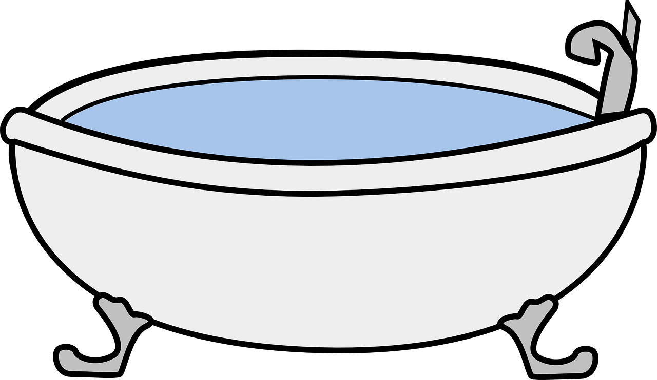
Skill development: You do
Read the sentence stem. Circle the subordinating conjunction ‘if’, ‘when’, ‘after’ or ‘before’.
Underline the action/ verb (what they are doing) that is being described before the comma.
Use this information to orally complete the sentence with a who and an action/ verb (what they are doing).
Write the sentence stem, followed by a comma, then who and an action/ verb (what they are doing).
CFU:
What is subordinating conjunction?
How do the sentences change?
Why do the sentences change?
What will the result/ effect be?
When I have bath,
What will the result/ effect be?
If I have a bath,
What might happen next?
After I have a bath,
What might happen before a bath?
Before I have a bath,
Notes:
https://cdn.pixabay.com/photo/2014/04/02/10/40/bathtub-304193_1280.png

Slide 17
Skill development: You do
Read the sentence stem. Circle the subordinating conjunction ‘if’, ‘when’, ‘after’ or ‘before’.
Underline the action/ verb (what they are doing) that is being described before the comma.
Use this information to orally complete the sentence with a who and an action/ verb (what they are doing).
Write the sentence stem, followed by a comma, then who and an action/ verb (what they are doing).
CFU:
What is subordinating conjunction?
How do the sentences change?
Why do the sentences change?
What will the result/ effect be?
Insert text - use examples from content/texts/topics from class
What will the result/ effect be?
Insert text - use examples from content/texts/topics from class
What might happen next?
Insert text - use examples from content/texts/topics from class
What might happen before a bath?
Insert text - use examples from content/texts/topics from class

