Slide 1
Year: 1
Term: 2
Objective: Complete a sentence when provided with a sentence stem beginning with a subordinating conjunction (If and When).
Author: Rebecca Glasson

Slide 2
Multiple Choice
Pair Share
Track with me
Pick a Stick/Answer (non-volunteer)
Whiteboards
Vote
Read with me
In Your Workbook

Slide 3
Learning Objective
We are learning to finish sentences when given a sentence stem starting with a conjunction ‘if’ or ‘when’.

Slide 4
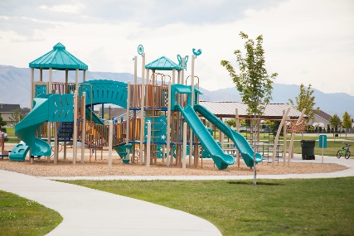
Activate prior knowledge
'If’ and ‘when’ tell us what has to happen before a related action will occur.
‘If’ means something else has to happen first or the other action will not happen.
‘When’ tells us what will happen after the first action has happened.
CFU:
If
This Photo by Unknown Author is licensed under CC BY-ND
This Photo by Unknown Author is licensed under CC BY-SA
this work
When
playground
If this work is done, you can play on the playground.
When this work is done, you can play on the playground.

Slide 5
Concept Development
When we are writing, we can use ‘If’ and ‘when’ at the beginning of a sentence.
A special name for these words is ‘subordinating conjunctions’.
The subordinating conjunctions of ‘if’ and ‘when’ show something will happen as a result of another action occurring.
CFU:
Notes:
*Teacher note – it is not necessary to teach the children specifically what subordinating conjunctions do or are in any detail. The reason the terminology is used is to give students the language needed for discussion about the topic and to begin to familiarise them with the terminology for future years.

Slide 6
Concept Development
‘When’ and ‘If’ are subordinating conjunctions. Their meaning is similar.
When indicates the second action will definitely happen after the first action happens.
If indicates the second action will only happen if the first action happens.
When a sentence begins with ‘when’ or ‘if’ and one action (what happens), we need to complete the sentence by adding a related action.
CFU:
What does when mean?
What does if mean?
These sentence stems are not ... (a complete thought)
Sentence stems:
If it is raining,
When it is raining,
If we finish our work,
When we finish our work,
These sentence stems are not complete thoughts. They tell us when something has happened or will happen but they are not a complete thought.

Slide 7
Concept Development
‘When’ and ‘If’ are subordinating conjunctions. Their meaning is similar.
When indicates the second action will definitely happen after the first action happens.
If indicates the second action will only happen if the first action happens.
When a sentence begins with ‘when’ or ‘if’ and one action (what happens), we need to complete the sentence by adding a related action.
CFU:
What does when tell us?
What does if tell us?
Which sentence out of each pair shows something will definitely happen?
Examples:
If we finish our work, we can play on the playground.
When we finish our work, we can play on the playground.
If it rains, we will stay inside.
When it rains, we will stay inside.

Slide 8
Concept Development
‘When’ and ‘If’ are subordinating conjunctions. Their meaning is similar.
When indicates the second action will definitely happen after the first action happens.
If indicates the second action will only happen if the first action happens.
When a sentence begins with ‘when’ or ‘if’ and one action (what happens), we need to complete the sentence by adding a related action.
CFU:
Why are these non examples?
How can we fix the non-examples?
Non-Examples:
If it rains, get wet.
This sentences does begin with If, but the sentence is not a complete thought. The section after the comma does not have a ‘subject’. We do not know who will get wet.
When it rains, we will go swimming.
This sentences does begin with when, but it is not likely that we will go swimming in the rain. The two parts of the sentence (clauses) do not match very well.

Slide 9
Concept Development
‘When’ and ‘If’ are subordinating conjunctions. Their meaning is similar.
When indicates the second action will definitely happen after the first action happens.
If indicates the second action will only happen if the first action happens.
When a sentence begins with ‘when’ or ‘if’ and one action (what happens), we need to complete the sentence by adding a related action.
CFU:
Why are these non examples?
How can we fix the non-examples?
Non-Examples:
Examples:
If it rains, get wet.
If it rains, we will get wet.
This sentences does begin with If, but the sentence is not a complete thought. The section after the comma does not have a ‘subject’. We do not know who will get wet.
When it rains, we will go swimming.
When it rains, we will use an umbrella.
This sentences does begin with when, but it is not likely that we will go swimming in the rain. The two parts of the sentence (clauses) do not match very well.
Notes:
Option 2 for non-examples to demonstrate how they can be fixed.

Slide 10
Concept Development – I do
‘When’ and ‘If’ are subordinating conjunctions that indicate something will happen only as a result or condition of another action happening.
Their meaning is similar.
When indicates the second action will definitely happen because of the first action.
If indicates the second action will only happen if the first action happens.
CFU:
Does the part after the comma have a subject and a verb?
What are they?
Are the two actions related?
Is the new sentence a complete thought?
Read the sentence stem. Circle the subordinating conjunction ‘when’ or ‘if’.
Underline the action/ verb (what they are doing) that is being described before the comma.
Now read the action/ verb (what they are doing) after the comma.
Are the actions related to each other?
If I eat my dinner,
I can have ice-cream.
When I eat my dinner,
I can have ice-cream.

Slide 11
Concept Development – We do
‘When’ and ‘If’ are subordinating conjunctions that indicate something will happen only as a result or condition of another action happening.
Their meaning is similar.
When indicates the second action will definitely happen because of the first action.
If indicates the second action will only happen if the first action happens.
CFU:
Does the part after the comma have a subject and a verb?
What are they?
Are the two actions related?
Are they in the correct order?
Is the new sentence a complete thought?
Read the sentence stem. Circle the subordinating conjunction ‘when’ or ‘if’.
Underline the action/ verb (what they are doing) that is being described before the comma.
Now read the action/ verb (what they are doing) after the comma.
Are the actions related to each other?
you can play outside.
If it is not raining,
you can play outside.
When it is not raining,

Slide 12
Hinge Point Question
‘When’ and ‘If’ are subordinating conjunctions that indicate something will happen only as a result or condition of another action happening.
Their meaning is similar.
When indicates the second action will definitely happen because of the first action.
If indicates the second action will only happen if the first action happens.
CFU:
Is the sentence a complete thought?
Do the actions before and after the comma match?
1. If it is hot tomorrow, we will go to the beach.
2. When it is hot tomorrow, we will go ice-skating.
3. If Lisa does not pack her lunch, she will be hungry.
4. When Mary played on the oval, fell over.

Slide 13
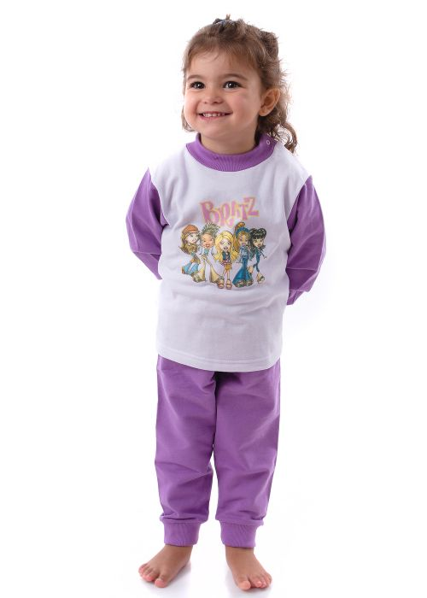
Identify the key word, the subordinating conjunction, and what it is modifying.
Use this information to complete the sentence with a who and a what they are doing.
Write the sentence stem, followed by a comma, then who and what.
Skill development: I do
Read the sentence stem. Circle the subordinating conjunction ‘if’ or ‘when’.
Underline the action/ verb (what they are doing) that is being described before the comma.
Use this information to orally complete the sentence with a who and an action/ verb (what they are doing).
Write the sentence stem, followed by a comma, then who and an action/ verb (what they are doing).
CFU:
What is action/verb before the comma?
Does this match the action/ verb after the comma?
If Lucy puts her pyjamas on quickly,
If Lucy puts her pyjamas on quickly, she can have a bed time story.
When Lucy puts her pyjamas on,
This Photo by Unknown Author is licensed under CC BY-NC-ND
When Lucy puts her pyjamas on, she can have a bed time story

Slide 14
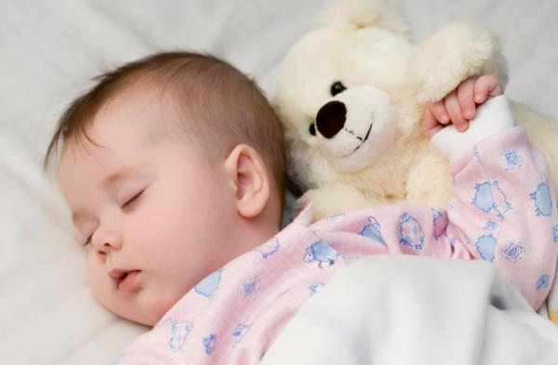
Skill development: We do
Read the sentence stem. Circle the subordinating conjunction ‘if’ or ‘when’.
Underline the action/ verb (what they are doing) that is being described before the comma.
Use this information to orally complete the sentence with a who and an action/ verb (what they are doing).
Write the sentence stem, followed by a comma, then who and an action/ verb (what they are doing).
CFU:
What is the subordinating conjunction?
What could the result of the first action be?
What might happen if the baby sleeps?
If the baby sleeps,
mum can rest.
What will happen if the baby sleeps?
mum can rest.
When the baby sleeps,
This Photo by Unknown Author is licensed under CC BY

Slide 15
Skill development: We do
Read the sentence stem. Circle the subordinating conjunction ‘if’ or ‘when’.
Underline the action/ verb (what they are doing) that is being described before the comma.
Use this information to orally complete the sentence with a who and an action/ verb (what they are doing).
Write the sentence stem, followed by a comma, then who and an action/ verb (what they are doing).
CFU:
What is the subordinating conjunction?
What could the result of the first action be?
What might the result be if the blocks fall?
If the blocks fall,
What might the result be when the blocks fall?
When the blocks fall,
Notes:
https://images.pexels.com/photos/3661453/pexels-photo-3661453.jpeg?cs=srgb&dl=two-children-playing-with-lego-blocks-on-floor-3661453.jpg&fm=jpg

Slide 16
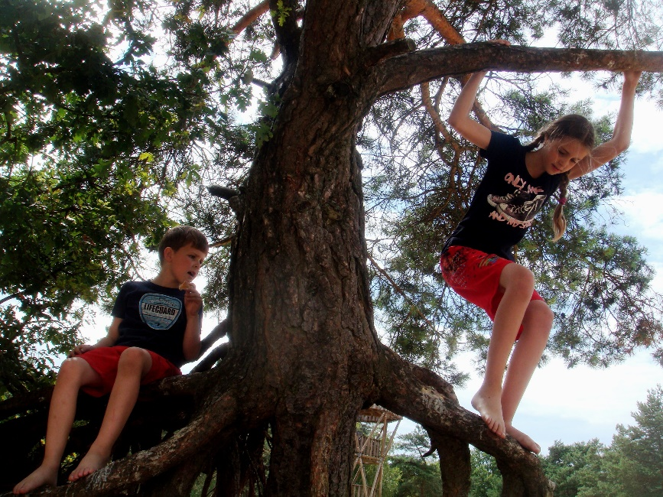
Skill development: You do
Read the sentence stem. Circle the subordinating conjunction ‘if’ or ‘when’.
Underline the action/ verb (what they are doing) that is being described before the comma.
Use this information to orally complete the sentence with a who and an action/ verb (what they are doing).
Write the sentence stem, followed by a comma, then who and an action/ verb (what they are doing).
CFU:
What is the subordinating conjunction?
What could the result of the first action be?
When they climb down,
If they climb down,
If they go to the park,
When they go to the park,
Notes:
https://get.pxhere.com/photo/tree-nature-forest-plant-flower-adventure-jump-spring-jungle-climbing-children-enjoy-work-together-woody-plant-1077454.jpg

Slide 17
Skill development: You do
Read the sentence stem. Circle the subordinating conjunction ‘if’ or ‘when’.
Underline the action/ verb (what they are doing) that is being described before the comma.
Use this information to orally complete the sentence with a who and an action/ verb (what they are doing).
Write the sentence stem, followed by a comma, then who and an action/ verb (what they are doing).
CFU:
What is the subordinating conjunction?
What could the result of the first action be?
Insert text - use examples from content/texts/topics from class
Insert text - use examples from content/texts/topics from class
Insert text - use examples from content/texts/topics from class
Insert text - use examples from content/texts/topics from class

