Slide 1
Year: 1
Term: 2
Objective: Complete a sentence when provided with a sentence stem beginning with a subordinating conjunction (before/after).
Author: Rebecca Glasson

Slide 2
Multiple Choice
Pair Share
Track with me
Pick a Stick/Answer (non-volunteer)
Whiteboards
Vote
Read with me
In Your Workbook

Slide 3
Learning Objective
We are learning to finish sentences when given a sentence stem starting with the conjunctions ‘before’ or ‘after’

Slide 4
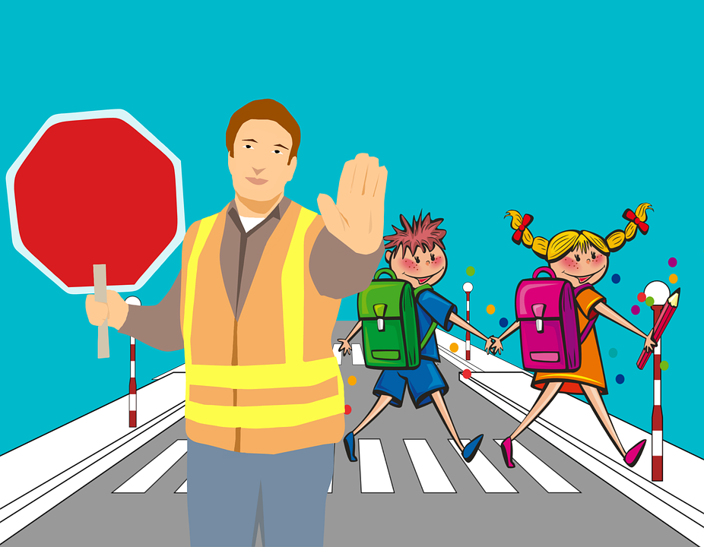
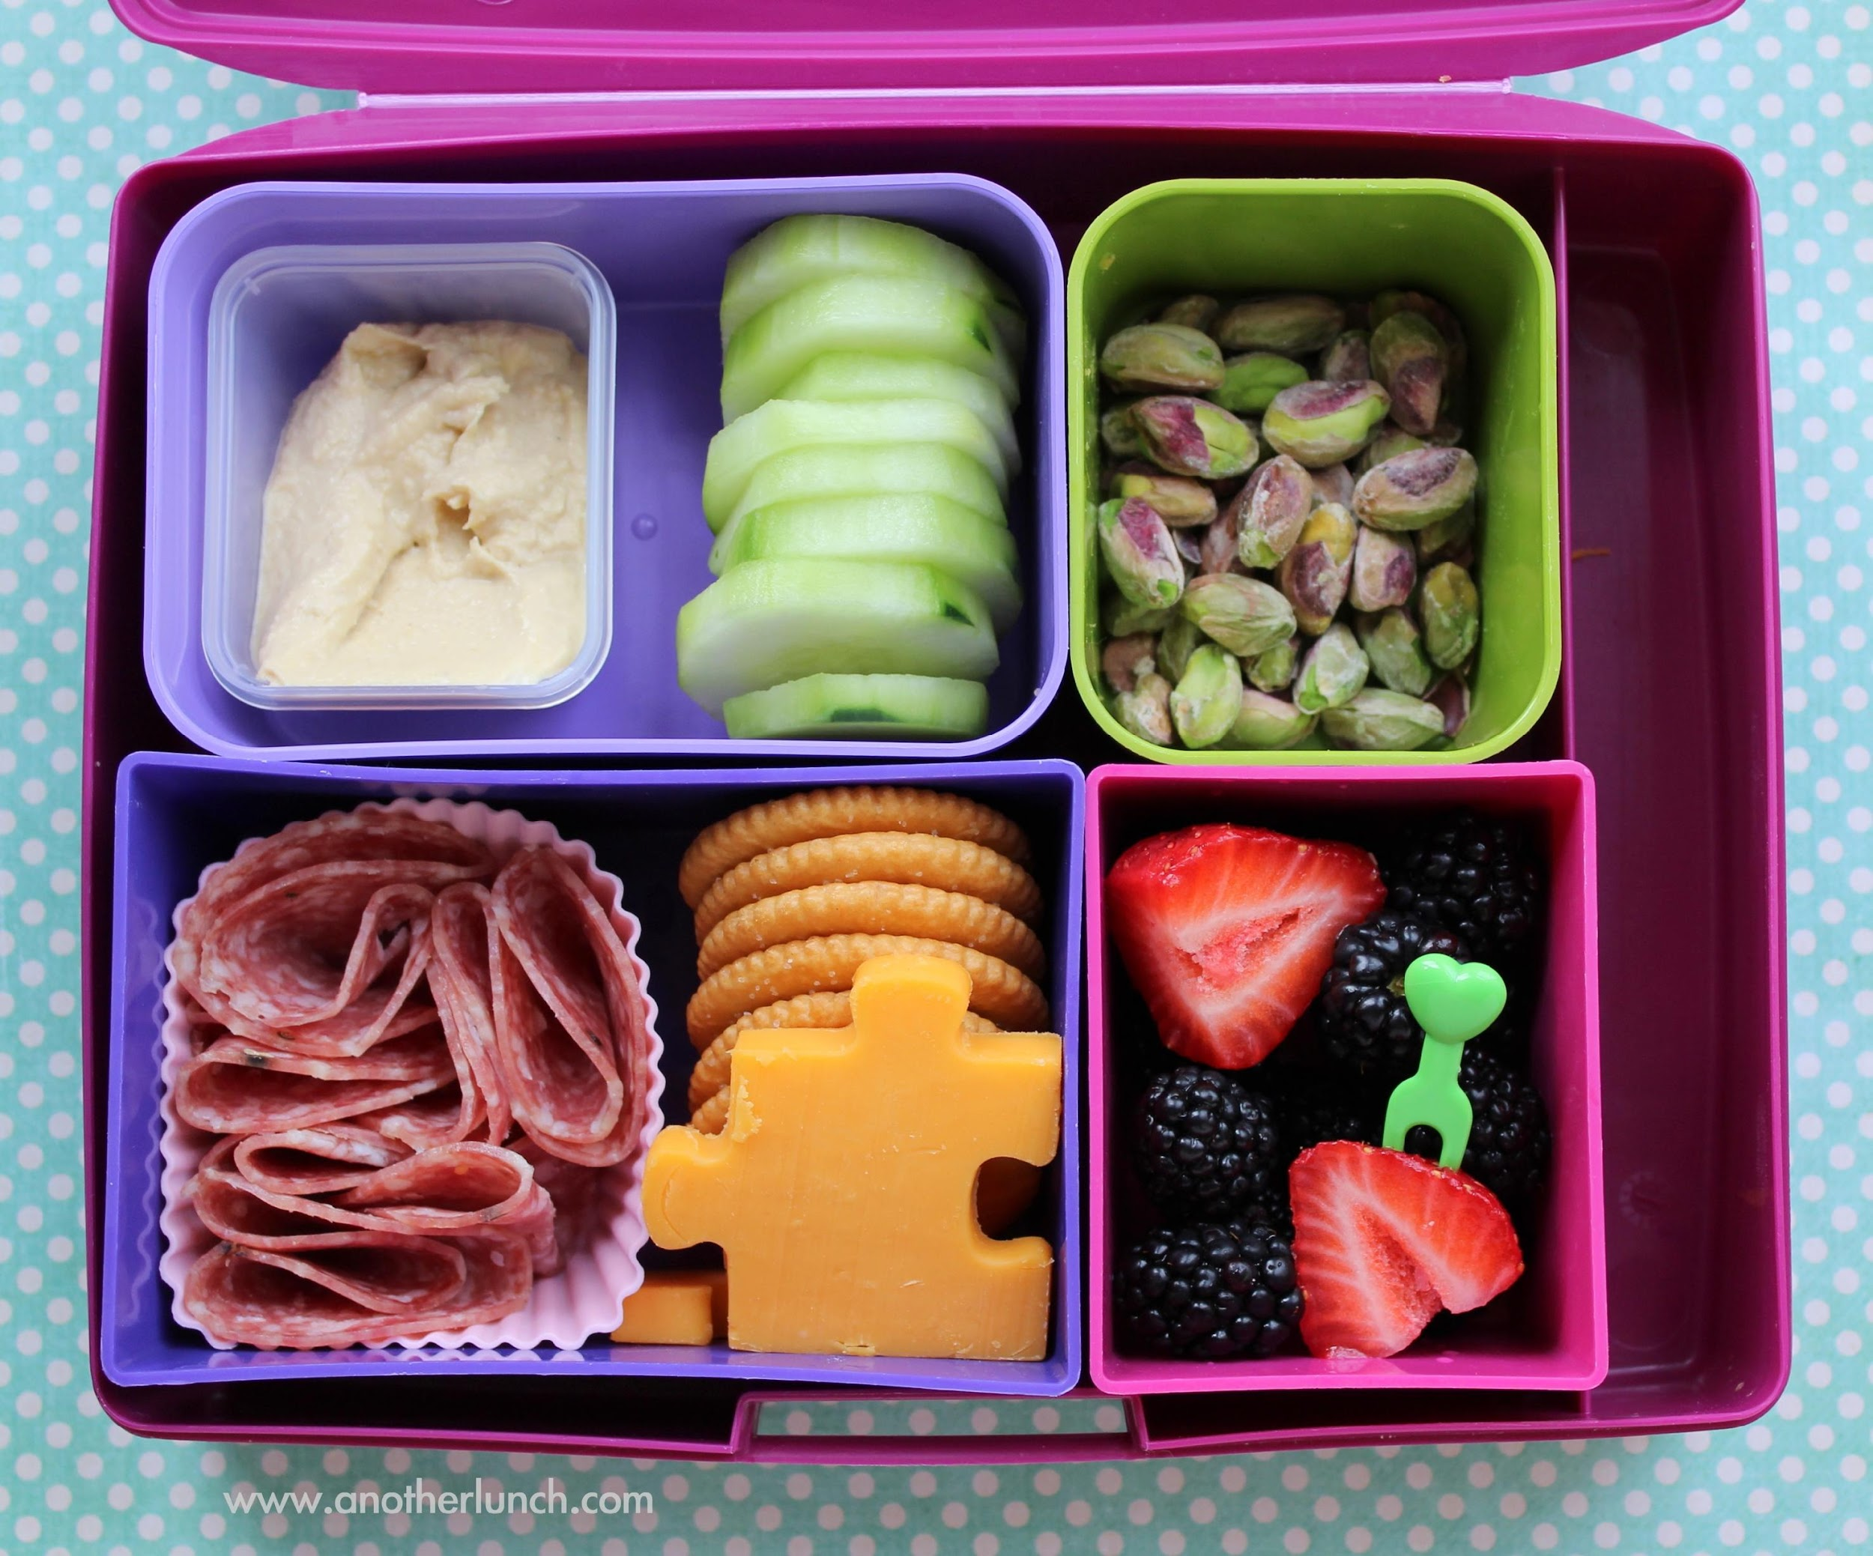
Activate prior knowledge
'Before’ and ‘after’ are words that tell us the order of when things happen.
Before means what happened earlier in time or prior to now.
After means what happened later in time or following now.
CFU:
Tell me something you did before school?
Tell me something you can do after school?
Before
After
This Photo by Unknown Author is licensed under CC BY-ND
This Photo by Unknown Author is licensed under CC BY
coming to school
this lesson
recess
Before you did this lesson, you came to school.
After you do this lesson, you can go to recess.

Slide 5
Concept Development
When we are writing, we can use ‘before’ and ‘after’ at the beginning of a sentence.
A special name for these words is ‘subordinating conjunctions’.
The subordinating conjunctions of ‘before’ and ‘after’ tell us the order of when things happen.
CFU:
Tell me something you did before school?
Tell me something you can do after school?
Notes:
*Teacher note – it is not necessary to teach the children specifically what subordinating conjunctions do or are in any detail. The reason the terminology is used is to give students the language needed for discussion about the topic and to begin to familiarise them with the terminology for future years.

Slide 6
Concept Development
‘Before’ and ‘after’ are subordinating conjunctions that tell us the order that events happen in.
When a sentence begins with ‘before’ or ‘after’ and one action (what happens), we need to complete the sentence by adding a related action with the correct order.
CFU:
Before and after tell us ... (when)
These sentence stems are not ... (a complete thought)
Sentence stems:
After he eats breakfast,
Before he eats breakfast,
After we clean our teeth,
Before we clean our teeth,
These sentence stems are not complete thoughts. They tell us when something has happened or will happen but they are not a complete thought.

Slide 7
Concept Development
‘Before’ and ‘after’ are subordinating conjunctions that tell us the order that events happen in.
When a sentence begins with ‘before’ or ‘after’ and one action (what happens), we need to complete the sentence by adding a related action with the correct order.
CFU:
Before and after tell us ... (when)
How does the starting with before and after change the sentence?
Examples:
After he ate breakfast, Billy got on the bus to go to school.
Before he ate breakfast, Billy got out of bed.
After we clean our teeth, we go to bed.
Before we clean our teeth, we eat our dinner.

Slide 8
Concept Development
‘Before’ and ‘after’ are subordinating conjunctions that tell us the order that events happen in.
When a sentence begins with ‘before’ or ‘after’ and one action (what happens), we need to complete the sentence by adding a related action with the correct order.
CFU:
Why are these non examples?
How can we fix the non-examples?
Non-Examples:
Before we clean our teeth, we go to bed.
This sentences does begin with before, but we do not clean our teeth once we are already in bed.
After we clean our teeth, bed.
This sentences does begin with after, but it is not a complete thought. There is no subject or verb after the sentence stem.

Slide 9
Concept Development
‘Before’ and ‘after’ are subordinating conjunctions that tell us the order that events happen in.
When a sentence begins with ‘before’ or ‘after’ and one action (what happens), we need to complete the sentence by adding a related action with the correct order.
CFU:
Why are these non examples?
How can we fix the non-examples?
Non-Examples:
Examples:
Before we clean our teeth, we go to bed.
Before we clean our teeth, we eat our dinner.
This sentences does begin with before, but we do not clean our teeth once we are already in bed.
After we clean our teeth, bed.
After we clean our teeth, we go to bed.
This sentences does begin with after, but it is not a complete thought. There is no subject or verb after the sentence stem.
Notes:
Option 2 for non-examples to demonstrate how they can be fixed.

Slide 10
Concept Development – I do
‘Before’ and ‘after’ are subordinating conjunctions that tell us the order that events happen in.
When a sentence begins with ‘before’ or ‘after’ and one action (what happens), we need to complete the sentence by adding a related action with the correct order.
CFU:
Does the part after the comma have a subject and a verb?
What are they?
Are the two actions related?
Are they in the correct order?
Is the new sentence a complete thought?
Read the sentence stem. Circle the subordinating conjunction ‘after’ or ‘before’.
Underline the action/ verb (what they are doing) that is being described before the comma.
Now read the action/ verb (what they are doing) after the comma.
Are the actions related to each other? Are the actions in the correct order?
After eating ice-cream,
we need to wash our faces.
Before eating ice-cream,
we need to chose a flavour.

Slide 11
Concept Development – We do
‘Before’ and ‘after’ are subordinating conjunctions that tell us the order that events happen in.
When a sentence begins with ‘before’ or ‘after’ and one action (what happens), we need to complete the sentence by adding a related action with the correct order.
CFU:
Does the part after the comma have a subject and a verb?
What are they?
Are the two actions related?
Are they in the correct order?
Is the new sentence a complete thought?
Read the sentence stem. Circle the subordinating conjunction ‘after’ or ‘before’.
Underline the action/ verb (what they are doing) that is being described before the comma.
Now read the action/ verb (what they are doing) after the comma.
Are the actions related to each other? Are the actions in the correct order?
After Frank turned out the lights,
he went to sleep.
Before Frank turned out the lights,
he put his pyjamas on.

Slide 12
Hinge Point Question
‘Before’ and ‘after’ are subordinating conjunctions that tell us the order that events happen in.
When a sentence begins with ‘before’ or ‘after’ and one action (what happens), we need to complete the sentence by adding a related action with the correct order.
CFU:
Do the actions before and after the comma match?
Are they in the correct order?
1. Before you start your work, make sure you write your name on the page.
2. After he set up his desk for the day, Sam left to go home.
3. After he climbed on the playground, Jack felt hot and tired.
4. Before Mia played on the oval, she put her hat in her school bag.

Slide 13
Hinge Point Question 2
Read the sentence stems. Circle the subordinating conjunctions ‘after’ or ‘before’.
Underline the actions/ verbs (what they are doing) that is being described before the comma.
Now read the actions/ verbs (what they are doing) after the comma.
Choose which action/ verb matches each sentence stem.
CFU:
Do the actions before and after the comma match?
Write the numbers 1 – 4 on your board.
We are then going to match the stems to the rest of the sentence.
1. After Jack and Jill went up the hill,
a) they washed off all of the sand.
2. Before Jack and Jill went up the hill,
b) they fell down the hill.
3. After the Jones family went to the beach,
c) they put sun cream on.
4. Before the Jones family went to the beach,
d) they got a pail.

Slide 14
Hinge Point Question 2
Read the sentence stems. Circle the subordinating conjunctions ‘after’ or ‘before’.
Underline the actions/ verbs (what they are doing) that is being described before the comma.
Now read the actions/ verbs (what they are doing) after the comma.
Choose which action/ verb matches each sentence stem.
CFU:
Let’s read the matched sentences.
1. After Jack and Jill went up the hill,
b) they fell down the hill.
2. Before Jack and Jill went up the hill,
d) they got a pail.
3. After the Jones family went to the beach,
a) they washed off all of the sand.
4. Before the Jones family went to the beach,
c) they put sun cream on.

Slide 15
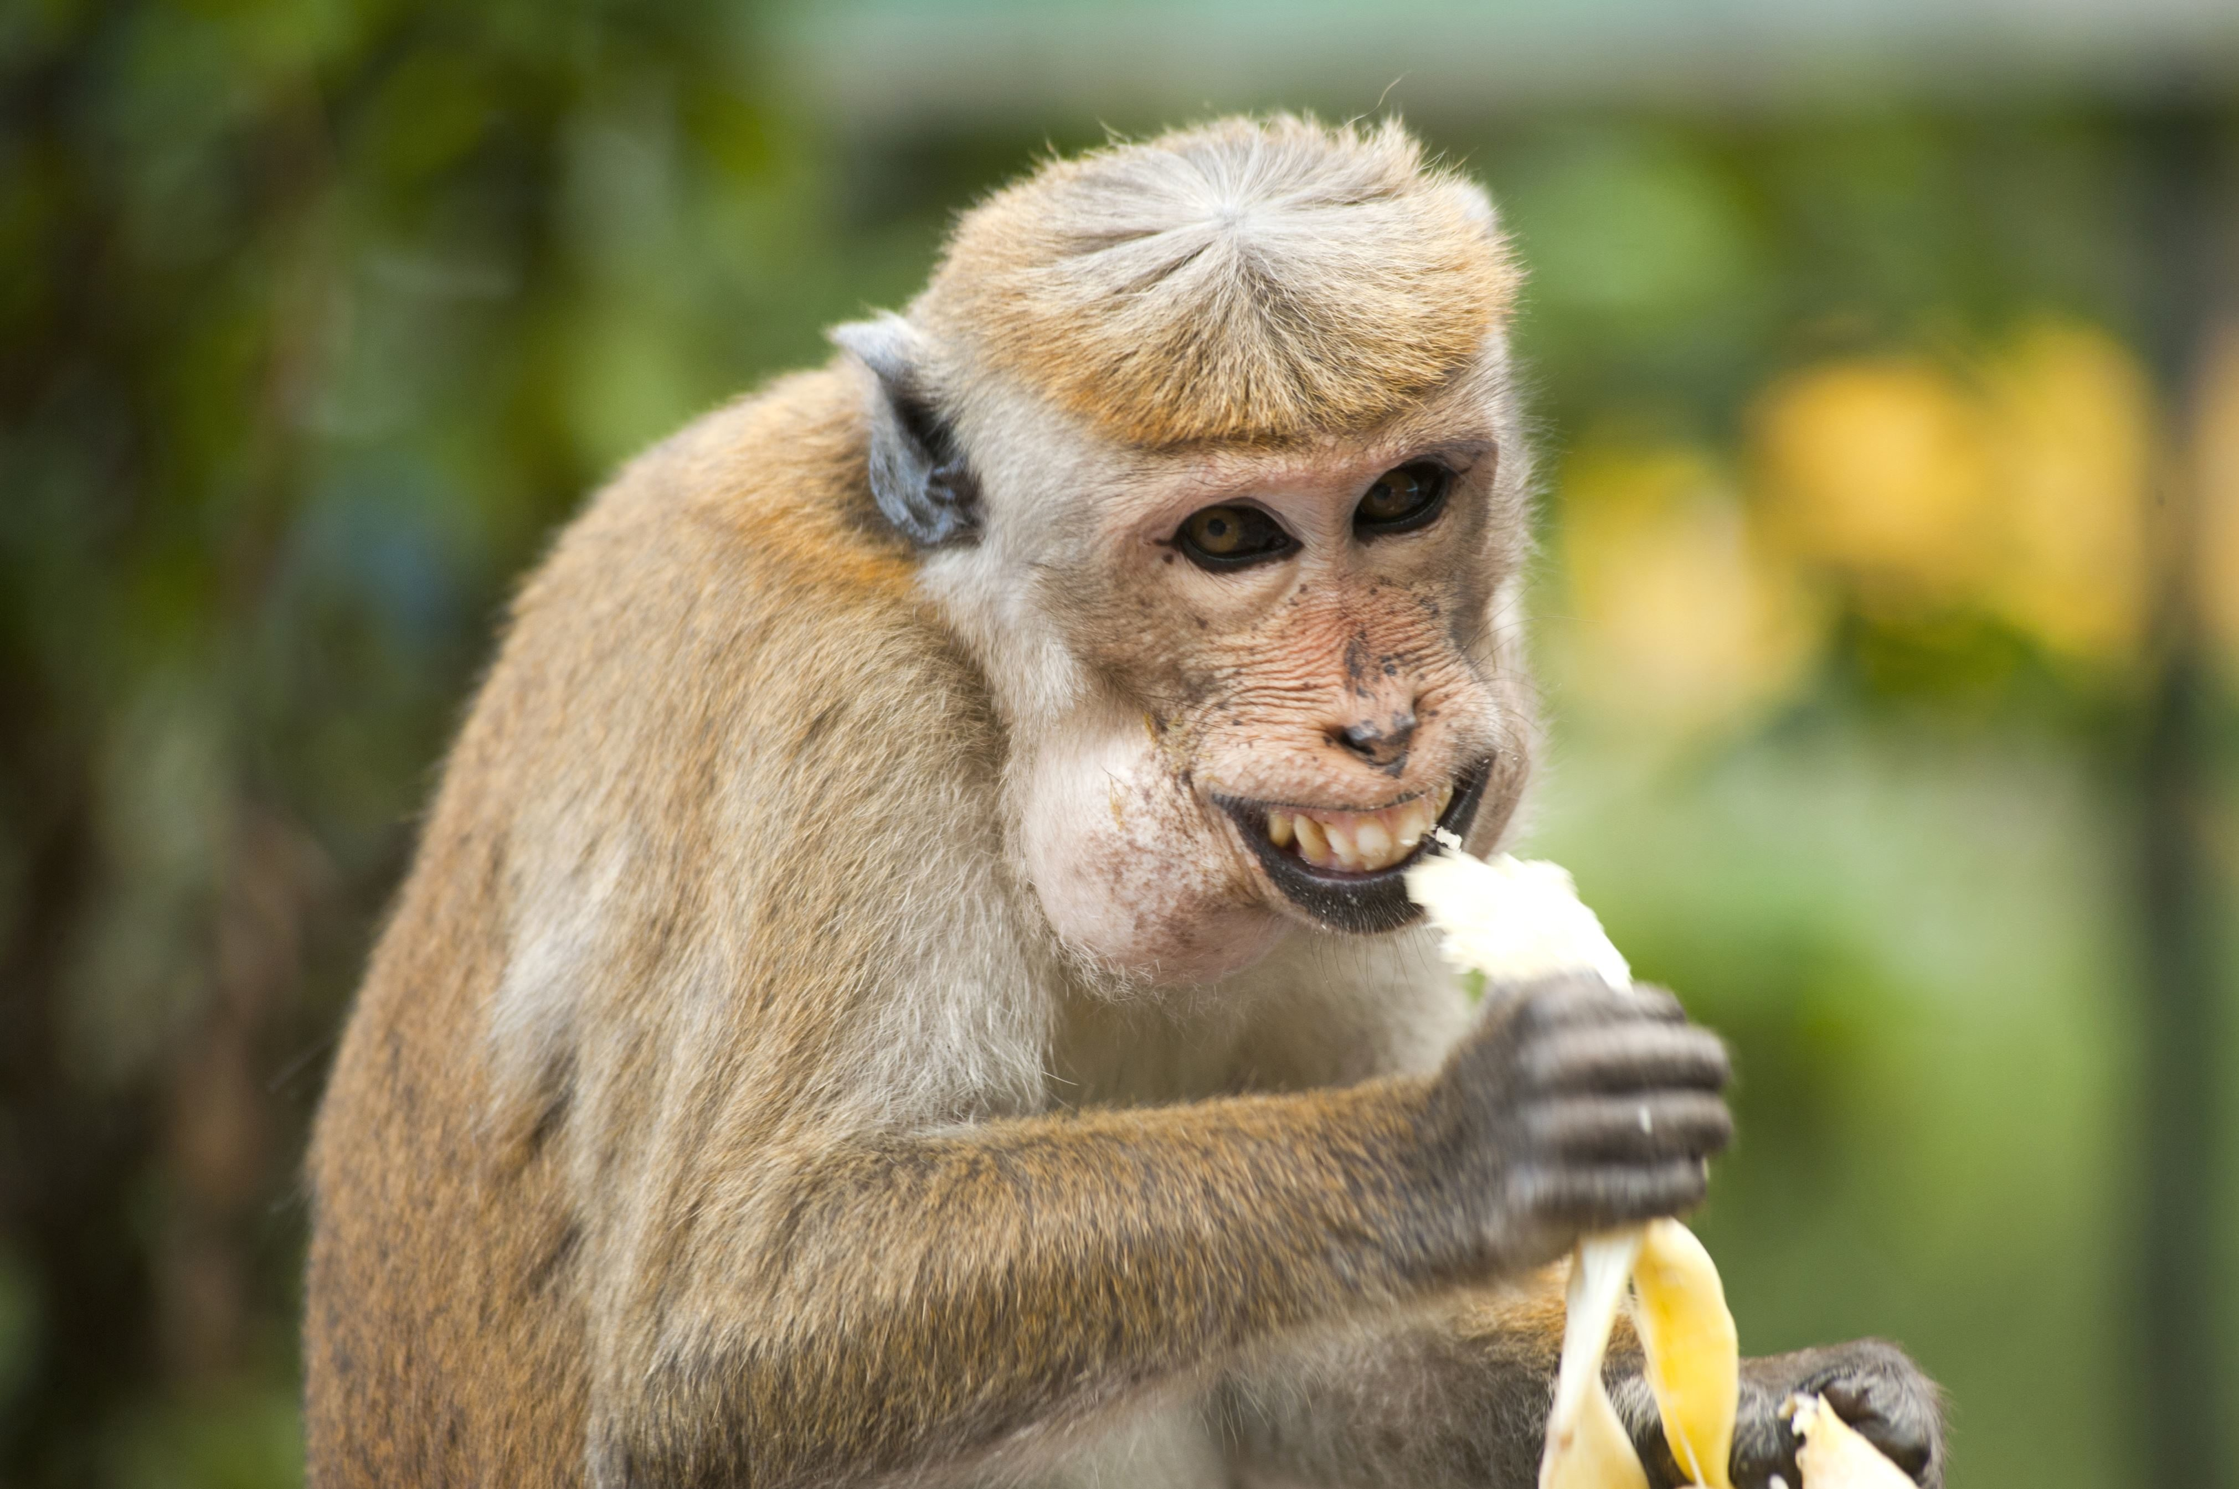
Identify the key word, the subordinating conjunction, and what it is modifying.
Use this information to complete the sentence with a who and a what they are doing.
Write the sentence stem, followed by a comma, then who and what.
Skill development: I do
Read the sentence stem. Circle the subordinating conjunction ‘after’ or ‘before’.
Underline the action/ verb (what they are doing) that is being described before the comma.
Use this information to orally complete the sentence with a who and an action/ verb (what they are doing).
Write the sentence stem, followed by a comma, then who and an action/ verb (what they are doing).
CFU:
What is action/verb before the comma?
Does this match the action/ verb after the comma?
How does changing subordinating conjunctions ’after’ and ‘before’ change the sentence?
After he ate the banana,
After he ate the banana, the monkey threw the peel on the ground.
Before he ate the banana,
Before he ate the banana, the monkey took it from the tree.
Notes:
https://pixnio.com/free-images/2017/03/25/2017-03-25-18-22-33.jpg

Slide 16
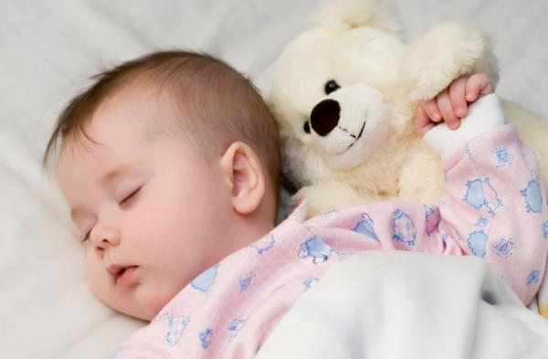
Skill development: We do
Read the sentence stem. Circle the subordinating conjunction ‘after’ or ‘before’.
Underline the action/ verb (what they are doing) that is being described before the comma.
Use this information to orally complete the sentence with a who and an action/ verb (what they are doing).
Write the sentence stem, followed by a comma, then who and an action/ verb (what they are doing).
CFU:
What is subordinating conjunction?
How do the two sentence change?
What can the baby do after she sleeps?
the baby plays with the teddy.
After she sleeps,
What did the baby do before she sleeps?
the baby cries a lot.
Before she sleeps,
This Photo by Unknown Author is licensed under CC BY

Slide 17
Skill development: We do
Read the sentence stem. Circle the subordinating conjunction ‘after’ or ‘before’.
Underline the action/ verb (what they are doing) that is being described before the comma.
Use this information to orally complete the sentence with a who and an action/ verb (what they are doing).
Write the sentence stem, followed by a comma, then who and an action/ verb (what they are doing).
CFU:
What is subordinating conjunction?
How do the two sentence change?
What might happen after the blocks fall?
After the blocks fall,
What happens before the blocks fall?
Before the blocks fall,
Notes:
https://images.pexels.com/photos/3661453/pexels-photo-3661453.jpeg?cs=srgb&dl=two-children-playing-with-lego-blocks-on-floor-3661453.jpg&fm=jpg

Slide 18
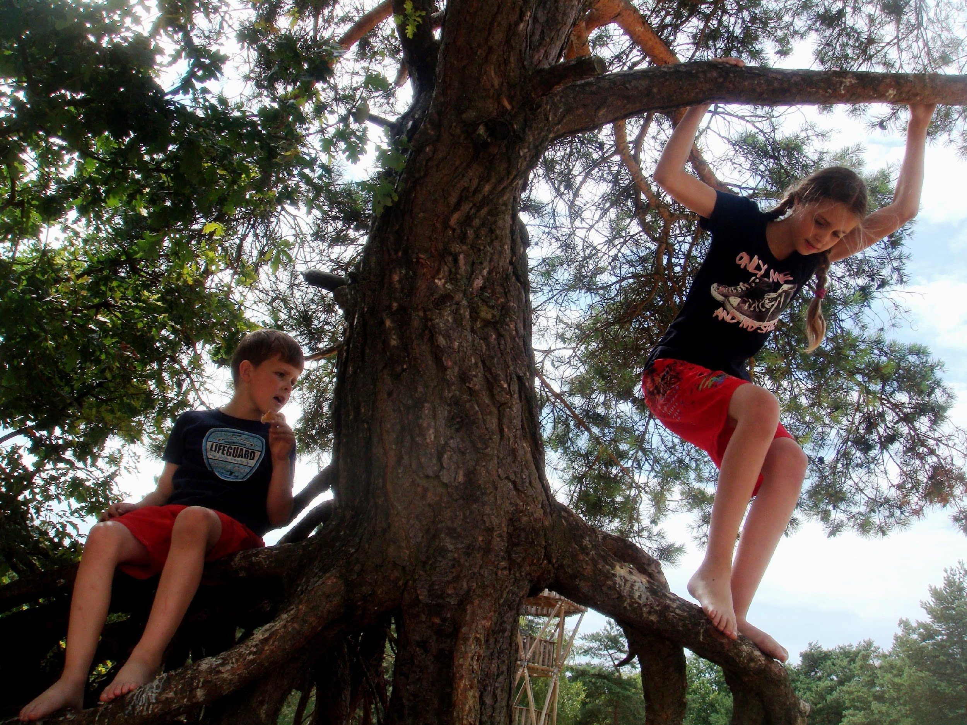
Skill development: You do
Read the sentence stem. Circle the subordinating conjunction ‘after’ or ‘before’.
Underline the action/ verb (what they are doing) that is being described before the comma.
Use this information to orally complete the sentence with a who and an action/ verb (what they are doing).
Write the sentence stem, followed by a comma, then who and an action/ verb (what they are doing).
CFU:
What is subordinating conjunction?
How do the two sentence change?
After they climbed the tree,
Before they climbed the tree,
After they go to the park,
Before they go to the park,
Notes:
https://get.pxhere.com/photo/tree-nature-forest-plant-flower-adventure-jump-spring-jungle-climbing-children-enjoy-work-together-woody-plant-1077454.jpg

Slide 19
Skill development: You do
Read the sentence stem. Circle the subordinating conjunction ‘after’ or ‘before’.
Underline the action/ verb (what they are doing) that is being described before the comma.
Use this information to orally complete the sentence with a who and an action/ verb (what they are doing).
Write the sentence stem, followed by a comma, then who and an action/ verb (what they are doing).
CFU:
What is subordinating conjunction?
How do the two sentence change?
Insert text - use examples from content/texts/topics from class
Insert text - use examples from content/texts/topics from class
Insert text - use examples from content/texts/topics from class
Insert text - use examples from content/texts/topics from class

