Slide 1
Year: 3
Term: 2
Objective: Combine and punctuate sentences using coordinating conjunctions
Author: Stephanie Le Lievre

Slide 2
Multiple Choice
Pair Share
Track with me
Pick a Stick/Answer (non-volunteer)
Whiteboards
Vote
Read with me
In Your Workbook

Slide 3
Learning Objective
We are learning to combine and punctuate sentences using coordinating conjunctions.

Slide 4
Concept Development
A compound sentence is made up of two independent clauses joined with a coordinating conjunction.
An independent clause is part of a sentence that has a subject and a verb and can be a stand alone sentence.
CFU:
Why are the clauses independent?
What is separating the clauses?
Coordinating conjunctions are For, And, Nor, But, Or, Yet, So (FANBOYS).
We left early for school, so that we could finish our homework.
I was so hungry, but there wasn’t any food left.
In both of these sentences, the independent clauses are underlined.

Slide 5
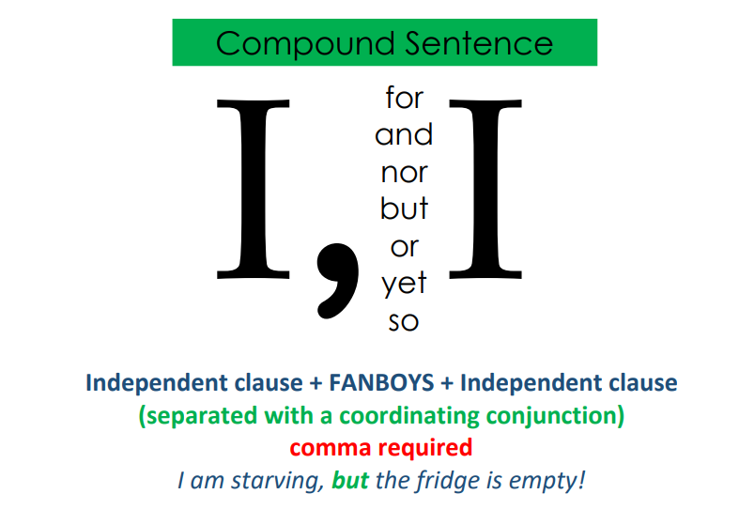
Concept Development
Coordinating conjunctions are For, And, Nor, But, Or, Yet, So (FANBOYS).

Slide 6
Concept Development
CFU:
What is the Coordinating conjunction?
Why is this an example of a compound sentence?
Examples of compound sentences:
1. Mary dropped the glass, so she needed to find a broom.
2. I love dogs, but I can’t stand cats.
3. Adam went to soccer practice, and Lucy went to swimming lessons.
4. Should I go to the movies with Alex, or should I stay home?
In all of these sentences, the independent clauses are underlined.

Slide 7
Concept Development
Non-Examples:
CFU:
Why is this not an example of a subordinate conjunction used in a complex sentence?
1. Kim and John like to play chess.
This sentence only contains one independent clause. The ‘and’ is separating subjects (Kim and John)- not clauses.
2. Math is my favourite subject because I’m very good at it.
This sentence contains a subordinating conjunction- ‘because’ isn’t a coordinating conjunction.

Slide 8
Hinge Point Question
CFU:
Why is it/ isn’t it a an example of a compound sentence?
What sentences are compound?
I love eating fish and chips.
Rod went to the shops, but he forgot his wallet.
Stacey will go to university after she finishes school.
I forgot my umbrella, so I had to borrow someone else’s.

Slide 9
Skill development: I do
Insert the subordinate conjunction into the complex sentence
CFU:
What’s the coordinating conjunction?
Why is that the best fit?
Blue is usually my favourite colour, ______ I love red roses.
and
but
so
or
Blue is usually my favourite colour, but I love red roses.

Slide 10
Skill development: We do
Insert the subordinate conjunction into the complex sentence
CFU:
What’s the coordinating conjunction?
Why is that the best fit?
Ethan was late for school, _____ he got a detention.
and
but
so
or
Ethan was late for school, so he got a detention.

Slide 11
Skill development: We do
Insert the subordinate conjunction into the complex sentence
CFU:
What’s the coordinating conjunction?
Why is that the best fit?
The trees fell, _________ the lumberjack stripped the branches from its trunk.
and
but
so
or
The trees fell, and the lumberjack stripped the branches from its trunk.

Slide 12
Skill development: I do
Combine these sentences using an appropriate coordinating conjunction
Fix the punctuation
CFU:
Why is this conjunction the best fit?
Why did I use a pronoun (she)?
Mary loves spaghetti.
Mary doesn’t like pizza.
Mary loves spaghetti, but she don’t love pizza.

Slide 13
Skill development: We do
Combine these sentences using an appropriate coordinating conjunction
Fix the punctuation
CFU:
Why did you choose that conjunction?
What pronoun did you add?
James forgot his toothbrush.
James has to buy a new one.
James forgot his toothbrush, so he has to buy a new one.

Slide 14
Skill development: We do
Combine these sentences using an appropriate coordinating conjunction
Fix the punctuation
CFU:
Why did you choose that conjunction?
What pronoun did you add?
Global warming is worsening.
Global warming requires it our urgent attention.
Global warming is worsening, so it requires our urgent attention.

Slide 15
Skill development: We do
Combine these sentences using an appropriate coordinating conjunction
Fix the punctuation
CFU:
Why did you choose that conjunction?
What pronoun did you add?
Lilly loves playing hockey.
Lilly loves playing basketball.
Lilly does not like dancing.
Lilly loves playing hockey and basketball, but she does not like dancing.

Slide 16
Skill development: We do
Combine these sentences using an appropriate coordinating conjunction
Fix the punctuation
CFU:
Why did you choose that conjunction?
What pronoun did you add?
Jade went to the zoo.
Jade did not see the lions.
Jade did not see the tigers.
Jade went to the zoo, but she did not see the lions or tigers.

Slide 17
Skill development: You do
Combine these sentences using an appropriate coordinating conjunction
Fix the punctuation
CFU:
Why is this a complex sentence?
What are the clauses?
Insert sentences here from texts/topics in class
Insert sentences here from texts/topics in class
Insert sentences here from texts/topics in class

