Slide 1
Year: Foundation
Term: 4
Week:
Objective: We are learning to complete a sentence with the conjunctions before and after.
Author: Suzi Hogg

Slide 2
Copy and paste these icons to the appropriate slides to indicate engagement norms/CFU strategies
Multiple Choice
Pair Share
Track with me
Pick a Stick/Answer (non-volunteer)
Whiteboards
Vote
Read with me
In Your Workbook

Slide 3
Learning Objective
We are learning to write sentences with the
conjunctions before and after.

Slide 4
Activate Prior Knowledge
A sentence is a complete thought.
It must contain a subject and a verb.
CFU:
Tell me the subject and the verb in these sentences?
Examples:
1. I took the dog for a walk.
2. We will be doing art today.
3. We must brush our teeth.

Slide 5
Activate Prior Knowledge
A sentence is a complete thought.
It must contain a subject and a verb.
CFU:
Tell me why these are not complete sentences.
Non-Examples:
1. Eating lunch.
2. Go to bed.
3. Before I went to work.

Slide 6
Concept Development
We can use the conjunctions of before and after to make our writing more interesting.
Before means at an earlier time.
After means at a later time.
CFU:
What is the conjunction in this sentence? Is it at the start or in the middle of the sentence?
Example:
1. Before we go to the shops, we need to take the dog for a walk.
2. After we finish eating lunch, we will be doing art.
3. We must brush our teeth before we go to bed.
4. You need to turn off the television after you have finished watching Bluey.

Slide 7
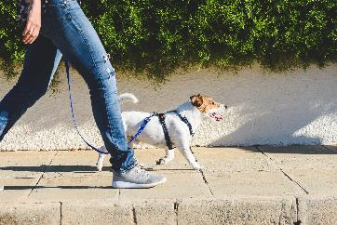
Concept Development
Example:
CFU:
What is the conjunction in this sentence? Is it at the start or in the middle of the sentence?
Before
Before we go to the shops, we need to take the dog for a walk.

Slide 8
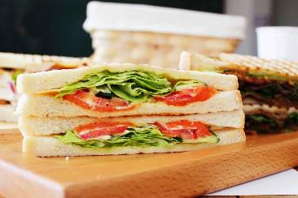
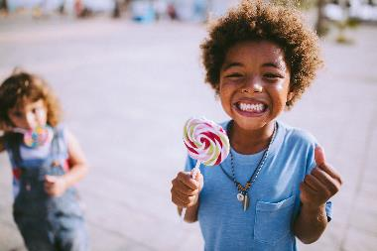
Concept Development
Example:
CFU:
What is the conjunction in this sentence? Is it at the start or in the middle of the sentence?
After
After we finish eating our lunch, we get lollypops.

Slide 9
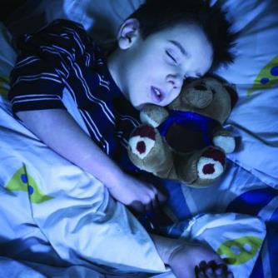
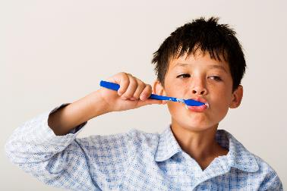
Concept Development
CFU:
What is the conjunction in this sentence? Is it at the start or in the middle of the sentence?
Example:
before
We need to brush our teeth before we go to bed.

Slide 10
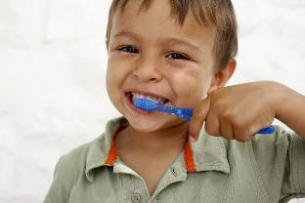
Concept Development
Example:
CFU:
What is the conjunction in this sentence? Is it at the start or in the middle of the sentence?
after
You need to brush your teeth after you have finished watching bluey.

Slide 11
Hinge Point Question
CFU:
Why is it/ isn’t it a an example of a conjunction
Go through each option one-at-a-time once students have answered on their whiteboards
Hinge-point question:
Which questions are an example of using the conjunctions before and after.
After you eat dinner, you can have dessert.
b) You can go to the pool.
c) I kicked the winning goal before the siren sounded.
d) Netball is played on Saturday.
The conjunctions before and after link ideas together.

Slide 12
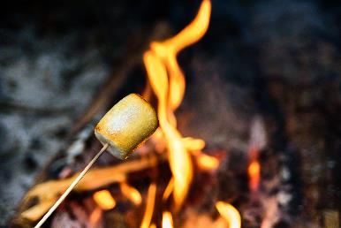
Skill development: I do
Read the sentence stem.
Choose the conjunction before or after.
Complete the sentence stem.
Re-read your sentence to check it makes sense.
CFU:
Which conjunction means at an earlier time?
after
before
I light the fire.
I am going to collect wood ___________ ___________________

Slide 13
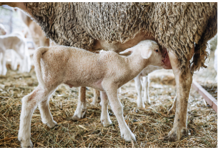
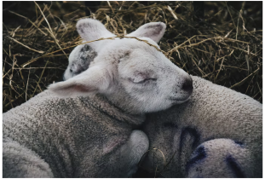
Skill development: We do
Read the sentence stem.
Choose the conjunction before or after.
Complete the sentence stem.
Re-read your sentence to check it makes sense.
CFU:
Why did we choose after and not before?
After
Before
it goes to sleep
__________ the lamb has milk, _________________.

Slide 14
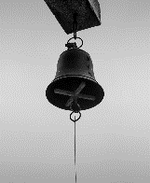
Skill development: We do
Read the sentence stem.
Choose the conjunction before or after.
Complete the sentence stem.
Re-read your sentence to check it makes sense.
after
before
after
the bell went
The students went to class___________ _______________.

Slide 15
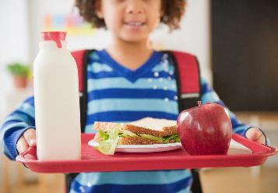
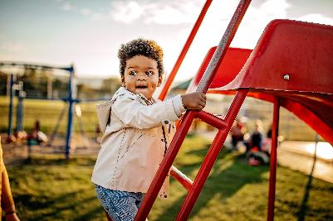
Skill development: We do
Read the sentence stem.
Choose the conjunction before or after.
Complete the sentence stem.
Re-read your sentence to check it makes sense.
after
before
After
we eat lunch
_______ _______________, we can go outside to play.

Slide 16
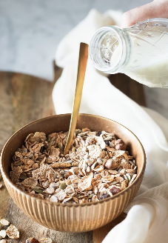
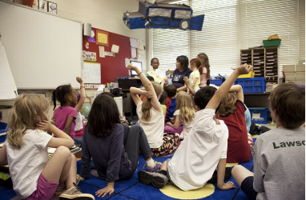
Skill development: We do
Read the sentence stem.
Choose the conjunction before or after.
Complete the sentence stem.
Re-read your sentence to check it makes sense.
after
before
before
we went to school.
We ate breakfast __________ ___________________

Slide 17
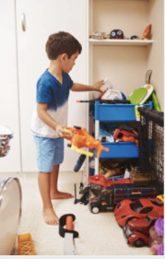
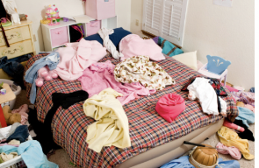
Skill development: We do
Read the sentence stem.
Choose the conjunction before or after.
Complete the sentence stem.
Re-read your sentence to check it makes sense.
after
before
The boy cleaned his room, ___________ _________________________

Slide 18
Skill development: You do
Read the sentence stem.
Choose the conjunction before or after.
Complete the sentence stem.
Re-read your sentence to check it makes sense.
Complete these in your workbook:
after
before
Insert sentence stems based on topics/literature etc. in class

