Slide 1
Year: Foundation
Term: 4
Week: 5
Objective: We are learning to complete a sentence with the subordinate conjunctions if and when.
Author: Suzi Hogg

Slide 2
Copy and paste these icons to the appropriate slides to indicate engagement norms/CFU strategies
Multiple Choice
Pair Share
Track with me
Pick a Stick/Answer (non-volunteer)
Whiteboards
Vote
Read with me
In Your Workbook

Slide 3
Learning Objective
We are learning to complete a sentence with the conjunctions if and when.

Slide 4
Activate Prior Knowledge
A sentence is a complete thought.
It must contain a subject and a verb.
CFU:
Tell me the subject and the verb in these sentences?
Examples:
1. Suzi took the horse for a ride.
2. Room 2 will be doing sport today.
3. We must brush our teeth.

Slide 5
Activate Prior Knowledge
A sentence is a complete thought.
It must contain a subject and a verb.
CFU:
Tell me why these are not complete sentences.
Non-Examples:
1. Sat down.
2. Get the car.
3. If I went to work.

Slide 6
Concept Development
We can use the conjunctions of if and when to make our writing more interesting.
CFU:
What is the conjunction in this sentence?
Is it at the start or in the middle of the sentence?
Example:
1. If you eat your dinner, you can have dessert.
2. When we finish eating lunch, we will go to sport.
3. We must brush our teeth if you want them to be healthy.
4. You need to turn off the television when Bluey is finished.

Slide 7
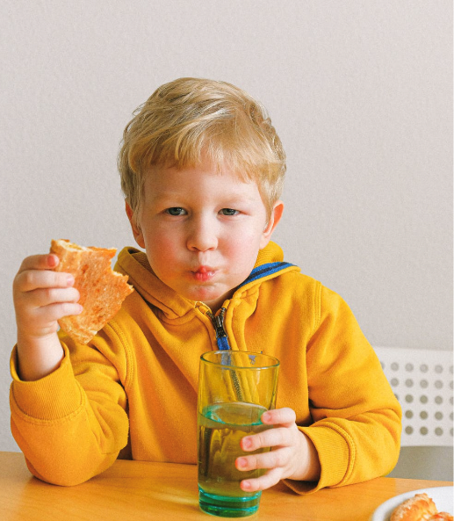
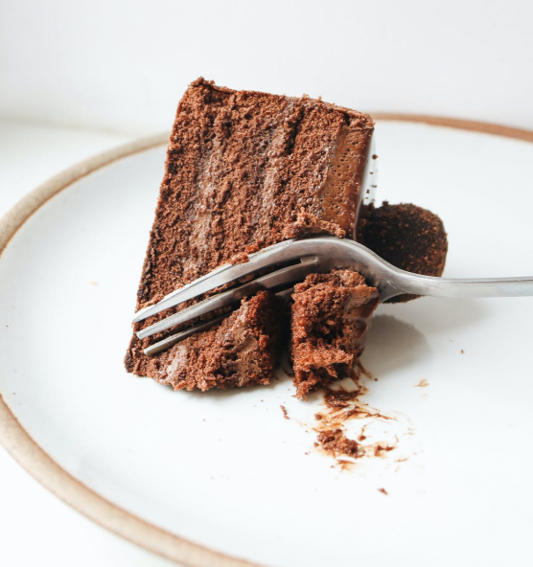
Concept Development
Example:
CFU:
What is the conjunction in this sentence?
Is it at the start or in the middle of the sentence?
If
If you eat your dinner, you can have dessert.

Slide 8
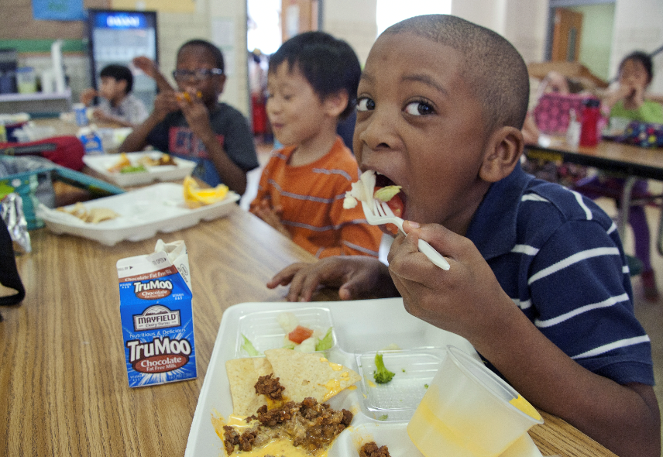
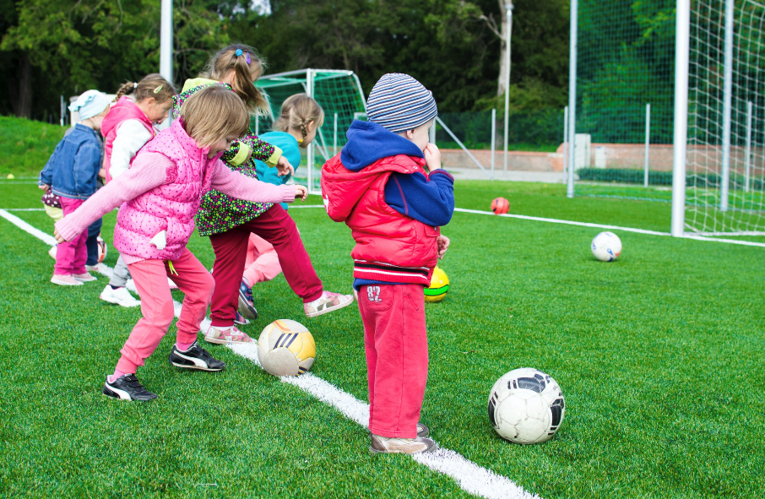
Concept Development
CFU:
What is the conjunction in this sentence?
Is it at the start or in the middle of the sentence?
Example:
When
When we finish eating our lunch, we will go to sport.

Slide 9
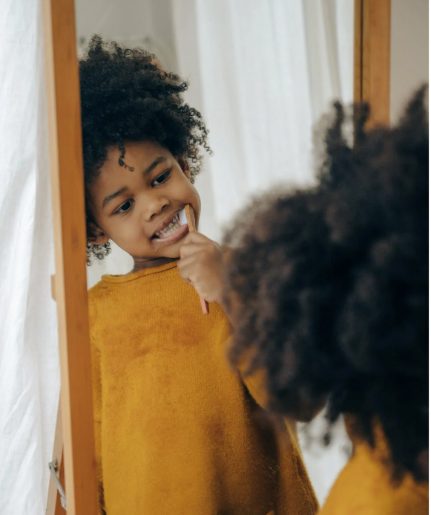
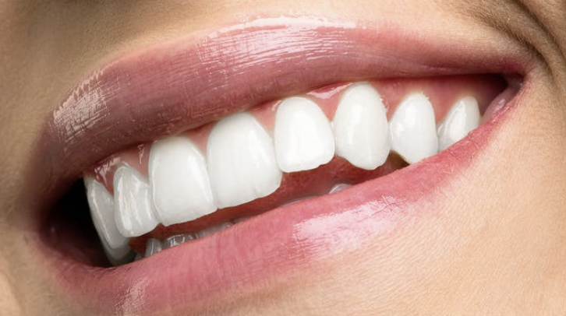
Concept Development
CFU:
What is the conjunction in this sentence?
Is it at the start or in the middle of the sentence?
Example:
if
We must to brush our teeth if you want them to be healthy.

Slide 10
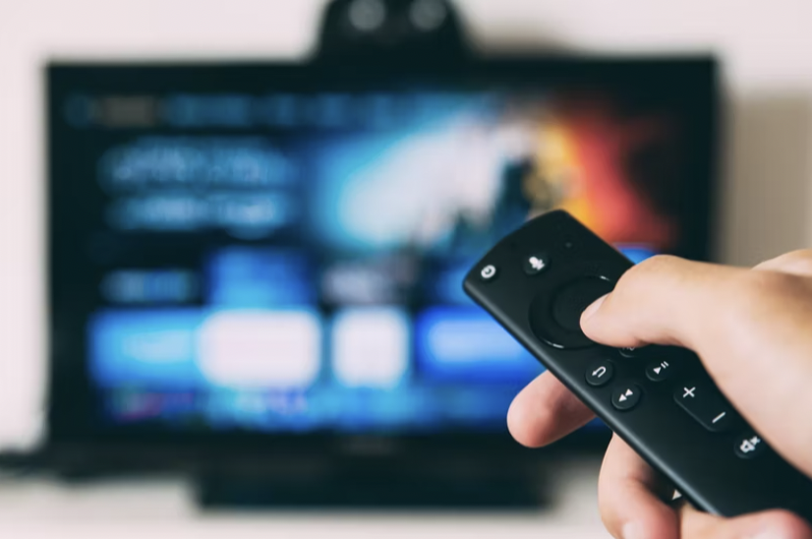
Concept Development
CFU:
What is the conjunction in this sentence?
Is it at the start or in the middle of the sentence?
Example:
when
You need to turn off the television when Bluey if finished.

Slide 11
Hinge Point Question
CFU:
Why is it/ isn’t it a an example of a conjunction
Go through each option one-at-a-time once students have answered on their whiteboards
Hinge-point question:
Which questions are an example of using the conjunctions if and when.
If it is hot, we can go to the beach.
We will go to the beach in the morning.
We can have free time when all your work is finished.
d) When is it my birthday?
The conjunctions if and when link ideas together.

Slide 12
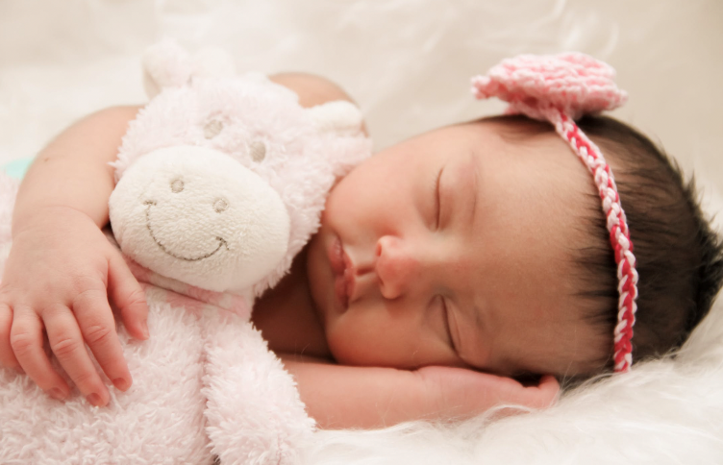
Skill development: I do
Read the sentence stem.
Insert the subordinating conjunction of if or when.
Complete the sentence.
Re-read extended sentence to check it makes sense.
If
when
the baby wakes up.
We are going to go to the shops _______ _______________________

Slide 13
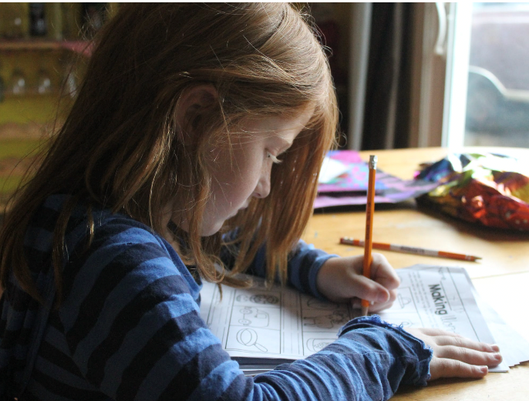
Skill development: We do
Read the sentence stem.
Choose the conjunction of if or when.
Complete the sentence stem.
Re-read extended sentence to check it makes sense.
when
if
___________ you do your homework, ______________________
we can play a game.

Slide 14
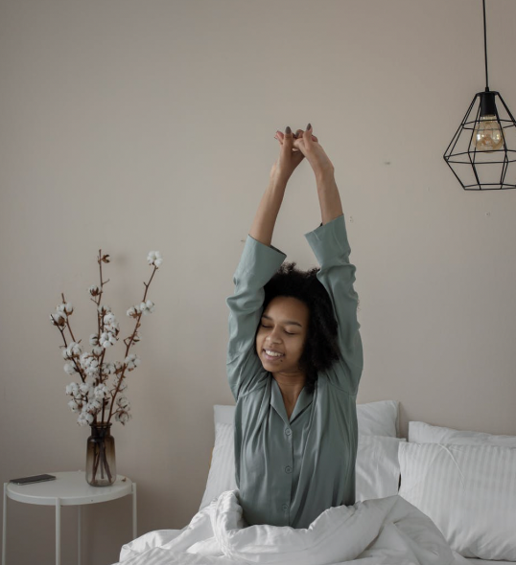
Skill development: We do
Read the sentence stem.
Insert the subordinating conjunction of if or when.
Complete the sentence stem.
Re-read extended sentence to check it makes sense.
if
when
when
everyone wakes up
We can open the Christmas presents___________ _____________________.

Slide 15
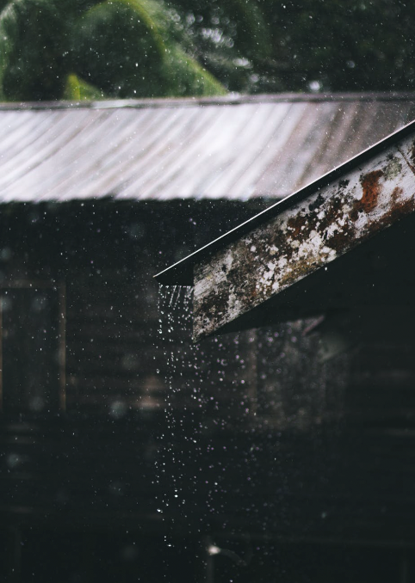
Skill development: We do
Read the sentence stem.
Insert the subordinating conjunction of if or when.
Complete the sentence stem.
Re-read extended sentence to check it makes sense.
if
when
If
it’s going to rain today
_____ ________________________, you might need an umbrella.

Slide 16
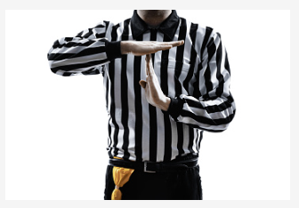
Skill development: We do
Read the sentence stem.
Insert the conjunction of if or when.
Complete the sentence stem.
Re-read extended sentence to check it makes sense.
If
when
If
the children get told off
____________ ________________________, they have to go to time out.

Slide 17
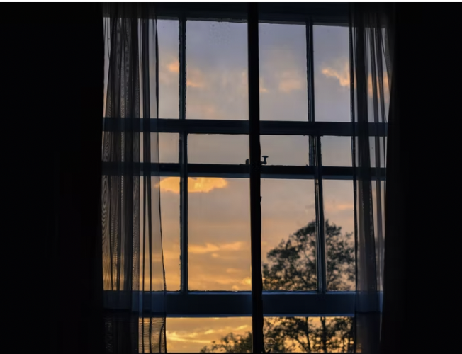
Skill development: We do
Read the sentence stem.
Insert the conjunction of if or when.
Complete the sentence stem.
Re-read extended sentence to check it makes sense.
if
when
when
I opened the curtains.
The sun shone through the window __________ ________________________

Slide 18
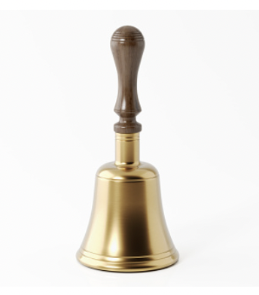
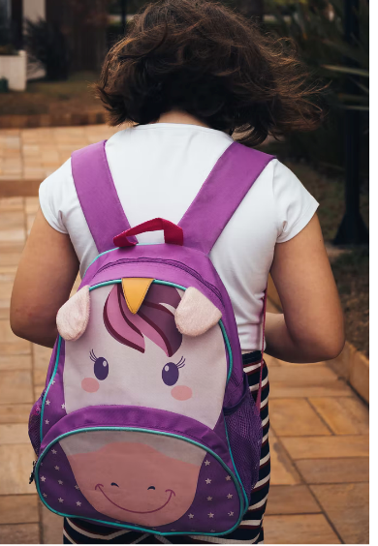
Skill development: We do
Read the sentence stem.
Insert the conjunction of if or when.
Complete the sentence stem.
Re-read extended sentence to check it makes sense.
if
when
When
the bell goes
_________ _______________________, we need to pack our school bags.

Slide 19
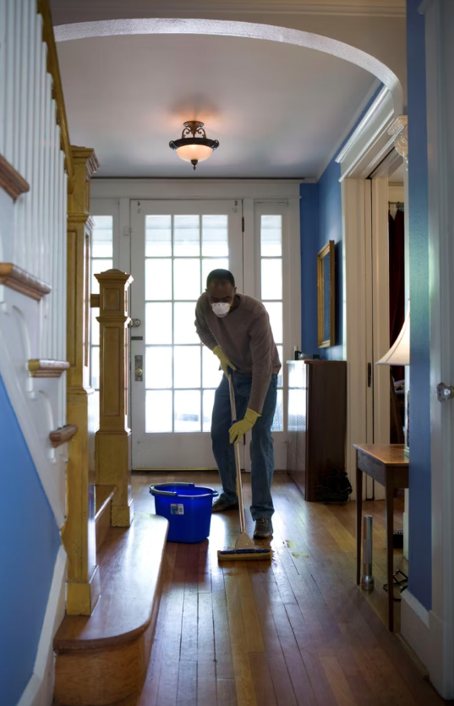
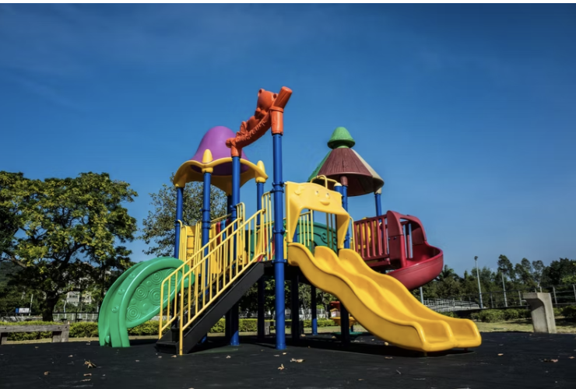
Skill development: We do
Read the sentence stem.
Insert the conjunction of if or when.
Complete the sentence stem.
Re-read extended sentence to check it makes sense.
if
when
when
I have cleaned the house.
We will go to the park ___________ _________________________

Slide 20
Skill development: You do
Read the sentence stem.
Insert the conjunction of if or when.
Complete the sentence stem.
Re-read extended sentence to check it makes sense.
Complete these in your workbook:
if
when
Insert sentence stems based on texts/topics/literature from class

