Slide 1
Year: 3
Term: 2
Objective: Identify coordinating conjunctions.
Complete sentence stems starting with a coordinating conjunction to form a compound sentence
Author: Stephanie Le Lievre

Slide 2
Multiple Choice
Pair Share
Track with me
Pick a Stick/Answer (non-volunteer)
Whiteboards
Vote
Read with me
In Your Workbook

Slide 3
Learning Objective
We are learning to:
Identify coordinating conjunctions
Complete sentence stems containing a coordinating conjunction to form a compound sentence

Slide 4
Concept Development
Coordinating conjunctions separate two words, phrases, clauses or sentences of equal rank.
Coordinating conjunctions are For, And, Nor, But, Or, Yet, So (FANBOYS).
We are focussing on and, but, or, so
CFU:
What are the coordinating conjunctions?
What does …. mean?
Coordinating conjunction | Meaning | Sentence
For | because/reason | I have to find a jacket, for it is snowing today.
And | in addition | Tim walked on the path, and Mary ran on the road.
Nor | and not | Sarah doesn’t like peas, nor does she like apples.
But | in contrast | I wanted to ride my bike to school, but it was raining.
Or | either | We could go to the zoo, or we could go to the movies.
Yet | But | It was raining outside, yet the sun was shining.
So | therefore | I dropped the glass, so the water went everywhere.

Slide 5
Concept Development
A compound sentence is made up of two independent clauses joined with a coordinating conjunction.
An independent clause is part of a sentence that has a subject and a verb and can be a stand alone sentence.
CFU:
Why are the clauses independent?
What is separating the clauses?
A coordinating conjunction can separate two independent clauses.
We left early for school, so that we could finish our homework.
I was so hungry, but there wasn’t any food left.
In both of these sentences, the independent clauses are underlined.

Slide 6
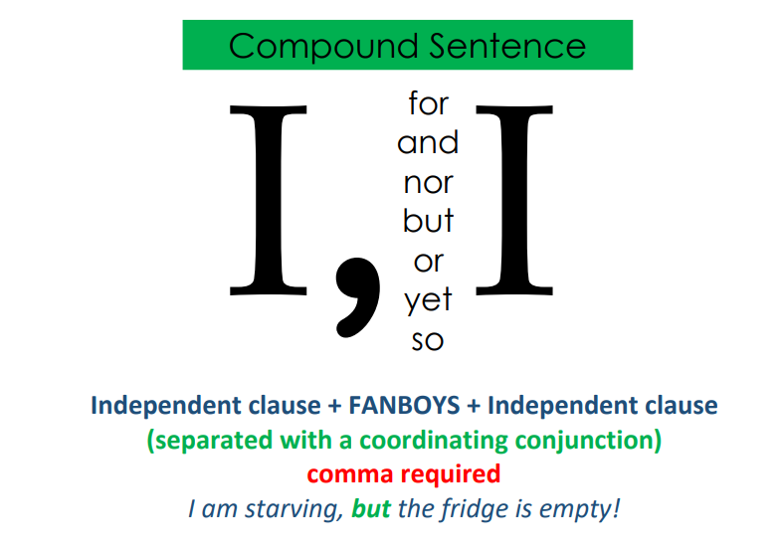
Concept Development
We use a comma to separate two independent clauses.

Slide 7
Concept Development
CFU:
What is the Coordinating conjunction?
Why is this an example of a compound sentence?
Examples of compound sentences:
1. Mary dropped the glass, so she needed to find a broom.
2. I love dogs, but I can’t stand cats.
3. Adam went to soccer practice, and Lucy went to swimming lessons.
4. Should I go to the movies with Alex, or should I stay home?
In all of these sentences, the independent clauses are underlined.

Slide 8
Concept Development
Non-Examples of compound sentences:
CFU:
Why is this not an example of a subordinate conjunction used in a complex sentence?
1. Kim and John like to play chess.
This sentence only contains one independent clause. The ‘and’ is separating subjects (Kim and John)- not clauses.
2. Math is my favourite subject because I’m very good at it.
This sentence contains a subordinating conjunction- ‘because’ isn’t a coordinating conjunction.

Slide 9
Hinge Point Question
CFU:
Why is it/ isn’t it a an example of a compound sentence?
What sentences are compound?
I walked to the shop to get milk.
I like dogs and cats
I like dogs, and Sarah likes cats.
She woke up late, so she was late for school.

Slide 10
Skill development: I do
Insert the coordinating conjunction into the complex sentence
CFU:
What’s the coordinating conjunction?
Why is that the best fit?
Martin fell off his bike, __________ he was taken to hospital.
and
but
so
or
Marin fell off his bike, so he was taken to hospital.

Slide 11
Skill development: We do
Insert the coordinating conjunction into the complex sentence
CFU:
What’s the coordinating conjunction?
Why is that the best fit?
Trinity found a shell in the sand, _________ Brian found a starfish in the ocean.
and
but
so
or
Trinity found a shell in the sand, and Brian found a starfish in the ocean.

Slide 12
Skill development: We do
Insert the coordinating conjunction into the complex sentence
CFU:
What’s the coordinating conjunction?
Why is that the best fit?
I feel like watching a movie, __________ there isn’t anything on that looks appealing.
and
but
so
or
I feel like watching a movie, but there isn’t anything on that looks appealing.

Slide 13
Skill development: We do
Insert the coordinating conjunction into the complex sentence
CFU:
What’s the coordinating conjunction?
Why is that the best fit?
The students could go to the library, ________ they could go to swimming lessons.
and
but
so
or
The students could go to the library, or they could go to swimming lessons.

Slide 14
Skill development: I do
Read the first clause
Complete the sentence by adding another clause to make a compound sentence
Check your completed sentence for correct punctuation
CFU:
What does this conjunction tell you about the relationship between the clauses?
Mary loves spaghetti, but …
she doesn’t get to eat it often.
Mary loves spaghetti, so …
she made some for dinner.
Mary loves spaghetti, and …
her brother loves it too.
Remember that you can just insert one word- it has to be a second clause (with a subject and verb).

Slide 15
Skill development: We do
Read the first clause
Complete the sentence by adding another clause to make a compound sentence
Check your completed sentence for correct punctuation
CFU:
What does this conjunction tell you about the relationship between the clauses?
We could watch the cricket, or…
we could watch the tennis .
Tom made a mess in the kitchen, so …
his mum told him off.
I want to go for a swim, but
I’m afraid of sharks.
Remember that you can just insert one word- it has to be a second clause (with a subject and verb).

Slide 16
Skill development: You do
Read the first clause
Complete the sentence by adding another clause to make a compound sentence
Check your completed sentence for correct punctuation
CFU:
What does this conjunction tell you about the relationship between the clauses?
Insert sentence stems and coordinating conjunctions here based on texts/content covered in class

