Slide 1
Year: Kindergarten (Year Prior to Foundation)
Term: 1
Objective: We are learning to speak in full sentences (oral)
Author: Jasmyn Hall

Slide 2
Multiple Choice
Pair Share
Track with me
Pick a Stick/Answer (non-volunteer)
Whiteboards
Vote
Read with me
In Your Workbook

Slide 3
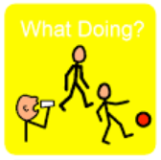
Concept Review
A sentence is a complete thought that makes sense.
A sentence must:
make sense
have a WHO
have a DO

Slide 4
Learning Objective
We are learning to speak in full sentences.
We are going to add more parts to our sentences to make them longer and more interesting.

Slide 5
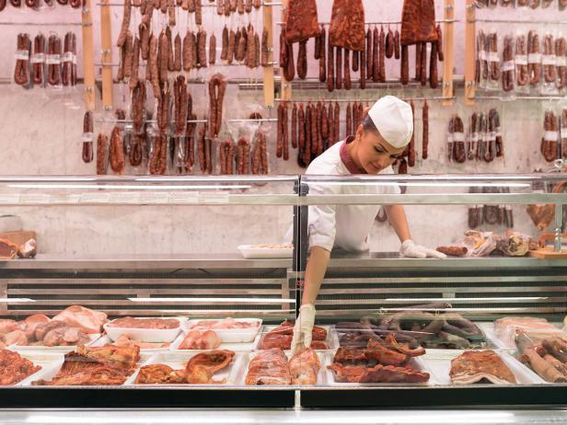
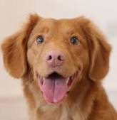
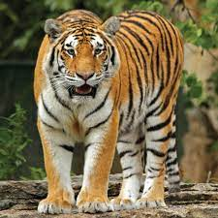
Concept Review
WHO words tell us the person or animal we are talking about
WHO words are orange words
CFU:
What does WHO name / tell us?
Say WHO:
person
animal
person
animal
butcher
dog
pirate
tiger

Slide 6
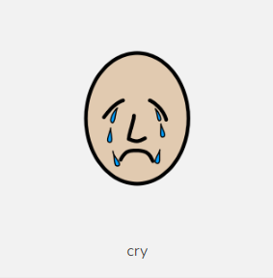
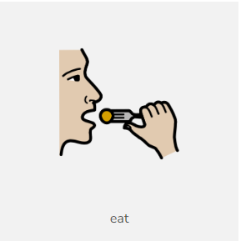
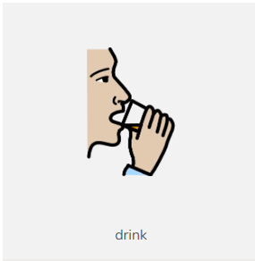
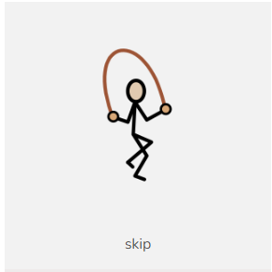
Concept Review
DO words tell us what a person or animal is doing
DO words are yellow words
CFU:
What does DO tell us?
Say the DO:
cry
eat
drink
skip

Slide 7
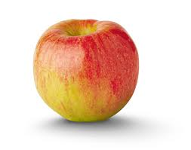
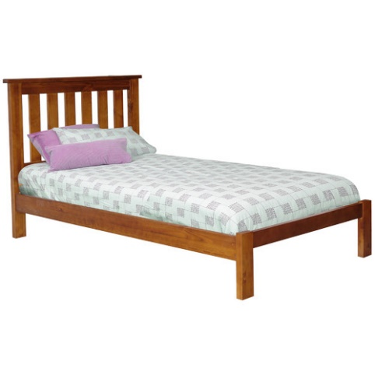
Concept Development
WHAT words tell us THINGS a person or animal has or is using
WHAT words are green words
CFU:
What does WHAT tell us?
Say the WHAT:
apple
bed
juice
ball

Slide 8
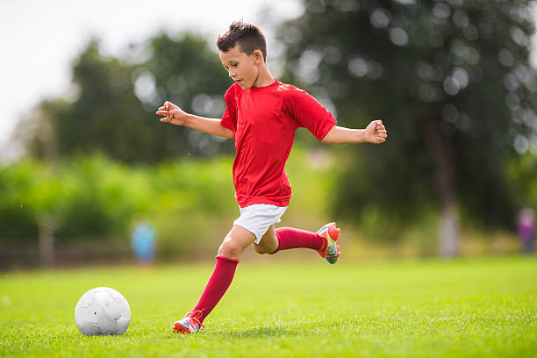
Concept Development: I do
Let’s find the ‘who’ , the ‘do’ and the ‘what’
I say the sentence then we say the sentence
CFU:
What’s the WHO of the sentence?
What’s the DO of the sentence?
What’s the WHAT of the sentence?
A sentence must:
make sense
have a WHO
have a DO

Slide 9
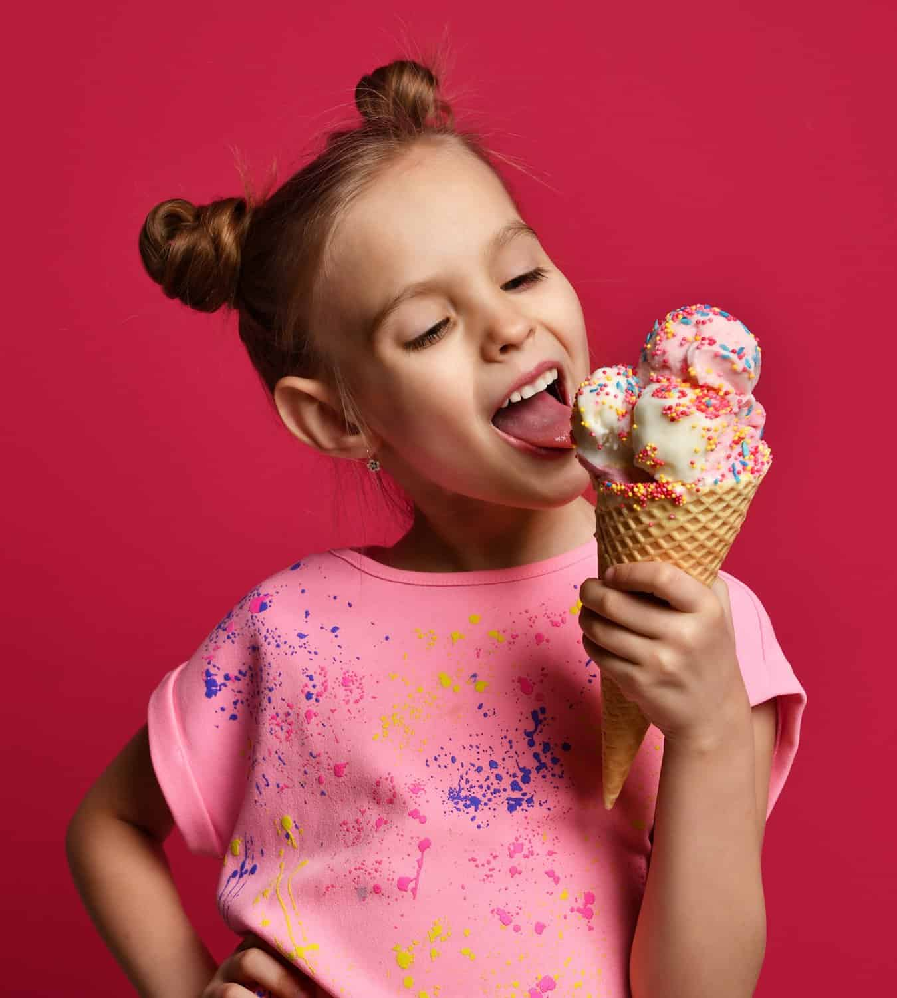
Concept Development: I do
Let’s find the ‘who’ , the ‘do’ and the ‘what’
I say the sentence then we say the sentence
CFU:
What’s the WHO of the sentence?
What’s the DO of the sentence?
What’s the WHAT of the sentence?
A sentence must:
make sense
have a WHO
have a DO

Slide 10
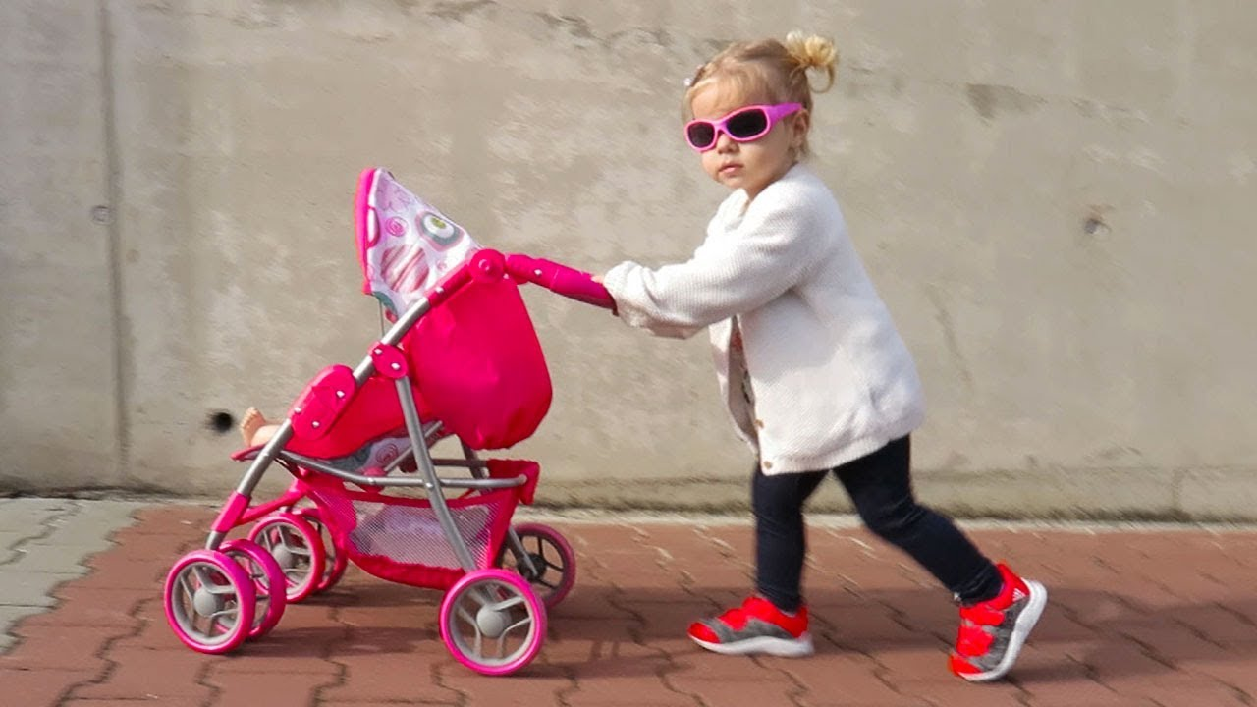
Concept Development: We do
Let’s find the ‘who’ , the ‘do’ and the ‘what’
I say the sentence then we say the sentence
CFU:
What’s the WHO of the sentence?
What’s the DO of the sentence?
What’s the WHAT of the sentence?
A sentence must:
make sense
have a WHO
have a DO

Slide 11
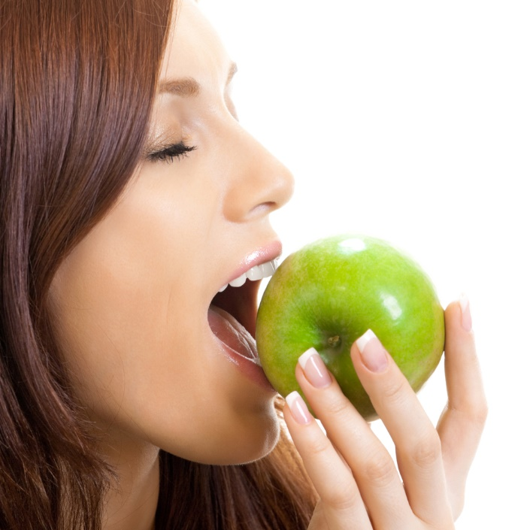
Concept Development: We do
Let’s find the ‘who’ , the ‘do’ and the ‘what’
I say the sentence then we say the sentence
CFU:
What’s the WHO of the sentence?
What’s the DO of the sentence?
What’s the WHAT of the sentence?
A sentence must:
make sense
have a WHO
have a DO

Slide 12
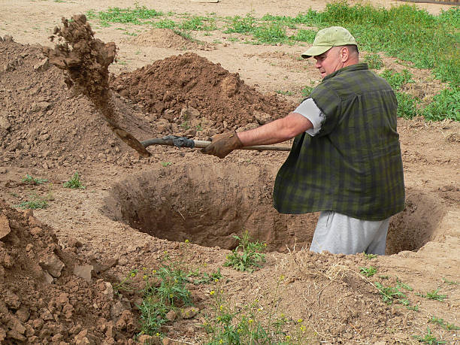
Concept Development: We do
Let’s find the ‘who’ , the ‘do’ and the ‘what’
I say the sentence then we say the sentence
CFU:
What’s the WHO of the sentence?
What’s the DO of the sentence?
What’s the WHAT of the sentence?
A sentence must:
make sense
have a WHO
have a DO

Slide 13
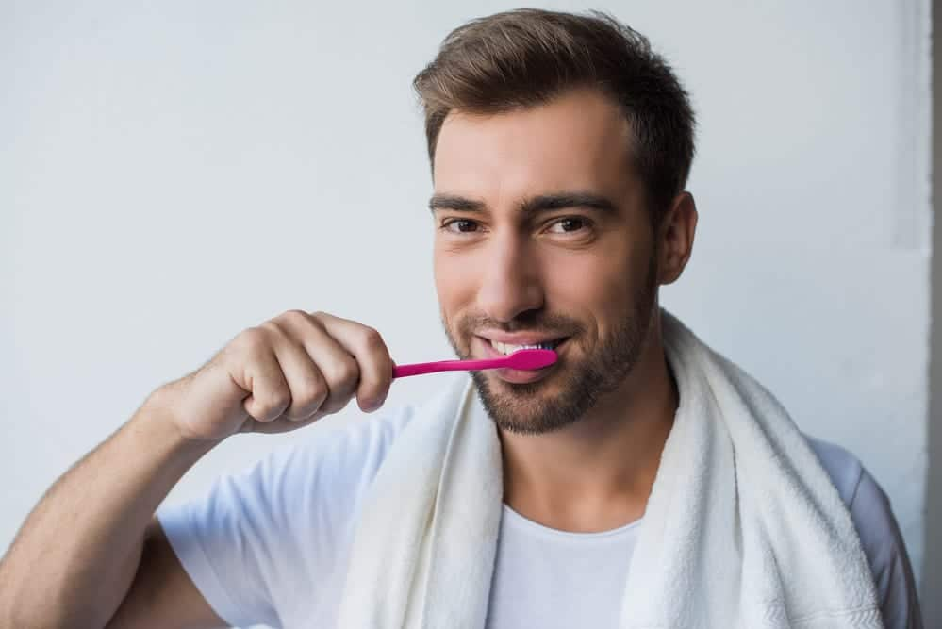
Concept Development: We do
Let’s find the ‘who’ , the ‘do’ and the ‘what’
I say the sentence then we say the sentence
CFU:
What’s the WHO of the sentence?
What’s the DO of the sentence?
What’s the WHAT of the sentence?
A sentence must:
make sense
have a WHO
have a DO

Slide 14
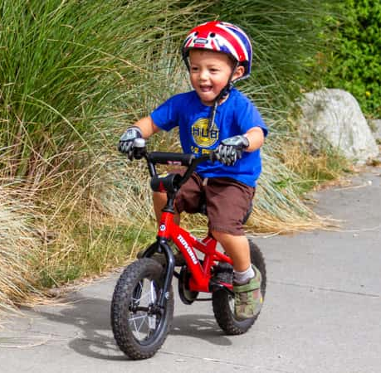
Concept Development: We do
Let’s find the ‘who’ , the ‘do’ and the ‘what’
I say the sentence then we say the sentence
CFU:
What’s the WHO of the sentence?
What’s the DO of the sentence?
What’s the WHAT of the sentence?
A sentence must:
make sense
have a WHO
have a DO

Slide 15
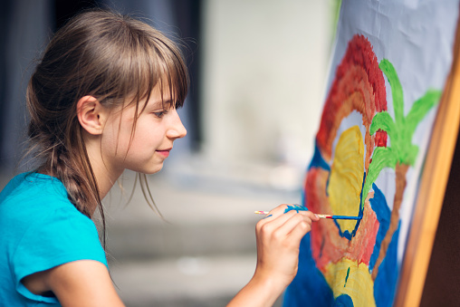
Skill Development: We do
Say the sentence
CFU:
What’s the WHO of the sentence?
What’s the DO of the sentence?
What’s the WHAT of the sentence?
A sentence must:
make sense
have a WHO
have a DO

Slide 16
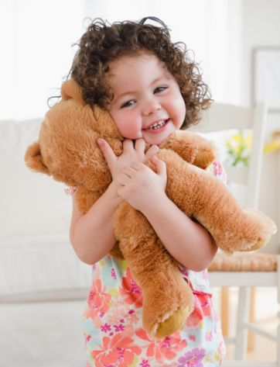
Skill Development: We do
Say the sentence
CFU:
What’s the WHO of the sentence?
What’s the DO of the sentence?
What’s the WHAT of the sentence?
A sentence must:
make sense
have a WHO
have a DO

Slide 17
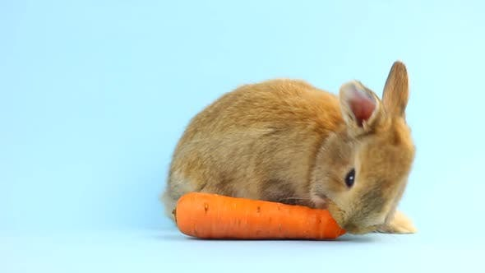
Skill Development: We do
Say the sentence
CFU:
What’s the WHO of the sentence?
What’s the DO of the sentence?
What’s the WHAT of the sentence?
A sentence must:
make sense
have a WHO
have a DO

Slide 18
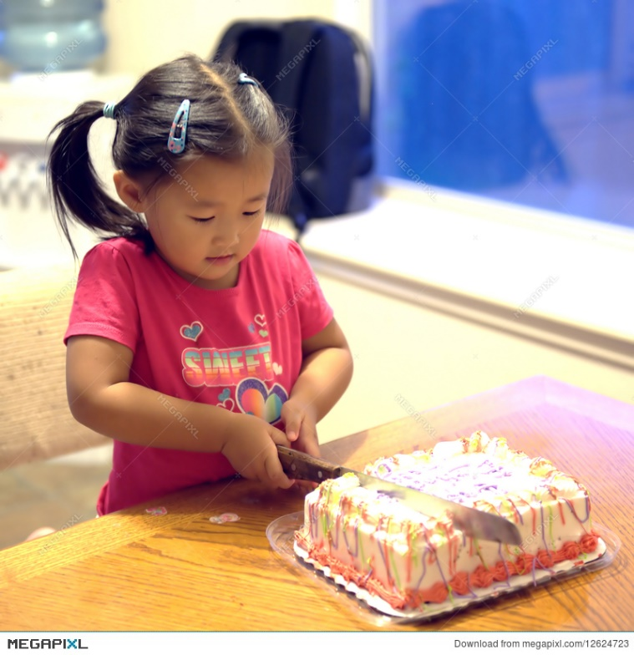
Skill Development: We do
Say the sentence
CFU:
What’s the WHO of the sentence?
What’s the DO of the sentence?
What’s the WHAT of the sentence?
A sentence must:
make sense
have a WHO
have a DO

Slide 19
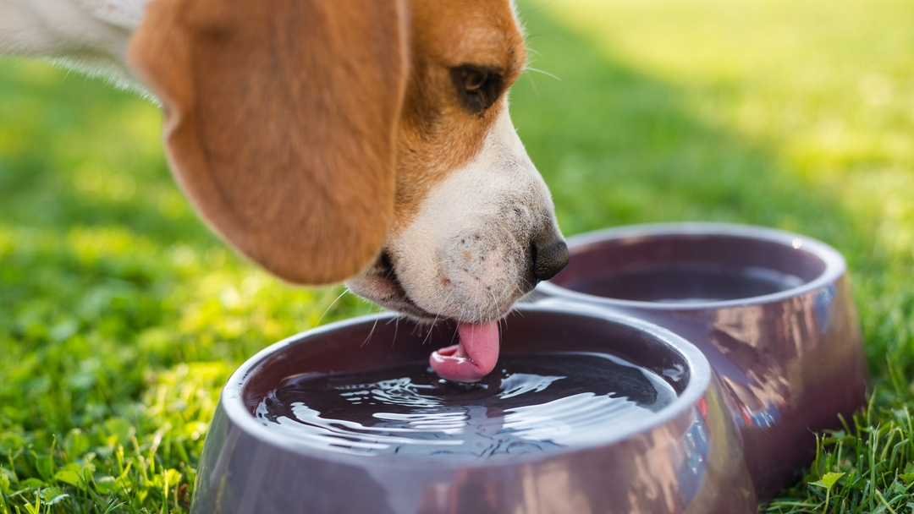
Skill Development: You do
Say the sentence
CFU:
What’s the WHO of the sentence?
What’s the DO of the sentence?
What’s the WHAT of the sentence?
A sentence must:
make sense
have a WHO
have a DO

Slide 20
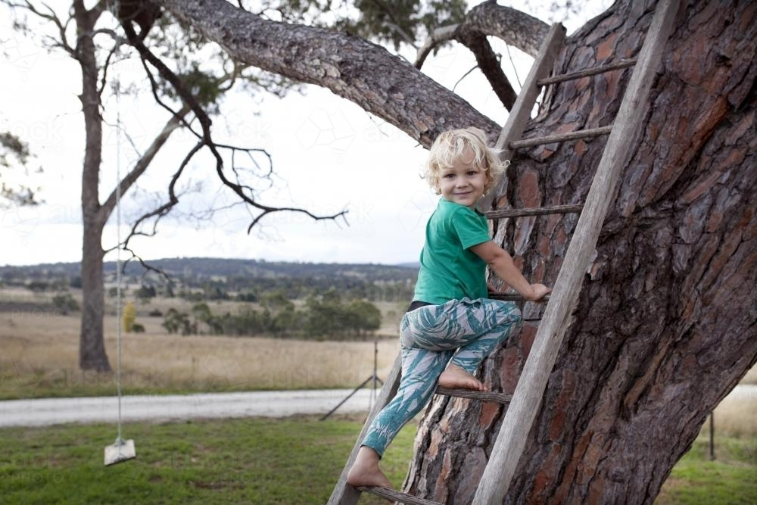
Skill Development: You do
Say the sentence
CFU:
What’s the WHO of the sentence?
What’s the DO of the sentence?
What’s the WHAT of the sentence?
A sentence must:
make sense
have a WHO
have a DO

Slide 21
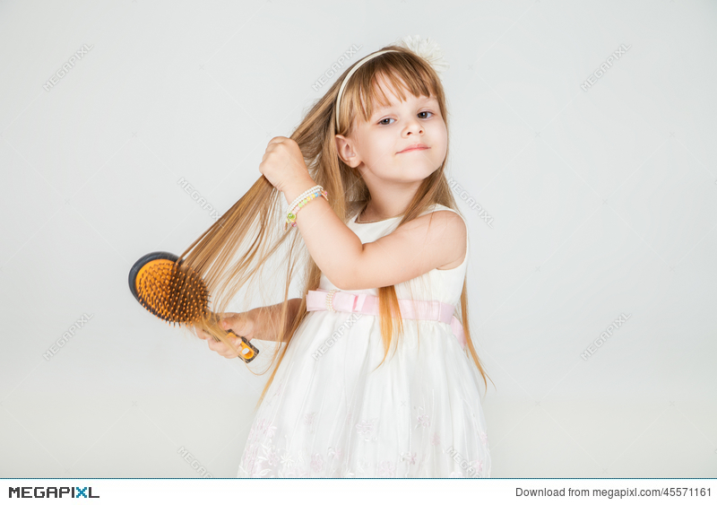
Skill Development: You do
Say the sentence
CFU:
What’s the WHO of the sentence?
What’s the DO of the sentence?
What’s the WHAT of the sentence?
A sentence must:
make sense
have a WHO
have a DO

Slide 22
Skill Development: You do
Let’s find the ‘who’ , the ‘do’ and the ‘what’
I say the sentence then we say the sentence
CFU:
What’s the WHO of the sentence?
What’s the DO of the sentence?
What’s the WHAT of the sentence?
Insert WHO + DO + WHAT images here
from storybooks / knowledge units / topics currently used in the classroom
A sentence must:
make sense
have a WHO
have a DO

Slide 23
Skill Development: You do
Let’s find the ‘who’ , the ‘do’ and the ‘what’
I say the sentence then we say the sentence
CFU:
What’s the WHO of the sentence?
What’s the DO of the sentence?
What’s the WHAT of the sentence?
Insert WHO + DO + WHAT images here
from storybooks / knowledge units / topics currently used in the classroom
A sentence must:
make sense
have a WHO
have a DO

Slide 24
Skill Development: You do
Let’s find the ‘who’ , the ‘do’ and the ‘what’
I say the sentence then we say the sentence
CFU:
What’s the WHO of the sentence?
What’s the DO of the sentence?
What’s the WHAT of the sentence?
Insert WHO + DO + WHAT images here
from storybooks / knowledge units / topics currently used in the classroom
A sentence must:
make sense
have a WHO
have a DO

Slide 25
Skill Development: You do
Let’s find the ‘who’ , the ‘do’ and the ‘what’
I say the sentence then we say the sentence
CFU:
What’s the WHO of the sentence?
What’s the DO of the sentence?
What’s the WHAT of the sentence?
Insert WHO + DO + WHAT images here
from storybooks / knowledge units / topics currently used in the classroom
A sentence must:
make sense
have a WHO
have a DO

Slide 26
Skill Development: You do
Let’s find the ‘who’ , the ‘do’ and the ‘what’
I say the sentence then we say the sentence
CFU:
What’s the WHO of the sentence?
What’s the DO of the sentence?
What’s the WHAT of the sentence?
Insert WHO + DO + WHAT images here
from storybooks / knowledge units / topics currently used in the classroom
A sentence must:
make sense
have a WHO
have a DO

