Slide 1
Year: Kindergarten (Year Prior to Foundation)
Term: 1
Objective: We are learning to speak in full sentences (oral)
Author: Jasmyn Hall

Slide 2
Multiple Choice
Pair Share
Track with me
Pick a Stick/Answer (non-volunteer)
Whiteboards
Vote
Read with me
In Your Workbook

Slide 3
Learning Objective
We are learning to speak in full sentences.

Slide 4
Concept Development
A sentence is a complete thought that makes sense.
A sentence must:
make sense
have a WHO
have a DO

Slide 5
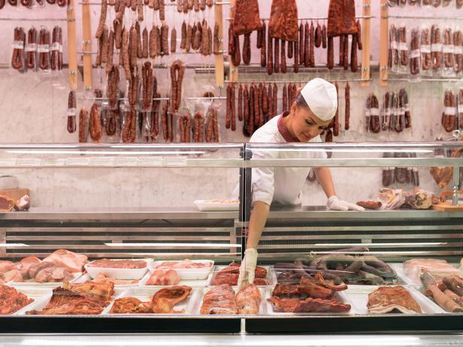
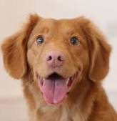
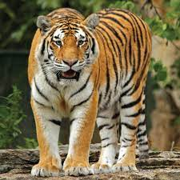
Concept Development
WHO words tell us the person or animal we are talking about
WHO words are orange words
CFU:
What does WHO name / tell us?
Say WHO:
person
animal
person
animal
butcher
dog
pirate
tiger

Slide 6
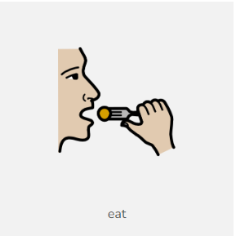
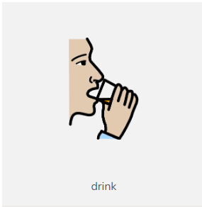
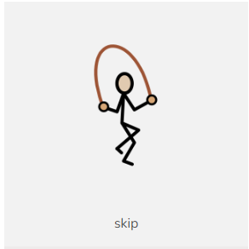
Concept Development
DO words tell us what a person or animal is doing
DO words are yellow words
CFU:
What does DO tell us?
Say the DO:
cry
eat
drink
skip

Slide 7
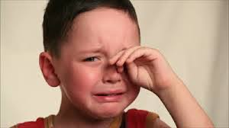
Concept Development: I do
Let’s find the ‘who’ and the ‘do’
I say the sentence then we say the sentence
CFU:
What’s the WHO of the sentence?
What’s the DO of the sentence?
A sentence must:
make sense
have a WHO
have a DO

Slide 8
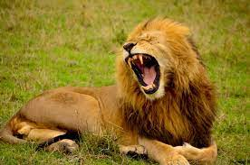
Concept Development: I do
Let’s find the ‘who’ and the ‘do’
I say the sentence then we say the sentence
CFU:
What’s the WHO of the sentence?
What’s the DO of the sentence?
A sentence must:
make sense
have a WHO
have a DO

Slide 9
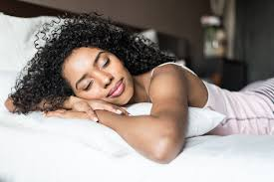
Concept Development: We do
Let’s find the ‘who’ and the ‘do’
Say the sentence together
CFU:
What’s the WHO of the sentence?
What’s the DO of the sentence?
A sentence must:
make sense
have a WHO
have a DO

Slide 10
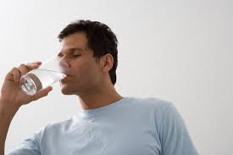
Concept Development: We do
Let’s find the ‘who’ and the ‘do’
Say the sentence together
CFU:
What’s the WHO of the sentence?
What’s the DO of the sentence?
A sentence must:
make sense
have a WHO
have a DO

Slide 11
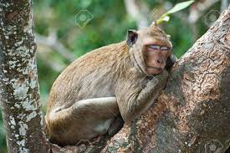
Skill Development: We do
Say the sentence
CFU:
What’s the WHO of the sentence?
What’s the DO of the sentence?
A sentence must:
make sense
have a WHO
have a DO

Slide 12
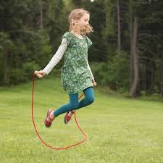
Skill Development: We do
Say the sentence
CFU:
What’s the WHO of the sentence?
What’s the DO of the sentence?
A sentence must:
make sense
have a WHO
have a DO

Slide 13
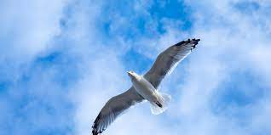
Skill Development: We do
Say the sentence
CFU:
What’s the WHO of the sentence?
What’s the DO of the sentence?
A sentence must:
make sense
have a WHO
have a DO

Slide 14
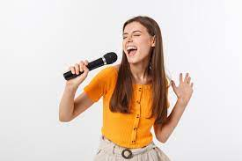
Skill Development: We do
Say the sentence
CFU:
What’s the WHO of the sentence?
What’s the DO of the sentence?
A sentence must:
make sense
have a WHO
have a DO

Slide 15
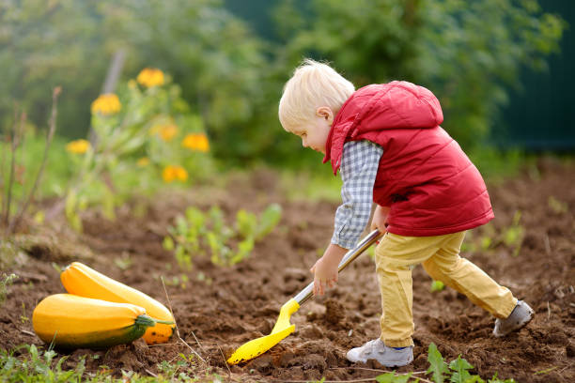
Skill Development: We do
Say the sentence
CFU:
What’s the WHO of the sentence?
What’s the DO of the sentence?
A sentence must:
make sense
have a WHO
have a DO

Slide 16
Skill Development: You do
Say the sentence
CFU:
What’s the WHO of the sentence?
What’s the DO of the sentence?
A sentence must:
make sense
have a WHO
have a DO

Slide 17
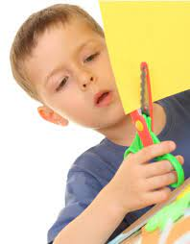
Skill Development: You do
Say the sentence
CFU:
What’s the WHO of the sentence?
What’s the DO of the sentence?
A sentence must:
make sense
have a WHO
have a DO

Slide 18
Skill Development: You do
Say the sentence
CFU:
What’s the WHO of the sentence?
What’s the DO of the sentence?
Insert WHO + DO images here
from storybooks / knowledge units / topics currently used in the classroom
A sentence must:
make sense
have a WHO
have a DO

Slide 19
Skill Development: You do
Say the sentence
CFU:
What’s the WHO of the sentence?
What’s the DO of the sentence?
Insert WHO + DO images here
from storybooks / knowledge units / topics currently used in the classroom
A sentence must:
make sense
have a WHO
have a DO

Slide 20
Skill Development: You do
Say the sentence
CFU:
What’s the WHO of the sentence?
What’s the DO of the sentence?
Insert WHO + DO images here
from storybooks / knowledge units / topics currently used in the classroom
A sentence must:
make sense
have a WHO
have a DO

Slide 21
Skill Development: You do
Say the sentence
CFU:
What’s the WHO of the sentence?
What’s the DO of the sentence?
Insert WHO + DO images here
from storybooks / knowledge units / topics currently used in the classroom
A sentence must:
make sense
have a WHO
have a DO

Slide 22
Skill Development: You do
Say the sentence
CFU:
What’s the WHO of the sentence?
What’s the DO of the sentence?
Insert WHO + DO images here
from storybooks / knowledge units / topics currently used in the classroom
A sentence must:
make sense
have a WHO
have a DO

