Slide 1
Year: 4
Term: 1
Objective: Identify and use concrete and abstract nouns.
Author: Amanda Di Pietro

Slide 2
Copy and paste these icons to the appropriate slides to indicate engagement norms/CFU strategies
Multiple Choice
Pair Share
Track with me
Pick a Stick/Answer (non-volunteer)
Whiteboards
Vote
Read with me
In Your Workbook

Slide 3
Learning Objective
We are learning to identify and use concrete and abstract nouns.

Slide 4
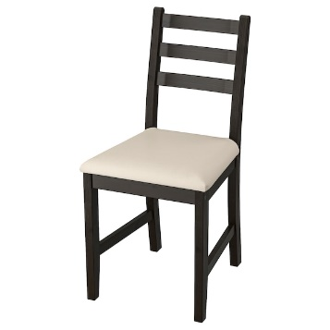
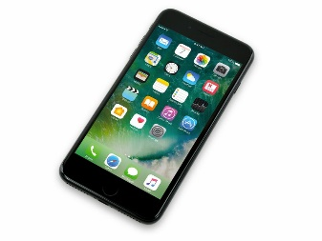
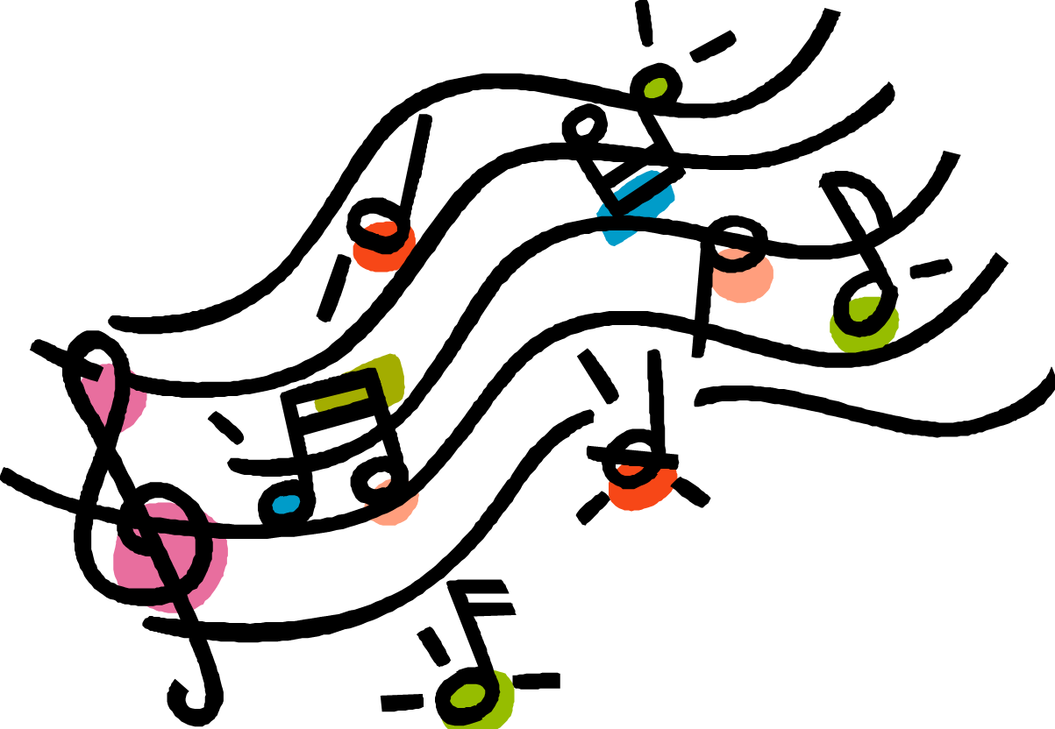
Concept Development
A concrete noun is a noun (naming word) that you can experience with your senses (taste, touch, sight, sound and smell).
Examples:
CFU:
What is a concrete noun?
Why is ‘face’ an example of a concrete noun?
1. chair
You can touch and see chair.
You can touch and see a flame.
2. flame
3. phone
You can touch and see a phone.
You can hear music.
4. Music
You can hear music.

Slide 5
Concept Development
A concrete noun is a noun (naming word) that you can experience with your senses (taste, touch, sight, sound and smell).
CFU:
Why is ‘love’ not an example of a concrete noun?
Non-Examples:
1. courage
Courage cannot be seen, smelt, felt, tasted or heard.
2. anger
Anger cannot be seen, smelt, felt, tasted or heard.

Slide 6
Concept Development
An abstract noun is a noun (naming word) that you cannot experience with your senses (taste, touch, sight, sound and smell).
Abstract nouns names ideas or feelings.
CFU:
What is an abstract noun?
Why is ‘confusion’ an example of a concrete noun?
Examples:
Trust is the name of a feeling/idea.
1. trust
Happiness is the name of a feeling.
2. happiness
An idea cannot be seen, felt, heard, tasted or smelt.
3. idea

Slide 7
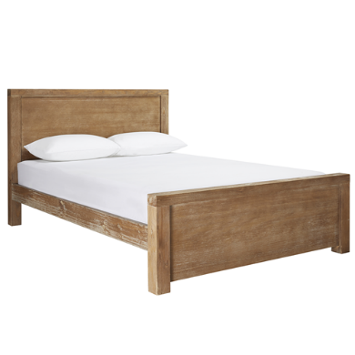
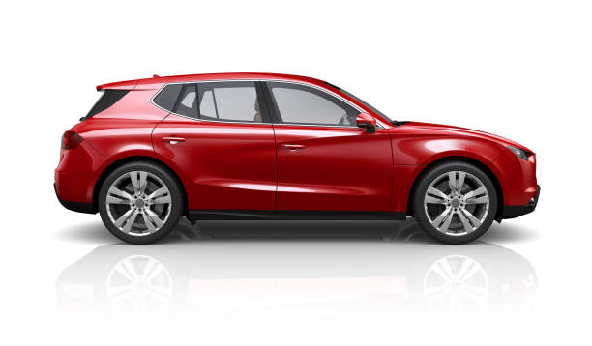
Concept Development
An abstract noun is a noun that you cannot experience with your senses (taste, touch, sight, sound and smell).
Abstract nouns names ideas or feelings.
CFU:
Why is ‘table’ not an example of an abstract noun?
Non-Examples:
1. bed
A bed can be seen and felt. It is a concrete noun.
2. car
A car can be seen, heard and felt. It is a concrete noun.

Slide 8
Concept Development
A concrete noun is a noun (naming word) that you can experience with your senses (taste, touch, sight, sound and smell).
CFU:
Explain why the circled words are concrete nouns.
Find the concrete nouns in the sentences below.
Write the concrete noun onto your whiteboard.
The blue car drove quickly.
The small bird sang beautifully.
The small child cried.

Slide 9
Concept Development
An abstract noun is a noun (naming word) that you cannot experience with your senses (taste, touch, sight, sound and smell).
Abstract nouns names ideas or feelings.
CFU:
Explain why the circled words are abstract nouns.
Find the abstract nouns in the sentences below.
Write the abstract noun onto your whiteboard.
Johnny was in love with his new sister.
The small child felt jealousy towards his older brother.
The dog experienced sadness when his bone was taken away.
She showed dedication as the student leader.

Slide 10
Hinge Point Question
CFU:
Why is this an example/not an example?
Go through each option one-at-a-time once students have answered on their whiteboards
Identify the sentences that contain an abstract noun.
Jenny drove the car quickly.
The child suffered from loneliness.
Bobby experienced sadness when his friend left.
The pet bird was blue.
An abstract noun is a noun (naming word) that you cannot experience with your senses (taste, touch, sight, sound and smell).
Abstract nouns names ideas or feelings.

Slide 11
Concept Development- re-explanation
An abstract noun is a noun (naming word) that you cannot experience with your senses (taste, touch, sight, sound and smell).
Abstract nouns names ideas or feelings.
CFU:
Explain why the circled words are abstract nouns.
Identify the abstract noun in the sentences below.
Write the abstract noun on your whiteboard.
The purpose of this slide is further practice at the concept development stage, prior to moving on with the lesson. This is only required if there were some misconceptions identified in the Hinge Point.
The small child displayed curiousiness.
The teacher exhibited unhappiness when the children didn’t listen to her instructions.
The education of children is the highest priority.

Slide 12
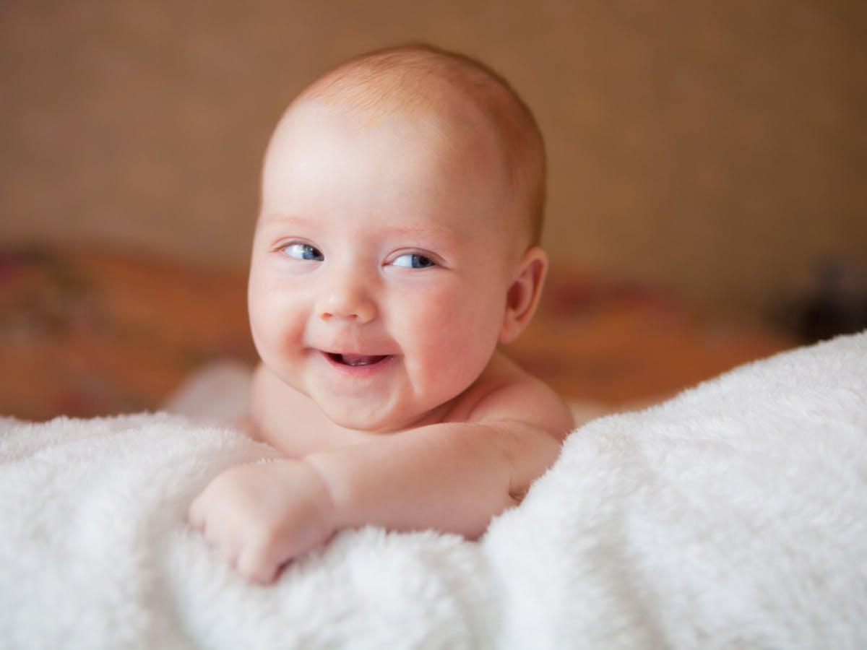
Skill Development: I do
Let’s write a sentence about the child below, using an abstract noun.
Discuss with your partner what the child might be feeling?
Complete the sentence using an abstract noun.
CFU:
What abstract noun can we use?
happiness
cheekiness
sadness
The child displayed ___________.

Slide 13
Skill Development: We do
Let’s write a sentence about the child below, using an abstract noun.
Discuss with your partner what the child might be feeling?
Complete the sentence using an abstract noun.
CFU:
What abstract noun have you used? Explain why it is abstract.
anger
resentment
love
She felt ______________ towards her parents.

Slide 14
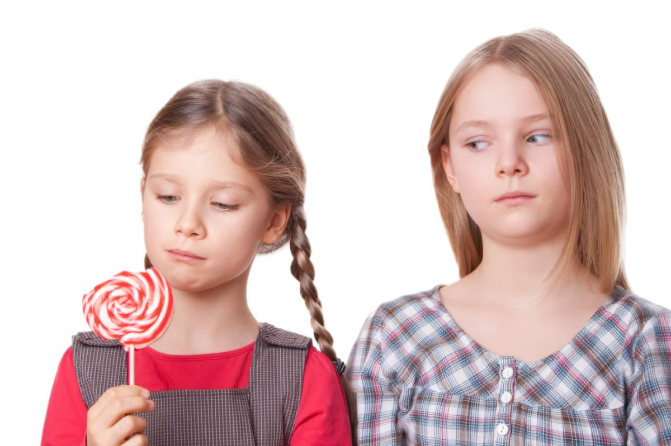
Skill Development: We do
Let’s write a sentence about the child below, using an abstract noun.
Discuss with your partner what the child might be feeling?
Complete the sentence using an abstract noun.
CFU:
What abstract noun have you used? Explain why it is abstract.
jealousy
dismay
annoyance
She was overcome with ________________.

Slide 15
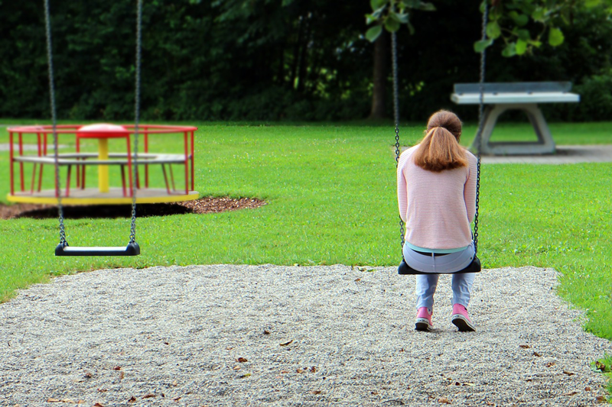
Skill Development: We do
Let’s write a sentence about the child below, using an abstract noun.
Complete the sentence using an abstract noun.
CFU:
What abstract noun have you used? Explain why it is abstract.
sadness
excitement
annoyance
There was a sense of _______________ in the community after the bush fires.

Slide 16
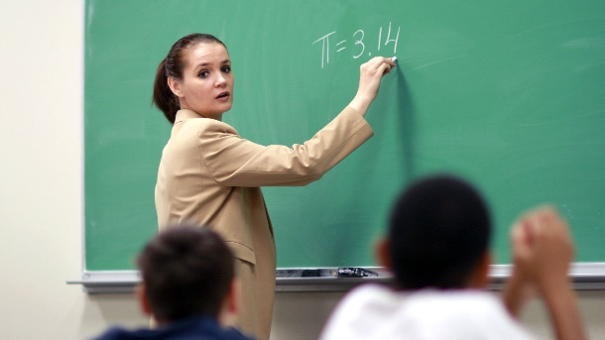
Skill Development: We do
Let’s write a sentence about the child below, using an abstract noun.
Complete the sentence using an abstract noun.
CFU:
What abstract noun have you used? Explain why it is abstract.
professionalism
excitement
loyalty
She showed great __________________ in the classroom.

Slide 17
Skill Development: You do
Let’s write a sentence about the child below, using an abstract noun.
Complete the sentence using an abstract noun.
CFU:
What abstract noun have you used? Explain why it is abstract.
anxiety
excitement
loyalty
________________ overcame her as she walked into the classroom.

Slide 18
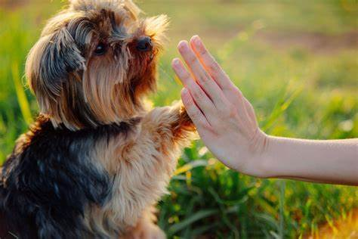
Skill Development: You do
Let’s write a sentence about the child below, using an abstract noun.
Complete the sentence using an abstract noun.
CFU:
What abstract noun have you used? Explain why it is abstract.
obedience
excitement
loyalty
The dog displayed incredible _________________.

