Slide 1
Year: 1
Term: 3
Objective: Identify and define adverbs (of manner). Match to common verbs.
Author: Ashe-Leigh Arrowsmith

Slide 2
Learning Objective
We are learning to identify adverbs and use them with common verbs.

Slide 3
Concept Development
Adverbs are words that modify or describe a verb.
They often tell us HOW something is happening or how it happened.
They often end in –ly, but not always!
CFU:
What is an adverb?
Why is this an example of an adverb?
How did she sing?
How did he walk?
How do we cut the paper?
Examples:
1. She sang loudly.
2. He walked quickly to the library.
3. He cut the paper carefully.

Slide 4
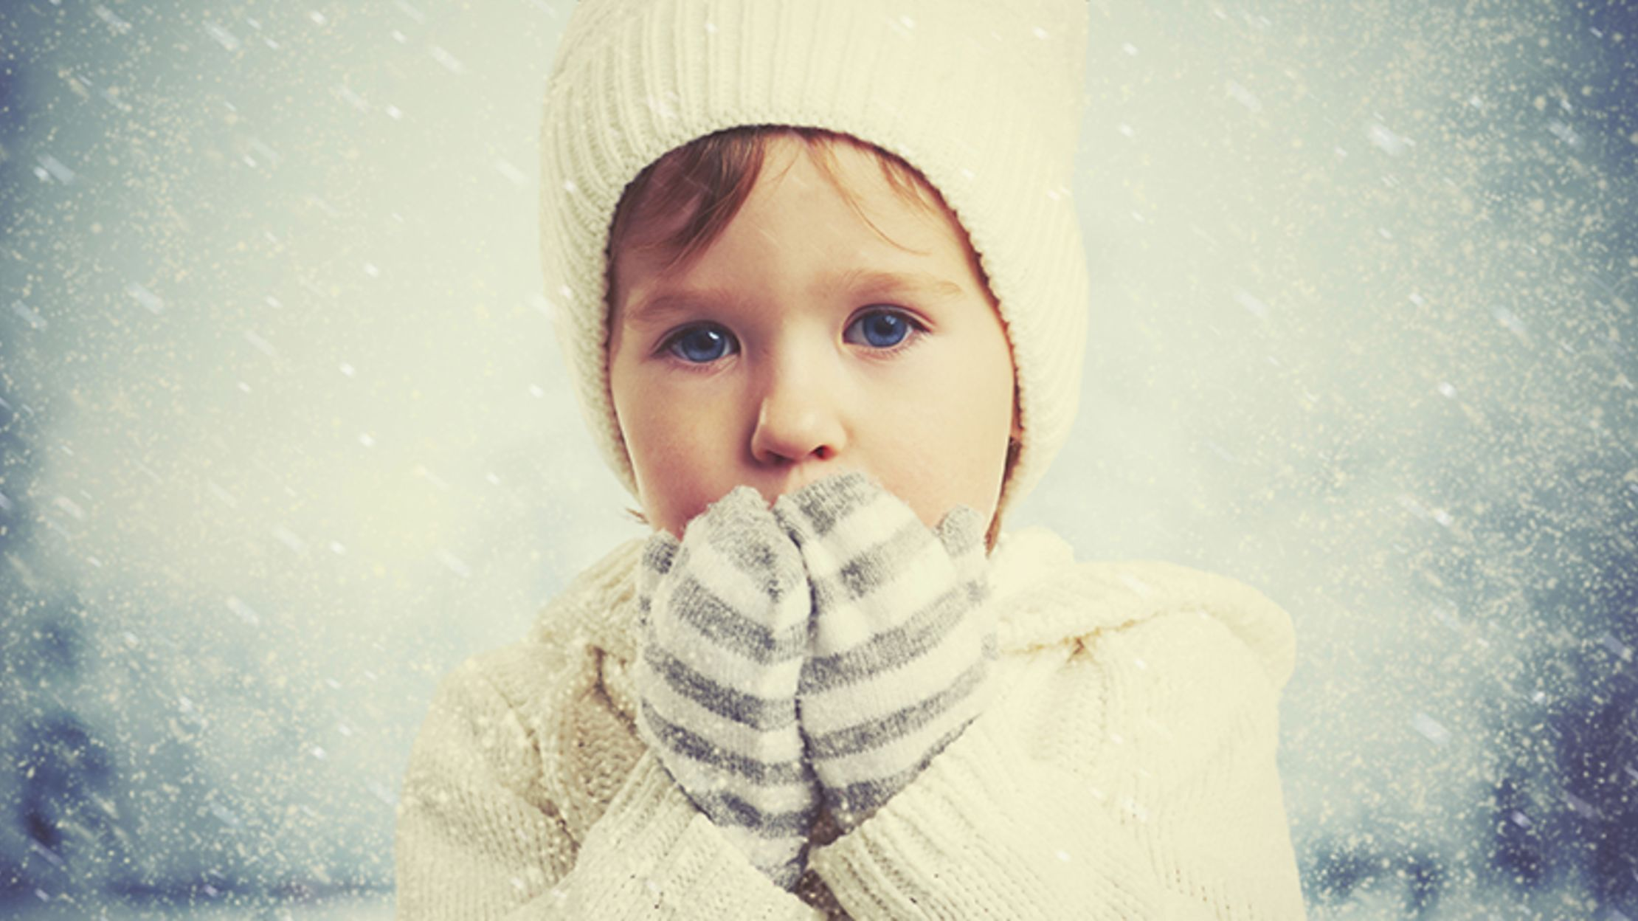
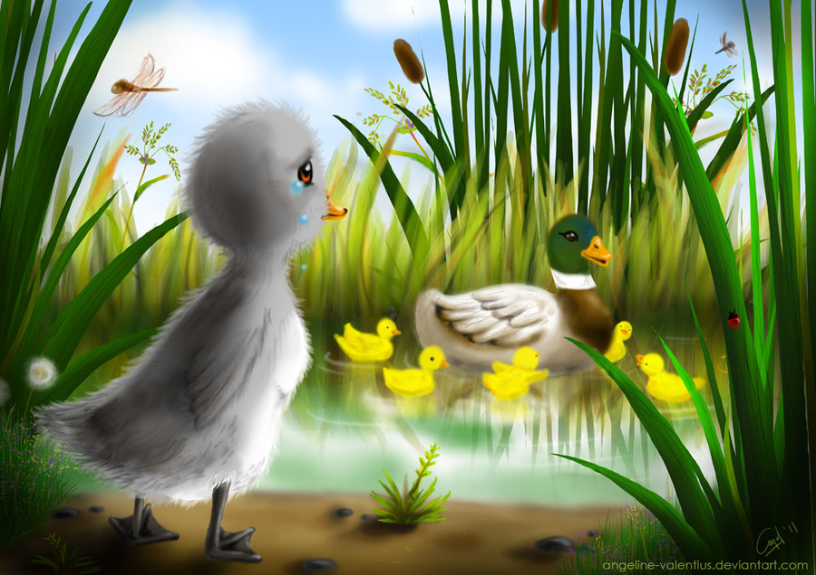
Concept Development
Adverbs are words that modify or describe a verb.
They often tell us HOW something is happening or how it happened.
They often end in –ly, but not always!
CFU:
Why is this not an example of an adverb?
Non-Examples:
1. It was a chilly day.
chilly ends in –ly, but it is not an adverb. It is an adjective as it is describing or modifying a noun!
2. The ugly duckling turned into a Swan.
ugly ends in –ly, but it is not an adverb. It is an adjective as it is describing or modifying a noun!

Slide 5
Concept Development
Identify the verb
Identify the adverb that shows HOW (modifies the verb)
CFU:
What is the verb in this sentence?
What is the adverb?
How do you know that is the adverb?
Can you think of another adverb for that sentence?
She played the piano beautifully.
The trees were swaying wildly in the wind.
The boy was happily skipping to class.

Slide 6
Hinge Point Question
Which sentences contain adverbs?
CFU:
Why is it/ isn’t it a an example of a sentence with an adverb?
Go through each option one-at-a-time once students have answered on their whiteboards
They patiently sat during the school assembly.
They sat during the school assembly.
The dragon flew quickly to the top of the mountain.
He was bored with his maths work, so he drew a picture.

Slide 7
Concept Development- re-clarification
Identify the verb
Identify the adverb that shows HOW (modifies the verb)
CFU:
What is the verb in this sentence?
What is the adverb?
How do you know that is the adverb?
Can you think of another adverb for that sentence?
She danced gracefully in the school performance.
The little puppy barked angrily at the scared postman.
I grumpily washed the dishes.

Slide 8
Skill development: I do
Identify the verb
Choose an adverb to match the verb
Read the sentence
CFU:
What’s the adverb?
How did he speak?
He spoke ____________ to the children.
kindly
sternly
calmly
He spoke kindly to the children.

Slide 9
Skill development: We do
Identify the verb
Choose an adverb to match the verb
Read the sentence
CFU:
What’s the adverb?
How did she dance?
The ballerina twirled __________ across the dance floor.
clumsily
gracefully
crazily
The ballerina twirled gracefully across the dance floor.

Slide 10
Skill development: We do
Identify the verb
Choose an adverb to match the verb
Read the sentence
CFU:
What’s the adverb?
How did they finish their work?
They ___________ finished their work so they could go to recess.
neatly
slowly
quickly
They quickly finished their work so they could go to recess.

Slide 11
Skill development: We do
Identify the verb
Choose an adverb to match the verb
Read the sentence
CFU:
What’s the adverb?
How did they brush their teeth?
I brush my teeth ___________ before bed.
thoroughly
carefully
neatly
I brush my teeth thoroughly before bed.

Slide 12
Skill development: You do
Identify the verb
Choose an adverb
Write the sentence with the adverb – think about where you will place it within the sentence
Reread to make sure your sentence makes sense.
She ran to school because she was late.
Adverbs: quickly, softly, sadly

Slide 13
Skill development: You do
Identify the verb
Choose an adverb
Write the sentence with the adverb – think about where you will place it within the sentence
Reread to make sure your sentence makes sense.
The bird chirped in the tree.
Adverbs: sadly, sweetly, happily

Slide 14
Skill development: You do
Identify the verb
Choose an adverb
Write the sentence with the adverb – think about where you will place it within the sentence
Reread to make sure your sentence makes sense.
Add sentences based on topics/units/texts from class
Adverbs:

