Slide 1
Year: 1
Term: 4
Objective: Develop sentences (statement, question, command, exclamation) based on a picture or story
Author: Cole Muldoon

Slide 2
Copy and paste these icons to the appropriate slides to indicate engagement norms/CFU strategies
Multiple Choice
Pair Share
Track with me
Pick a Stick/Answer (non-volunteer)
Whiteboards
Vote
Read with me
In Your Workbook

Slide 3
Learning Objective
We are learning to write 4 sentence types (statement, question, command, and command) based on a picture.

Slide 4
Concept Development
A statement sentence tells you an idea.
A statement sentence ends with a full stop.
CFU:
What is a statement sentence?
Why is this an example of a statement sentence?
What punctuation mark is at the end?
Examples:
I see a rainbow.
The blocks will fall.
The sky is blue.
Notes:
Statement OR Declarative

Slide 5
Concept Development
A statement sentence tells you an idea.
A statement sentence ends with a full stop.
CFU:
Why is this not an example of a statement sentence?
Non-Examples:
What is your name?
It is a question, not a statement.
It is asking for information, not telling you information.
Go to your room.
It is a command, not a statement.
It is telling you what to do, not telling you an idea.
Notes:
Statement OR Declarative

Slide 6
Concept Development
A question sentence asks something.
A question sentence ends with a question mark.
CFU:
What is a question sentence?
Why is this an example of a question sentence?
What punctuation mark is at the end?
Examples:
Can I have a snack?
Where is the bathroom?
Do you want to play?
Notes:
Question or Interrogative

Slide 7
Concept Development
A question sentence asks something.
A question sentence ends with a question mark.
CFU:
Why is this not an example of a question sentence?
Non-Examples:
I have red hair.
It is a statement, not a question. It tells you something, it doesn’t ask you something.
Give me a lolly.
It is a command, not a question. It tells you to do something, it doesn’t ask you something.
Notes:
Question or Interrogative

Slide 8
Concept Development
An exclamation sentence shows strong feelings.
An exclamation sentence ends with an exclamation mark.
CFU:
What is an exclamation sentence?
Why is this an example of an exclamation sentence?
What punctuation is at the end?
Examples:
I love the big slide!
What a fast car that is!
I can’t believe I won the race!
Notes:
Exclamation or Exclamatory

Slide 9
Concept Development
An exclamation sentence shows strong feelings.
An exclamation sentence ends with an exclamation mark.
CFU:
Why is this not an example of an exclamation sentence?
Non-Examples:
It is Monday.
It is a statement, not an exclamation. It doesn’t have a strong feeling.
Do you want to go to the park?
It is a question, not an exclamation. It doesn’t have a strong feeling. It asks something.
Notes:
Exclamation or Exclamative

Slide 10
Concept Development
A command sentence tells someone to do something.
A command sentence ends with a full stop or exclamation mark.
A command sentence starts with a doing verb.
CFU:
What is a command sentence?
Why is this an example of a command sentence?
What does a command start with?
Examples:
Stop it!
Go to the back.
Do your homework.
Notes:
Command OR Imperative The subject of a command (imperative) sentence is always you. Often the you is not stated. In such cases, you is the understood subject.

Slide 11
Concept Development
A command sentence tells someone to do something.
A command sentence ends with a full stop or exclamation mark.
A command sentence starts with a doing verb.
CFU:
Why is this not an example of a command sentence?
Non-Examples:
I want you to clean your room.
It is a statement, not a command. It is telling you information (about what they want), not telling you to do something.
Can I please have a lolly?
It is a question, not a command. It is asking something, not telling someone to do something.
Notes:
Command OR Imperative

Slide 12
Concept Development
A statement sentence tells an idea.
A question sentence asks something.
An exclamation sentence shows strong feelings.
A command sentence tells you to do something.
CFU:
What type of sentence is it?
How do you know?
What punctuation would you add?
Write S, Q, C or E to show whether the sentence is a Statement, Question, Command or Exclamation.
S
I like to sing
can I sing with you
Q
E
this is the best song ever
C
stop singing so loudly

Slide 13
Hinge Point Question
What sentences are commands?
run to the gate
do you have a sister
do the dishes
the bird eats bugs
CFU:
Why is it/ isn’t it a an example of a command sentence?
A statement sentence tells an idea.
A question sentence asks something.
An exclamation sentence shows strong feelings.
A command sentence tells you to do something.
Notes:
Hinge-point question:
Hinge-point questions are usually multiple choice questions that you ask your students when you reach the point in a lesson when you need to check if students are ready to move on, and if yes, in which direction. You can make it so there are multiple correct answers- this ensures there’s less chance of a ‘lucky guess’.
Go through each option one-at-a-time once students have answered on their whiteboards

Slide 14
Concept Development-
re-explanation
A statement sentence tells an idea.
A question sentence asks something.
An exclamation sentence shows strong feelings.
A command sentence tells you to do something.
CFU:
What type of sentence is it?
How do you know?
What punctuation would you add?
Write S, Q, C or E to show whether the sentence is a Statement, Question, Command or Exclamation.
I went to Perth
S
Q
have you been to Perth
C
go to Perth
E
I can’t wait to go to Perth
Notes:
The purpose of this slide is further practice at the concept development stage, prior to moving on with the lesson. This is only required if there were some misconceptions identified in the Hinge Point.

Slide 15
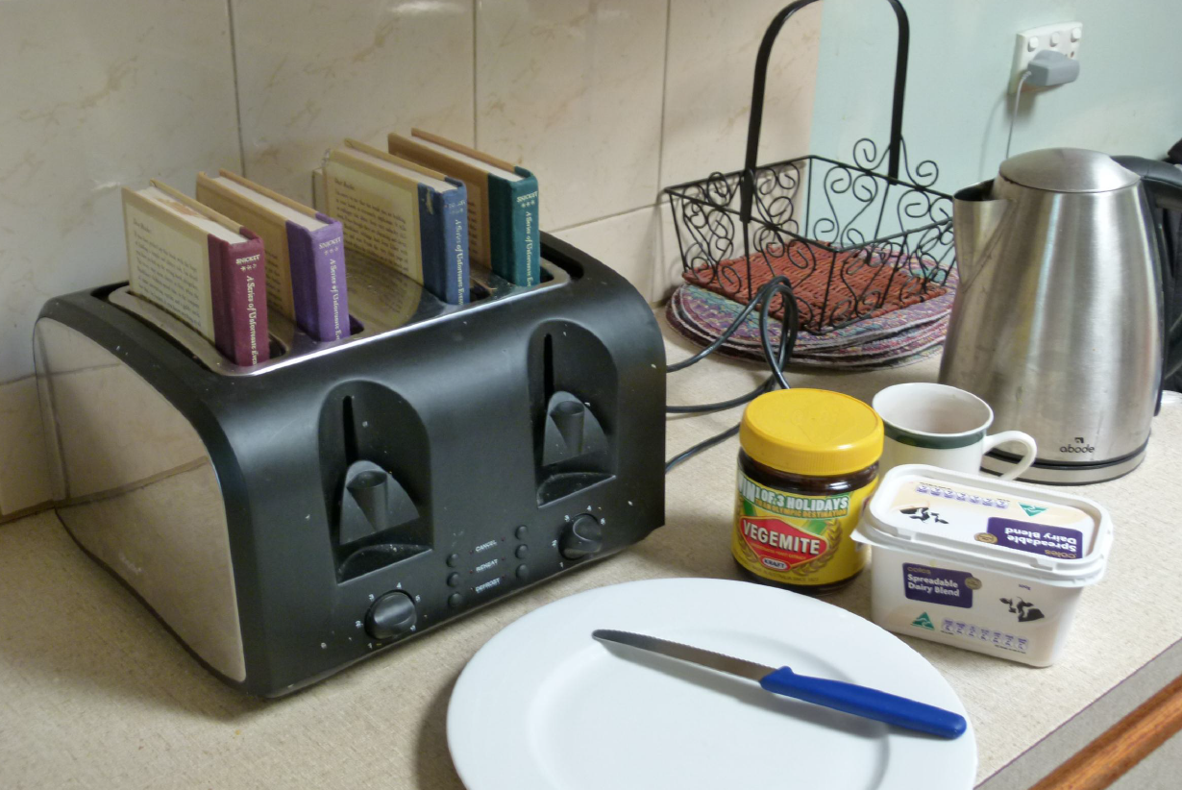
Skill development: I do
Write a statement, a question, a command and an exclamation sentence about the picture.
End each sentence with the correct punctuation mark.
CFU:
How do you know it’s a statement /question/command/exclamation?
Statement:
The books are in the toaster.
Question:
Why are the books in the toaster?
Command:
Take the books out of the toaster!
Exclamation:
The books are going to catch on fire!

Slide 16
Skill development: We do
Say a command sentence about the picture.
End the sentence with the correct punctuation mark.
CFU:
How do you know it’s a question?

Slide 17
Skill development: We do
Say an exclamation sentence about the picture.
End the sentence with the correct punctuation mark.
CFU:
How do you know it’s an exclamation?

Slide 18
Skill development: We do
Write a statement sentence about the picture.
End the sentence with the correct punctuation mark.
CFU:
How do you know it’s a statement?

Slide 19
Skill development: We do
Write a question sentence about the picture.
End the sentence with the correct punctuation mark.
CFU:
How do you know it’s a question?

Slide 20
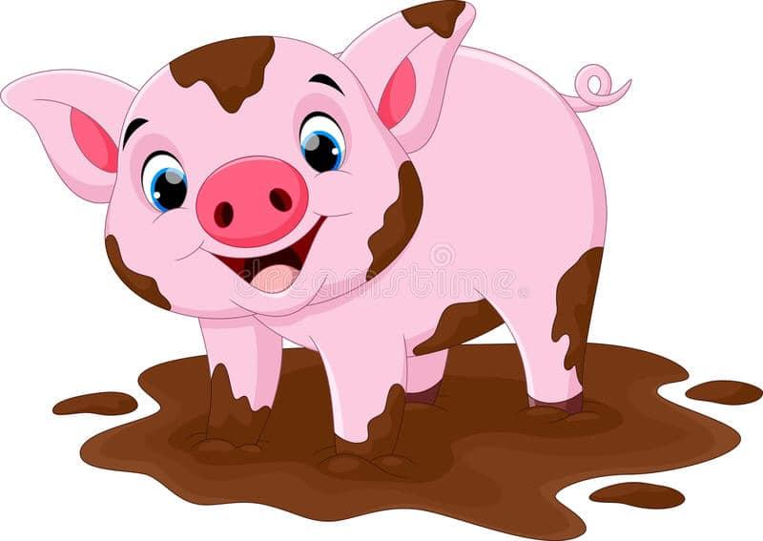
Skill development: You do
Write a statement, a question, a command and an exclamation sentence about the picture.
End each sentence with the correct punctuation mark.
Complete these in your workbook:
Statement
Question
Command
Exclamation

