Slide 1
Year: 4
Term: 1
Objective: Expand sentences using 2 or more adjectives, using order of adjectives.
Author: Amanda Di Pietro & Nathan Brown

Slide 2
Copy and paste these icons to the appropriate slides to indicate engagement norms/CFU strategies
Multiple Choice
Pair Share
Track with me
Pick a Stick/Answer (non-volunteer)
Whiteboards
Vote
Read with me
In Your Workbook

Slide 3
Learning Objective
We are learning to expand sentences by using 2 or more adjectives and using order of adjectives.

Slide 4
Concept Development
What is an adjective?
An adjective is a word that describes or modifies a noun or pronoun.
Modifies means to change by giving more information.

Slide 5
Concept Development
CFU:
What does an adverb modify or describe?
An adjective is a word that describes or modifies a noun or pronoun
NOUN / PRONOUN
ADJECTIVE

Slide 6
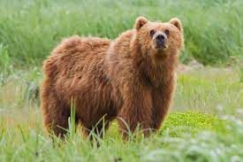
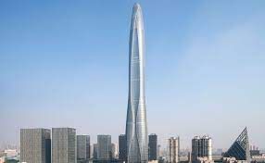
Concept Development
An adjective is a word that describes or modifies a noun or pronoun
CFU:
What is an adjective?
Give an example of an adjective on your whiteboard.
Examples:
The brown bear hunted for prey.
1. brown
The hot fire crackled.
2. hot
3. tall
We climbed to the top of the tall building.

Slide 7
Concept Development
An adjective is a word that describes or modifies a noun or pronoun
CFU:
Why is ‘slowly’ not an example of an adjective?
Non-Examples:
1. quickly
Quickly describes a verb, not a noun.
2. suspiciously
Suspiciously describes a verb, not a noun.

Slide 8
Concept Development
An adjective is a word that describes or modifies a noun or pronoun
Adjectives can be put into categories
We can use more than 1 adjective to describe a noun, but there is a specific order they must be placed in based on their category.
CFU:
Can I use as many adjectives as I like to describe a noun? Explain your answer.
Can I place adjectives in any order when describing a noun? Explain your answer.
Order of adjectives
Determiner | Observation | Size | Shape | Age | Colour | Origin | Material | Qualifier/Purpose | The Noun
We can expand sentences using adjectives!
Rule of thumb – we generally don’t use anymore than 3 adjectives (not including the determiner)

Slide 9
Concept Development
An adjective is a word that describes or modifies a noun or pronoun
Adjectives can be put into categories
We can use more than 1 adjective to describe a noun, but there is a specific order they must be placed in based on their category.
CFU:
What is a determiner?
What is the determiner in this sentence?
Determiner:
A determiner generally describes the number of items, or who it belongs to. Sometimes they can be considered different to an adjective.
Examples:
A dinosaur walked through the swamp.
Three dinosaurs walked through the swamp.
My best friend is 2 years older than me.

Slide 10
Concept Development
An adjective is a word that describes or modifies a noun or pronoun
Adjectives can be put into categories
We can use more than 1 adjective to describe a noun, but there is a specific order they must be placed in based on their category.
CFU:
What is an observation adjective?
What is the observation adjective in this sentence?
Observation/Opinion
An Observation or opinion gives is an adjective for feeling and thought rather than fact.
Examples:
Richard just bought an awesome car.
“That is a beautiful tree,” said James.

Slide 11
Concept Development
An adjective is a word that describes or modifies a noun or pronoun
Adjectives can be put into categories
We can use more than 1 adjective to describe a noun, but there is a specific order they must be placed in based on their category.
CFU:
What is the size adjective in this sentence?
Size
Describes the physical attributes of an item, usually for size, mass or weight.
Examples:
The tiny crow collected objects for its nest. The fat cat sat on the mat.

Slide 12
Concept Development
An adjective is a word that describes or modifies a noun or pronoun
Adjectives can be put into categories
We can use more than 1 adjective to describe a noun, but there is a specific order they must be placed in based on their category.
CFU:
What is the shape adjective in this sentence?
Shape
Also describes the physical attributes of an object, usually using two or three dimensional shape words.
Examples:
The boy put the ball in the rectangular box. The animal in the painting had an oval head.

Slide 13
Concept Development
An adjective is a word that describes or modifies a noun or pronoun
Adjectives can be put into categories
We can use more than 1 adjective to describe a noun, but there is a specific order they must be placed in based on their category.
CFU:
What is the age adjective in this sentence?
Age
Describes how old the noun is.
Examples:
John had an old hat that he thought was lucky.
The traditional dance was performed at the assembly.

Slide 14
Concept Development
An adjective is a word that describes or modifies a noun or pronoun
Adjectives can be put into categories
We can use more than 1 adjective to describe a noun, but there is a specific order they must be placed in based on their category.
CFU:
What is the colour adjective in this sentence?
Colour
Describes the colour of the noun.
Examples:
Fred has a red race car.
The tree has green leaves.

Slide 15
Concept Development
An adjective is a word that describes or modifies a noun or pronoun
Adjectives can be put into categories
We can use more than 1 adjective to describe a noun, but there is a specific order they must be placed in based on their category.
CFU:
What is the material adjective in this sentence?
Material
Also describes the physical attributes of an object, usually using what the noun is made of.
Examples:
The wooden horse was a gift from his grandparents.
Tina loves to eat chocolate cake.

Slide 16
Concept Development
An adjective is a word that describes or modifies a noun or pronoun
Adjectives can be put into categories
We can use more than 1 adjective to describe a noun, but there is a specific order they must be placed in based on their category.
CFU:
What is a qualifier?
What is the qualifier in this sentence?
Qualifier/purpose
A qualifier is a also known as an ‘adjectival noun’- a noun that is used to describe other nouns.
Any adjective ending in –ing may also function as a qualifier, as long as they describe the purpose of the noun.
Examples:
She wore a green evening gown.
He had a red sports car.
They went to see the talented marching band.
The weather machine was broken.

Slide 17
Concept Development
When using multiple adjectives, use them in order of their categories from left to right.
Example:
An expensive, red European sports car drove past.
Determiner | Observation | Size | Shape | Age | Colour | Origin | Material | Qualifier | Noun
Use the categories above to stimulate students to generate adjectives. Some have been provided on the next slide.

Slide 18
Concept Development
Determiner | Observation | Size | Shape | Age | Colour | Origin | Material | Qualifier /Purpose | Noun
a | stunning | grand | squat | immortal | turquoise | Egyptian | wooden | diving | pool
an | breathtaking | tiny | oblong | ancient | apple-red | English | gold | umbrella | stand
the | hideous | miniscule | circular | retired | opaque | Australian | rayon | football | jersey
many | broken down | expansive | box-like | mortal | beige | Jewish | concrete | care | package
eight | scrumptious | enormous | lumpy | antique | coal-black | South American | cotton | hair | products
this | valuable | wide | billowy | young | magenta | Chinese | leather | marker | box
my | humorous | heavy | cylindrical | modern | transparent | French | copper | card | game
our | peaceful | big | dwarf-like | new | wheat-coloured | Spanish | plastic | library | book
a few | uninteresting | narrow | flat | middle-aged | brown | American | nylon | grandmother’s | recipe
Reference: Writing Matters (William Van Cleave, 2018)

Slide 19
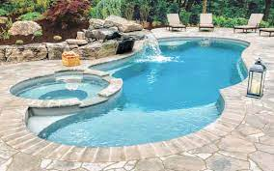
Concept Development
An adjective is a word that describes or modifies a noun or pronoun
We can use more than 1 adjective to describe a noun, but there is a specific order they must be placed in.
We start with the determiner and end with the noun.
CFU:
If the words ‘stunning’ and ‘turquoise’ are swapped in the noun phrase, would the sentence still be correct? Explain your answer.
Determiner | Observation | Size | Shape | Age | Colour | Origin | Material | Qualifier | Noun
Examples:
1. pool
A stunning turquoise swimming pool

Slide 20
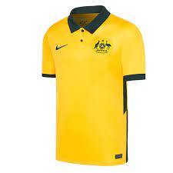
Concept Development
An adjective is a word that describes or modifies a noun or pronoun
We can use more than 1 adjective to describe a noun, but there is a specific order they must be placed in.
We start with the determiner and end with the noun.
CFU:
If I take out the word ‘large’ from this noun phrase and add the word ‘cotton’, where should the new word be placed in the sentence?
Determiner | Observation | Size | Shape | Age | Colour | Origin | Material | Qualifier | Noun
Examples:
1. jersey
The large, yellow football jersey

Slide 21
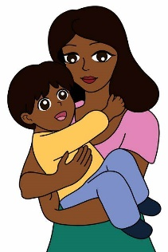
Concept Development
An adjective is a word that describes or modifies a noun or pronoun
We can use more than 1 adjective to describe a noun, but there is a specific order they must be placed in.
We start with the determiner and end with the noun.
CFU:
If I take out the word ‘kind’ from this noun phrase and add the word ‘middle-aged’, how would the sentence read? Why?
Determiner | Observation | Size | Shape | Age | Colour | Origin | Material | Qualifier | Noun
Examples:
1. woman
A friendly, kind woman

Slide 22
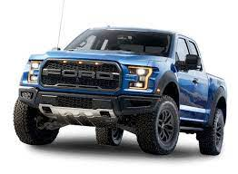
Concept Development
An adjective is a word that describes or modifies a noun or pronoun
We can use more than 1 adjective to describe a noun, but there is a specific order they must be placed in.
We start with the determiner and end with the noun.
CFU:
Why is the noun phrase wrong?
What order should the adjectives have been placed in? Write the answer on your whiteboard.
Determiner | Observation | Size | Shape | Age | Colour | Origin | Material | Qualifier | Noun
Non-Examples:
1. Ute
The old, American large ute
These adjectives are in the wrong order!

Slide 23
Concept Development
An adjective is a word that describes or modifies a noun or pronoun
We can use more than 1 adjective to describe a noun, but there is a specific order they must be placed in.
We start with the determiner and end with the noun.
CFU:
What type of adjective is ________________?
Find the adjectives for the underlined noun in each sentence.
Write the adjectives on your whiteboard.
The large, blue, wooden house was the biggest in the street.
An orange, plastic coat stand stood in the entry way to the house.
My loveable, old, American grandmother came to visit.

Slide 24
Concept Development
We place a comma between coordinating adjectives (adjectives that have the same weight).
A good test for comma usage:
if the word ‘and’ can be used between the adjectives, a comma is used.
Example:
A wise, old woman once told me to follow my dreams.
(We use a comma because ‘and’ could be inserted between the adjectives)
She is a charming, thoughtful person.
(We use a comma because ‘and’ could be inserted between the adjectives)
Non-example:
The Rangers are a skilled hockey team.
(We don’t need a comma because ‘and’ cannot be inserted between them)
CFU:
How can we tell if we need a comma between adjectives?

Slide 25
Hinge Point Question
Identify the sentences which contain the correct order of adjectives.
A black, cute, old cat ran across the street.
The rectangular, brown, wooden jewellery box contained expensive jewellery.
The circular, red, plastic container contained left over food.
Many beautiful black birds danced on the grass.
CFU:
Why is ‘A’ not correct?
Why is ‘B’ not correct?
Determiner | Observation | Size | Shape | Age | Colour | Origin | Material | Qualifier | Noun
An adjective is a word that describes or modifies a noun or pronoun
We can use more than 1 adjective to describe a noun, but there is a specific order they must be placed in.
We start with the determiner and end with the noun.
We place a comma between coordinating adjectives (adjectives that have the same weight).

Slide 26
Concept Development- re-explanation
An adjective is a word that describes or modifies a noun or pronoun
We can use more than 1 adjective to describe a noun, but there is a specific order they must be placed in.
We start with the determiner and end with the noun.
CFU:
Explain why the sentences below are incorrect.
The adjectives below are in the incorrect order.
Rewrite the adjectives on your whiteboard in the correct order.
The purpose of this slide is further practise at the concept development stage, prior to moving on with the lesson. This is only required if there were some misconceptions identified in the Hinge Point.
The small, young, happy child looked at the sky.
Many hungry, green ducks flew away.
My grey, lazy dog sniffed for food.
Determiner | Observation | Size | Shape | Age | Colour | Origin | Material | Qualifier | Noun

Slide 27
Skill development: I do
Order the adjectives based on their category
Write a sentence using the adjectives and noun provided.
Check whether your sentence needs commas.
Remember: a comma is needed if adjectives have equal weight (coordinating adjectives)
Noun: castle
Adjectives (not in order): French, enormous, beautiful,
Determiner | Observation | Size | Shape | Age | Colour | Origin | Material | Qualifier | Noun

Slide 28
Skill development: We do
Order the adjectives based on their category
Write a sentence using the adjectives and noun provided.
Check whether your sentence needs commas.
Remember: a comma is needed if adjectives have equal weight (coordinating adjectives)
Noun: Echidna
Adjectives (not in order): spiky, aggressive, brown, Australian
Determiner | Observation | Size | Shape | Age | Colour | Origin | Material | Qualifier | Noun

Slide 29
Skill development: We do
Order the adjectives based on their category
Write a sentence using the adjectives and noun provided.
Check whether your sentence needs commas.
Remember: a comma is needed if adjectives have equal weight (coordinating adjectives)
Noun: fish tank
Adjectives (not in order): glass, round, dirty
Determiner | Observation | Size | Shape | Age | Colour | Origin | Material | Qualifier | Noun

Slide 30
Skill development: We do
Order the adjectives based on their category
Write a sentence using the adjectives and noun provided.
Check whether your sentence needs commas.
Remember: a comma is needed if adjectives have equal weight (coordinating adjectives)
Noun: roller coaster
Adjectives (not in order): enormous, frightening, aging
Determiner | Observation | Size | Shape | Age | Colour | Origin | Material | Qualifier | Noun

Slide 31
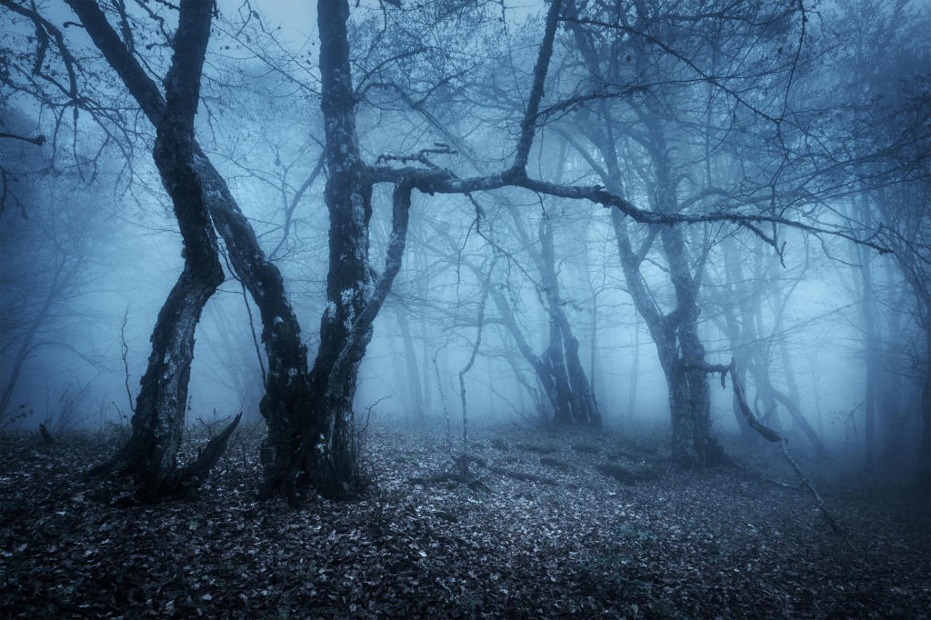
Skill development: We do
Let’s write a sentence about the forest below, using 2 adjectives.
Discuss with your partner what adjectives you can use to describe the forest.
Write the sentence with the two adjectives inserted (using the correct order).
Check whether your sentence needs a comma between adjectives.
CFU:
If I used the words ‘ancient’ and ‘haunted’, to describe the forest, what order would they go in? Explain your answer.
The ________ __________ forest became too dangerous to swim in.
Determiner | Observation | Size | Shape | Age | Colour | Origin | Material | Qualifier | Noun

Slide 32
Skill development: We do
Let’s write a sentence about the forest below, using 2 adjectives.
Discuss with your partner what adjectives you can use to describe the forest.
Write the sentence with the two adjectives inserted (using the correct order).
Check whether your sentence needs a comma/commas between adjectives.
CFU:
If I used the words ‘blue’, ‘salty’ and ‘rough’ to describe the ocean, what order would they go in? Explain your answer.
The ________ ________ __________ ocean became too dangerous to swim in.
Determiner | Observation | Size | Shape | Age | Colour | Origin | Material | Qualifier | Noun

Slide 33
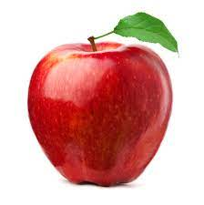
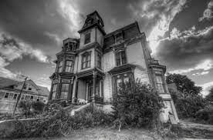
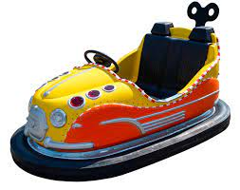
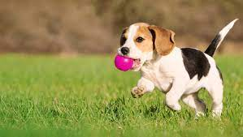
Skill development: You do
Write a sentence about each of the pictures below.
Describe each noun using 2-3 adjectives.
Use the correct order of adjectives.
Check whether your sentence needs a comma/commas
Complete these in your workbook:
1.
2.
3.
4.
Determiner | Observation | Size | Shape | Age | Colour | Origin | Material | Qualifier | Noun

