Slide 1
Year: 1
Term: 3
Objective: To expand simple sentences with an adverb
Author: Yvonne Cooper

Slide 2
Question Words
Who/what?
(did) What?
When?
Where?
Why?
How?
Display this chart in classroom prior to lesson.
Optional: use Colourful Semantics icons in addition to question words. But please note, TWR does not distinguish between the ‘what doing/did what’ (verb) and the ‘what’ (object). If you are using a Colourful Semantics approach, you will need to consider this.

Slide 3
Multiple Choice
Pair Share
Track with me
Pick a Stick/Answer (non-volunteer)
Whiteboards
Vote
Read with me
In Your Workbook

Slide 4
Learning Objective
We are learning to expand simple sentences with an adverb.
Expand means to add more information to a sentence.
A verb is an action word.
An adverb is a word that modifies or describes a verb.

Slide 5
Concept Development
Adverbs are words that modify or describe a verb.
They often tell us HOW something is happening or how it happened.
They often end in –ly, but not always!
CFU:
What is an adverb?
Why is this an example of an adverb?
How did she sing?
How did he walk?
How do we cut the paper?
Examples:
1. She sang loudly.
2. He walked quickly to the library.
3. He cut the paper carefully.

Slide 6
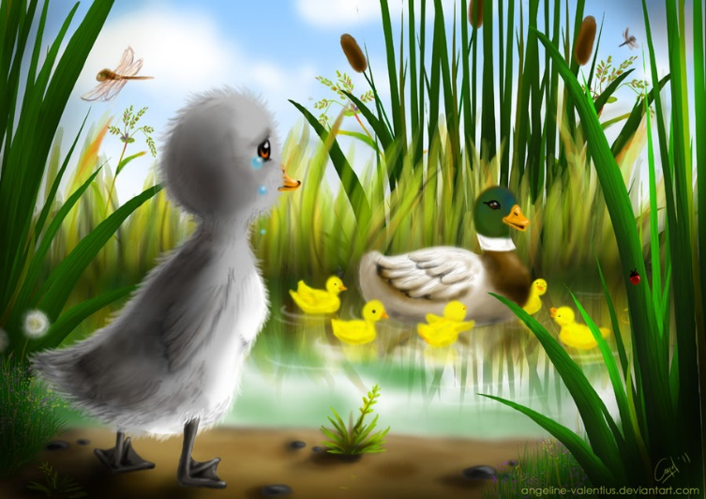
Concept Development
Adverbs are words that modify or describe a verb.
They often tell us HOW something is happening or how it happened.
They often end in –ly, but not always!
CFU:
Why is this not an example of an adverb?
Non-Examples:
1. It was a chilly day.
chilly ends in –ly, but it is not an adverb. It is an adjective as it is describing or modifying a noun!
2. The ugly duckling turned into a Swan.
ugly ends in –ly, but it is not an adverb. It is an adjective as it is describing or modifying a noun!

Slide 7
Hinge Point Question
Which sentence(s) are expanded to show how by using adverbs to describe the verb?
CFU:
Why is it/ isn’t it a an example of an adverb being used to describe a verb.
How is the verb being described?
He played.
The silent mouse crept softly along the edge of the skirting board.
The colourful kite soared magnificently.
The baby cried.
Sam ran.
An adverb is a word that modifies or describes a verb

Slide 8
Skill Development: I do
Circle the verbs.
Choose the best adverb.
Re-write the sentence with the adverb.
CFU:
What is the verb in this sentence?
What is the adverb in this sentence?
The girl sang.
How:
loudly
softly
sweetly
The girl sang sweetly.

Slide 9
Skill Development: We do
Circle the verbs.
Choose the best adverb.
Re-write the sentence with the adverb.
CFU:
What is the verb in this sentence?
What is the adverb in this sentence?
The car stopped.
How:
suddenly
abruptly
safely
The car abruptly stopped.

Slide 10
Skill Development: We do
Circle the verbs.
Choose the best adverb.
Re-write the sentence with the adverb.
CFU:
What is the verb in this sentence?
What is the adverb in this sentence?
The ship sank
How:
swiftly
quickly
slowly
The ship slowly sank.

Slide 11
Skill development: You do
Circle the verbs.
Choose the best adverb.
Re-write the sentence with the adverb.
CFU:
What is the verb in this sentence?
What is the adverb in this sentence?
The player kicked.
How:
accurately
forcefully
swiftly

Slide 12
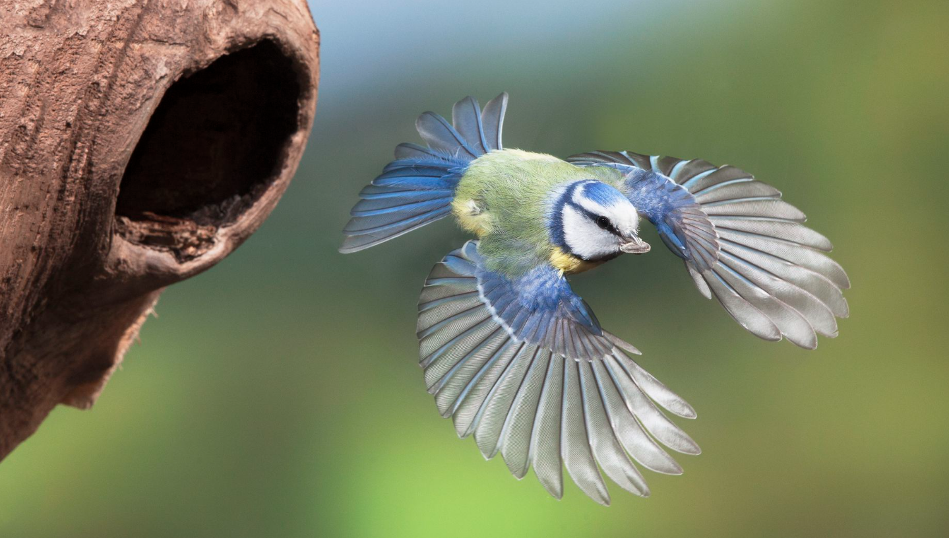
Skill Development: We do
1. Answer the questions in note form
Write your sentence using correct punctuation.
Read your sentence – does it sound right?
CFU:
Who/what is the subject?
What is the action? (verb)
How does it happen?
It flew.
Who/what:
How (adverb):
The bird
quickly

Slide 13
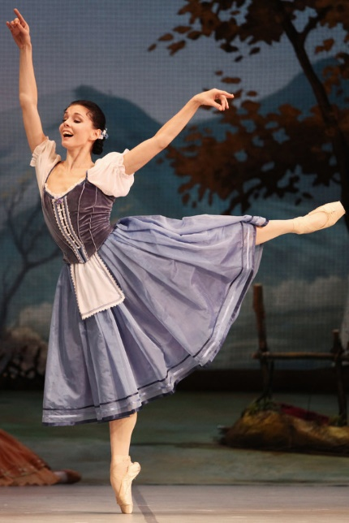
Skill Development: We do
1. Answer the questions in note form
Write your sentence using correct punctuation.
Read your sentence – does it sound right?
CFU:
Who/what is the subject?
What is the action? (verb)
How does it happen?
She danced.
Who/what:
How (adverb):
The lady
gracefully

Slide 14
Skill Development: You do
1. Answer the questions in note form
Write your sentence using correct punctuation.
Read your sentence – does it sound right?
CFU:
Who/what is the subject?
What is the action? (verb)
How does it happen?
Insert kernels with pictures from topics/texts/knowledge units from class
Who/what:
How (adverb):

