Slide 1
Year: 1
Term: 1
Objective: Sentence Expansion – when & where
Author: Rebecca Glasson

Slide 2
Multiple Choice
Pair Share
Track with me
Pick a Stick/Answer (non-volunteer)
Whiteboards
Vote
Read with me
In Your Workbook

Slide 3
Question Words
Who/what?
(did) What?
When?
Where?
Why?
How?
Display this chart in classroom prior to lesson.
Optional: use Colourful Semantics icons in addition to question words. But please note, TWR does not distinguish between the ‘what doing/did what’ (verb) and the ‘what’ (object). If you are using a Colourful Semantics approach, you will need to consider this.

Slide 4
Learning Objective
We are learning to expand our sentences by adding extra information about WHERE and WHEN.

Slide 5
Concept Development
A sentence is a group of words that makes sense by itself.
It has a subject (what/who the sentence is about) and a verb (what the subject does, is or has).
It starts with a capital and ends with a punctuation mark.
CFU:
What is a noun?
Why is this an example person? Place? Thing?
Does it…
make sense?
have a subject (the WHO/WHAT)?
have a verb (the DO)?
begin with a capital letter?
end with a full stop, exclamation mark or question mark?
The man walked to the shops.
The cat jumped on the bed.
She is going to school.
Are we visiting Tom?

Slide 6
Concept Development
A sentence is a group of words that makes sense by itself.
It has a subject (what/who the sentence is about) and a verb (what the subject does, is or has).
It starts with a capital and ends with a punctuation mark.
CFU:
Tell me the subject.
Tell me the verb.
Examples:
She ran.
Bob ate.
Joe napped.
Boring !
These sentences are boring and do not contain any additional information.

Slide 7
Concept Development
By adding additional information, we can expand sentences to make them more interesting.
Including when and where will make your sentence more informative for the reader:
CFU:
Who ran?
Where?
When did they run?
When?
Where?
Who?
What?
As the sun set, the lady ran on the beach.
Boring !
The lady ran.

Slide 8
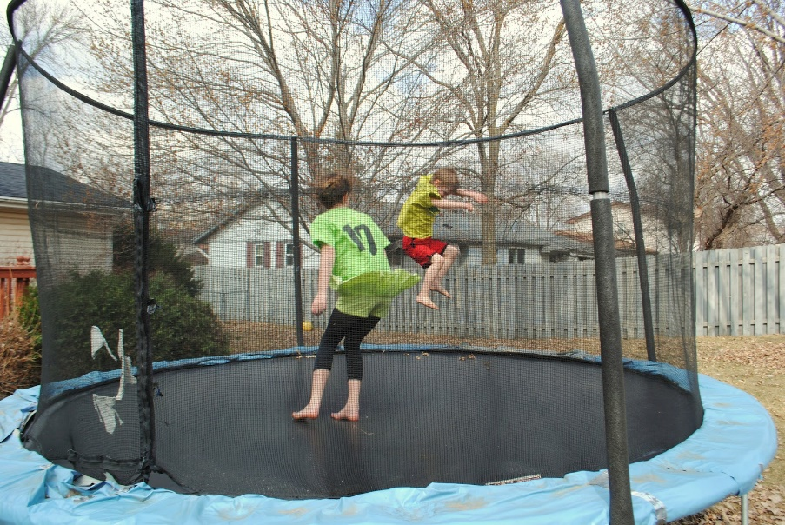
Concept Development
By adding additional information, we can expand sentences to make them more interesting.
Including when and where will make your sentence more informative for the reader:
CFU:
Who jumped?
Where?
When did they jump?
When?
Where?
Who?
What?
On a cloudy day, the boys jumped on the trampoline.
Boring !
The boys jumped

Slide 9
Concept Development
WHERE words
through
on
in
at
under
next to
beside
inside
outside
around
between
near
above
below
behind
to
WHERE phrases
through the grass
on the boat
in the lake
at the oval
under the tree
next to the house
beside the shed
inside the temple
outside the city
around the block
between the trees
near the farm
above the horizon
below the water
behind the shelf
to the shops

Slide 10
Concept Development
These sentences contain a WHERE detail:
CFU:
Where did the girl run?
Where did the birds fly?
The girl ran to the shops.
He skipped behind the shed.
The birds flew between the trees.

Slide 11
Concept Development
WHEN words
before
after
during
at
in
on
one
WHEN phrases
before lunch
after dinner
during the night
at sunset
in the morning
on Monday
one cold day

Slide 12
Concept Development
These sentences contain a WHEN and a WHERE detail:
CFU:
When did the girl run?
When did the boy skip?
After breakfast, the girl ran to the shops.
Before dinner, he skipped behind the shed.
In the morning, the birds flew between the trees.

Slide 13
Hinge Point Question
Which sentences contain the a WHEN detail?
In the morning, the rooster crowed.
Tom ate his banana.
After breakfast, Mary walked to school.
Tim and Ted sat under a shady tree.
a & c

Slide 14
Hinge Point Question
Which sentences contain the a WHERE detail?
The dog bolted to the park.
The fish swam behind the coral
We had sandwiches for lunch.
In the morning, we went for a walk.
a & b

Slide 15
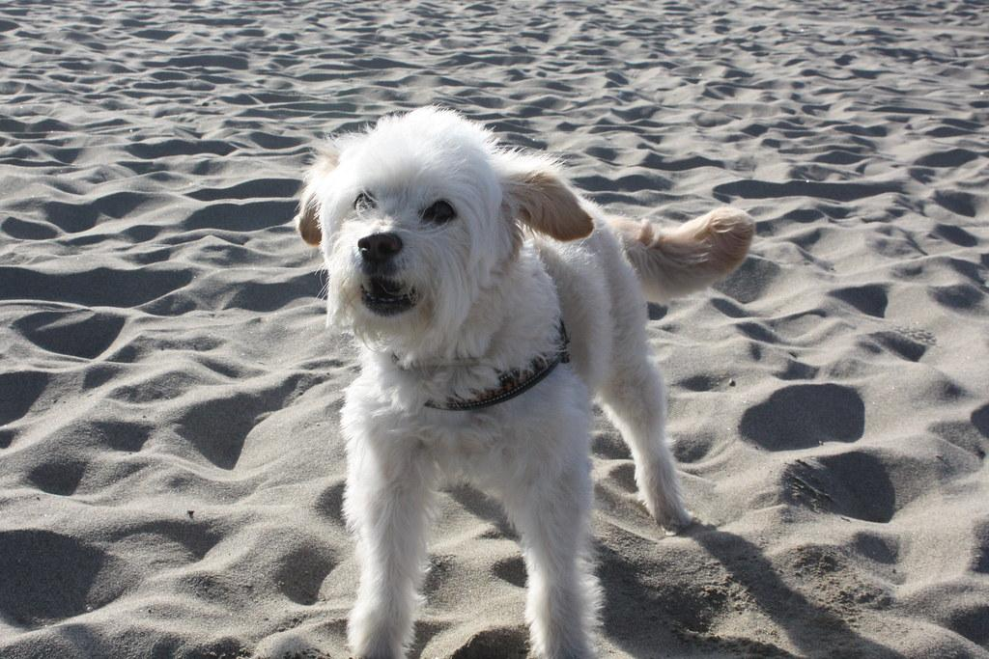
Skill Development: I do
Answer the questions in note form
Use the notes to say the sentence, in this order:
When, who/what (did) what where.
3. Write your sentence using correct punctuation.
When, who/what (did) what where.
4. Read your sentence – does it sound right?
CFU:
Tell me the who/subject.
Tell me the verb.
Where does it occur?
When does it happen?
The dog barked.
When:
Where:
Early in the morning
on the beach
Early in the morning, the dog barked on the beach.

Slide 16
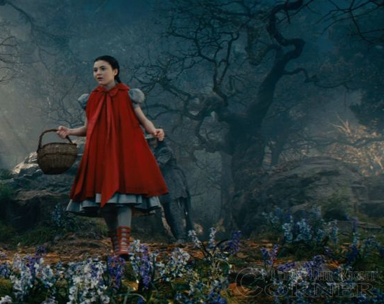
Skill Development: We do
Answer the questions in note form
Use the notes to say the sentence, in this order:
When, who/what (did) what where.
3. Write your sentence using correct punctuation.
When, who/what (did) what where.
4. Read your sentence – does it sound right?
The little girl walked.
When:
Where:
After dinner
into the woods
After dinner, the little girl walked into the woods.

Slide 17
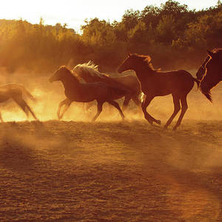
Skill Development: We do
Answer the questions in note form
Use the notes to say the sentence, in this order:
When, who/what (did) what where.
3. Write your sentence using correct punctuation.
When, who/what (did) what where.
4. Read your sentence – does it sound right?
The horses galloped.
When:
Where:
At sunset
in the field
At sunset, the horses galloped in the field.

Slide 18
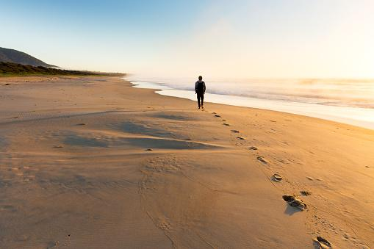
Skill Development: We do
Answer the questions in note form
Use the notes to say the sentence, in this order:
When, who/what (did) what where.
3. Write your sentence using correct punctuation.
When, who/what (did) what where.
4. Read your sentence – does it sound right?
The girl walked.
When:
Where:
At sunrise
along the beach
At sunrise, the girl walked along the beach.

Slide 19
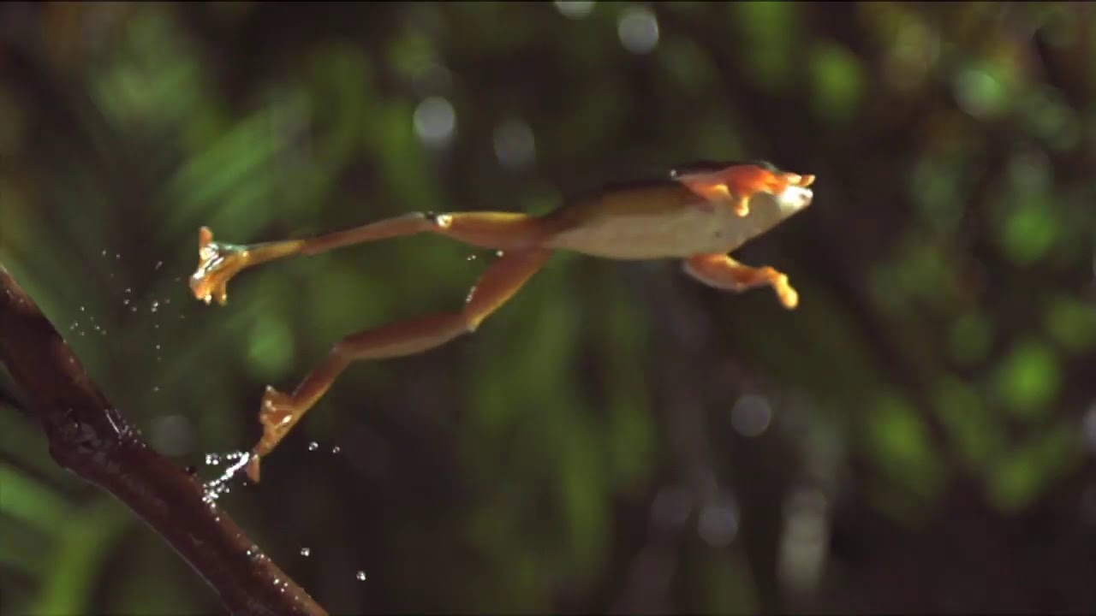
Skill Development: You do
Answer the questions in note form
Use the notes to say the sentence, in this order:
When, who/what (did) what where.
3. Write your sentence using correct punctuation.
When, who/what (did) what where.
4. Read your sentence – does it sound right?
The frog jumped.
When:
Where:

Slide 20
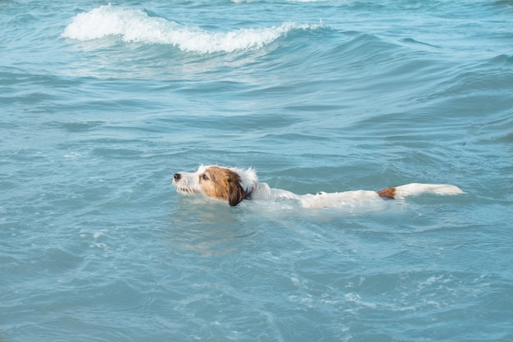
Skill Development: You do
Answer the questions in note form
Use the notes to say the sentence, in this order:
When, who/what (did) what where.
3. Write your sentence using correct punctuation.
When, who/what (did) what where.
4. Read your sentence – does it sound right?
The puppy swam.
When:
Where:

Slide 21
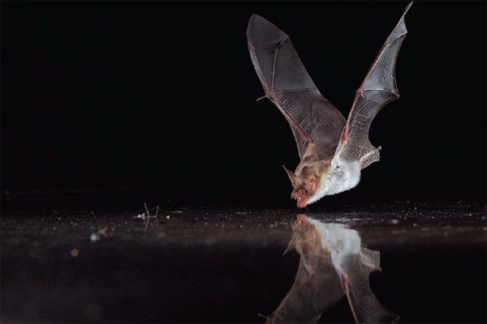
Skill Development: You do
Answer the questions in note form
Use the notes to say the sentence, in this order:
When, who/what (did) what where.
3. Write your sentence using correct punctuation.
When, who/what (did) what where.
4. Read your sentence – does it sound right?
The bat looked for food.
When:
Where:

