Slide 1
Year: 1
Term: 1
Objective: Sentence Expansion – when, who/what, where
Author: Rebecca Glasson

Slide 2
Multiple Choice
Pair Share
Track with me
Pick a Stick/Answer (non-volunteer)
Whiteboards
Vote
Read with me
In Your Workbook

Slide 3
Question Words
Who/what?
(did) What?
When?
Where?
Why?
How?
Display this chart in classroom prior to lesson.
Optional: use Colourful Semantics icons in addition to question words. But please note, TWR does not distinguish between the ‘what doing/did what’ (verb) and the ‘what’ (object). If you are using a Colourful Semantics approach, you will need to consider this.

Slide 4
Learning Objective
We are learning to expand our sentences by adding extra information.

Slide 5
Activate Prior Knowledge
A sentence is a complete thought.
It must contain a subject and a verb.
CFU:
Tell me the verb.
Tell me the subject.
Examples:
She ran.
Bob ate.
Joe napped.

Slide 6
Concept Development
A sentence is a complete thought.
It must contain a subject and a verb.
CFU:
Tell me the subject.
Tell me the verb.
Examples:
She ran.
Bob ate.
Joe napped.
Boring !
These sentences are boring and do not contain any additional information.

Slide 7
Concept Development
By adding additional information, we can expand sentences to make them more interesting.
Including when, who, what, and where will make your sentence more informative for the reader:
CFU:
Who ran?
Where?
When did they run?
2. What does ‘she’ refer to in the kernel sentence.
When?
Where?
Who?
What?
As the sun set, the lady ran on the beach.
Boring !
She ran.

Slide 8
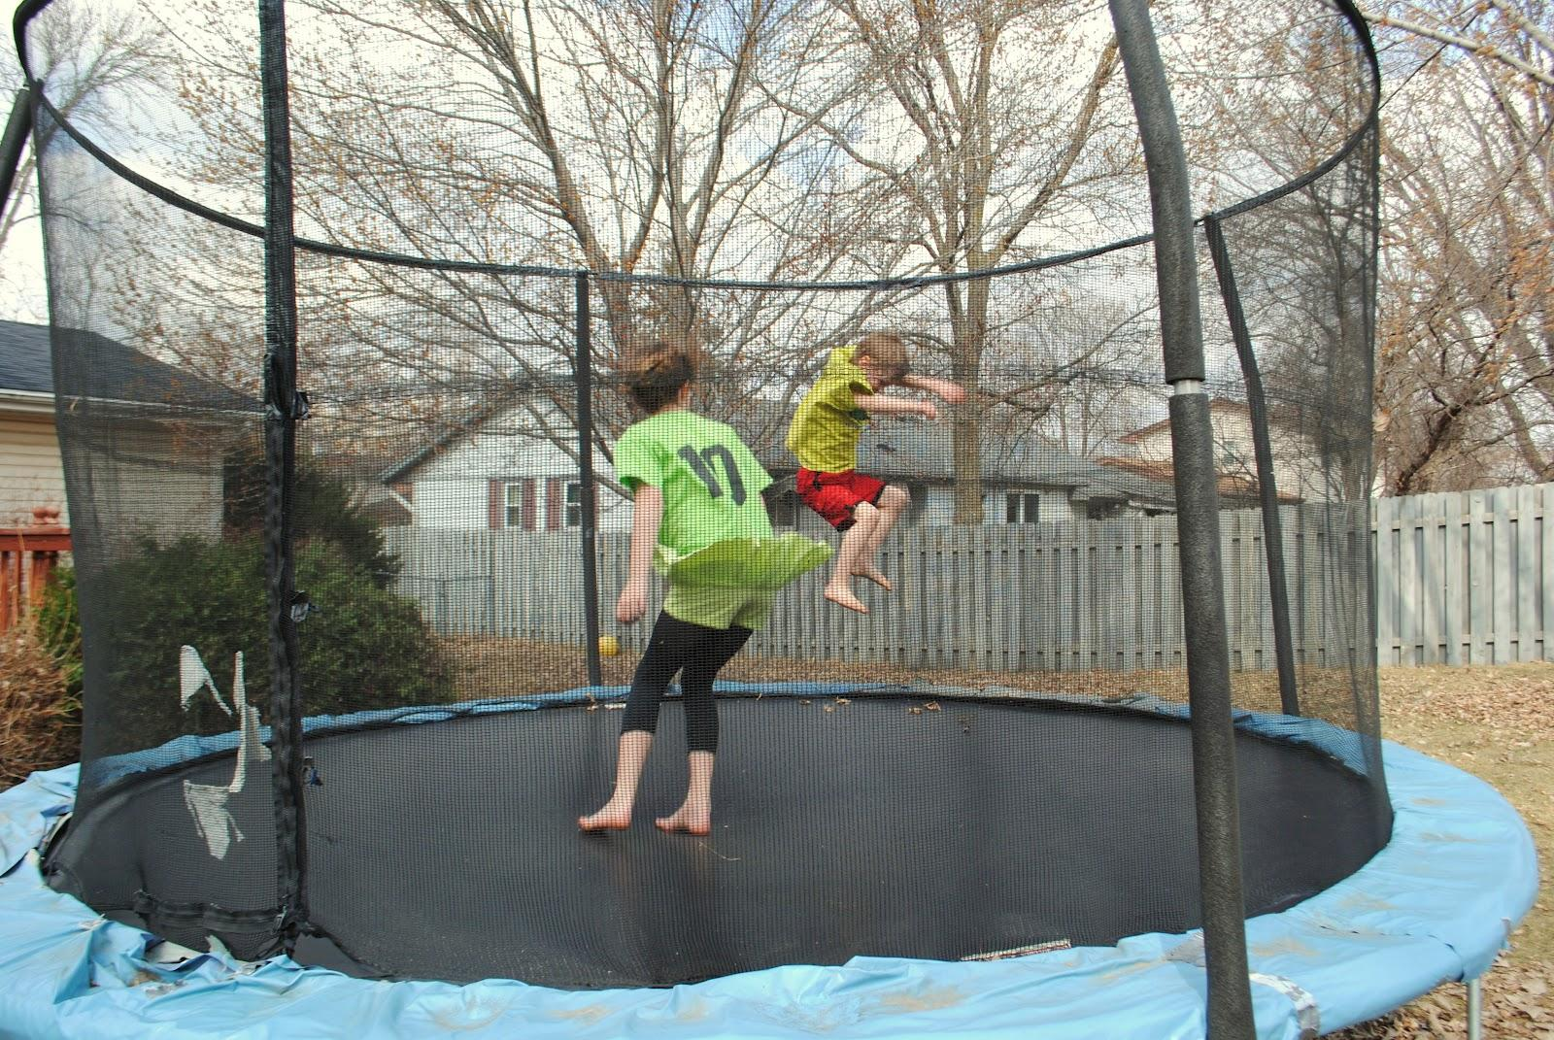
Concept Development
By adding additional information, we can expand sentences to make them more interesting.
Including when, who, what, and where will make your sentence more informative for the reader:
CFU:
Who jumped?
Where?
When did they jump?
2. What does ‘they’ refer to in the kernel sentence.
When?
Where?
Who?
What?
On a cloudy day, the two boys jumped on the trampoline.
Boring !
They jumped

Slide 9
Hinge Point Question
Which sentences contain a WHEN and WHERE detail?
As the moon rose, Lucy walked along the dusty track.
Lily ate an apple.
Yesterday, the children played on the playground.
Billy and Bob sat under the shady tree.

Slide 10
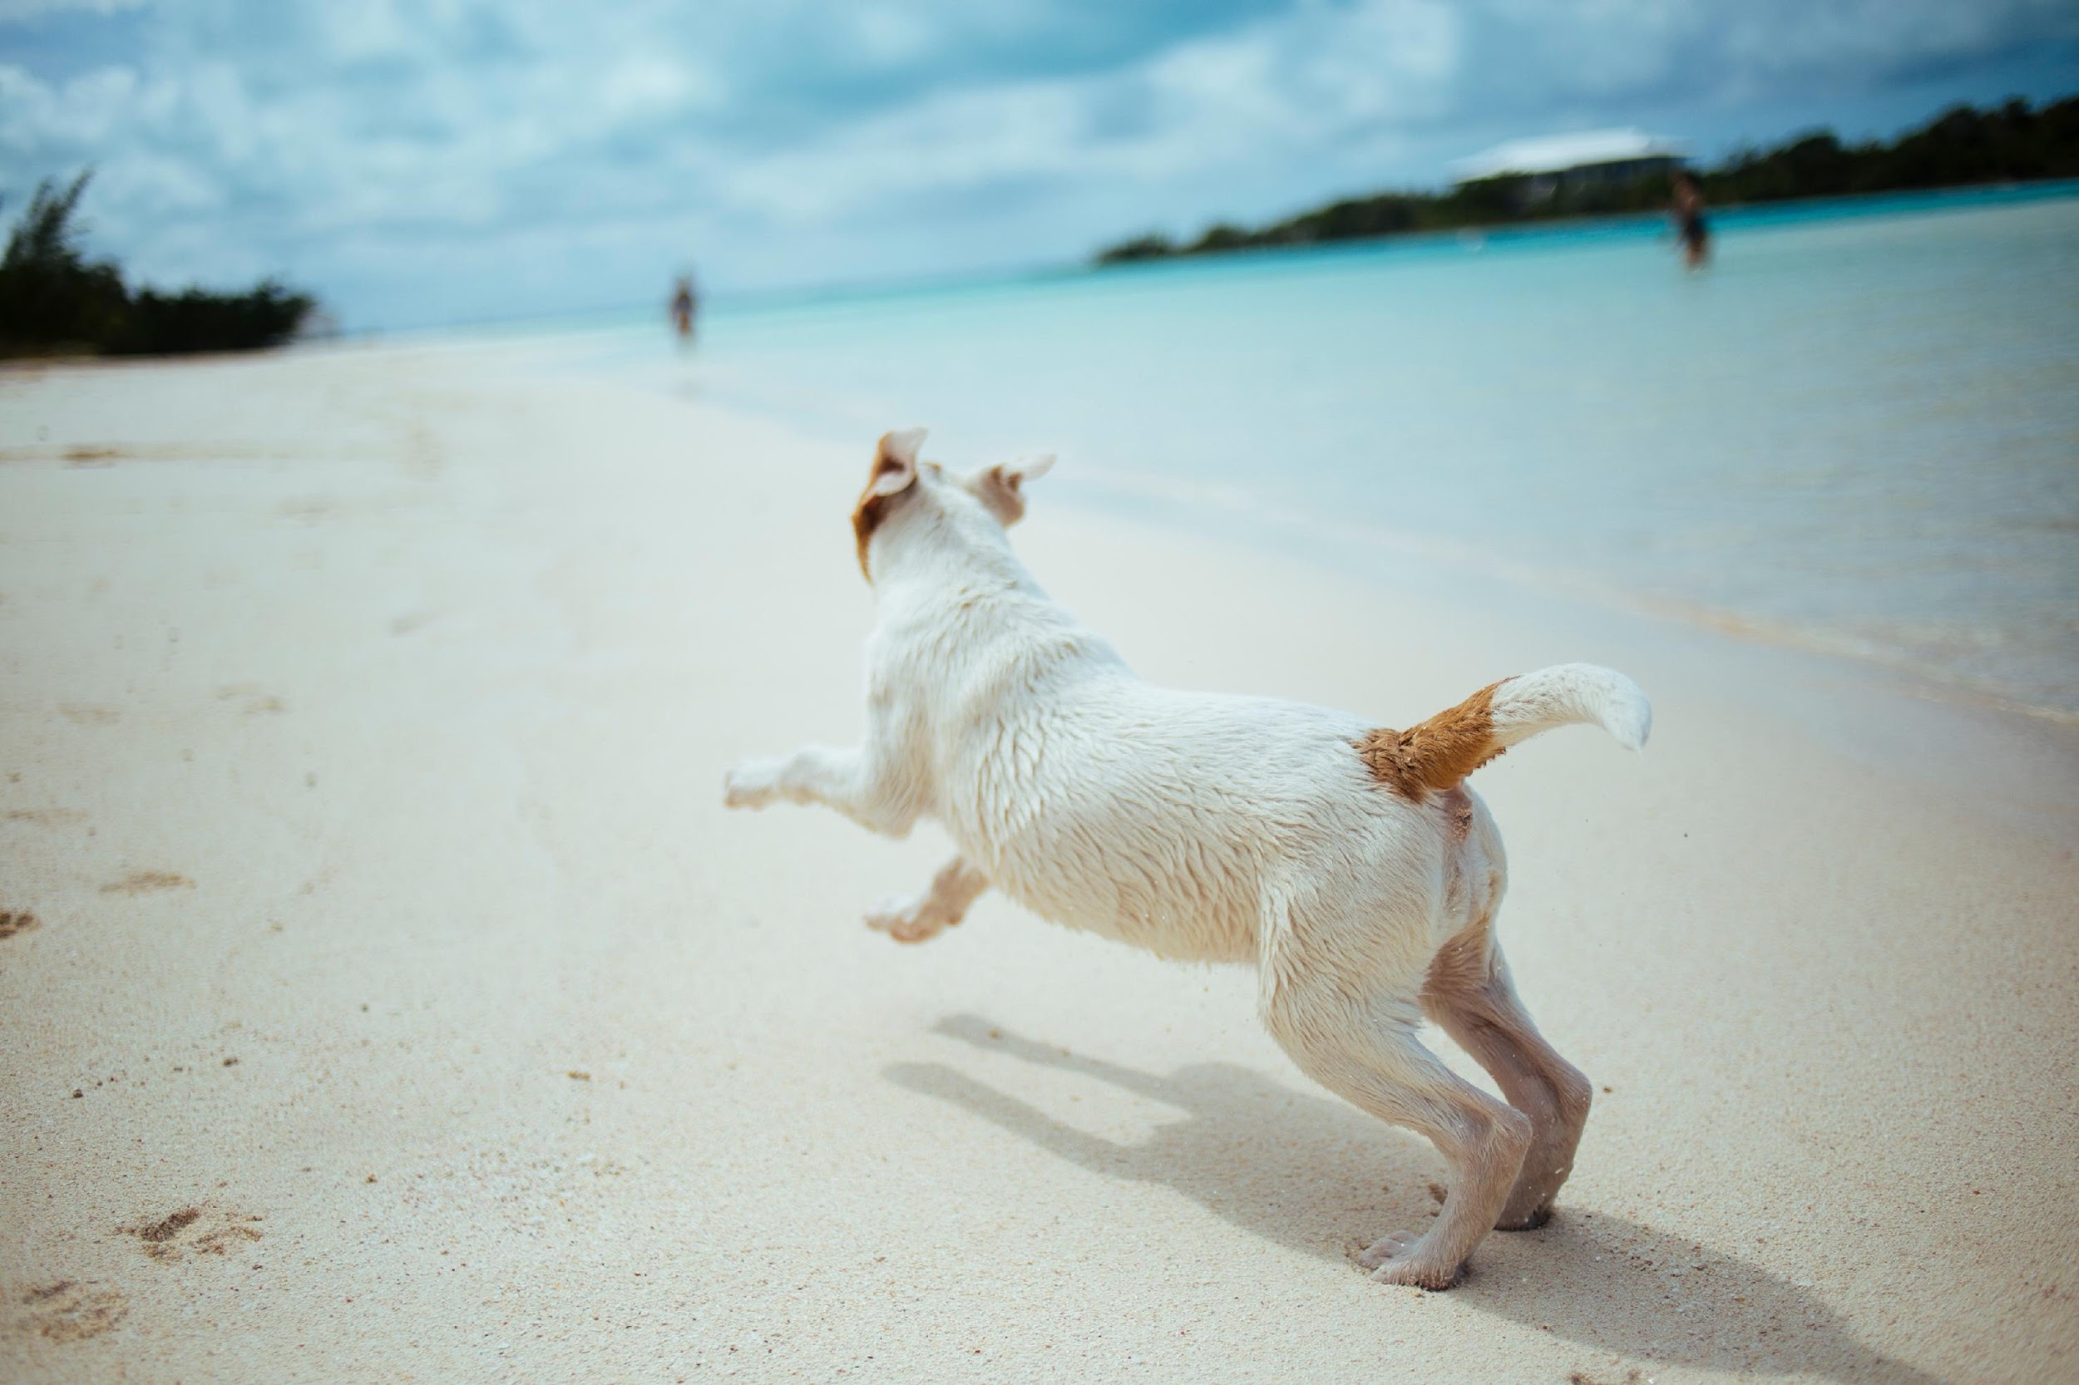
Skill Development: I do
Answer the questions in note form
Use the notes to say the sentence, in this order:
When, who, what, and where.
3. Write your sentence using correct punctuation.
When, who what where.
4. Read your sentence – does it sound right?
CFU:
What is the subject.
What is the verb.
Where does it occur?
When does it happen?
She ran.
Who:
When:
Where:
the little dog
early in the morning
beach
Early in the morning, the little dog ran on the beach.

Slide 11
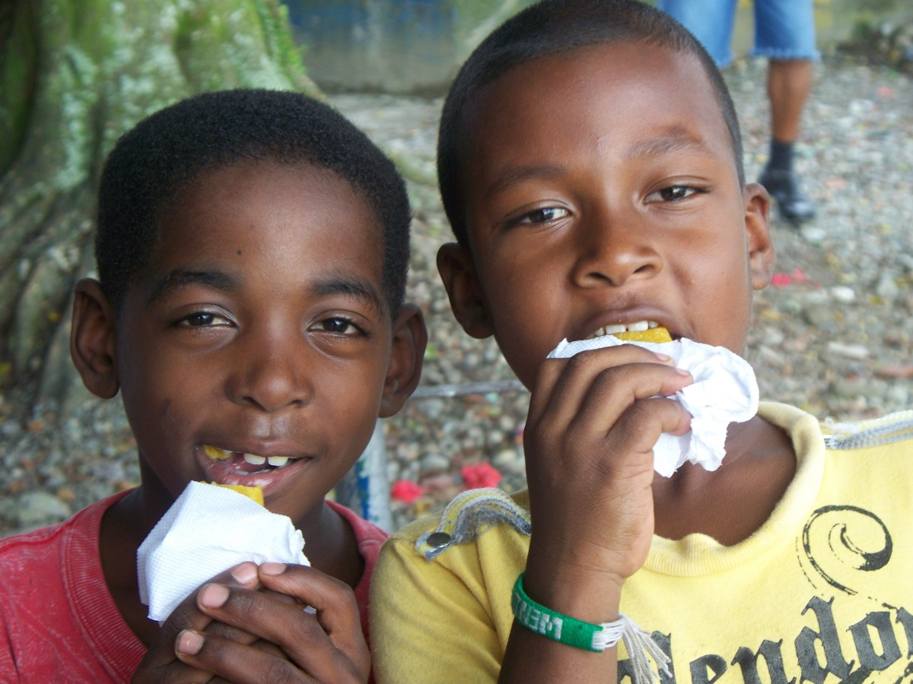
Skill Development: I do
Answer the questions in note form
Use the notes to say the sentence, in this order:
When, who, what, and where.
3. Write your sentence using correct punctuation.
When, who what where.
4. Read your sentence – does it sound right?
CFU:
What is the subject.
What is the verb.
Where does it occur?
When does it happen?
They ate.
Who:
When:
Where:
the hungry boys
before dinner
kitchen
Before dinner, the hungry boys ate in the kitchen.

Slide 12
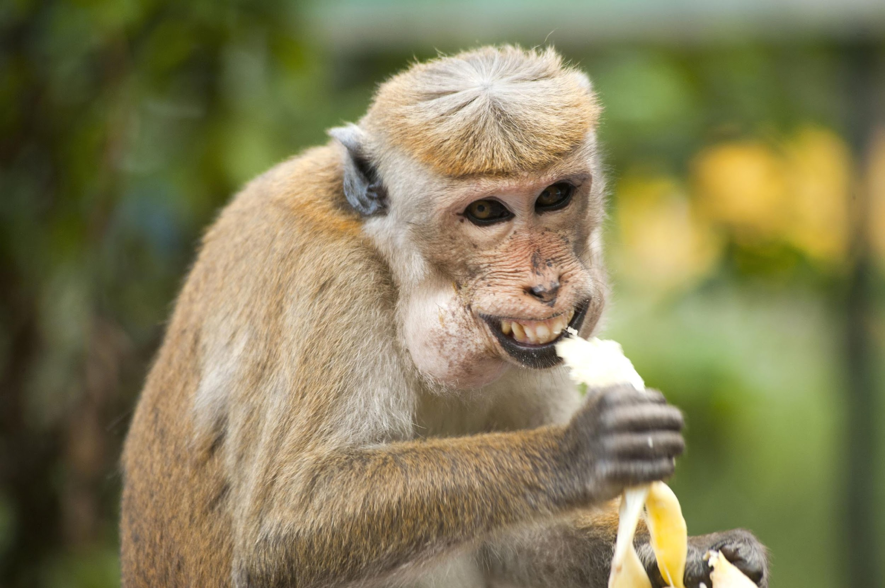
Skill development: I do
Answer the questions in note form
Use the notes to say the sentence, in this order:
When, who, what, and where.
3. Write your sentence using correct punctuation.
When, who what where.
4. Read your sentence – does it sound right?
CFU:
What is the subject.
What is the verb.
Where does it occur?
When does it happen?
It ate.
Who:
When:
Where:
the cheeky monkey
on a sunny day
in a tree
On a sunny day, the cheeky monkey ate in a tree.

Slide 13
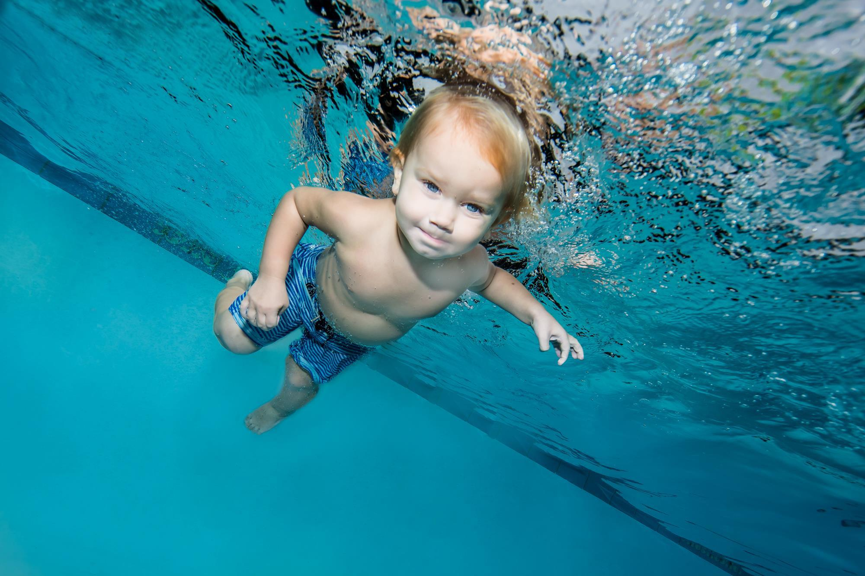
Skill development: We do
Answer the questions in note form
Use the notes to say the sentence, in this order:
When, who, what, and where.
3. Write your sentence using correct punctuation.
When, who what where.
4. Read your sentence – does it sound right?
CFU:
What is the subject.
What is the verb.
Where does it occur?
When does it happen?
He swam.
Who:
When:
Where:
the toddler
a warm day
swimming pool

Slide 14
Skill development: We do
Answer the questions in note form
Use the notes to say the sentence, in this order:
When, who, what, and where.
3. Write your sentence using correct punctuation.
When, who what where.
4. Read your sentence – does it sound right?
CFU:
What is the subject.
What is the verb.
Where does it occur?
When does it happen?
She stacks blocks.
Who:
When:
Where:
the little girl
after recess
on the desk

Slide 15
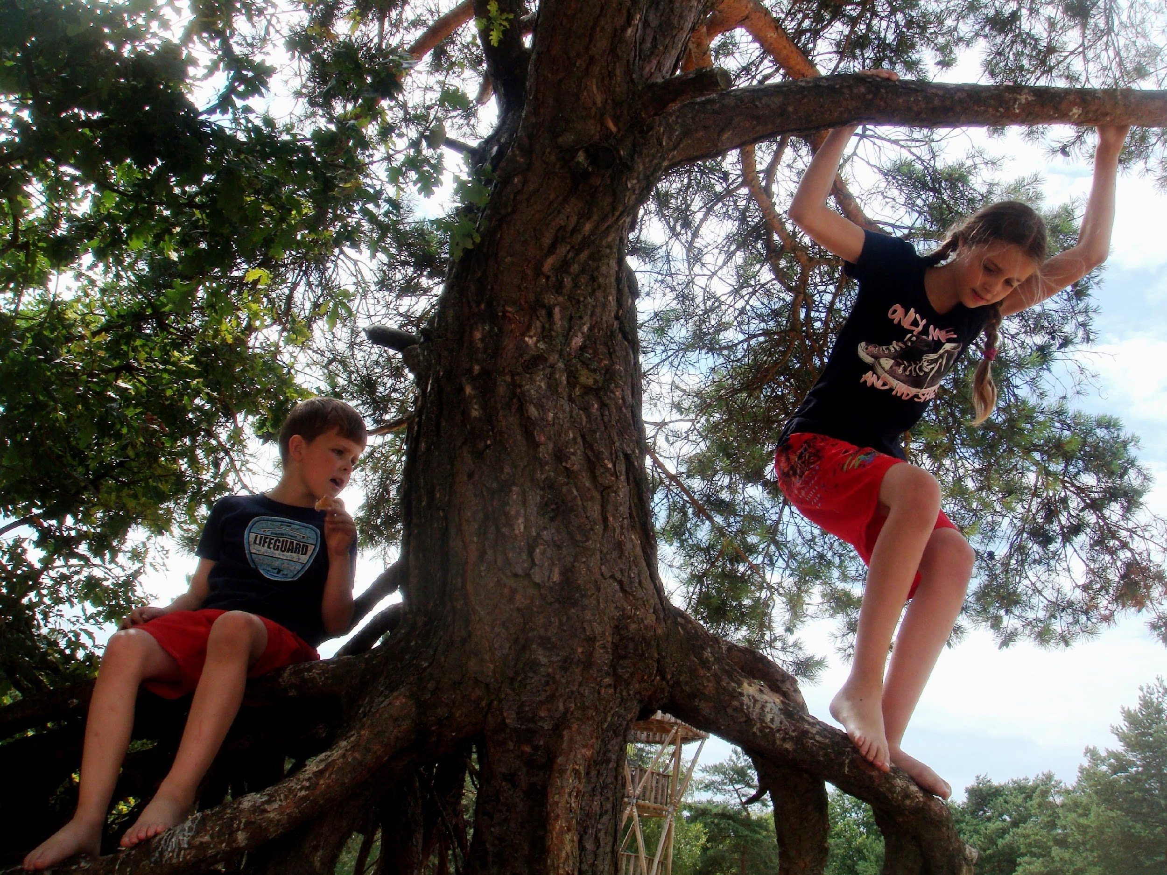
Skill development: You do
Answer the questions in note form
Use the notes to say the sentence, in this order:
When, who, what, and where.
3. Write your sentence using correct punctuation.
When, who what where.
4. Read your sentence – does it sound right?
CFU:
What is the subject.
What is the verb.
Where does it occur?
When does it happen?
They climb.
Who:
When:
Where:

