Slide 1
Year: 1
Term: 2
Objective: expand simple sentences with an adjective (to describe the subject or object in the sentence)
Author: Rebekah Winning

Slide 2
Multiple Choice
Pair Share
Track with me
Pick a Stick/Answer (non-volunteer)
Whiteboards
Vote
Read with me
In Your Workbook

Slide 3
Learning Objective
We are learning to expand simple sentences with an adjective (to describe the subject or object in the sentence)

Slide 4
Concept Development
What is an adjective?
An adjective is a word that describes or modifies a noun or pronoun.
Modifies means to change by giving more information.

Slide 5
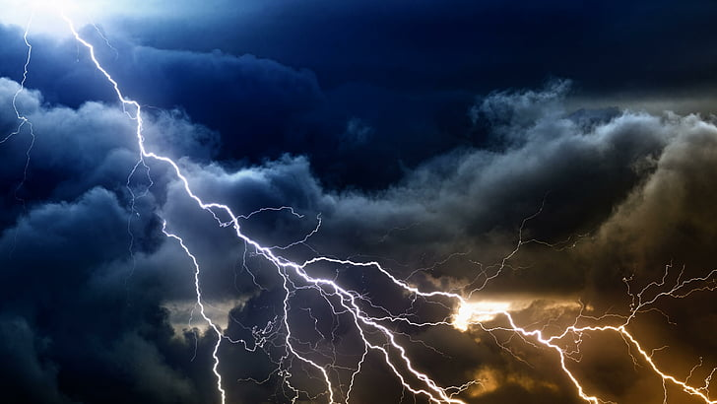
Concept Development
Which word modifies the noun ‘sky’ ?
stormy
thunder
clouds

Slide 6
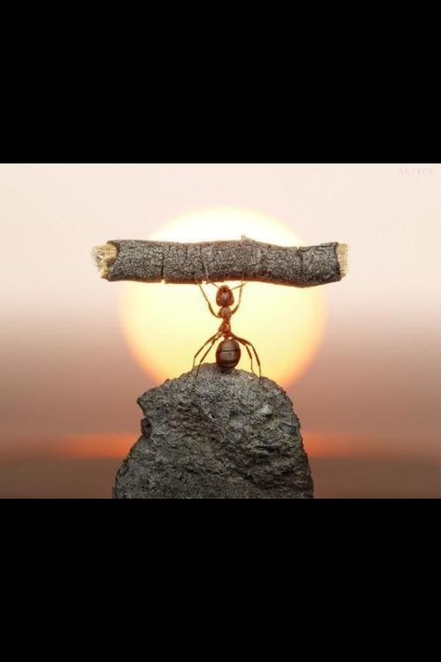
Concept Development
Which word modifies the noun ‘ant’ ?
strong
sun
rock

Slide 7
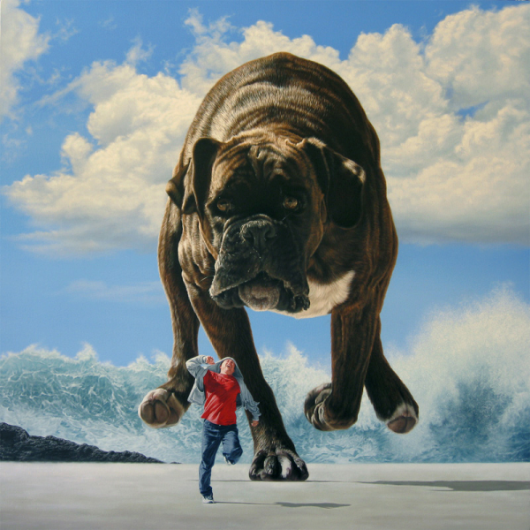
Concept Development
Adjectives can be used in sentences to modify the subject.
CFU:
What is the adjective in this sentence? What is it describing?
The dog ran along the ice.
The giant dog ran along the ice.

Slide 8
Concept Development
Adjectives can also be used to describe other nouns like the where detail.
CFU:
What is the adjective in this sentence? What is it describing?
The dog ran along the ice.
The giant dog ran along the freezing ice.

Slide 9
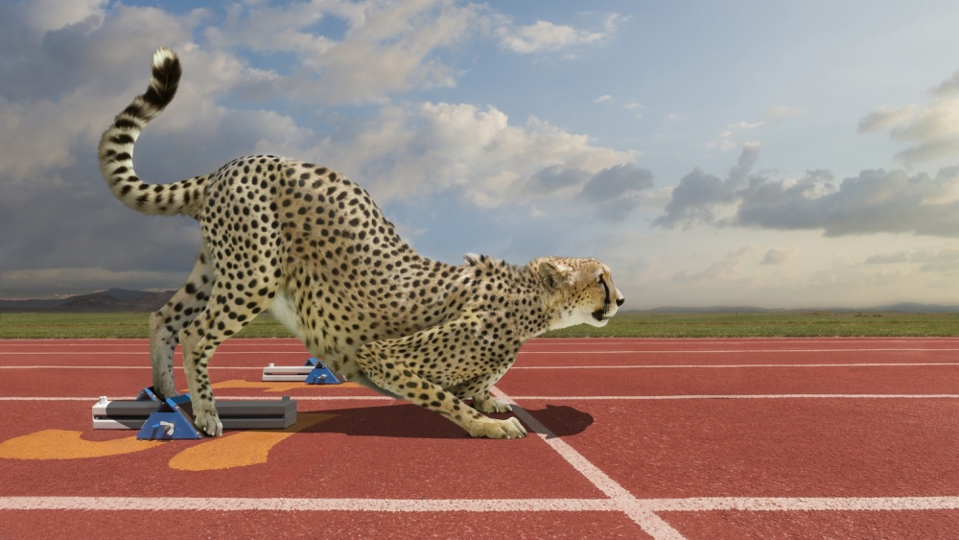
Concept Development
CFU:
What is the adjective in this sentence? What is it modifying?
The cheetah sprinted on the track.
The majestic cheetah sprinted on the red track.

Slide 10
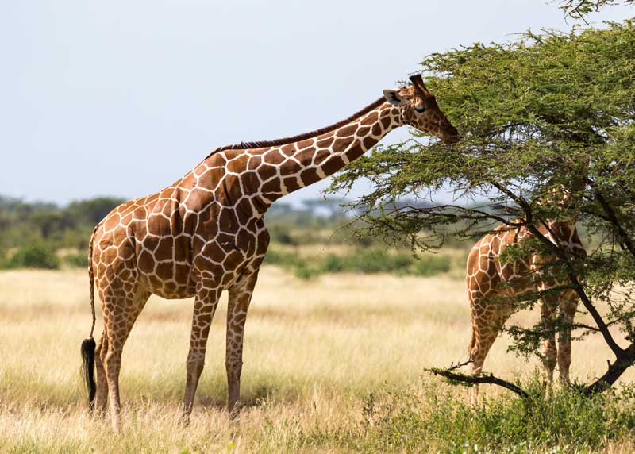
Skill development: I do
Answer the questions in note form
Use the notes to say the sentence, in this order:
Who (did)what where.
3. Add an adjective to the ‘who’ or the ‘where’
3. Write your sentence using correct punctuation.
Who (did)what where.
4. Read your sentence – does it sound right?
CFU:
What adjective did I use to modify the who (subject)?
It ate leaves.
Who/what:
Where:
The elegant giraffe
savannah
The elegant giraffe ate leaves in the savannah.

Slide 11
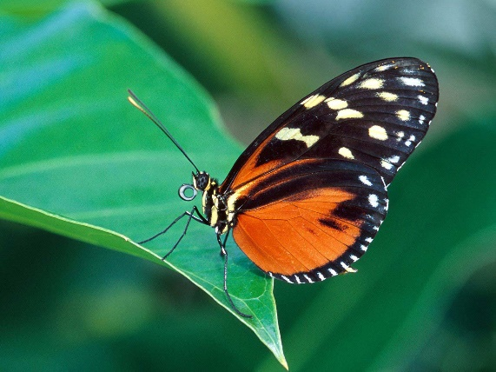
Skill development: We do
Answer the questions in note form
Use the notes to say the sentence, in this order:
Who (did)what where.
3. Add an adjective to the ‘who’ or the ‘where’
3. Write your sentence using correct punctuation.
Who (did)what where.
4. Read your sentence – does it sound right?
CFU:
What adjective did you use to modify the who (subject)? Or the where?
It landed.
Who/what:
Where:
The beautiful butterfly
green leaf
The beautiful butterfly landed on the green leaf.

Slide 12
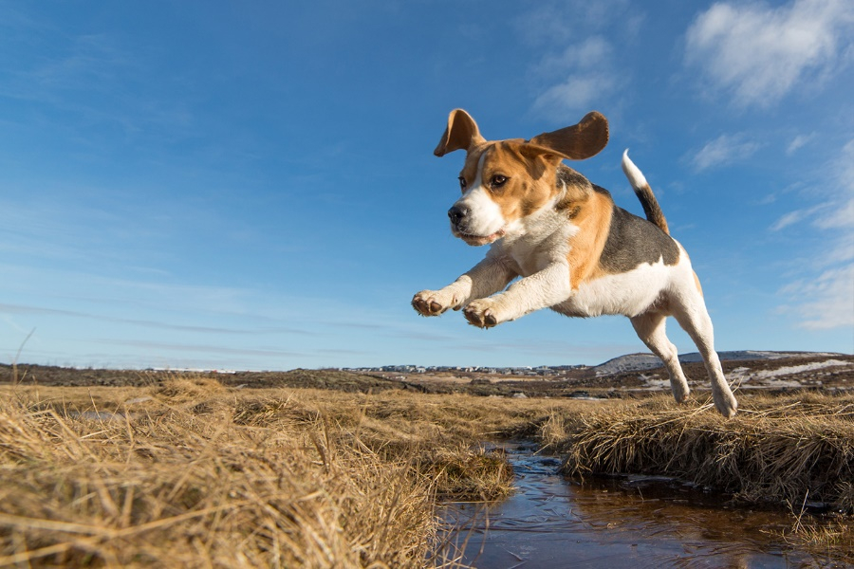
Skill development: We do
Answer the questions in note form
Use the notes to say the sentence, in this order:
Who (did)what where.
3. Add an adjective to the ‘who’ or the ‘where’
3. Write your sentence using correct punctuation.
Who (did)what where.
4. Read your sentence – does it sound right?
CFU:
What adjective did you use to modify the who (subject)? Or the where?
It jumped.
Who/what:
Where:
The mischievous dog
over the dirty creek
The mischievous dog jumped over the dirty creek.

Slide 13
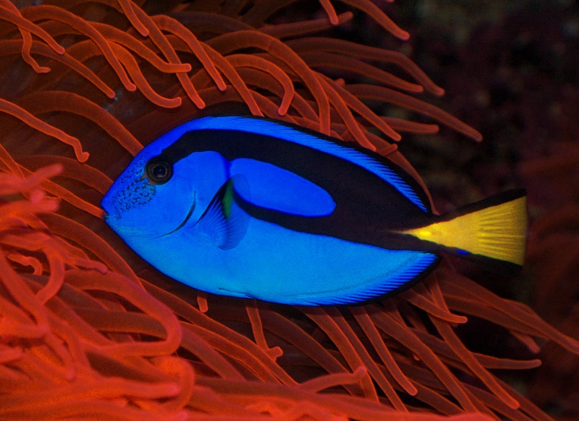
Skill development: We do
Answer the questions in note form
Use the notes to say the sentence, in this order:
Who (did)what where.
3. Add an adjective to the ‘who’ or the ‘where’
3. Write your sentence using correct punctuation.
Who (did)what where.
4. Read your sentence – does it sound right?
CFU:
What adjective did you use to modify the who (subject)? Or the where?
It swam.
Who/what:
Where:
The magnificent fish
beautiful coral
The magnificent fish swam amongst the beautiful coral.

Slide 14
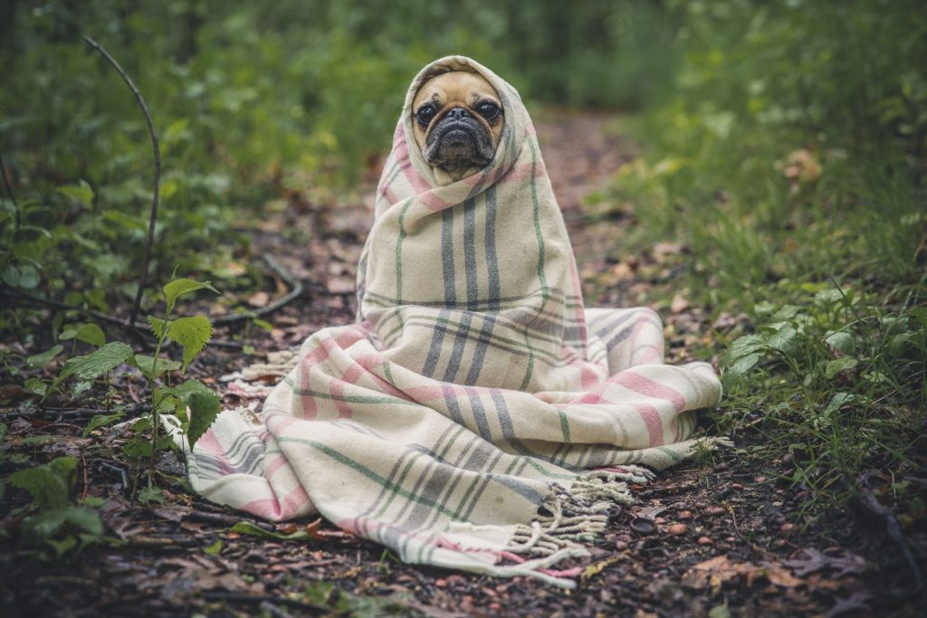
Skill development: You do
Answer the questions in note form
Use the notes to say the sentence, in this order:
Who (did)what where.
3. Add an adjective to the ‘who’ or the ‘where’
3. Write your sentence using correct punctuation.
Who (did)what where.
4. Read your sentence – does it sound right?
CFU:
What adjective did you use to modify the who (subject)? Or the where?
It sat.
Who/what:
Where:
The adorable pug
cozy rug
The adorable pug sat on a cozy rug.

Slide 15
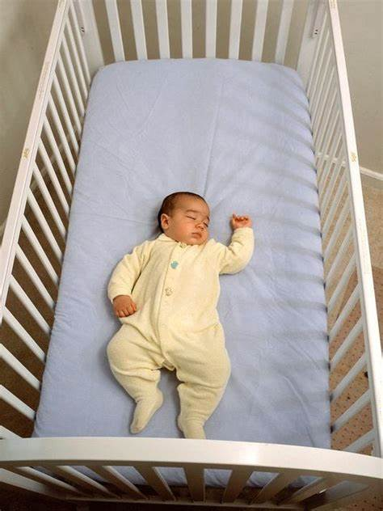
Skill development: You do
Answer the questions in note form
Use the notes to say the sentence, in this order:
Who (did)what where.
3. Add an adjective to the ‘who’ or the ‘where’
3. Write your sentence using correct punctuation.
Who (did)what where.
4. Read your sentence – does it sound right?
CFU:
What adjective did you use to modify the who (subject)? Or the where?
It slept.
Who/what:
Where:
The adorable baby
comfy cot
The adorable baby slept in her comfy cot.

Slide 16
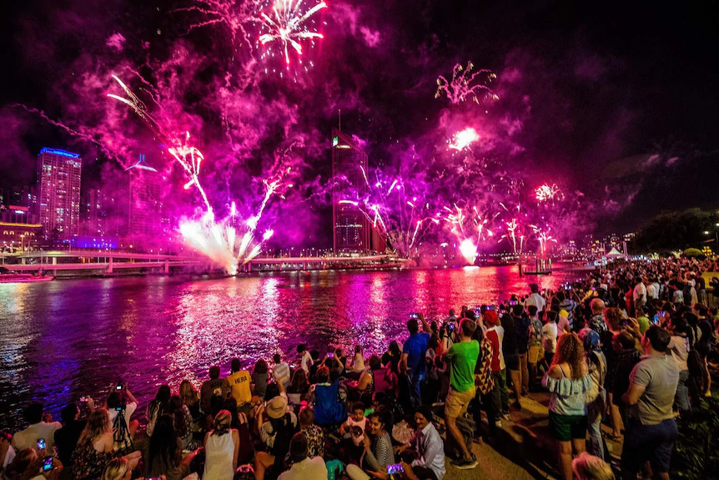
Skill development: You do
Answer the questions in note form
Use the notes to say the sentence, in this order:
Who (did)what where.
3. Add an adjective to the ‘who’ or the ‘where’
3. Write your sentence using correct punctuation.
Who (did)what where.
4. Read your sentence – does it sound right?
CFU:
What adjective did you use to modify the who (subject)? Or the where?
They erupted.
Who:
Where:
The magnificent fireworks
glistening river
The magnificent fireworks erupted over the glistening river.

