Slide 1
Year: Foundation
Term: 2
Objective: Expand simple sentences with an adjective
Author: Natalie Old

Slide 2
Copy and paste these icons to the appropriate slides to indicate engagement norms/CFU strategies
Multiple Choice
Pair Share
Track with me
Pick a Stick/Answer (non-volunteer)
Whiteboards
Vote
Read with me
In Your Workbook

Slide 3
Learning Objective
We are learning to expand simple sentences with an adjective.

Slide 4
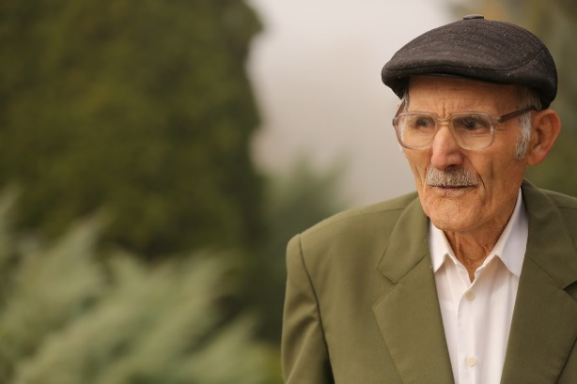
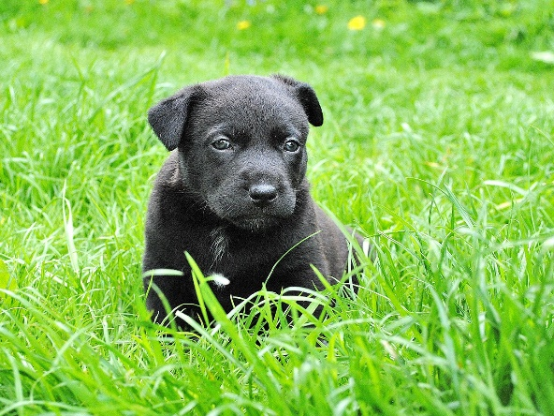
Concept Development
Adjectives describe nouns.
Examples:
CFU:
What is an adjective?
Why is this an example of adjective?
What other adjectives could you think of for this picture?
old man
blue flower
cute puppy
Notes:
https://pixnio.com/free-images/2020/08/12/2020-08-12-11-28-09-1200x800.jpg
https://cdn.pixabay.com/photo/2014/03/19/00/05/anemone-290340_960_720.jpg
https://cdn.pixabay.com/photo/2014/03/04/19/53/dog-279698_1280.jpg

Slide 5
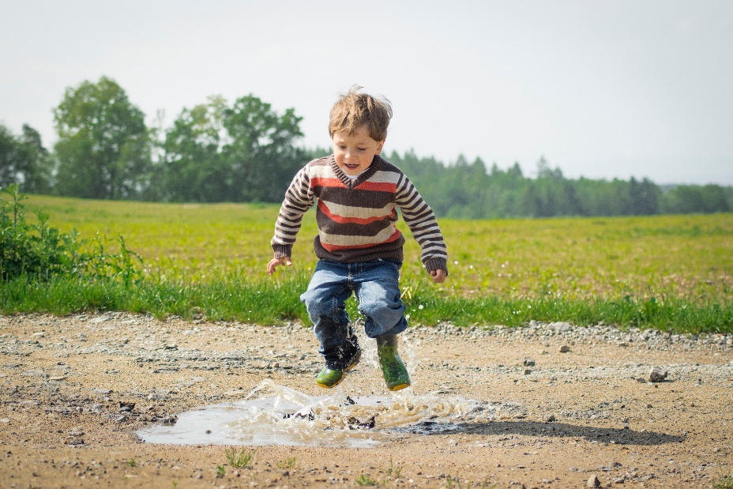
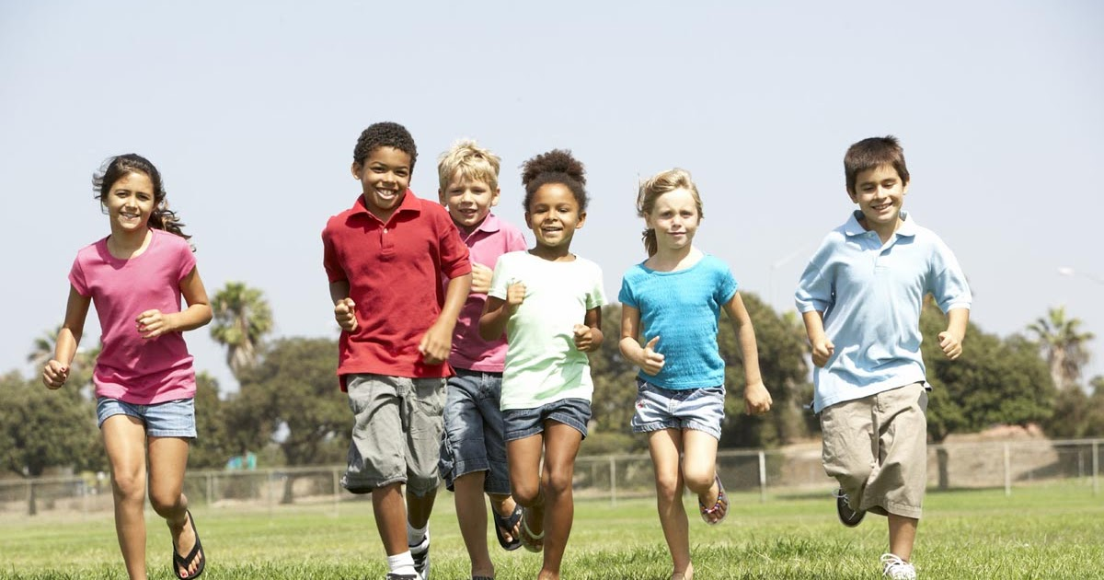
Concept Development
Adjectives describe nouns.
Non-Examples:
CFU:
Why is this not an example of a …
1. The kids are running.
2. The boy is jumping.
Running is the verb in the sentence. It tells what the kids are doing, it doesn’t describe them.
jumping is the verb. It tells what the boy is doing, it doesn’t describe him.
Notes:
https://3.bp.blogspot.com/-4QqaP-wPtxU/WMBywvyV-MI/AAAAAAAABcM/h0hADX4gbNsNiI3s9M6gdlheR2zfC_yzACLcB/w1200-h630-p-k-no-nu/149.children-running.jpg
https://images.pexels.com/photos/1104014/pexels-photo-1104014.jpeg?cs=srgb&dl=pexels-luna-lovegood-1104014.jpg&fm=jpg

Slide 6
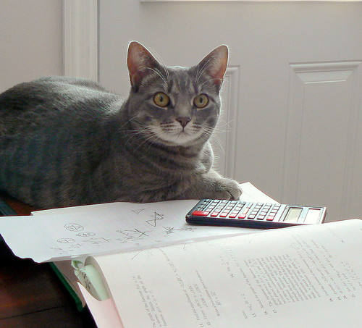
Skill Development: I Do
Identify the noun.
Think of an adjective to describe it.
Say the sentence with the adjective.
CFU:
What is the noun?
What’s an adjective to describe it?
Adjectives:
smart
clever
Intelligent
___________
Noun: cat
The _______________ cat is doing my homework.
Notes:
https://live.staticflickr.com/3617/3324301004_48853f97ca.jpg

Slide 7
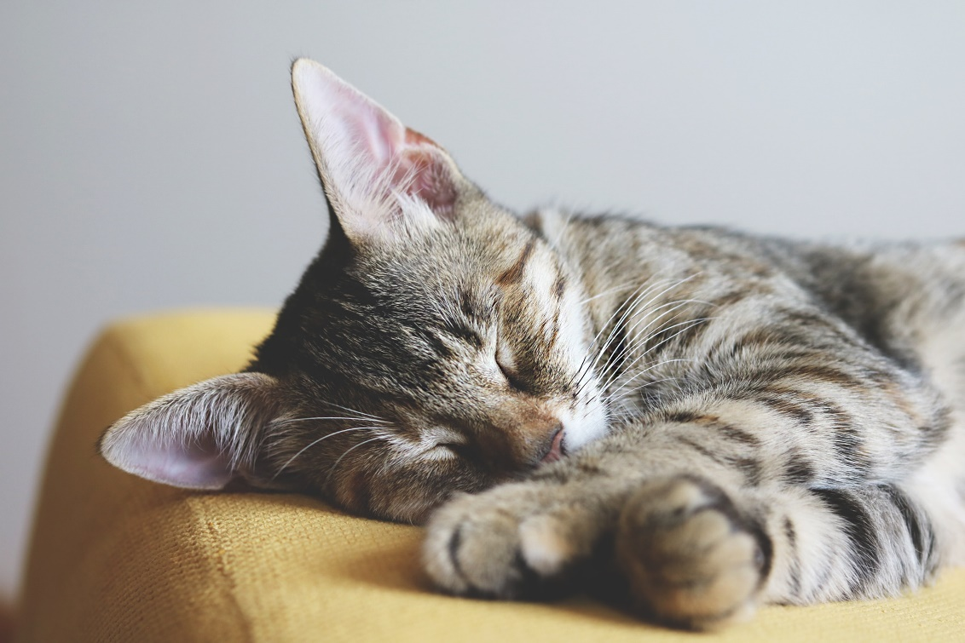
Skill Development: We Do
Identify the noun.
Think of an adjective to describe it.
Say the sentence with the adjective.
CFU:
What is the noun?
What’s an adjective to describe it?
Adjectives:
tired
lazy
____________
____________
Noun: cat
The _______________ cat is sleeping.
Notes:
https://images.pexels.com/photos/1440918/pexels-photo-1440918.jpeg?cs=srgb&dl=close-up-photography-of-gray-tabby-cat-sleeping-on-yellow-1440918.jpg&fm=jpg

Slide 8
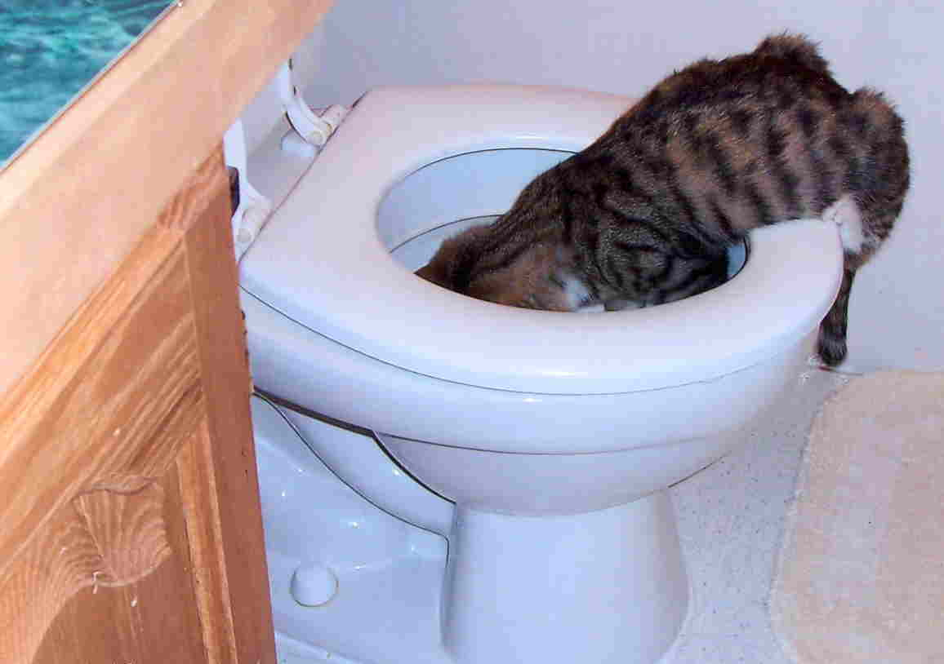
Skill Development: We Do
Identify the noun.
Think of an adjective to describe it.
Say the sentence with the adjective.
CFU:
What is the noun?
What’s an adjective to describe it?
Adjectives:
helpful
____________
____________
____________
Noun: cat
The _______________ cat is fixing the toilet.
Notes:
https://xueshu.info/wp-content/uploads/2009/12/cat_toilet.jpg

Slide 9
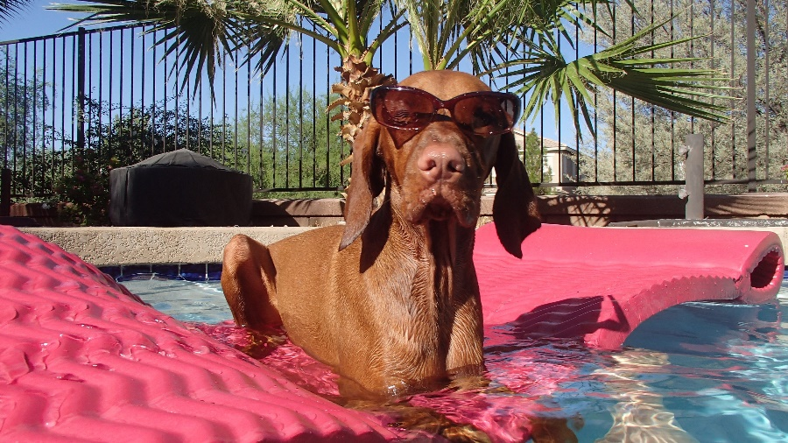
Hinge Point Question
Which sentence is expanded with an adjective?
CFU:
Go through each option one-at-a-time once students have answered on their whiteboards
Identify noun and adjective, discuss answers
The dog is relaxing.
The pampered dog is relaxing.
The pampered, brown dog is relaxing.
The dog is in the pool.
Adjectives describe nouns.
Notes:
https://images.pexels.com/photos/51807/pexels-photo-51807.jpeg?cs=srgb&dl=dog-relax-summer-51807.jpg&fm=jpg

Slide 10
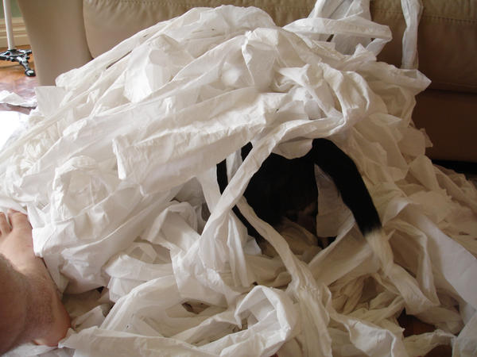
Hinge Point Question
Which sentence is expanded with an adjective?
CFU:
Go through each option one-at-a-time once students have answered on their whiteboards
Identify noun and adjective, discuss answers
The dog chewed toilet paper.
The naughty dog chewed toilet paper.
The bored dog made a huge mess.
The dog chewed white toilet paper.
Adjectives describe nouns.
Notes:
http://img12.deviantart.net/9acf/i/2009/147/4/1/puppies_and_toilet_paper_20082_by_dougamer.jpg

Slide 11
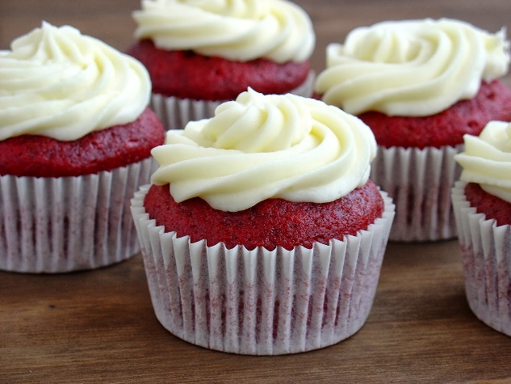
Skill Development: You do
Identify the noun.
Think of an adjective to describe it.
Rewrite the sentence including the adjective.
CFU:
Identify the noun.
What words could describe it?
I had a ___________ cupcake from the shop.
__________________________________________________________________.
___________________________________________________________________.
Notes:
https://2.bp.blogspot.com/-M0Yl3mbzV4s/UtLH8_sb9pI/AAAAAAAAIEY/1ucKEZgjJPI/s1600/DSC05379+-+copia.JPG

Slide 12
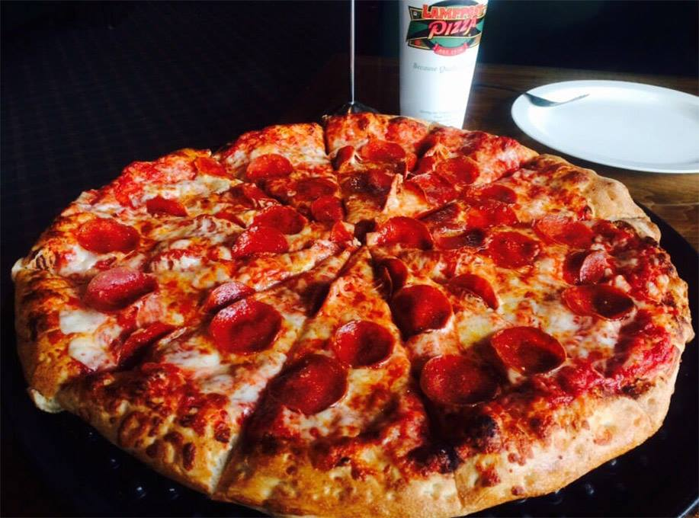
Skill Development: You Do
Identify the noun.
Think of an adjective to describe it.
Rewrite the sentence including the adjective.
CFU:
Identify the noun.
What words could describe it?
We had a ___________ pizza for lunch.
___________________________________________________________________.
___________________________________________________________________.
Notes:
https://yournorthcounty.com/wp-content/uploads/2017/08/lamppost-pizza.jpg

Slide 13
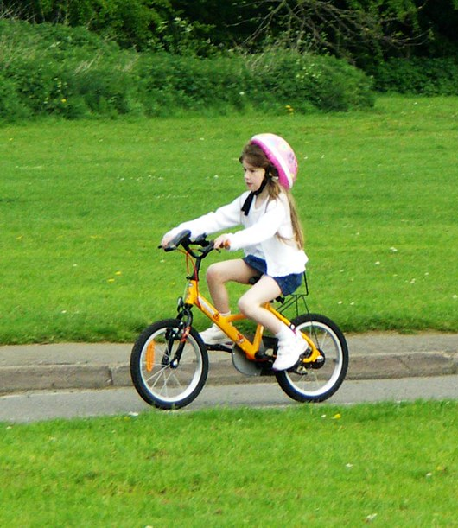
Skill development: We do
Identify the noun.
Think of an adjective to describe it.
Rewrite the sentence including the adjective.
CFU:
Identify the noun.
What words could describe it?
The girl rode a ______________ bike.
___________________________________________________________________.
___________________________________________________________________.
Notes:
https://live.staticflickr.com/9/12617059_c5835ff0d5_b.jpg

Slide 14
Skill development: We do
Identify the noun.
Think of an adjective to describe it.
Rewrite the sentence including the adjective.
CFU:
Identify the noun.
What words could describe it?
Add in sentences from decodable texts/ or picture books currently being used in class
___________________________________________________________________.
___________________________________________________________________.
Notes:
https://live.staticflickr.com/9/12617059_c5835ff0d5_b.jpg

