Slide 1
Year: 2
Term: 1
Objective: To expand simple sentences with an adverb
Author: Yvonne Cooper

Slide 2
Question Words
Who/what?
(did) What?
When?
Where?
Why?
How?
Display this chart in classroom prior to lesson.
Optional: use Colourful Semantics icons in addition to question words. But please note, TWR does not distinguish between the ‘what doing/did what’ (verb) and the ‘what’ (object). If you are using a Colourful Semantics approach, you will need to consider this.

Slide 3
Multiple Choice
Pair Share
Track with me
Pick a Stick/Answer (non-volunteer)
Whiteboards
Vote
Read with me
In Your Workbook

Slide 4
Learning Objective
We are learning to expand simple sentences with an adverb.
Expand means to add more information to a sentence.
A verb is an action word.
An adverb is a word that modifies or describes a verb.

Slide 5
Concept Development
An adverb is a word that modifies or describes a verb
CFU:
What is the verb in this sentence?
What is the adverb in this sentence?
How is the adverb used in this sentence? What does it tell us about the verb?
Examples: These sentences include an adverb to explain how.
The small child ran happily into her mother’s arms.
2. The horrible garbage cans slowly released their pungent odours into the surrounding street .
3. The umpire blew his whistle loudly from behind the goal posts.

Slide 6
Concept Development
An adverb is a word that modifies or describes a verb
CFU:
Why is this not an example of an adverb being used to expand a sentence?
Non-Examples:
1. The girl screamed.
The word ‘screamed’ is the verb. We don’t know how the girl screamed as no adverbs have been used.
2. The car stopped.
The word ‘stopped’ is the verb. We don’t know how the car stopped as no adverbs have been used.

Slide 7
Hinge Point Question
Which sentence(s) are expanded to show how by using adverbs to describe the verb?
CFU:
Why is it/ isn’t it a an example of an adverb being used to describe a verb.
How is the verb being described?
He played.
The silent mouse crept softly along the edge of the skirting board.
The colourful kite soared magnificently.
The baby cried.
Sam ran.
An adverb is a word that modifies or describes a verb

Slide 8
Skill Development: I do
Circle the verbs.
Choose the best how and where word(s)
Say the sentence.
CFU:
What is the verb in this sentence?
What is the adverb in this sentence?
The girl screamed.
How:
loudly
shrilly piercingly
Where:
at the dentist
in the car
down the slide
The girl screamed loudly down the slide.

Slide 9
Skill Development: We do
Circle the verbs.
Choose the best how and where word(s)
Say the sentence.
CFU:
What is the verb in this sentence?
What is the adverb in this sentence?
The car stopped.
How: suddenly
unexpectedly
abruptly
safely
Where: at the traffic lights
at the side of the road
against the curb
in the middle of the parking lot
The car abruptly stopped in the middle of the parking lot.

Slide 10
Skill Development: We do
Circle the verbs.
Choose the best how and where word(s)
Say the sentence.
CFU:
What is the verb in this sentence?
What is the adverb in this sentence?
The ship sank.
How: swiftly
painfully
rapidly
Where: beneath the waves
below the water
at the edge of the horizon
The ship swiftly sank beneath the waves.

Slide 11
Skill development: We do
Circle the verbs.
Choose the best how and where word(s)
Say the sentence.
CFU:
What is the verb in this sentence?
What is the adverb in this sentence?
The dog ran.
How: tirelessly
stubbornly
relentlessly
Where: after his master’s car
to the missing child’s side
after the thieving fox
The dog tirelessly ran after the thieving fox.

Slide 12
Skill development: You do
Circle the verbs.
Choose the best how and where word(s)
Say the sentence.
CFU:
What is the verb in this sentence?
What is the adverb in this sentence?
The pirate hid.
Add your own.
How: craftily
safely
angrily
Where: amongst the coconut trees.
in the hidden cove
behind the deadly reef

Slide 13
Skill development: You do
Circle the verbs.
Choose the best how and where word(s)
Say the sentence.
CFU:
What is the verb in this sentence?
What is the adverb in this sentence?
The player kicked.
Add your own.
How: accurately
courageously
relentlessly
Where: from the fifty metre mark
from amongst the scrum
anywhere he could find an opportunity

Slide 14
Skill development: You do
Circle the verbs.
Choose the best how and where word(s)
Say the sentence.
CFU:
What is the verb in this sentence?
What is the adverb in this sentence?
The ball flew.
How: swiftly
accurately
Where: across the field
from his racket
Add your own.

Slide 15
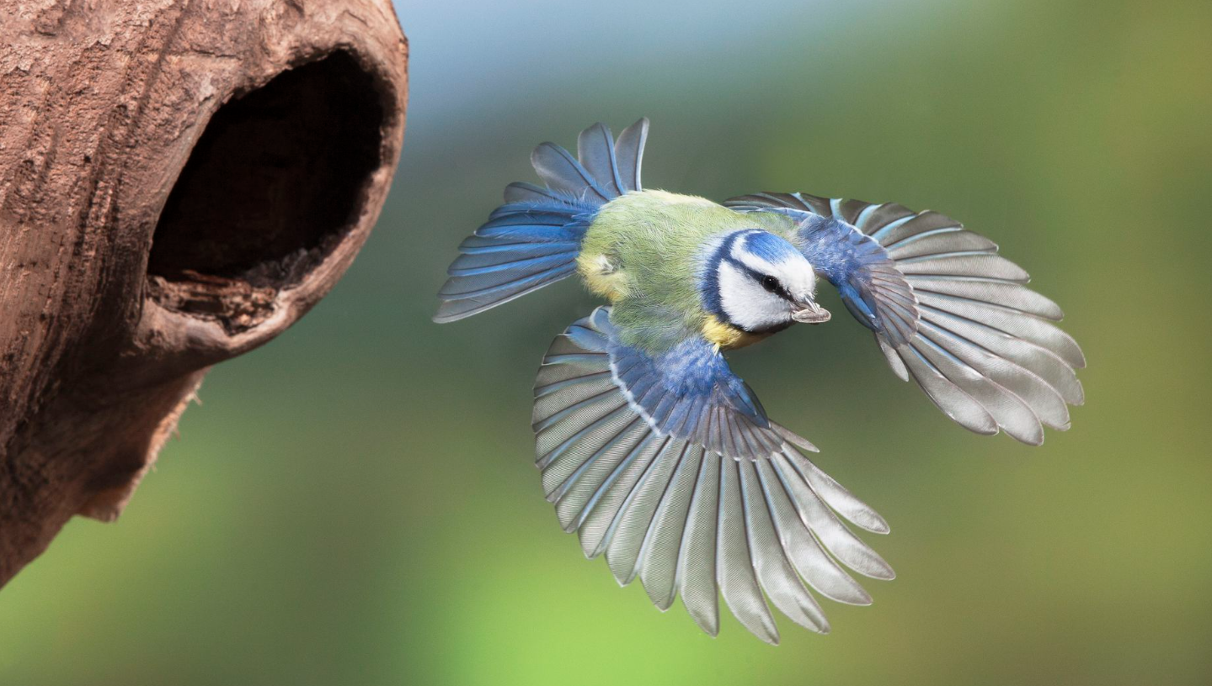
Skill Development: We do
1. Answer the questions in note form
Write your sentence using correct punctuation.
Read your sentence – does it sound right?
CFU:
Who/what is the subject?
What is the action? (verb)
How does it happen?
Where does it happen?
It flew.
Who/what
How:
Where:
The bird
quickly
away from its nest

Slide 16
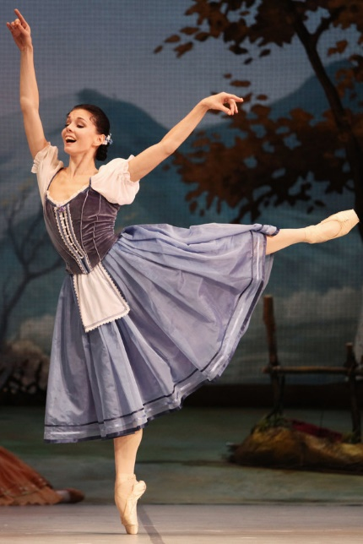
Skill Development: We do
1. Answer the questions in note form
Write your sentence using correct punctuation.
Read your sentence – does it sound right?
CFU:
Who/what is the subject?
What is the action? (verb)
How does it happen?
Where does it happen?
She danced.
Who/what
How:
Where:
The beautiful woman
gracefully
on stage

Slide 17
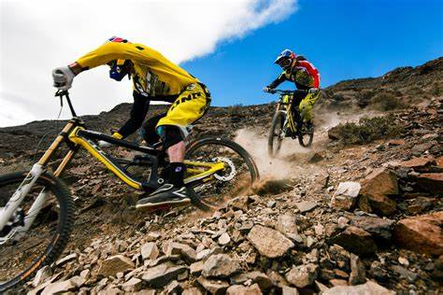
Skill Development: You do
1. Answer the questions in note form
Write your sentence using correct punctuation.
Read your sentence – does it sound right?
CFU:
Who/what is the subject?
What is the action? (verb)
How does it happen?
Where does it happen?
They rode.
Who/what
How:
Where:

