Slide 1
Year: 3
Term: 1
Objective:
-Identify the subject and verb within a simple sentence
-Convert fragments to sentences
Author: Stephanie Le Lievre

Slide 2
Multiple Choice
Pair Share
Track with me
Pick a Stick/Answer (non-volunteer)
Whiteboards
Vote
Read with me
In Your Workbook

Slide 3
Learning Objective
We are learning to:
-Identify the subject and verb within a simple sentence
-Convert fragments to sentences

Slide 4
Concept Development
A sentence is a group of words that makes sense by itself.
It has a subject (what/who the sentence is about) and a verb (what the subject does, is or has).
It starts with a capital and ends with a punctuation mark.
Does it…
make sense?
have a subject?
have a verb?
begin with a capital letter?
end with a full stop, exclamation mark or question mark?

Slide 5
Concept Development
A sentence must contain at least one clause.
A clause must contain a subject and a verb.
Subject:
Tells WHO or WHAT the sentence is about.
Predicate:
Tells what the subject DOES or IS and contains the verb.

Slide 6
Concept Development
A sentence must contain at least one clause.
A clause must contain a subject and a verb.
Subject:
Tells WHO or WHAT the sentence is about.
Predicate:
Tells what the subject DOES or IS and contains the verb.
CFU:
What is the subject?
What is the predicate?
What is the main verb?
The little mouse ran quickly past the cat.
The lazy boy snored loudly in his comfy bed.
The tall lady walked briskly to the library.
Examples of a complete sentence
S
P
S
P
S: Subject
P: Predicate
S
P

Slide 7
Concept Development
A sentence must contain at least one clause.
A clause must contain a subject and a predicate.
CFU:
What is missing in each of these fragments?
Non-examples of a sentence.
These are fragments.
The happy girl.
Ran quickly past the cat.
Over the roof.
The tall lady.
Missing the verb
Missing the subject
Missing the subject and verb- this is just a phrase.
Missing the subject
S: Subject
P: Predicate

Slide 8
Concept Development
Sentence or fragment? Punctuation has not been included (it gives the game away!)
CFU:
Why is it a complete sentence?
Why is it a fragment? What’s missing?
the little puppy played on the mat
The little puppy played on the mat.
walked down the road
she fell
She fell.
screamed with excitement

Slide 9
Hinge Point Question
Sentence or fragment? Punctuation has not been included (it gives the game away!)
Which ones are complete sentences (punctuation has not been included - it gives the game away!)
the boy ran
my dearest friend
the spider jumped
the Tokyo Olympics
went between the tall trees
S
F
S
F
F
a & c

Slide 10
Concept Development:
Re-explanation
Sentence or fragment? Punctuation has not been included (it gives the game away!)
CFU:
Why is it a complete sentence?
Why is it a fragment? What’s missing?
the door swang open
The door swang open.
tricked her
I rode my bike
I rode my bike.
the other day

Slide 11
Skill development: I do
Convert the fragment into a complete sentence.
Edit for correct punctuation
CFU:
Why is it a fragment? What’s missing?
crept past the cat
The little mouse crept past the cat.

Slide 12
Skill development: We do
Convert the fragment into a complete sentence.
Edit for correct punctuation
CFU:
Why is it a fragment? What’s missing?
the mysterious noise
The mysterious noise was coming from the back shed.

Slide 13
Skill development: We do
Convert the fragment into a complete sentence.
Edit for correct punctuation
CFU:
Why is it a fragment? What’s missing?
studied for the Maths test
The students studied for the Maths test.

Slide 14
Skill development: We do
Convert the fragment into a complete sentence.
Edit for correct punctuation
CFU:
Why is it a fragment? What’s missing?
coughed all over the doctor’s desk
The sick child coughed all over the doctor’s desk.

Slide 15
Skill development: We do
Convert the fragment into a complete sentence.
Edit for correct punctuation
CFU:
Why is it a fragment? What’s missing?
across the field
The horse galloped across the field.

Slide 16
Skill development: We do
Convert the fragment into a complete sentence.
Edit for correct punctuation
CFU:
Why is it a fragment? What’s missing? There is a subject and verb in this fragment, but it is an incomplete sentence. Why?
she laughed at the
She laughed at the television show.

Slide 17
Skill development: We do
Convert the fragment into a complete sentence.
Edit for correct punctuation
CFU:
Why is it a fragment? What’s missing?
the elegant dancers
The elegant dancers performed for the crowd.

Slide 18
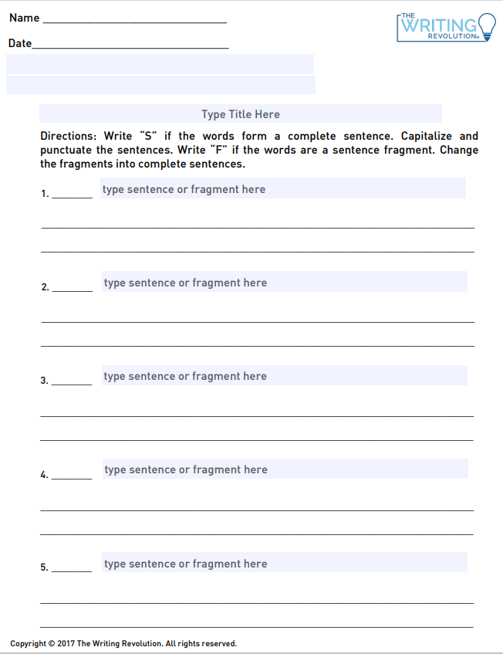
Skill development: You do
Complete the worksheet independently
For every fragment you find, convert it into a sentence and edit for correct punctuation.
For every sentence, write it out again with correct punctuation.
Download TWR template from the website.

