Slide 1
Year: Foundation
Term: 2
Objective: Identify and define adjectives.
Author: Natalie Old

Slide 2
Copy and paste these icons to the appropriate slides to indicate engagement norms/CFU strategies
Multiple Choice
Pair Share
Track with me
Pick a Stick/Answer (non-volunteer)
Whiteboards
Vote
Read with me
In Your Workbook

Slide 3
Learning Objective
We are learning to identify and define adjectives.

Slide 4
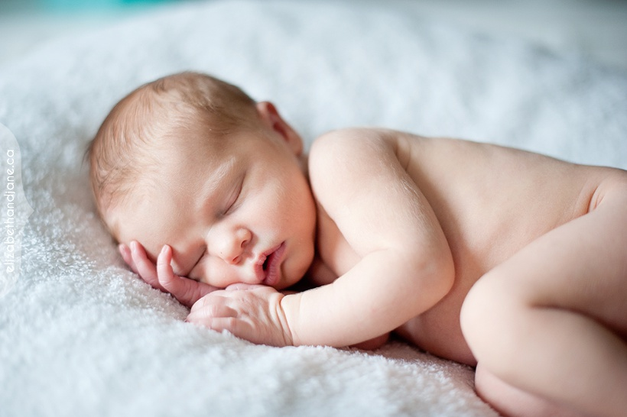
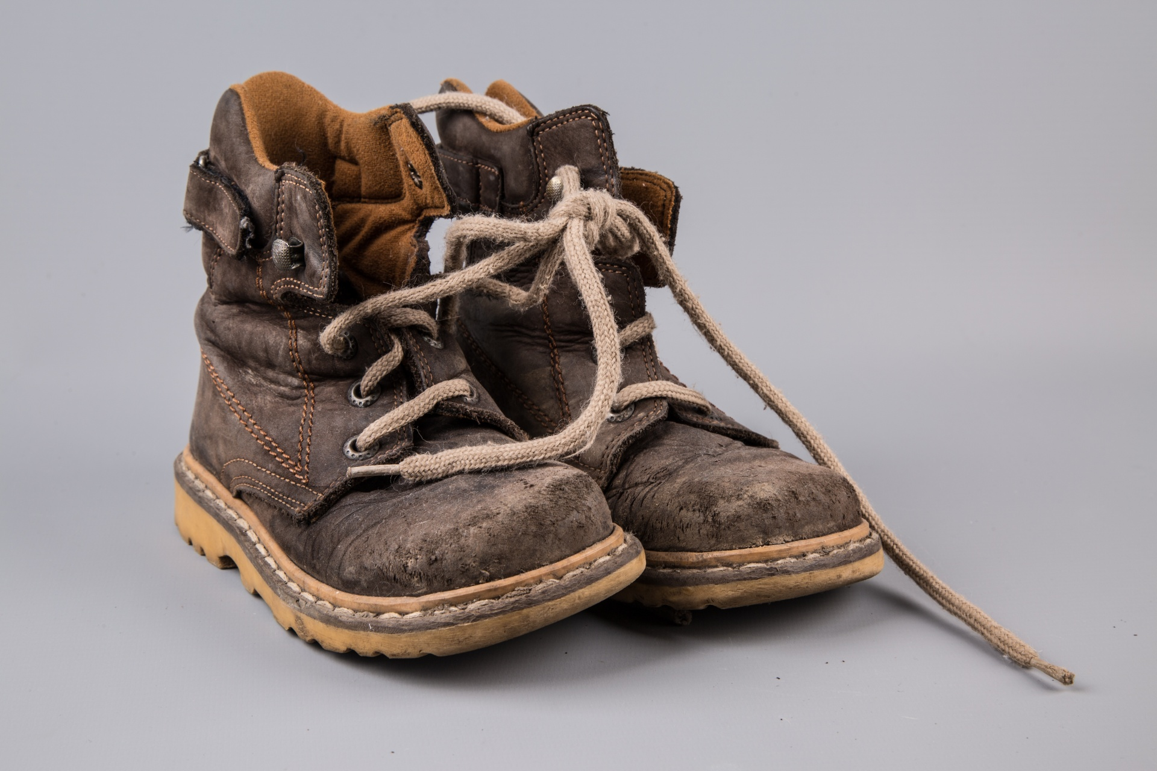
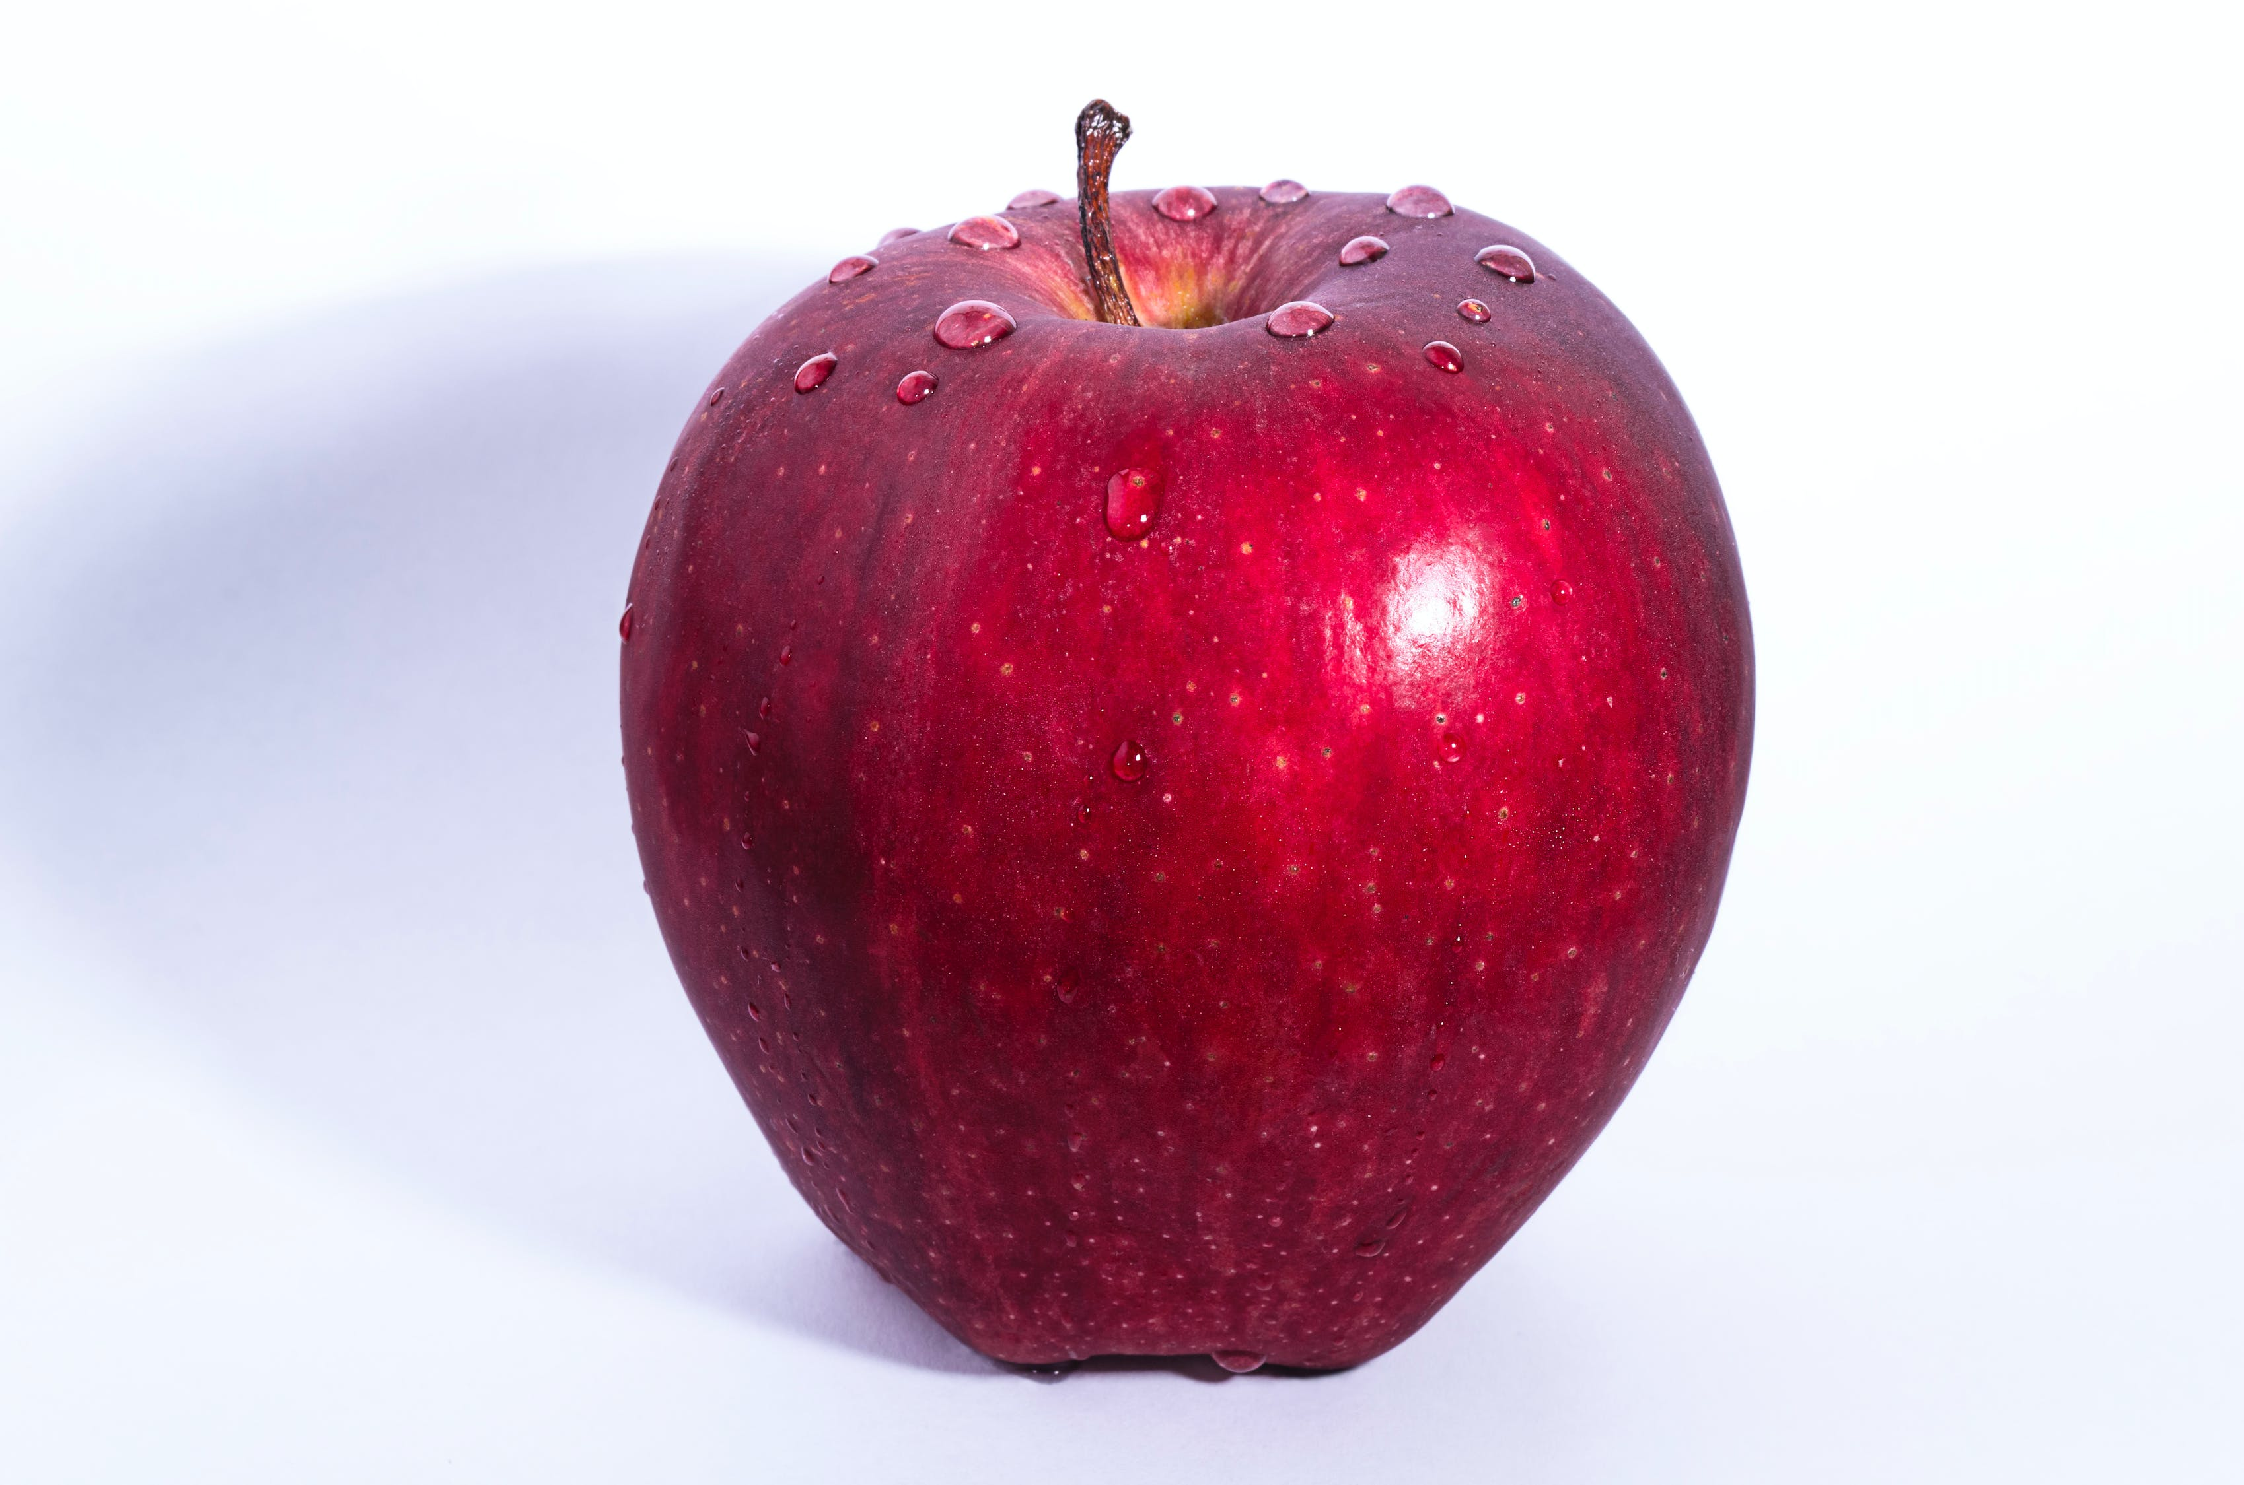
Concept Development
Adjectives describe nouns.
CFU:
What is a…?
Why is this an example of a…?
What is the …. in this sentence?
Examples:
old shoes
red apple
cute baby
Notes:
https://www.publicdomainpictures.net/pictures/180000/velka/old-shoes-1466074526leD.jpg
https://elizabethandjane.ca/wp-content/uploads/2012/11/ottawa-newborn-photography-elizabethandjane-baby-a_11.jpg
https://images.pexels.com/photos/39803/pexels-photo-39803.jpeg?auto=compress&cs=tinysrgb&dpr=3&h=750&w=1260

Slide 5
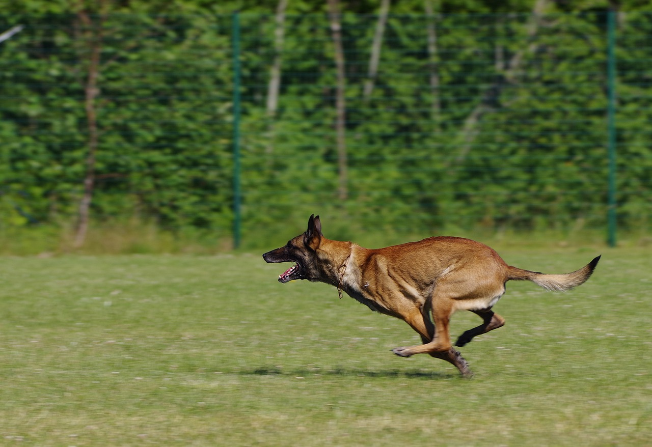
Concept Development
Adjectives describe nouns.
CFU:
Why is this not an example of a …
Non-Examples:
1. A dog is running.
2. A baby is sleeping
Running is the verb. It tells what the dog is doing, it doesn’t describe it.
Sleeping is the verb. It tells what the baby is doing, it doesn’t describe it
Notes:
https://www.maxpixel.net/static/photo/2x/Dog-Running-Belgian-Shepherd-Malinois-2543354.jpg
https://images.pexels.com/photos/39803/pexels-photo-39803.jpeg?auto=compress&cs=tinysrgb&dpr=3&h=750&w=1260

Slide 6
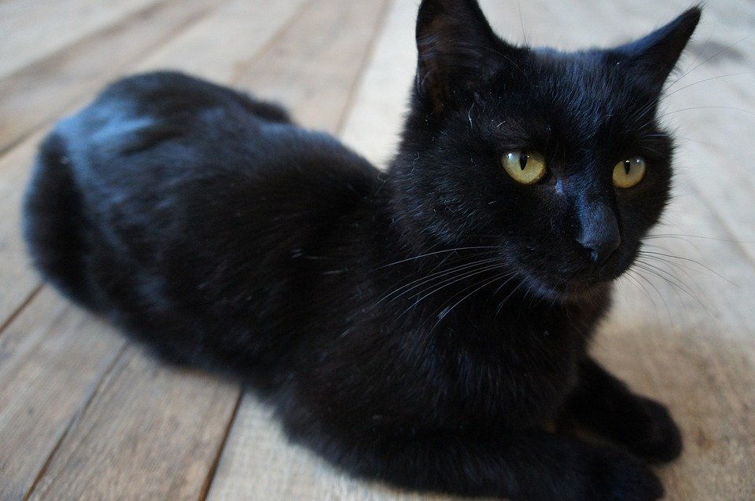
Concept Development
Adjectives describe nouns.
CFU:
What is the noun?
Which word is before the noun?
What is the adjective in this sentence?
A black cat is resting.
black
cat
resting
Notes:
https://cdn.pixabay.com/photo/2017/10/27/03/57/the-cat-is-black-2893170_960_720.jpg

Slide 7
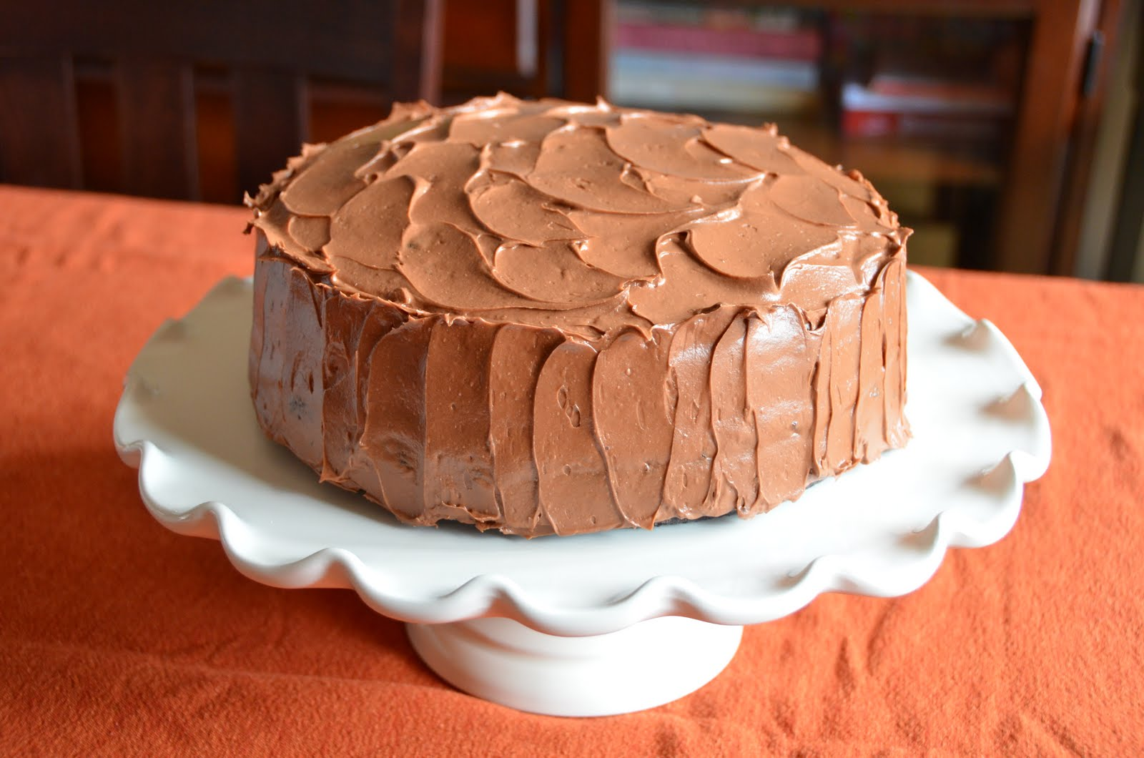
Concept Development
Adjectives describe nouns.
CFU:
What is the noun?
Which word is before the noun?
What is the adjective in this sentence?
I had chocolate cake for dessert.
cake
dessert
chocolate
Notes:
http://4.bp.blogspot.com/-HZfCZqhkeg0/TbR29rsG7xI/AAAAAAAAAJQ/bdEYpwNVBM4/s1600/chocolate+cake+%252824%2529.JPG

Slide 8
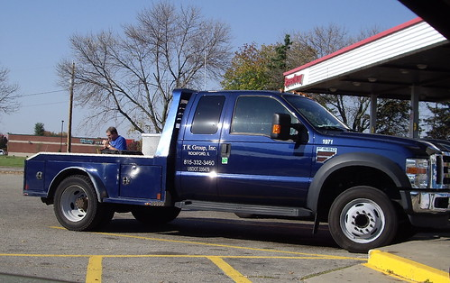
Concept Development
Adjectives describe nouns.
CFU:
What are the nouns in the sentence?
What word is before the noun?
Is this an adjective?
What is the adjective in this sentence?
I took my blue truck to the park.
truck
blue
park
Notes:
https://live.staticflickr.com/6100/6259035167_47e1a95d32.jpg

Slide 9
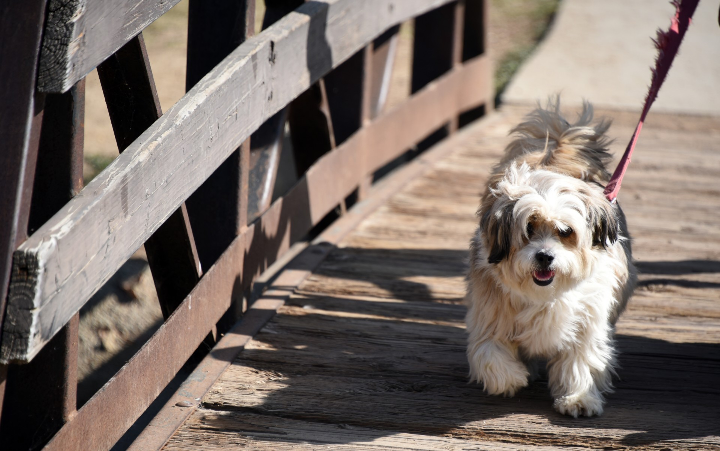
Hinge Point Question
Which is the adjective in this sentence?
I am walking my fluffy dog.
CFU:
Why is it/ isn’t it a an example of a …
Go through each option one-at-a-time once students have answered on their whiteboards
walking
fluffy
dog
my
Adjectives describe nouns.
Notes:
https://www.publicdomainpictures.net/pictures/120000/velka/shaggy-dog-walking.jpg

Slide 10
Hinge Point Question (harder)
Which sentence has the adjective in green?
CFU:
Why is it/ isn’t it a an example of a …
Go through each option one-at-a-time once students have answered on their whiteboards
I wear my black helmet when I ride my scooter.
I wear my black helmet when I ride my scooter.
I wear my black helmet when I ride my scooter.
I wear my black helmet when I ride my scooter.
Adjectives describe nouns.

Slide 11
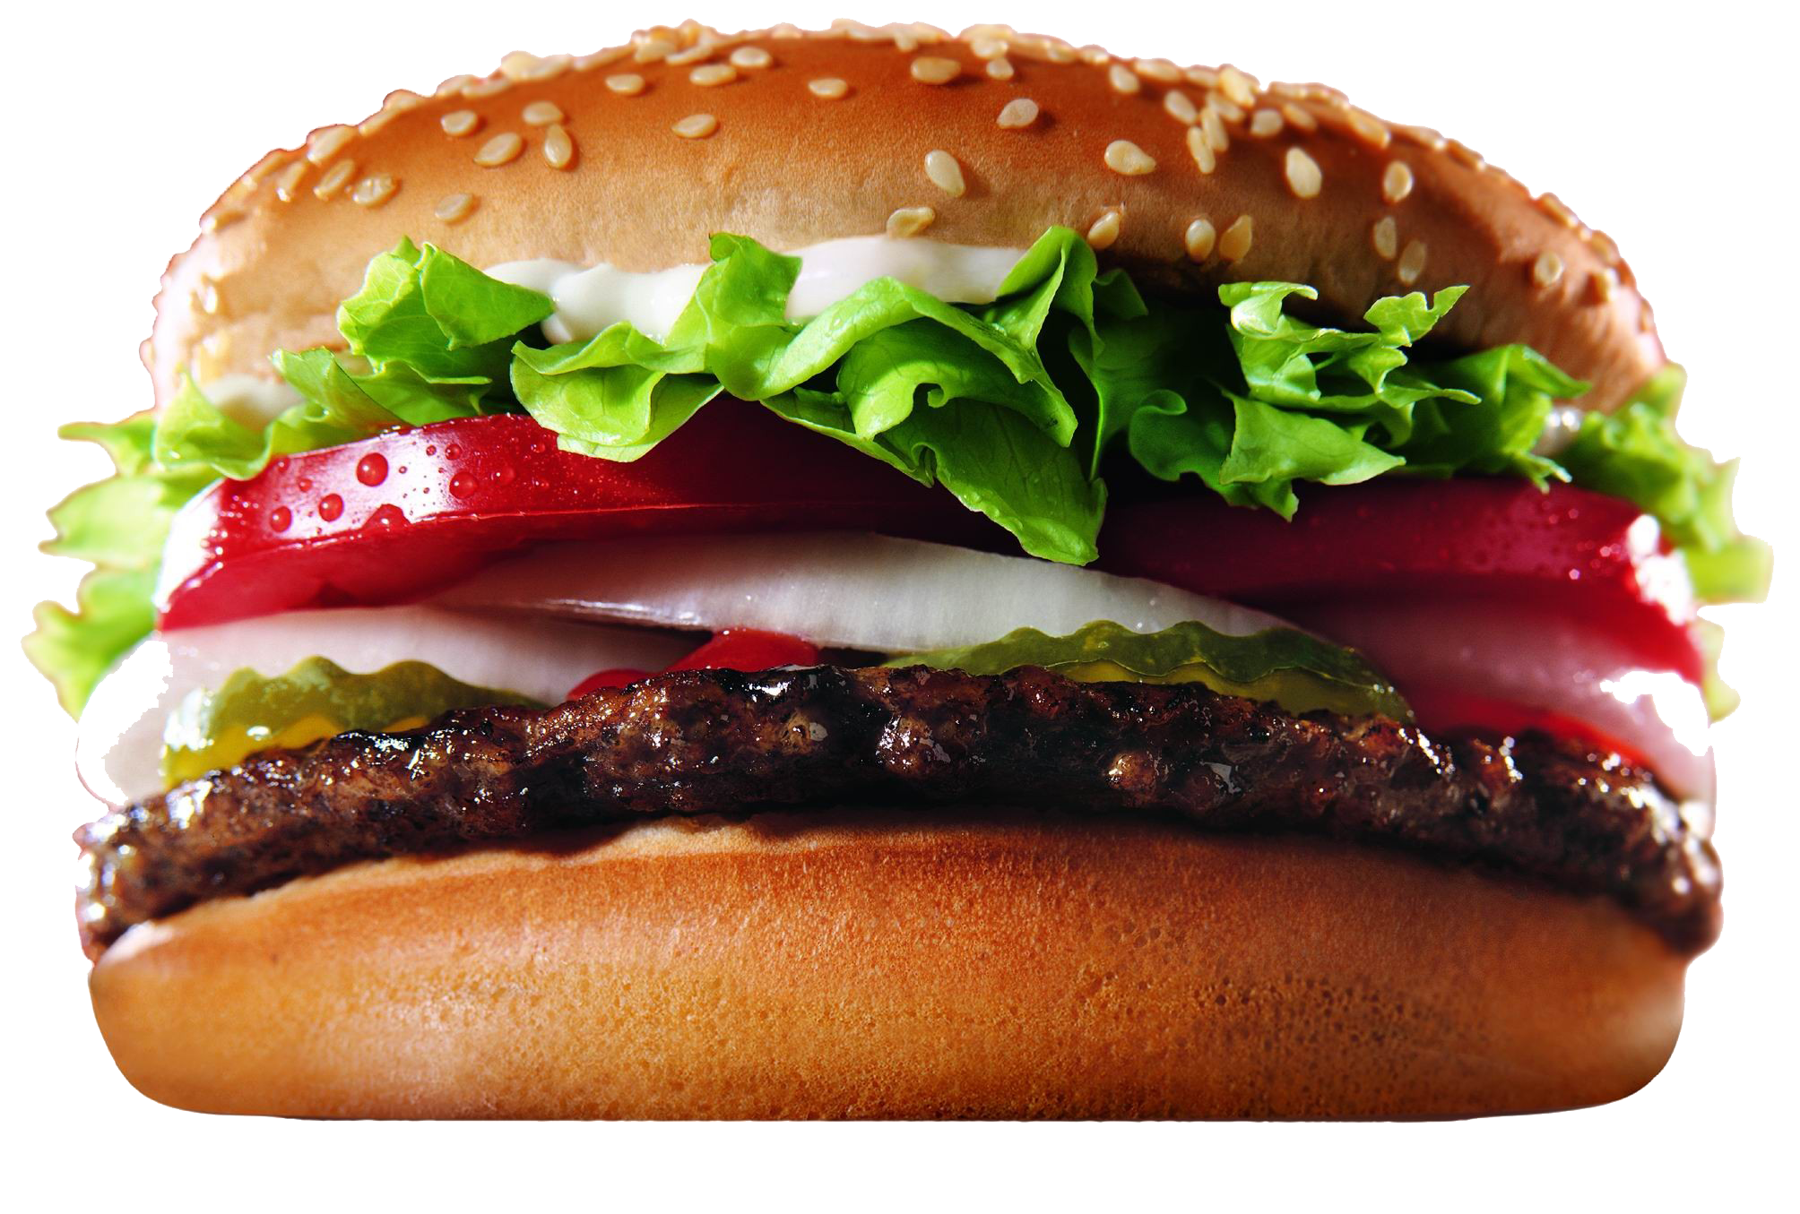
Skill Development: I do, We do
Think of an adjective for this picture.
Share with your partner.
CFU:
What is an adjective for the…?
Notes:
https://freepngimg.com/thumb/burger/7-2-burger-png-picture.png

Slide 12
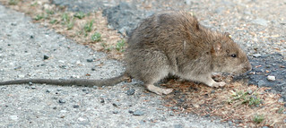
Skill development: We Do
Think of an adjective for this picture.
Share with your partner.
CFU:
What is an adjective for the rat?
What adjective did your partner tell you?
Notes:
https://live.staticflickr.com/3238/2452925814_27a4dff2af_n.jpg

Slide 13
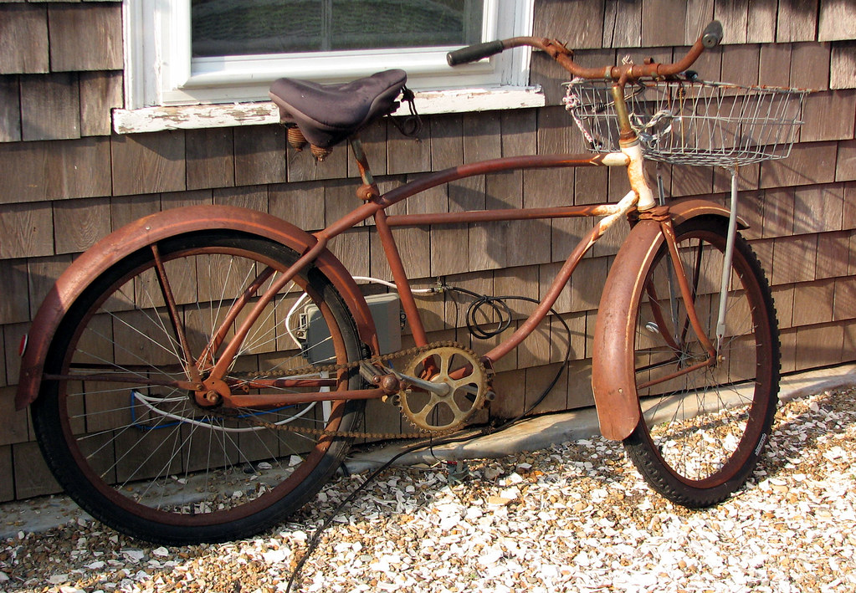
Skill development: You do
Think of an adjective to describe the bike.
Tell your partner your adjective.
Write an adjective to describe the bike on your whiteboard.
CFU:
What is an adjective for the bike?
What adjective did your partner tell you?

Slide 14
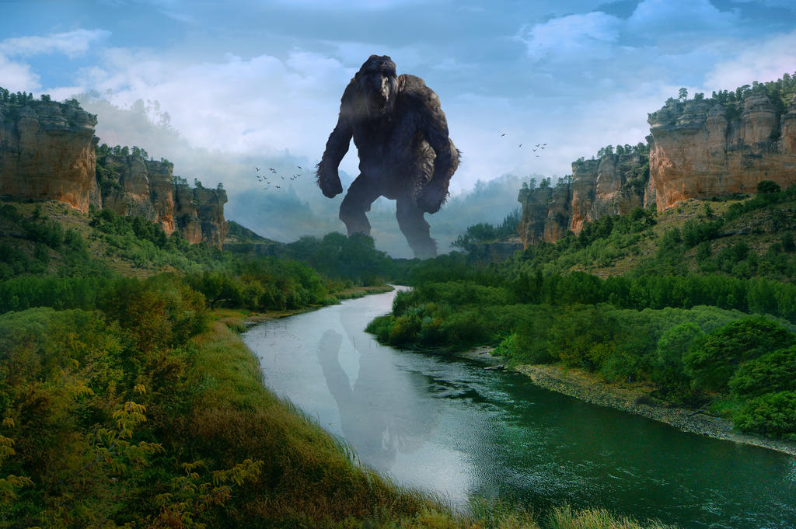
Skill development: You do
Think of an adjective to describe the troll.
Tell your partner your adjective.
Write an adjective to describe the troll on your whiteboard.
CFU:
What is an adjective for the troll?
What adjective did your partner tell you?
Notes:
https://img00.deviantart.net/b9c7/i/2017/123/c/3/giant_troll_by_nikos23a-db7yovw.jpg

