Slide 1
Year: 1
Term: 1
Objective:
We are learning to identify and define adjectives
We are learning to match adjectives to nouns
Author: Rebekah Winning

Slide 2
Multiple Choice
Pair Share
Track with me
Pick a Stick/Answer (non-volunteer)
Whiteboards
Vote
Read with me
In Your Workbook

Slide 3
Learning Objective
We are learning identify and define adjectives
We are learning to match adjectives to nouns

Slide 4
Concept Development
What is an adjective?
An adjective is a word that describes or modifies a noun or pronoun.
Modifies means to change by giving more information.

Slide 5
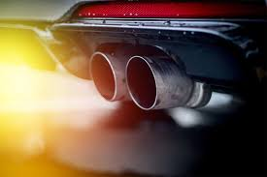
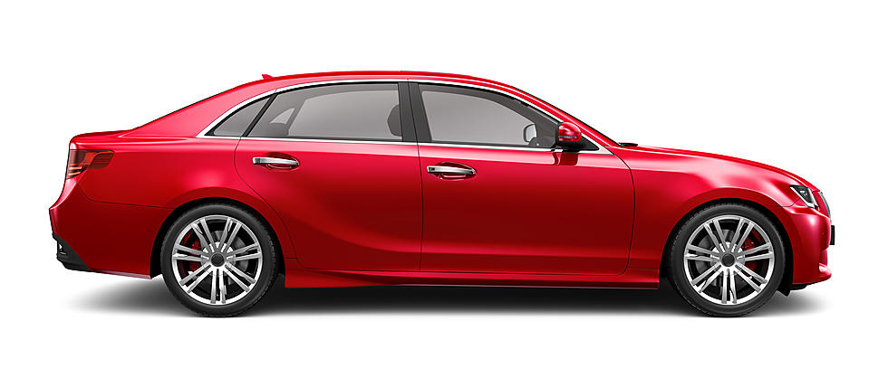
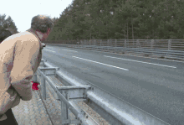
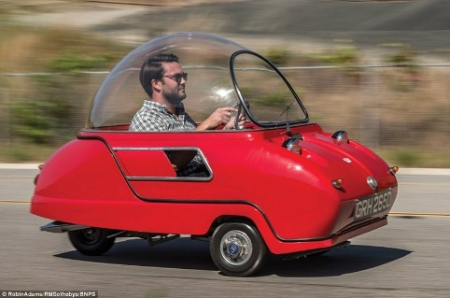
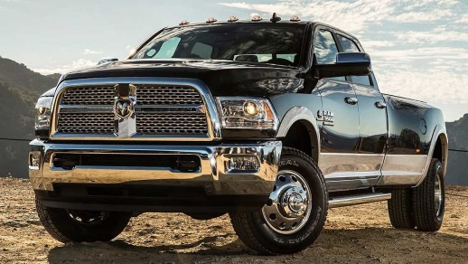
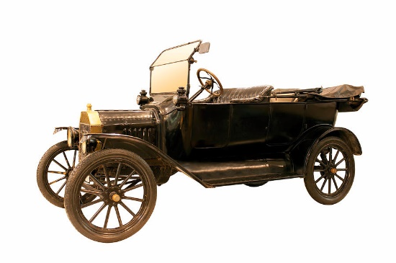
Concept Development
What words can be used to describe a car?
fast
noisy
red
BIG
ancient
small

Slide 6
Concept Development
What is the adjective in this sentence.
CFU:
What information has the adjective given us about the car?
blue
The blue car is driving slowly.

Slide 7
Concept Development
What is the adjective in this sentence.
CFU:
What information has the adjective given us about the fish?
The glistening fish swam in the ocean.
glistening

Slide 8
Concept Development
What is the adjective in this sentence.
CFU:
What information has the adjective given us about the giraffe?
The tall giraffe ate leaves from the tree.
tall

Slide 9
Concept Development
What is the adjective in this sentence.
CFU:
What information has the adjective given us about the tree?
The giraffe ate leaves from the tall tree.
tall

Slide 10
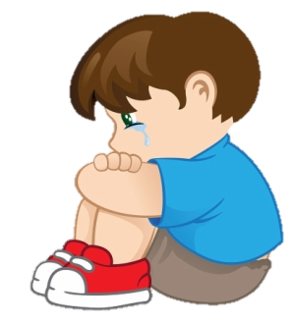
Concept Development
Which word modifies the noun ‘boy’ ?
sad
CFU:
Can you use the words ‘sad’ and ‘boy’ in a sentence?
child
tears

Slide 11
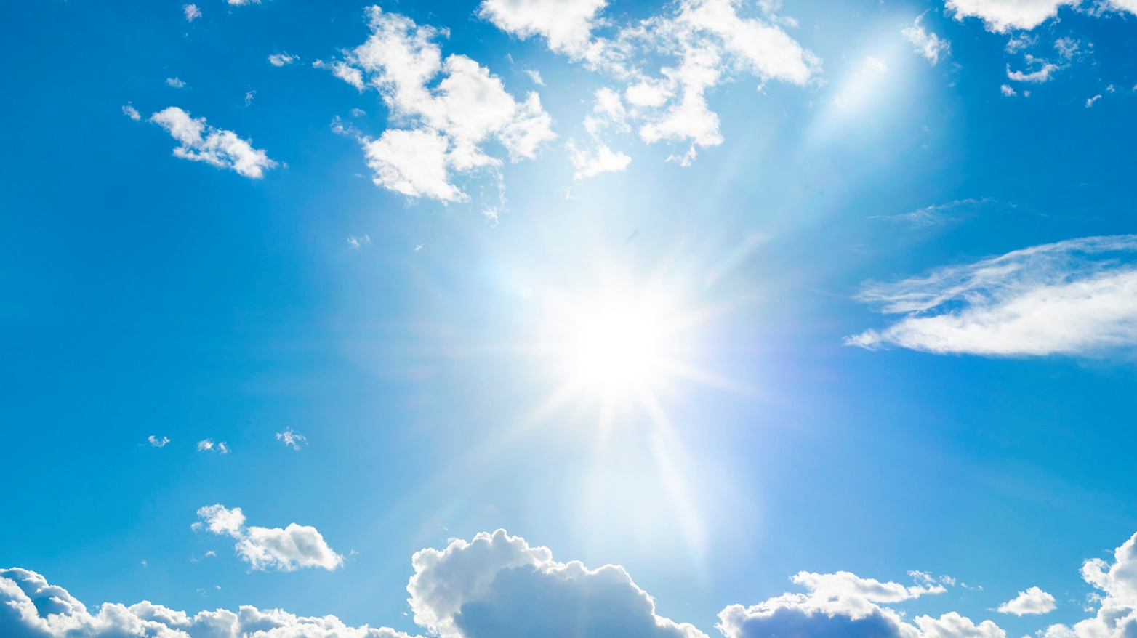
Concept Development
Which word modifies the noun ‘sky’ ?
sun
CFU:
Can you use the words ‘blue’ and ‘sky’ in a sentence?
clouds
blue

Slide 12
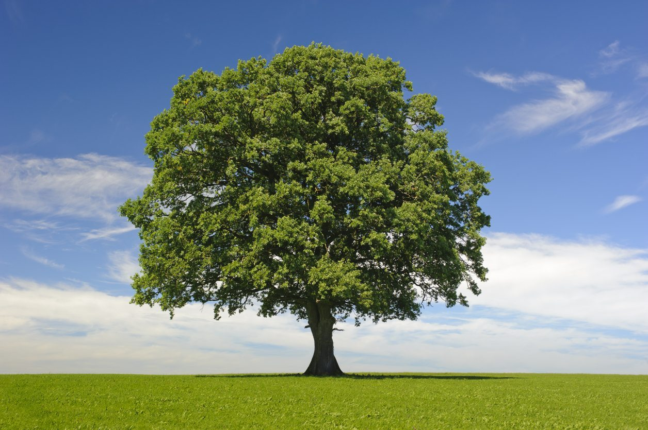
Concept Development
Which word modifies the noun ‘tree’ ?
trunk
CFU:
Can you use the words ‘enormous’ and ‘tree’ in a sentence?
enormous
leaves

Slide 13
Hinge Point Question
Which sentences contain an adjective?
The yellow car zoomed past.
The girl wandered to school.
The sun shone down.
The small puppy yelped.
The mouse ate the large block of cheese.
a, d, e

Slide 14
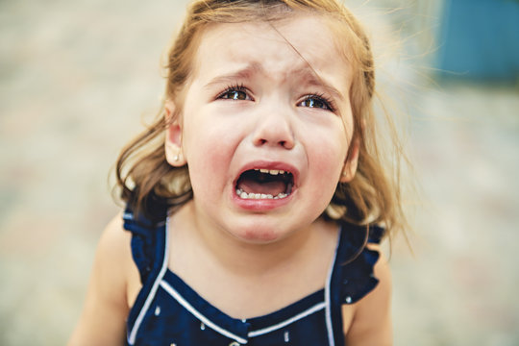
Skill Development: I do
Match the adjective to the noun
happy
green
calm
sad
sad
The child is .

Slide 15
Skill Development: We do
Match the adjective to the noun
dull
blue
hot
friendly
The sun is .
hot

Slide 16
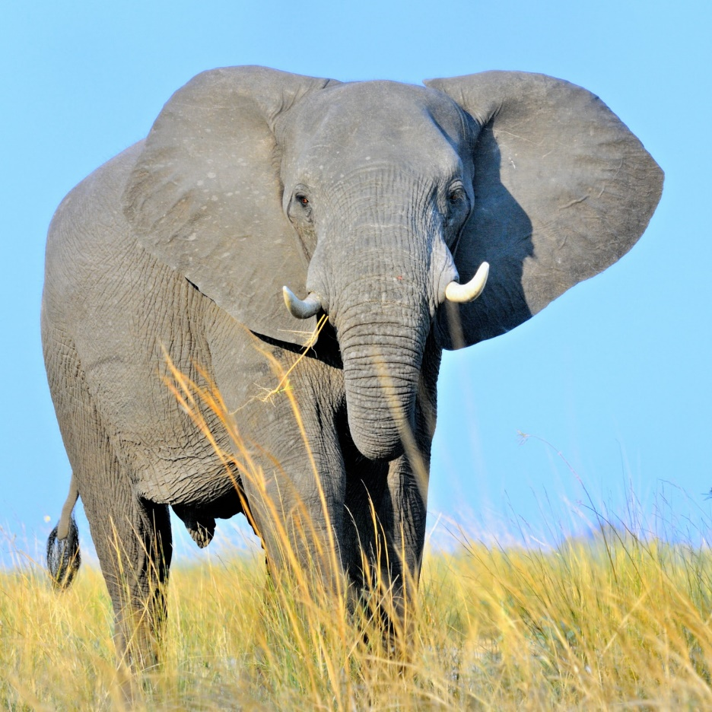
Skill Development: We do
Match the adjective to the noun
yellow
huge
narrow
helpful
The elephant is .
huge

Slide 17
Skill Development: You Do
Match the adjectives to the noun
fast
beautiful
sleepy
enormous
sharp
fresh
eggs
cockroach
car
baby
butterfly
knife
CFU:
Put the matched words into a sentence (oral).
E.g. fresh & eggs – he gathered the fresh eggs from the coop.

