Slide 1
Year: 2
Term: 1
Objective: Identify and define adverbs.
Author: Yvonne Cooper

Slide 2
Multiple Choice
Pair Share
Track with me
Pick a Stick/Answer (non-volunteer)
Whiteboards
Vote
Read with me
In Your Workbook

Slide 3
Learning Objective
We are learning to identify and define adverbs.

Slide 4
Concept Development
An adverb is a word that modifies or describes a verb
CFU:
What is an adverb?
Why is this an example of the use of an adverb in this sentence?
What is the adverb in this sentence?
Examples:
The sneaky fox crept quietly into the hen house.
2. Susan cried loudly when she was not allowed to play on the tablet.
3. Brent threw the ball long and low towards his team mate at the other end of the field.

Slide 5
Concept Development
An adverb is a word that modifies or describes a verb
CFU:
Why is this not an example of an adverb being used?
Non-Examples:
1. Sam ran to his mother and told her what he had found.
‘Ran’ and ‘told’ are the verbs.
No adverbs have been used.
2. We washed the dishes before we watched television.
‘Washed’ and ‘ watched’ are the verbs.
No adverbs have been used.

Slide 6
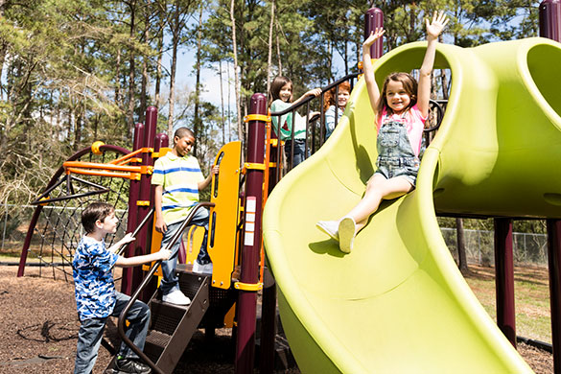
Concept Development
An adverb is a word that modifies or describes a verb
CFU:
How is the adverb modifying the verb? What is it telling us about the verb?
Verb Adverb
smiled brightly
slid excitedly
waved happily
waited patiently
played together
Can you think of any more?

Slide 7
Concept Development
Circle the verbs.
Underline the words used to describe them.
CFU:
Which words are the adverbs?
How do you know which verbs they are modifying?
I. The sun shone brightly from the summer sky.
An adverb is a word that modifies (or described) a verb
It describes how, where or when.

Slide 8
Concept Development
Circle the verbs.
Underline the words used to describe them.
CFU:
Which words are the adverbs?
How do you know which verbs they are modifying?
The dancer carefully chose the most stunning outfit for her performance .
She expertly styled her hair and proudly laced up her ballet slippers.
An adverb is a word that modifies (or described) a verb
It describes how, where or when.

Slide 9
Concept Development
Circle the verbs.
Underline the words used to describe them.
CFU:
Which words are the adverbs?
How do you know which verbs they are modifying?
After the siren blew loudly across the oval, the students raced hurriedly to their classrooms.
An adverb is a word that modifies (or described) a verb
It describes how, where or when.

Slide 10
Concept Development
Circle the verbs.
Underline the words used to describe them.
CFU:
Which words are the adverbs?
How do you know which verbs they are modifying?
The time passed slowly after lunch.
All the children laughed happily when they were given the reward.
Arnold wrote quickly and neatly so he could play with his friends.

Slide 11
Concept Development
Circle the verbs.
Underline the words used to describe them.
CFU:
Which words are the adverbs?
How do you know which verbs they are modifying?
Don’t talk loudly when other people are singing.
Raymond carefully measured the ingredients and slowly poured them into the bowl.
We sang loudly and happily as we waited patiently for the next train to arrive.

Slide 12
Hinge Point Question
Which sentence(s) show all the adverbs underlined correctly?
CFU:
Why is it/ isn’t it a an example?
Jada quietly watched the movie as she ate her popcorn.
The tired puppy lazily licked its bone, slowly closed his eyes and slept soundly.
Lilly suddenly stopped her bike and stared hungrily at the advert for fried chicken.
The wind wailed wearily through the bare branches of the storm tossed trees.
The teenager tiredly typed throughout the night to finally finish his assignment.
An adverb is a word that modifies (or describes) a verb
It describes how, where or when.

Slide 13
Concept Development-
re-explanation
An adverb is a word that modifies or describes a verb
CFU:
Which words are the adverbs?
How do you know which verbs they are modifying?
Circle the verbs.
Underline the adverbs used to modify them.
Stir gently so the mixture doesn’t spill.
The paramedic quickly assessed her patient’s breathing.
The chickens squawked loudly as they finally heard their owner arrive with their food.

Slide 14
Skill development: I do
Circle the verb(s).
Choose an adverb to expand the sentence and modify the verb(s).
CFU:
What is the adjective doing?
Does the sentence make sense?
sparkling darkly mostly brightly sandy
The stars shone from the dark, silent sky.

Slide 15
Skill development: We do
Circle the verb(s).
Choose an adverb to expand the sentence and modify the verb(s).
CFU:
What is the adjective doing?
Does the sentence make sense?
funny quietly assembly wrong respectfully
Every student in the school sat as they listened to the serviceman speak about his experiences.

Slide 16
Skill development: You do
Circle the verb(s).
Choose an adverb to expand the sentence and modify the verb(s).
CFU:
What is the adjective doing?
Does the sentence make sense?
suddenly wet cold skilfully frightened
As he skated across the frozen lake, the ice cracked and began to split.

