Slide 1
Year: Foundation
Term: 1
Objective: Identify the noun/s in a sentence
Author: Jasmyn Hall & Stephanie Le Lievre

Slide 2
Multiple Choice
Pair Share
Track with me
Pick a Stick/Answer (non-volunteer)
Whiteboards
Vote
Read with me
In Your Workbook

Slide 3
Learning Objective
We are learning to identify the NOUN in a sentence

Slide 4
Concept Development
A sentence is a complete thought that makes sense.
A sentence must:
make sense
have a WHO/WHAT
and a WHAT DOING

Slide 5
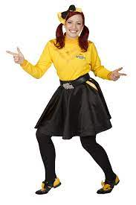
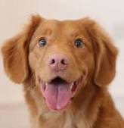
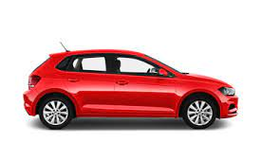
Concept Development
A noun is a word that names a person, an animal, a place or a thing
CFU:
What is a noun?
What does a noun name?
Example:
person
animal
place
thing
Emma
dog
beach
car

Slide 6
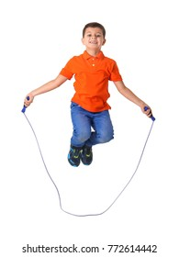
Concept Development: I do
Let’s say a sentence to tell what is happening in this picture
Identify the noun in the sentence
CFU:
What is a noun?
How do we know this is a noun?
The boy is skipping.

Slide 7
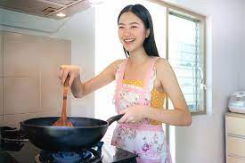
Concept Development: We do
Let’s say a sentence to tell what is happening in this picture
Identify the nouns in the sentence
CFU:
What is a noun?
How do we know this is a noun?
The girl is cooking.

Slide 8
Concept Development: We do
Let’s say a sentence to tell what is happening in this picture
Identify the noun in the sentence
CFU:
What is a noun?
How do we know this is a noun?
The dog is sleeping.

Slide 9
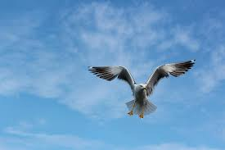
Concept Development: We do
Let’s say a sentence to tell what is happening in this picture
Identify the noun in the sentence
CFU:
What is a noun?
How do we know this is a noun?
The bird is flying.

Slide 10
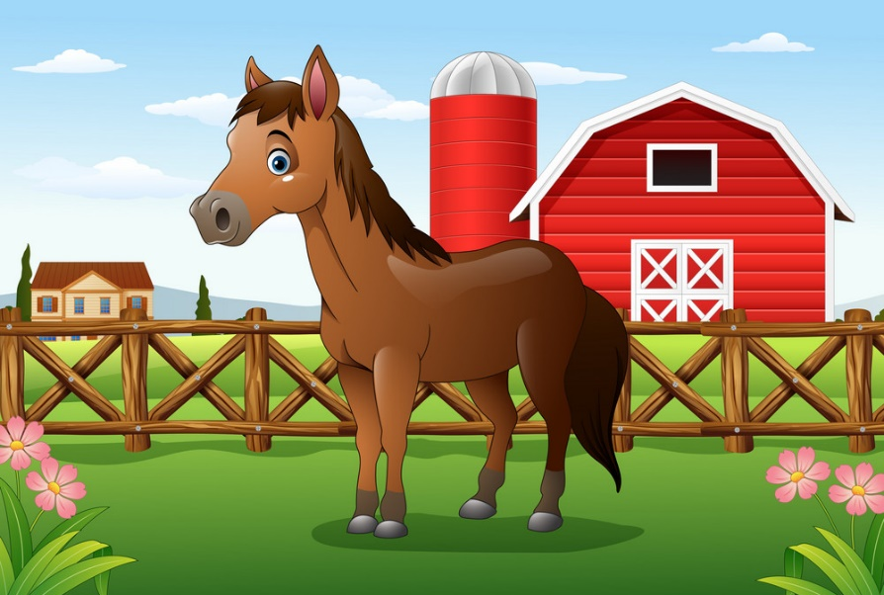
Concept Development: We do
Let’s say a sentence to tell what is happening in this picture
Identify the nouns in the sentence
CFU:
What is a noun?
How do we know this is a noun?
The horse is on the farm.

Slide 11
Concept Development: We do
Let’s say a sentence to tell what is happening in this picture
Identify the nouns in the sentence
CFU:
What is a noun?
How do we know this is a noun?
The kids are playing in the playground.

Slide 12
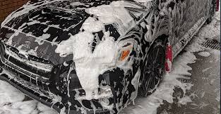
Concept Development: We do
Let’s say a sentence to tell what is happening in this picture
Identify the noun in the sentence
CFU:
What is a noun?
How do we know this is a noun?
The car is getting washed.

Slide 13
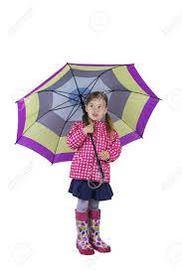
Concept Development: We do
Let’s say a sentence to tell what is happening in this picture
Identify the nouns in the sentence
CFU:
What is a noun?
How do we know this is a noun?
The girl is holding an umbrella.

Slide 14
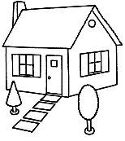
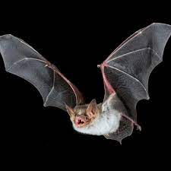
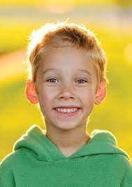
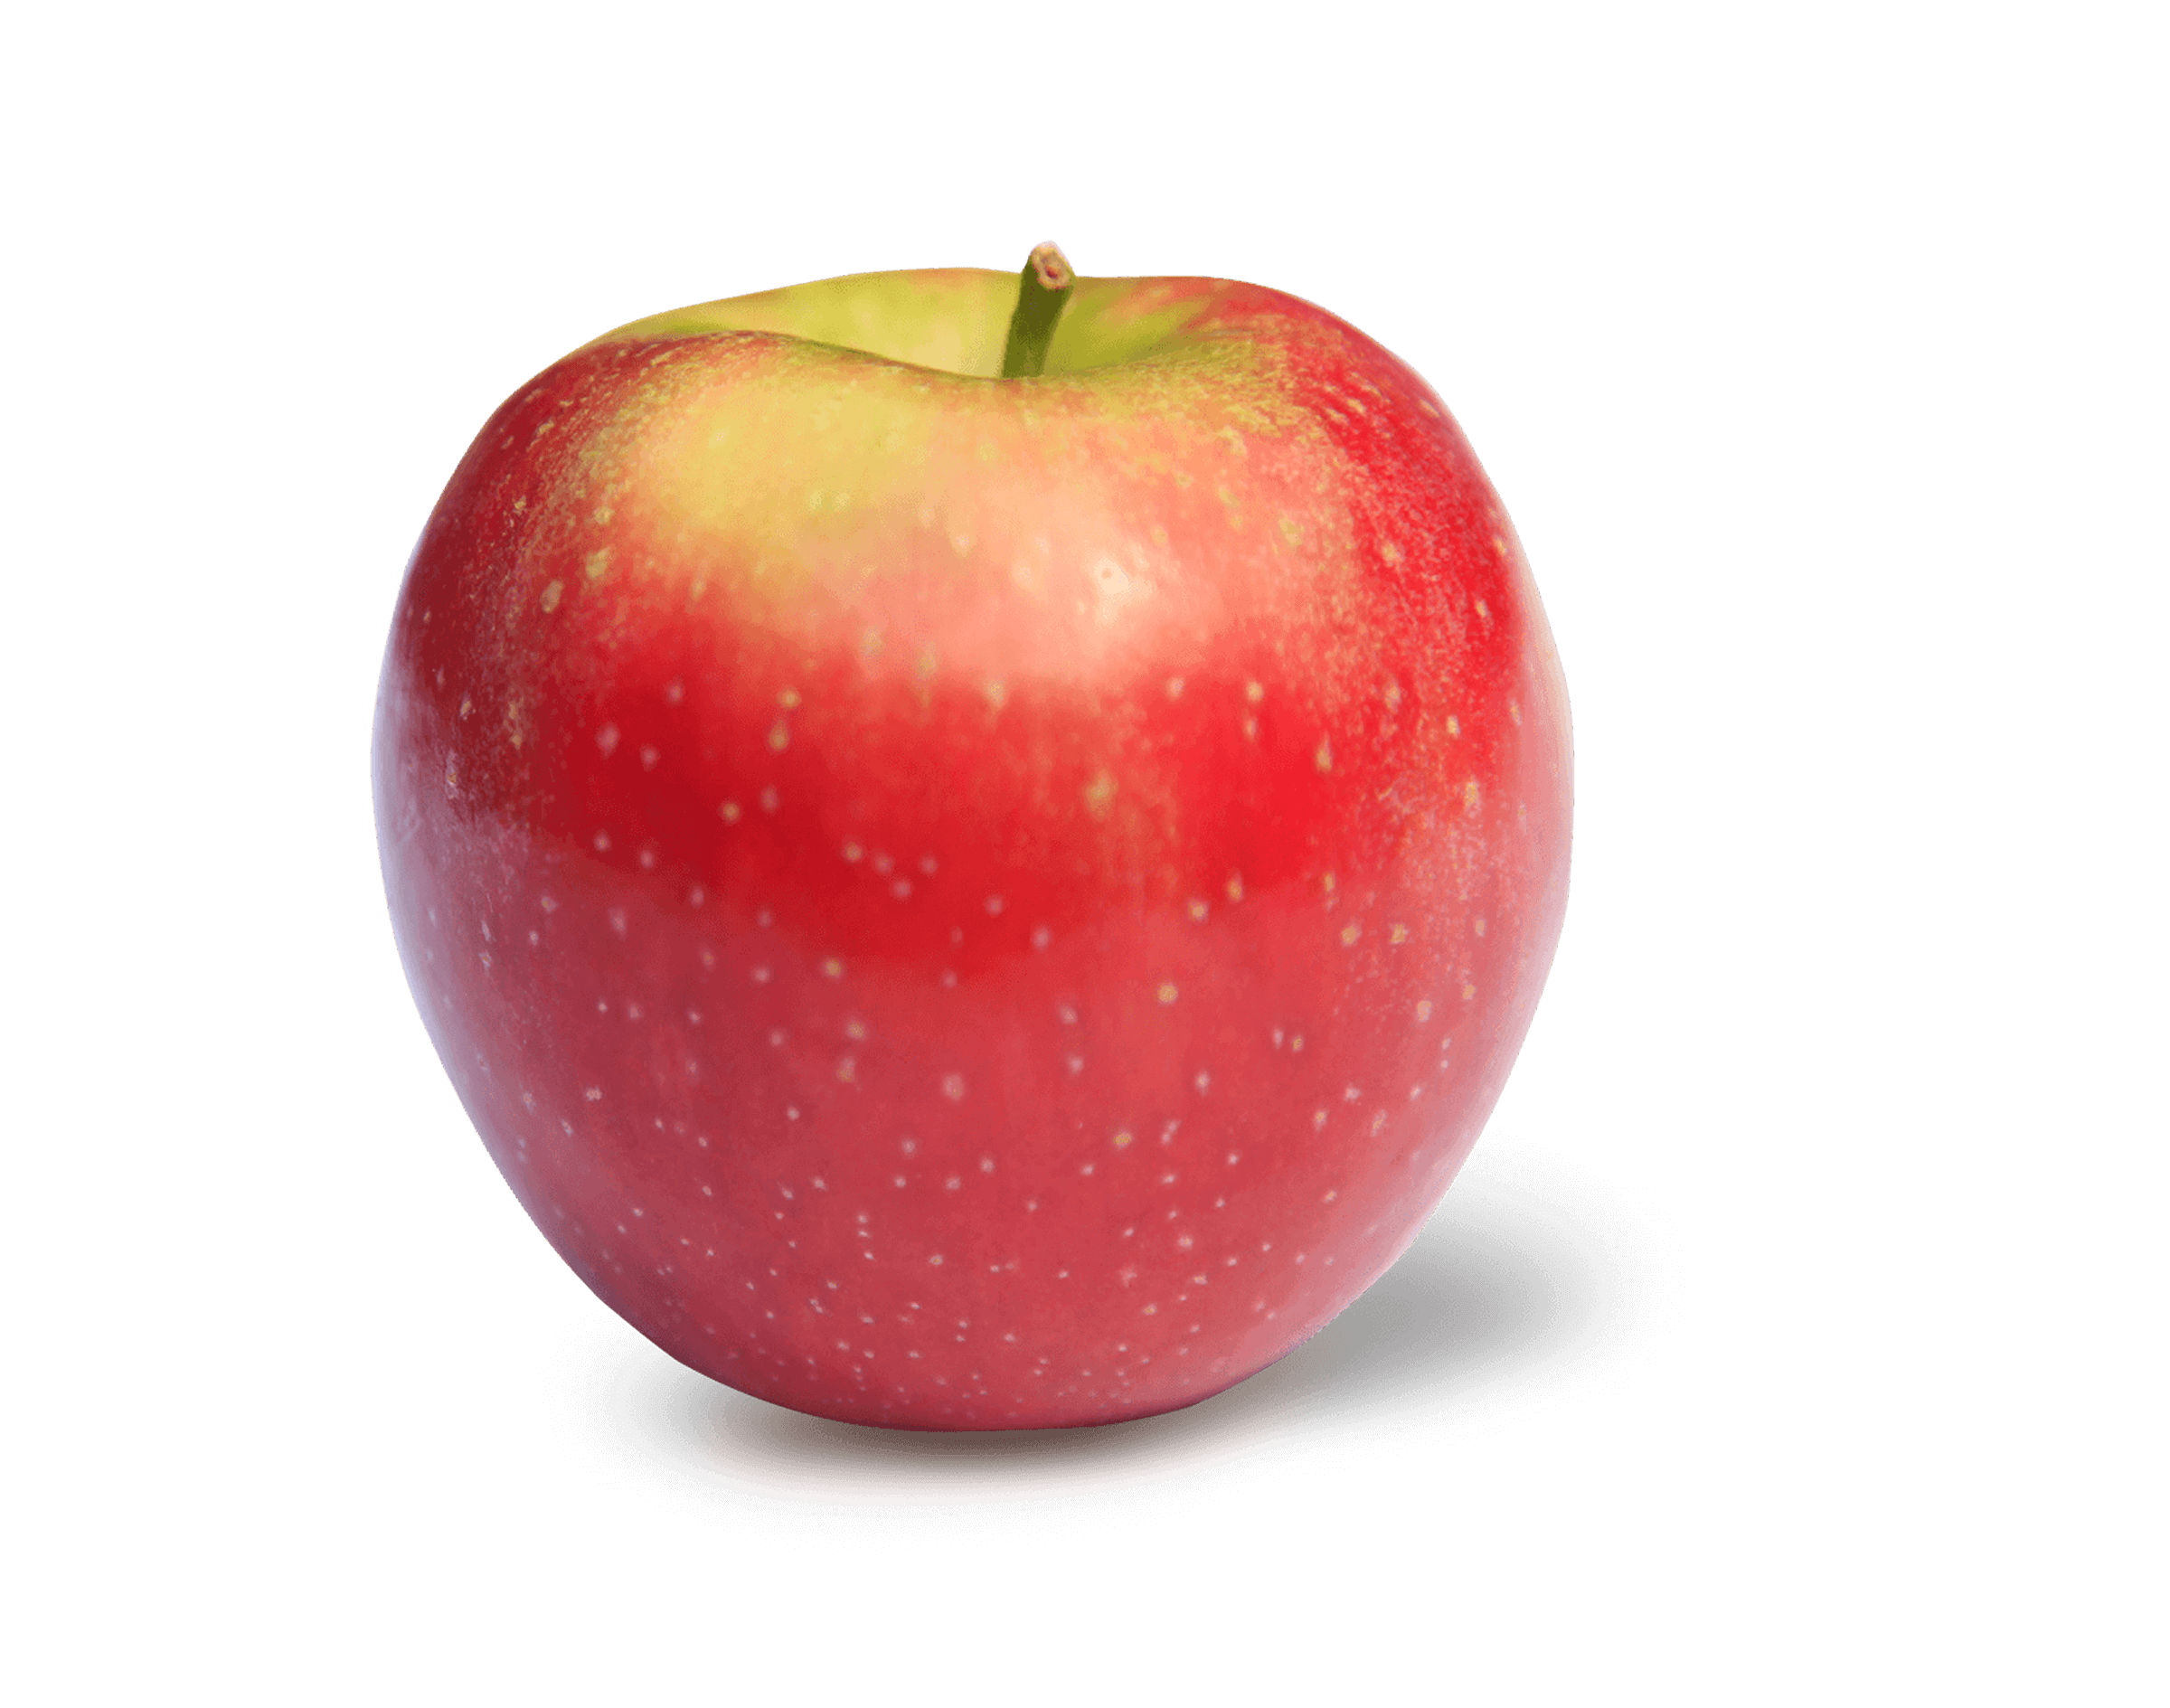
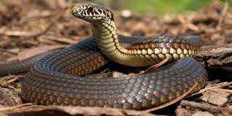
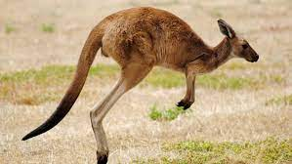
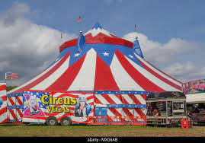
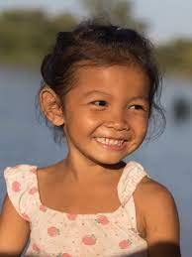
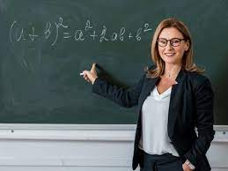
Concept Development: We do
Sort the nouns into person, animal, place, thing
Name the nouns
CFU:
What is a noun?
How do we know this is a noun?
Person | Animal | Place | Thing

Slide 15
Concept Development: You do
Sort the nouns into person, animal, place, thing
Name the nouns
CFU:
What is a noun?
How do we know this is a noun?
Person | Animal | Place | Thing
Use pictures of common nouns from texts/topics from class.- print off blank sorting sheet (see next page)

Slide 16
Person | Animal | Place | Thing

