Slide 1
Year: Foundation
Term: 1
Objective: Identify the verb in a sentence
Author: Jasmyn Hall

Slide 2
Multiple Choice
Pair Share
Track with me
Pick a Stick/Answer (non-volunteer)
Whiteboards
Vote
Read with me
In Your Workbook

Slide 3
Learning Objective
We are learning to identify the verb in a sentence

Slide 4
Concept Development
A sentence is a complete thought that makes sense.
A sentence must:
make sense
have a WHO/WHAT
and a WHAT DOING

Slide 5
Concept Development
A verb is a doing word- it’s the ‘do’ of the sentence
Every sentence must have a verb
CFU:
What is a verb?
What are they doing?
walk
ride
drink
run

Slide 6
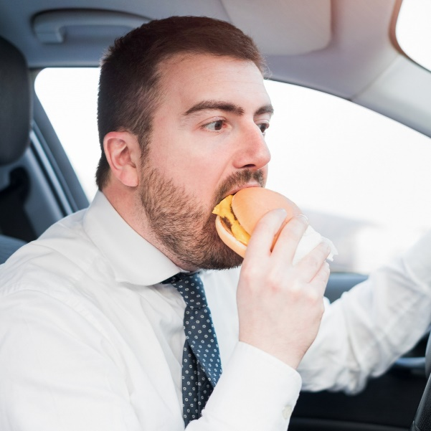
Concept Development: I do
Let’s say a sentence to tell what is happening in this picture
Identify the verb in the sentence
Hint: ask yourself “what are they doing” to find the verb
CFU:
What is a verb?
How do we know this is a verb?
Do the action
The man is eating.

Slide 7
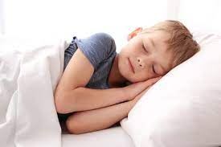
Concept Development: We do
Let’s say a sentence to tell what is happening in this picture
Identify the verb in the sentence
Hint: ask yourself “what are they doing” to find the verb
CFU:
What is a verb?
How do we know this is a verb?
Do the action
The boy is sleeping.

Slide 8
Concept Development: We do
Let’s say a sentence to tell what is happening in this picture
Identify the verb in the sentence
Hint: ask yourself “what are they doing” to find the verb
CFU:
What is a verb?
How do we know this is a verb?
Do the action
The girl is drawing.

Slide 9
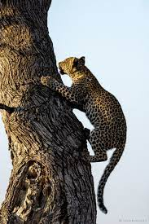
Concept Development: We do
Let’s say a sentence to tell what is happening in this picture
Identify the verb in the sentence
Hint: ask yourself “what are they doing” to find the verb
CFU:
What is a verb?
How do we know this is a verb?
Do the action
The leopard climbs.

Slide 10
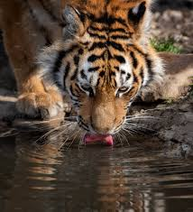
Concept Development: We do
Let’s say a sentence to tell what is happening in this picture
Identify the verb in the sentence
Hint: ask yourself “what are they doing” to find the verb
CFU:
What is a verb?
How do we know this is a verb?
Do the action
The tiger is drinking.

Slide 11
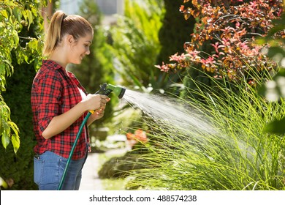
Concept Development: We do
Let’s say a sentence to tell what is happening in this picture
Identify the verb in the sentence
Hint: ask yourself “what are they doing” to find the verb
CFU:
What is a verb?
How do we know this is a verb?
Do the action
The girl is watering.

Slide 12
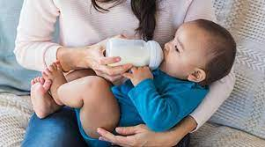
Concept Development: We do
Let’s say a sentence to tell what is happening in this picture
Identify the verb in the sentence
Hint: ask yourself “what are they doing” to find the verb
CFU:
What is a verb?
How do we know this is a verb?
Do the action
The baby is drinking.

Slide 13
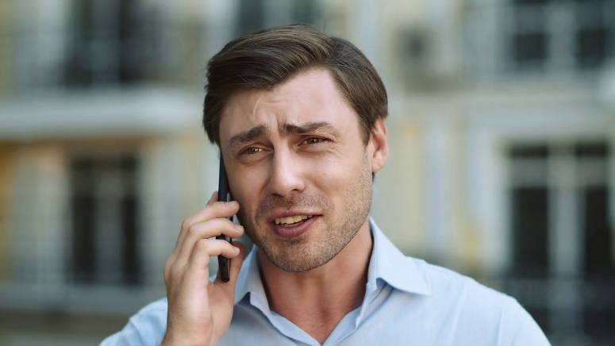
Concept Development
Let’s say a sentence to tell what is happening in this picture
Identify the verb in the sentence
Hint: ask yourself “what are they doing” to find the verb
CFU:
What is a verb?
How do we know this is a verb?
Do the action
The man is talking.

Slide 14
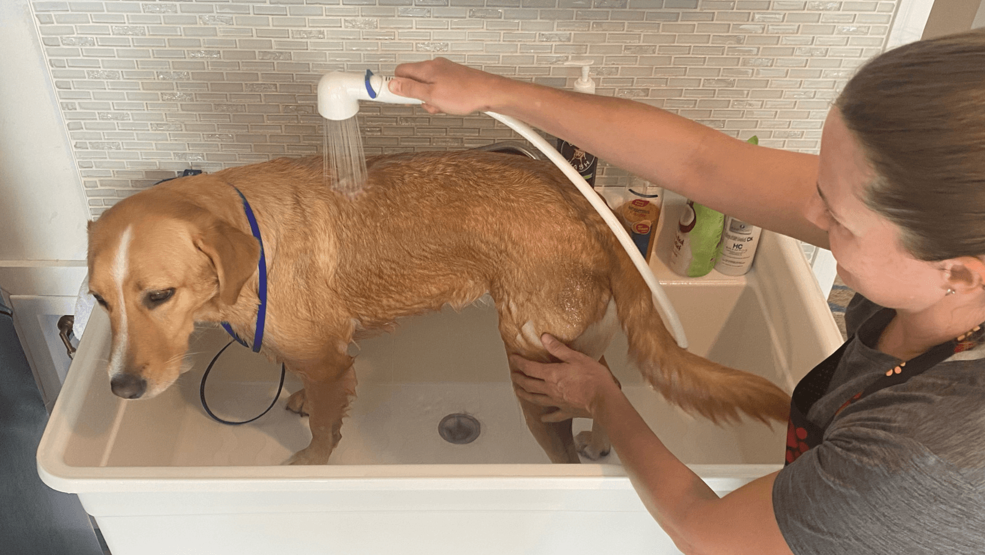
Concept Development: We do
Let’s say a sentence to tell what is happening in this picture
Identify the verb in the sentence
Hint: ask yourself “what are they doing” to find the verb
CFU:
What is a verb?
How do we know this is a verb?
Do the action
The girl is washing the dog.

Slide 15
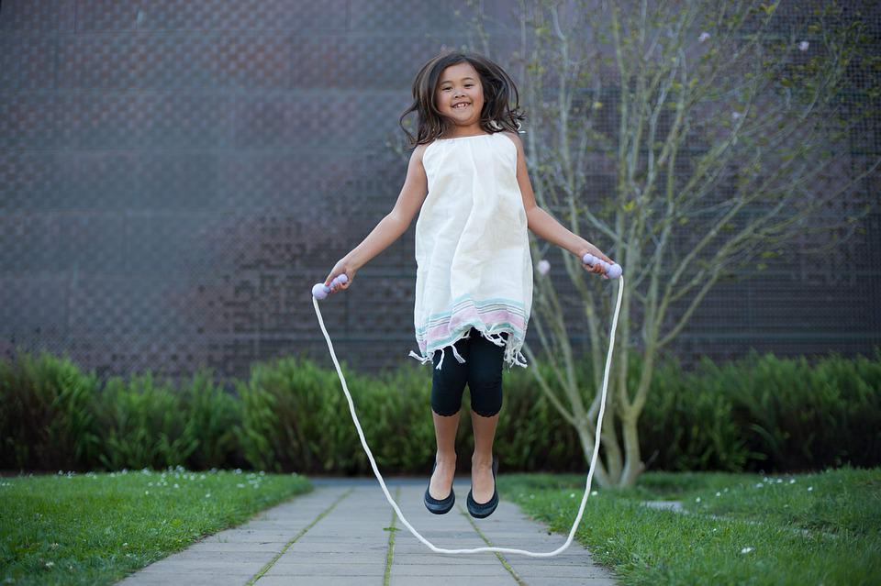
Concept Development: You do
Let’s say a sentence to tell what is happening in this picture
Identify the verb in the sentence
Hint: ask yourself “what are they doing” to find the verb
CFU:
What is a verb?
How do we know this is a verb?
Do the action
The girl skips.

Slide 16
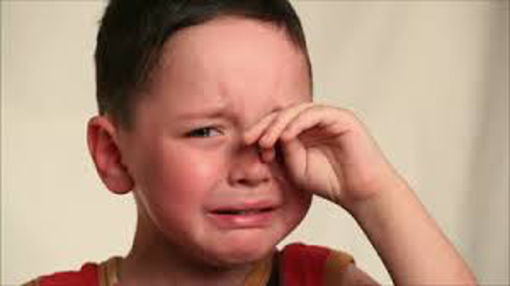
Concept Development: You do
Let’s say a sentence to tell what is happening in this picture
Identify the verb in the sentence
Hint: ask yourself “what are they doing” to find the verb
CFU:
What is a verb?
How do we know this is a verb?
Do the action
The boy is crying.

Slide 17
Concept Development: You do
Let’s say a sentence to tell what is happening in this picture
Identify the verb in the sentence
Hint: ask yourself “what are they doing” to find the verb
CFU:
What is a verb?
How do we know this is a verb?
Do the action
Add in pictures based on texts/topics/knowledge units in class

