Slide 1
Year: 3
Term: 1
Objective: Identify and use mental verbs within a sentence
Author: Stephanie Le Lievre
It would also be beneficial to link this lesson to your explicit vocabulary instruction, as many of the mental verbs are Tier 2 words.

Slide 2
Copy and paste these icons to the appropriate slides to indicate engagement norms/CFU strategies
Multiple Choice
Pair Share
Track with me
Pick a Stick/Answer (non-volunteer)
Whiteboards
Vote
Read with me
In Your Workbook

Slide 3
Learning Objective
We are learning to identify mental verbs and use them within a sentence.

Slide 4
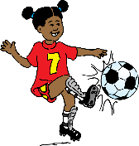
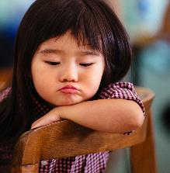
Concept Development
A verb is a word which describes an action, state, or occurrence.
It forms the main part of the predicate of a sentence
CFU:
What are the three main types of verbs?
A physical or mental action:
She walked.
They thought about the answers.
A state - form of being:
We are cold.
He was happy.
An occurrence -something happening:
The sun shone.
She became a teacher.

Slide 5
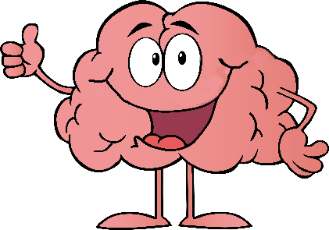
Concept Development
Mental verbs can be states or actions!
Mental verbs relate to the brain/thinking.
Examples:
CFU:
If you can’t see it, and it happens in our heads- it’s probably a mental verb!
Why are these mental verbs?
He remembered to pack his lunch.
She stressed over the homework task.
Lucy loathed bath time.
They hoped they would get into the finals.

Slide 6
Concept Development
Mental verbs can be states or actions!
Mental verbs relate to the brain/thinking.
Non-Examples:
CFU:
Why are these not examples of mental verbs?
(top 3 are actions, last one is a state)
He kicked the ball into the net.
Mary swam two laps of the pool.
We rode our bikes to the party.
It was freezing.

Slide 7
Hinge Point Question
CFU:
Why is it/ isn’t it a an example of a mental verb?
Go through each option one-at-a-time once students have answered on their whiteboards
Which of these sentences contain a mental verb?
I adore the smell of freshly cut grass.
He remembered to brush his teeth.
They loved the flowers.
They sailed around Australia.

Slide 8
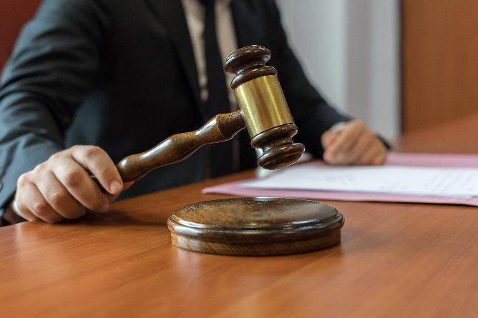
Skill Development: I do
Read this sentence
On your whiteboard, choose a mental verb to complete the sentence.
CFU:
What is the mental verb?
The police judge ____________ the right consequence for the criminal.
Suggestions (tier 1 and 2)
thought (about)
ruminated (on)
mulled (over)
deliberated (over)
contemplated
considered
reflected (on)

Slide 9
Skill Development: We do
Read this sentence
On your whiteboard, choose a mental verb to complete the sentence.
The mother ______________ her options for the weekend since the kids were at a sleepover.
Suggestions (tier 1 and 2)
thought (about)
ruminated (on)
mulled (over)
deliberated (over)
contemplated
considered
reflected (on)

Slide 10
Skill Development: We do
Read this sentence
On your whiteboard, choose a mental verb to complete the sentence.
Mary _______________ the newly elected politician.
Suggestions (tier 1 and 2)
loathes
detests
despises
hates

Slide 11
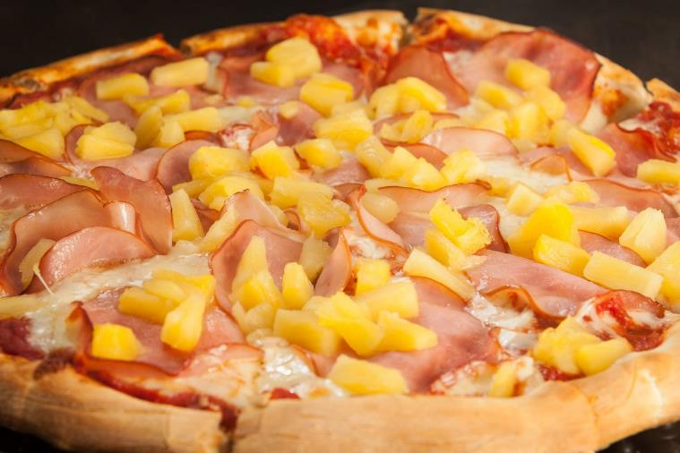
Skill Development: We do
Read this sentence
On your whiteboard, choose a mental verb to complete the sentence.
Sandra _______________ pineapple on her pizza.
Suggestions (tier 1 and 2)
loathes
detests
despises
hates

Slide 12
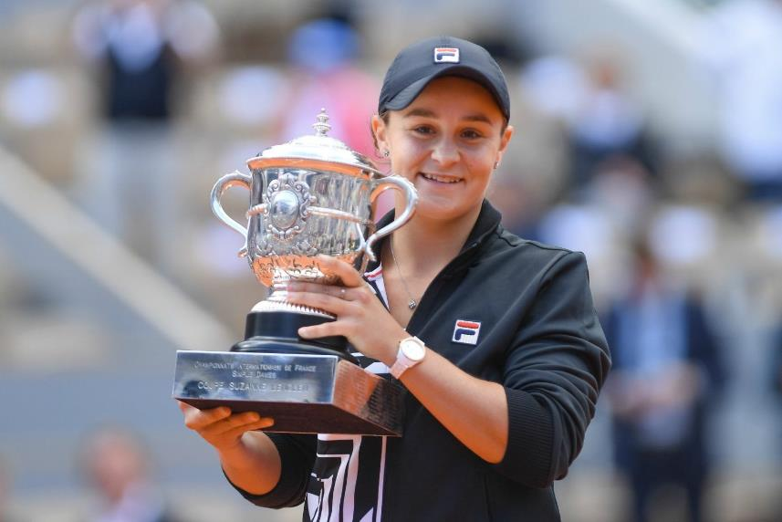
Skill Development: We do
Read this sentence
On your whiteboard, choose a mental verb to complete the sentence.
Ash Barty is ________________ by many Australians.
Suggestions (tier 1 and 2)
revered
adored
admired
loved

Slide 13
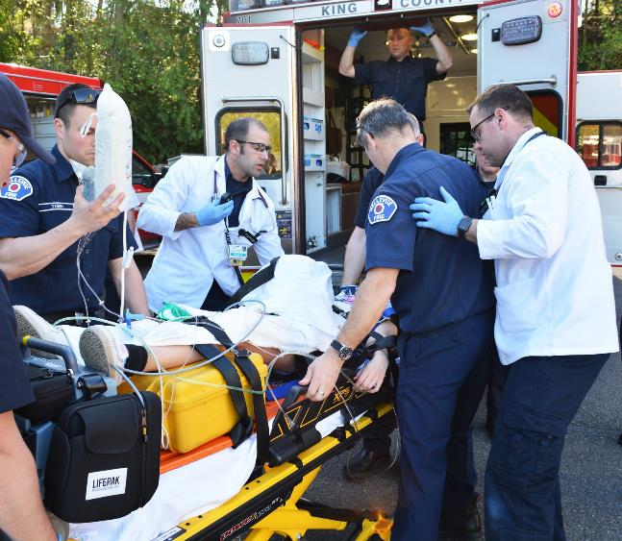
Skill Development: We do
Read this sentence
On your whiteboard, choose a mental verb to complete the sentence.
I _____________ the work of the emergency service workers.
Suggestions (tier 1 and 2)
revere
adore
admire
love

Slide 14
Skill Development: You do
Read this sentence
On your whiteboard, choose a mental verb to complete the sentence.
Choose sentences from texts/topics/content from class. Ask students to replace the mental verb.

