Slide 1
Year: 1
Term: 1
Objective: Identify sentence types- statements and questions
Author: Tara Noble

Slide 2
Copy and paste these icons to the appropriate slides to indicate engagement norms/CFU strategies
Multiple Choice
Pair Share
Track with me
Pick a Stick/Answer (non-volunteer)
Whiteboards
Vote
Read with me
In Your Workbook

Slide 3
Learning Objective
We are learning to identify statements and questions

Slide 4
Concept Development
A statement sentence tells you an idea. It ends with a full stop.
CFU:
A statement sentence tells you an _________.
A statement sentence ends with a __________.
Examples:
1. The sky is blue.
2. Edward visited lots of animals.
3. My favourite food is chocolate.

Slide 5
Concept Development
A statement sentence tells you an idea. It ends with a full stop.
CFU:
A statement sentence tells you an _________.
A statement sentence ends with a __________.
Non-Examples:
1. Sit down on the mat.
This is not a statement because it is not telling us an idea, it is telling us what to do.
2. How do I get to the zoo?
This is not a statement because it is not telling us an idea, it is asking us a question. It ends with a question mark.

Slide 6
Concept Development
A question sentence asks us something.
A question sentence often begins with what, when, how, why, who, do, can, where.
CFU:
A question sentence ______you something.
A question sentence ends with a __________.
Examples:
1. Why is the sky blue?
2. Where did Edward see the animals?
3. What is your favourite food?

Slide 7
Concept Development
A question sentence asks us something and ends with a question mark.
A question sentence often begins with what, when, how, why, who, do, can, where.
CFU:
A question sentence ______you something.
A question sentence ends with a __________.
Non-Examples:
1. Eat your dinner!
This is not a question because it is not asking us something, it is telling us what to do. It does not end with a question mark.
2. The children in this class work very hard.
This is not a question because it is not asking us something, it is telling us something. It does not end with a question mark.

Slide 8
Concept Development
A statement sentence tells you an idea. It ends with a full stop.
A question sentence asks us something and ends with a question mark.
A question sentence often begins with what, when, how, why, who, do, can, where.
CFU:
What is this sentence asking or telling us?
What punctuation do we need to add?
Statement or question
One sunny day, Jessica and Lilly went to the park
statement
One sunny day, Jessica and Lilly went to the park.
Do you like the swings or slide more
question
Do you like the swings or slide more?

Slide 9
Hinge Point Question
Which of these sentences are statements?
(punctuation not included)
CFU:
What makes it a statement?
When there is water and light in the sky, rainbows can form
b) How many colours can you see in a rainbow
c) I saw a rainbow on my way to school this morning
d) There are 7 colours in a rainbow

Slide 10
Concept Development
A statement sentence tells you an idea. It ends with a full stop.
A question sentence asks us something and ends with a question mark.
A question sentence often begins with what, when, how, why, who, do, can, where.
CFU:
What is this sentence asking or telling us?
What punctuation do we need to add?
Statement or question
When you mix blue and red, it makes the colour purple
statement
When you mix blue and red, it makes the colour purple.
What will happen if you mix blue and red together
question
What will happen if you mix blue and red together?

Slide 11
Skill development: I do
Read the sentence.
Label each sentence with a Q for question or S for statement.
CFU:
What punctuation does a statement sentence need?
What punctuation does a question sentence need?
Great White sharks have up to 300 teeth
S
Did you know that Great White sharks have up to 300 teeth
Q
How do sharks sleep
Q
Sharks do not actually sleep, they just rest and save energy
S

Slide 12
Skill development: We do
Read the sentence.
Label each sentence with a Q for question or S for statement.
CFU:
What punctuation does a statement sentence need?
What punctuation does a question sentence need?
Q
What are stars made of
The nearest star to Earth is the sun
The milky way contains hundreds of billions of stars
Can stars move
S
S
Q

Slide 13
Skill development: We do
Read the sentence.
Label each sentence with a Q for question or S for statement.
CFU:
What punctuation does a statement sentence need?
What punctuation does a question sentence need?
Disneyland in Florida is the most popular theme park in the world
Will I get to see all my favourite characters at Disneyland
How many rides are there in Disneyland
There are 6 Disneyland parks around the world
S
Q
Q
S

Slide 14
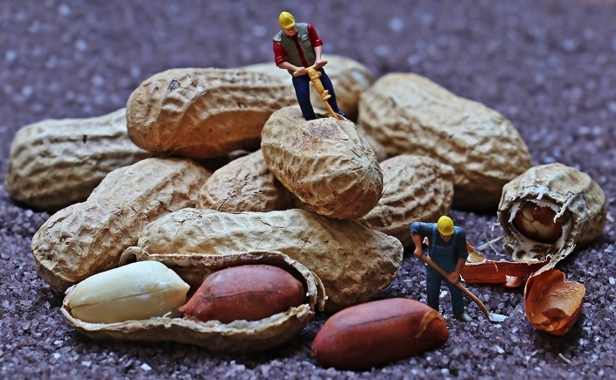
Skill development: We do
Read the sentence.
Label each sentence with a Q for question or S for statement.
CFU:
What punctuation does a statement sentence need?
What punctuation does a question sentence need?
The tiny workers are drilling into the peanuts
Why are there tiny workers drilling into peanuts
Is this picture real
The peanuts look much larger than the workers
S
Q
Q
S

Slide 15
Skill development: We do
Read the sentence.
Is it asking you something (question)or telling you about something (statement)?
Check for the correct punctuation.
CFU:
Is the sentence asking or telling something?
What punctuation is used for statements and question sentences?
Underline the statements and circle the questions.
One sunny day, Jessica and Lilly went to play at the park. When they got there the park was very busy.
“Do you like the swings or slide most?” asked Jessica.
“I like the swings.” said Lilly.
“Would you like to go on the swing first?” offered Jessica.

Slide 16
Skill development: We do
Read the sentence.
Is it asking you something (question)or telling you about something (statement)?
Check for the correct punctuation.
CFU:
Is the sentence asking or telling something?
What punctuation is used for statements and question sentences?
Underline the statements and circle the questions.
One dark night, a bat named Jimmy was sleeping on a branch in the forest. Suddenly he fell into a birds nest. The mother bird asked, “what are you doing in my nest?”
“I must have fell.” said Jimmy. ”How do I get back to my branch?”

Slide 17
Skill development: We do
Read the sentence.
Is it asking you something (question) or telling you about something (statement)?
Check for the correct punctuation.
CFU:
What is the function of a statement sentence?
What punctuation is used for statement sentences?
Make some statements about this picture.
The puppy is ……
The puppy has ………

Slide 18
Skill development: We do
Read the sentence.
Is it asking you something (question) or telling you about something (statement)?
Check for the correct punctuation.
CFU:
What is the function of a question sentence?
What punctuation is used for question sentences?
Make some questions about this picture.
Is the puppy ……
Will the puppy…

Slide 19
Skill development: I do
Read the sentence.
Write the sentences in the correct column.
Add a full-stop of question mark.
Statements | Questions
Would you rather be a cat or a dog
What was that noise
I like to play football
How old are you
My name is Sam
When it gets hot, it will melt
Is it raining

