Slide 1
Year: 1
Term: 1
Objective: Define pronouns and use them within a sentence (subject position).
Author: Stephanie Le Lievre

Slide 2












Copy and paste these icons to the appropriate slides to indicate engagement norms/CFU strategies
Multiple Choice
Pair Share
Track with me
Pick a Stick/Answer (non-volunteer)
Whiteboards
Vote
Read with me
In Your Workbook

Slide 3
Learning Objective
Define pronouns and use them within a sentence.

Slide 4
Concept Development
A noun names a person, place, thing or idea
Pronouns replace nouns
CFU:
Can you tell me one pronoun?
Pronouns
I
he
she
they
it
we

Slide 5

Concept Development
A noun names a person, place, thing or idea
Pronouns replace nouns
CFU:
What is a pronoun?
What is the noun that the pronoun is replacing?
Examples:
He
Tim went to school today.
He went to school today.

Slide 6
Concept Development
A noun names a person, place, thing or idea
Pronouns replace nouns
CFU:
What is a pronoun?
What is the noun that the pronoun is replacing?
Examples:
She
Sally went to school today.
She went to school today.

Slide 7
Concept Development
A noun names a person, place, thing or idea
Pronouns replace nouns
CFU:
What is a pronoun?
What is the noun that the pronoun is replacing?
Examples:
They
Tim and Sally went to school today.
They went to school today.

Slide 8
Concept Development
A noun names a person, place, thing or idea
Pronouns replace nouns
CFU:
What is a pronoun?
What is the noun that the pronoun is replacing?
Examples:
I
Mrs Le Lievre put the books away.
I put the books away.

Slide 9
Concept Development
A noun names a person, place, thing or idea
Pronouns replace nouns
CFU:
What is a pronoun?
What is the noun that the pronoun is replacing?
Examples:
We
The year 1 class are great writers.
We are great writers.

Slide 10
Concept Development
A noun names a person, place, thing or idea
Pronouns replace nouns
CFU:
What is a pronoun?
What is the noun that the pronoun is replacing?
Examples:
It
The dog chased the ball.
It chased the ball.

Slide 11


Hinge Point Question
CFU:
Why is it/ isn’t it a an example of a pronoun?
What noun is it taking the place of?
What sentences contain pronouns?
She went for a run.
He likes eating chips.
Chase is not at school.
Macy found a dog.
A noun names a person, place, thing or idea
Pronouns replace nouns
Pronouns keep our writing from sounding monotonous and repetitive

Slide 12
Skill development: I do
Select a pronoun to replace the underlined noun.
Write the sentence using the pronoun you have chosen.
Pronouns
I
he
she
they
it
we
CFU:
What does a pronoun take the place of?
Why did you choose that pronoun?
Mila loves to eat fish.
She loves to eat fish.

Slide 13
Skill development: We do
Select a pronoun to replace the underlined noun.
Write the sentence using the pronoun you have chosen.
Pronouns
I
he
she
they
it
we
CFU:
What does a pronoun take the place of?
Why did you choose that pronoun?
Jake and Lily walked to the shops.
They walked to the shops.

Slide 14
Skill development: We do
Select a pronoun to replace the underlined noun.
Write the sentence using the pronoun you have chosen.
Pronouns
I
he
she
they
it
we
CFU:
What does a pronoun take the place of?
Why did you choose that pronoun?
Santa is bringing presents.
He is bringing presents.

Slide 15
Skill development: We do
Select a pronoun to replace the underlined noun.
Write the sentence using the pronoun you have chosen.
Pronouns
I
he
she
they
it
we
CFU:
What does a pronoun take the place of?
Why did you choose that pronoun?
The horse rode away.
It rode away.

Slide 16
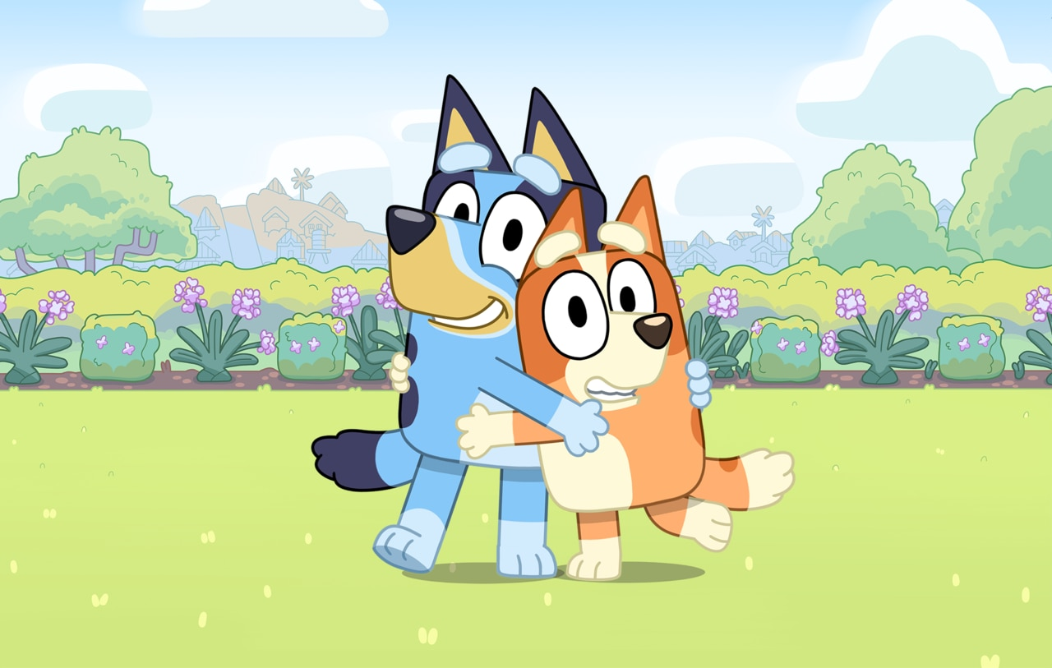
Skill development: We do
Select a pronoun to replace the underlined noun.
Write the sentence using the pronoun you have chosen.
Pronouns
I
he
she
they
it
we
CFU:
What does a pronoun take the place of?
Why did you choose that pronoun?
Bluey and Bingo hugged.
They hugged.

Slide 17
Skill development: You do
Select a pronoun to replace the underlined noun.
Write the sentence using the pronoun you have chosen.
Pronouns
I
he
she
they
it
we
CFU:
What does a pronoun take the place of?
Why did you choose that pronoun?
Insert sentences based on topics/books/units.

