Slide 1
Year: Pre Primary
Term: 3
Objective: Sentence Expansion – when, who, what, where (written)
Author: Janelle Walters

Slide 2
Multiple Choice
Pair Share
Track with me
Pick a Stick/Answer (non-volunteer)
Whiteboards
Vote
Read with me
In Your Workbook

Slide 3
Question Words
Who/what?
(did) What?
When?
Where?
Why?
How?
Display this chart in classroom prior to lesson.
Optional: use Colourful Semantics icons in addition to question words. But please note, TWR does not distinguish between the ‘what doing/did what’ (verb) and the ‘what’ (object). If you are using a Colourful Semantics approach, you will need to consider this.

Slide 4
Learning Objective
We are learning to expand our sentences by adding extra information.

Slide 5
Activate Prior Knowledge
A sentence is a complete thought.
It must contain a subject and a verb.
CFU:
What is the subject and the verb in these sentences?
Examples:
She ran.
Pat ate.
Tim napped.

Slide 6
Concept Development
A sentence is a complete thought.
It must contain a subject and a verb.
CFU:
What is the subject and the verb in these sentences?
Examples:
She ran.
Pat ate.
Tim napped.
Boring !
These sentences are boring and do not contain any additional information.

Slide 7
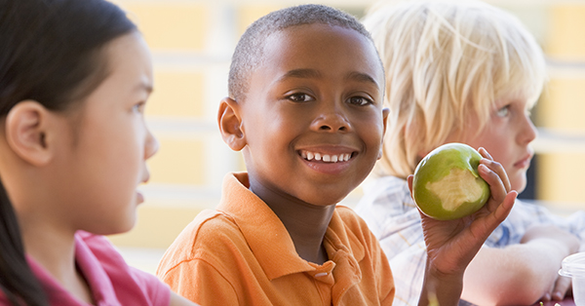
Concept Development
By adding additional information, we can expand sentences to make them more interesting.
Including when, who, what, and where will make your sentence more informative for the reader:
CFU:
Who ate?
Where?
When did they eat?
When?
Where?
Who?
What?
During lunchtime, Pat ate his apple outside.
Boring !
Pat ate.

Slide 8
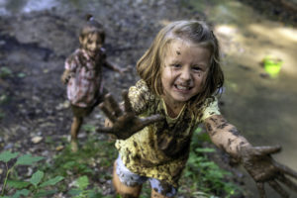
Concept Development
By adding additional information, we can expand sentences to make them more interesting.
Including when, who, what, and where will make your sentence more informative for the reader:
CFU:
Who splashed?
Where?
When did they splash?
2. What does ‘they’ refer to in the kernel sentence.
When?
Where?
Who?
What?
On a rainy day, the two girls splashed in muddy puddles.
Boring !
They splashed.

Slide 9
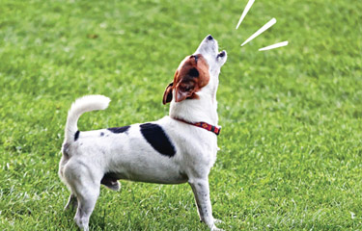
Concept Development
By adding additional information, we can expand sentences to make them more interesting.
Including when, who, and where will make your sentence more informative for the reader:
CFU:
Who is the subject?
What is the action?
Where does it occur?
When does it happen?
He was barking.
When:
Who:
Where:
In the morning
the yappy dog
in the park
Example:
In the morning, the yappy dog was barking in the park.

Slide 10
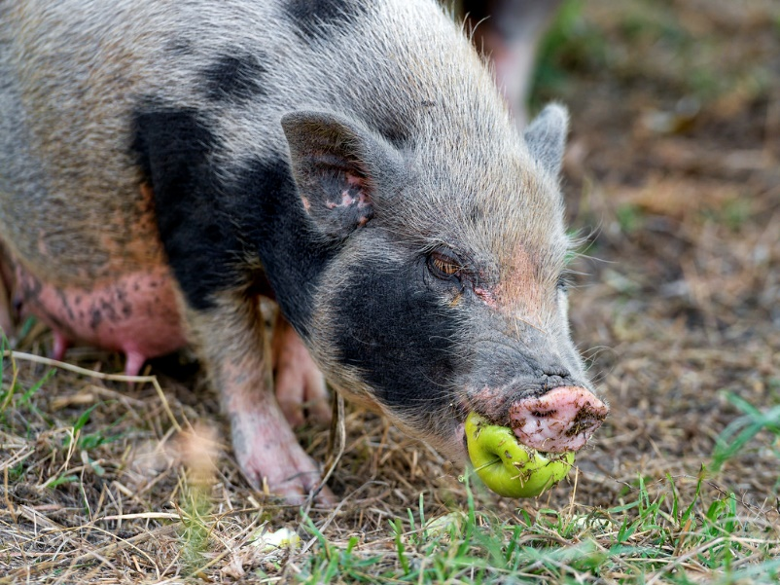
Skill development: I do
Answer the questions in note form
Use the notes to say the sentence, in this order:
When, who what where.
3. Write your sentence using correct punctuation.
When, who what where.
4. Read your sentence – does it sound right?
CFU:
Who is the subject?
What is the action?
Where does it occur?
When does it happen?
It was eating.
When:
Who:
Where:
In the afternoon
the hairy pig
in the pen
In the afternoon, the hairy pig was eating in the pen.

Slide 11
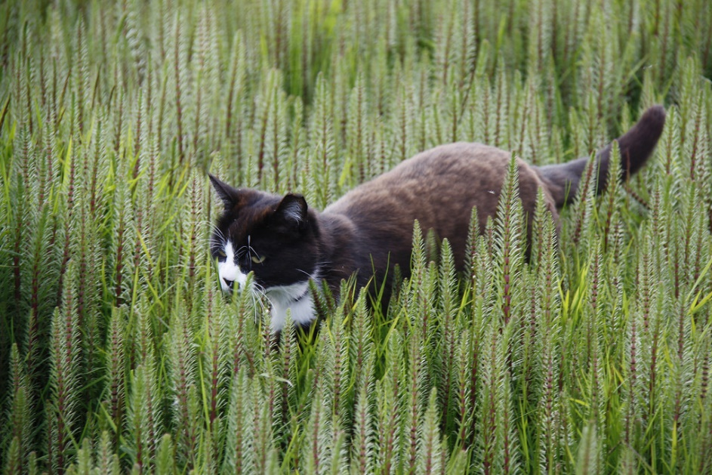
Skill development: We do
Answer the questions in note form
Use the notes to say the sentence, in this order:
When, who what where.
3. Write your sentence using correct punctuation.
When, who what where.
4. Read your sentence – does it sound right?
CFU:
Who is the subject?
What is the action?
Where does it occur?
When does it happen?
It crept.
When:
Who:
Where:
On a hot day
a cat
in the bushes
On a hot day,
a cat
in the bushes.
crept

Slide 12
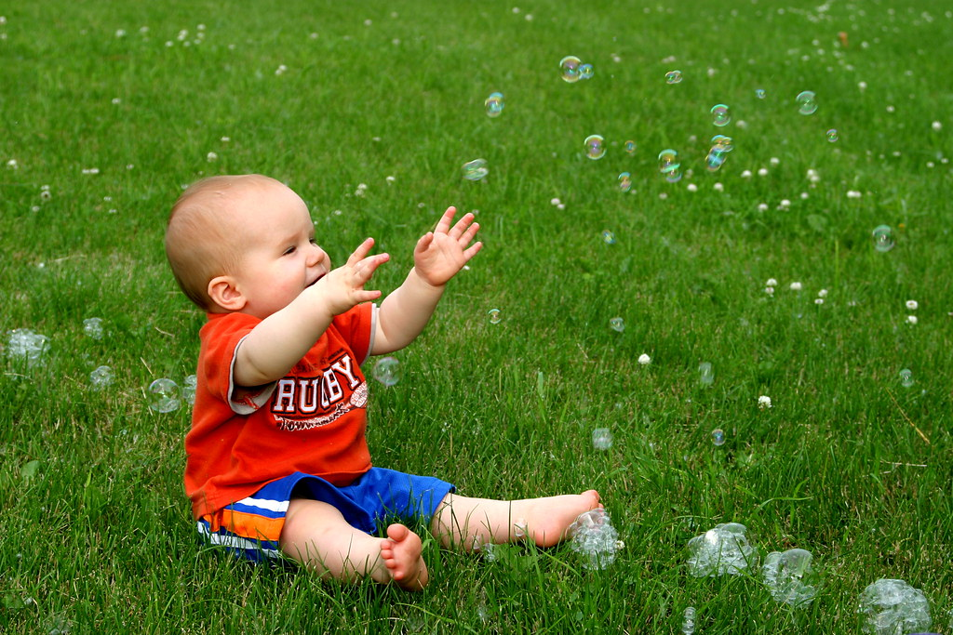
Skill development: We do
Answer the questions in note form
Use the notes to say the sentence, in this order:
When, who what where.
3. Write your sentence using correct punctuation.
When, who what where.
4. Read your sentence – does it sound right?
CFU:
Who is the subject?
What is the action?
Where does it occur?
When does it happen?
He blew bubbles.
When:
Who:
Where:
In the morning
the baby
on the grass
In the morning,
the baby
blew bubbles
on the grass.

Slide 13
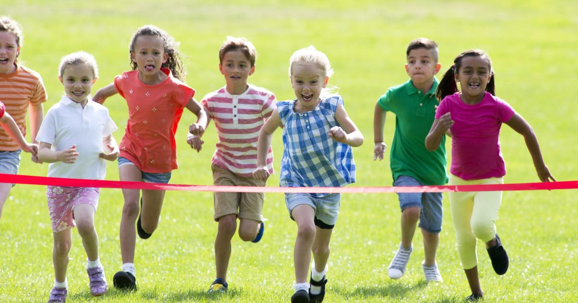
Skill development: We do
Answer the questions in note form
Use the notes to say the sentence, in this order:
When, who what where.
3. Write your sentence using correct punctuation.
When, who what where.
4. Read your sentence – does it sound right?
CFU:
Who is the subject?
What is the action?
Where does it occur?
When does it happen?
They ran.
When:
Who:
Where:
On Friday
the kids
on the oval
ran
On Friday,
the kids
on the oval.

Slide 14
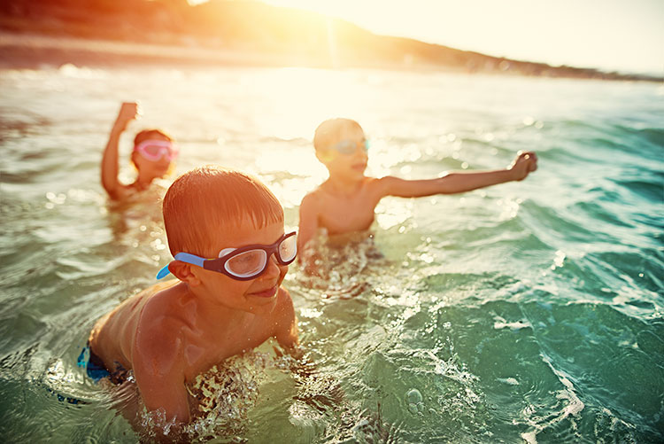
Skill development: We do
Answer the questions in note form
Use the notes to say the sentence, in this order:
When, who what where.
3. Write your sentence using correct punctuation.
When, who what where.
4. Read your sentence – does it sound right?
CFU:
Who is the subject?
What is the action?
Where does it occur?
When does it happen?
They swam.
When:
Who:
Where:
On Sunday
the kids
at the beach

