Slide 1
Year: 2
Term: 1
Objective: Expand a sentence by adding extra information.
Author: Robin Watson

Slide 2
Multiple Choice
Pair Share
Track with me
Pick a Stick/Answer (non-volunteer)
Whiteboards
Vote
Read with me
In Your Workbook

Slide 3
Question Words
Who/what?
(did) What?
When?
Where?
Why?
How?
Display this chart in classroom prior to lesson.
Optional: use Colourful Semantics icons in addition to question words. But please note, TWR does not distinguish between the ‘what doing/did what’ (verb) and the ‘what’ (object). If you are using a Colourful Semantics approach, you will need to consider this.

Slide 4
Learning Objective
We are learning to expand our sentences by adding extra information.

Slide 5
Activate Prior Knowledge
A sentence is a complete thought.
It must contain a subject and a verb.
CFU:
Who is the subject and what is the verb in these sentences?
Examples:
She ran.
Bob ate.
Joe napped.

Slide 6
Concept Development
A sentence is a complete thought.
It must contain a subject and a verb.
CFU:
Who is the subject and what is the verb in these sentences?
Examples:
She ran.
Bob ate.
Joe napped.
Boring !
These sentences are boring and do not contain any additional information.

Slide 7
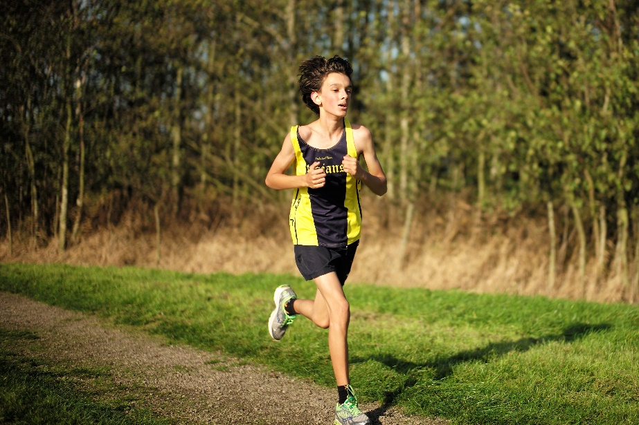
Concept Development
By adding additional information, we can expand sentences to make them more interesting.
Including when, who, what, where and why will make your sentence more informative for the reader:
CFU:
When does it occur?
Where does it occur?
Why does it happen?
What does ‘he’ refer to in the kernel sentence.
When?
Who?
What?
Where?
Why?
He ran
On a hot day, the young boy ran along the gravel road in the cross country race.
Boring !

Slide 8
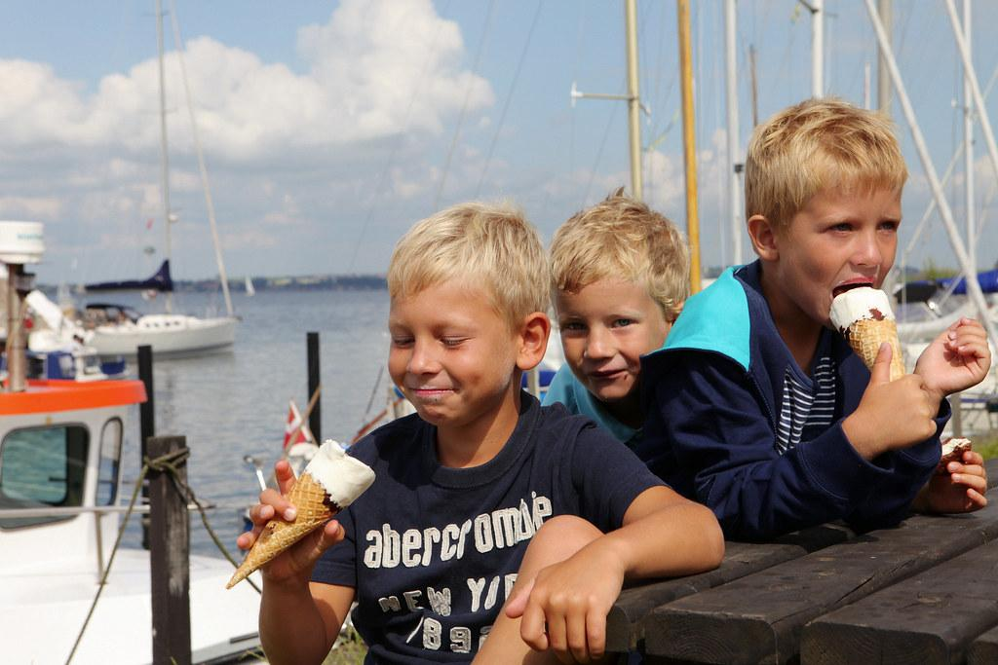
Concept Development
By adding additional information, we can expand sentences to make them more interesting.
Including when, who, what, where and why will make your sentence more informative for the reader:
CFU:
When does it occur?
Where does it occur?
Why does it happen?
What does ‘they’ refer to in the kernel sentence.
When?
Who?
What?
Where?
Why?
They ate
In the afternoon, the boys ate ice-cream at the beach because they were on holidays.
Boring !

Slide 9
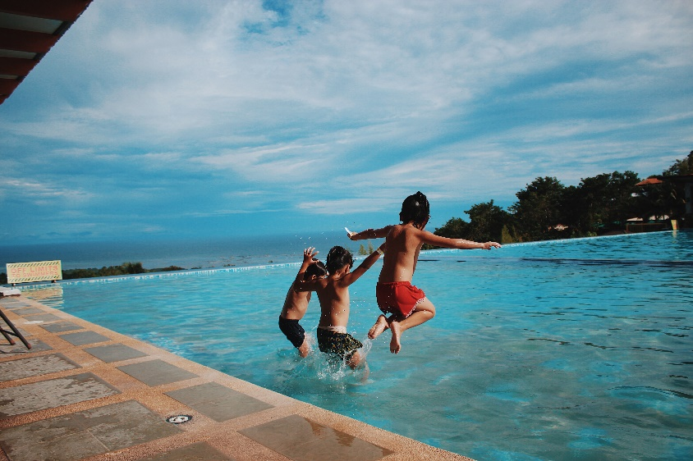
Skill Development: I do
Answer the questions in note form
Use the notes to say the sentence, in this order:
When, who, what, where and why
3. Write your sentence using correct punctuation.
When, who what where why.
4. Read your sentence – does it sound right?
CFU:
What is the action?
When does it occur?
Where does it occur?
Why does it happen?
They jumped.
Who:
What:
When:
Where:
Why:
young boys
jumped
In summer
pool
it was hot
In summer, the young boys jumped into the pool because it was hot.

Slide 10
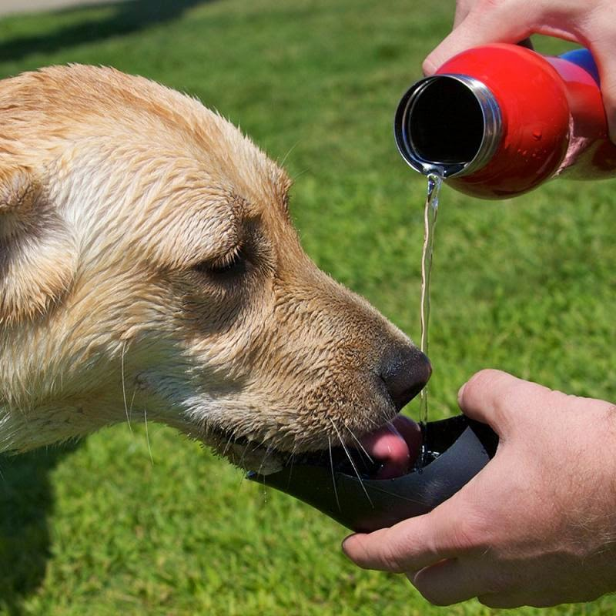
Skill development: We do
Answer the questions in note form
Use the notes to say the sentence, in this order:
When, who, what, where and why
3. Write your sentence using correct punctuation.
When, who what where why.
4. Read your sentence – does it sound right?
CFU:
What is the action?
When does it occur?
Where does it occur?
Why does it happen?
It drank.
Who:
What:
When:
Where:
Why:
the dog
drank water
on a hot day
in the park
It was thirsty

Slide 11
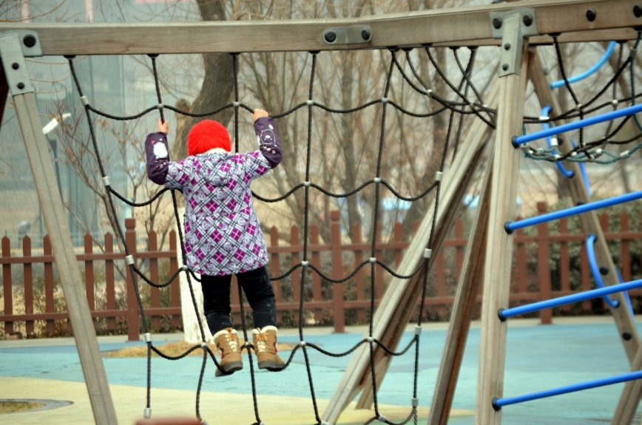
Skill development: We do
Answer the questions in note form
Use the notes to say the sentence, in this order:
When, who, what, where and why
3. Write your sentence using correct punctuation.
When, who what where why.
4. Read your sentence – does it sound right?
CFU:
What is the action?
When does it occur?
Where does it occur?
Why does it happen?
She climbed.
Who:
What:
When:
Where:
Why:
the little girl
climbs
on a cold day
in the playground
she didn’t want to stay home

Slide 12
Skill development: We do
Answer the questions in note form
Use the notes to say the sentence, in this order:
When, who, what, where and why
3. Write your sentence using correct punctuation.
When, who what where why.
4. Read your sentence – does it sound right?
CFU:
What is the action?
When does it occur?
Where does it occur?
Why does it happen?
He painted.
Who:
What:
When:
Where:
Why:
the young boy
painted a picture
on the holidays
at home
This Photo by Unknown Author is licensed under CC BY-SA-NC
for his mother

Slide 13
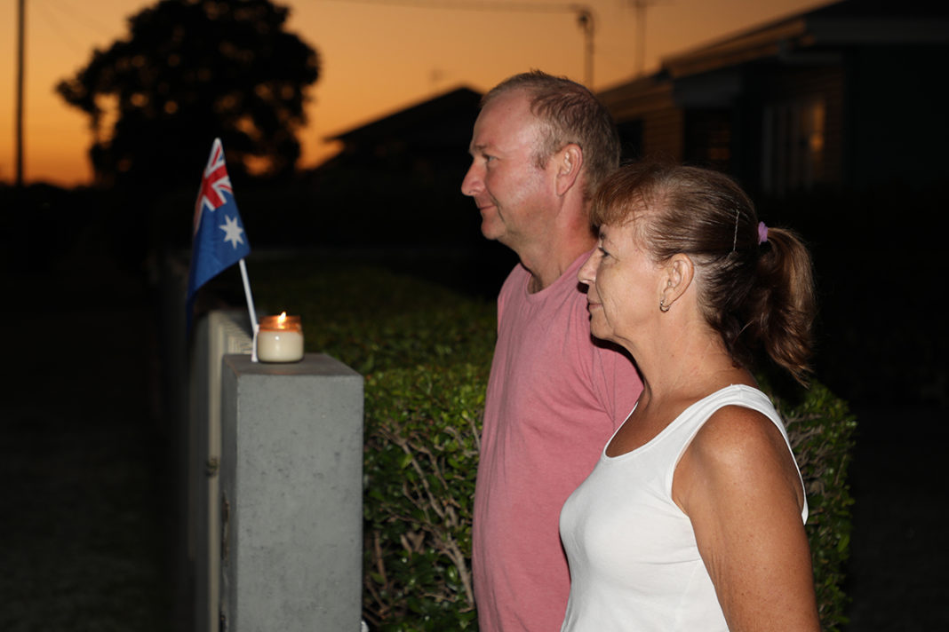
Skill development: You do
Answer the questions in note form
Use the notes to say the sentence, in this order:
When, who, what, where and why
3. Write your sentence using correct punctuation.
When, who what where why.
4. Read your sentence – does it sound right?
CFU:
What is the action?
When does it occur?
Where does it occur?
Why does it happen?
They stood.
Who:
What:
When:
Where:
Why:

