Slide 1
Year: 4
Term: 1
Objective: Expand a sentence by adding extra information.
Author: Tracy Munford

Slide 2
Multiple Choice
Pair Share
Track with me
Pick a Stick/Answer (non-volunteer)
Whiteboards
Vote
Read with me
In Your Workbook

Slide 3
Question Words
Who/what?
(did) What?
When?
Where?
Why?
How?
Display this chart in classroom prior to lesson.
Optional: use Colourful Semantics icons in addition to question words. But please note, TWR does not distinguish between the ‘what doing/did what’ (verb) and the ‘what’ (object). If you are using a Colourful Semantics approach, you will need to consider this.

Slide 4
Learning Objective
We are learning to expand our sentences by adding extra information.

Slide 5
Activate Prior Knowledge
A sentence is a complete thought.
It must contain a subject and a verb.
CFU:
Tell me the subject.
Tell me the verb.
Examples:
She ran.
Bob ate.
Joe napped.
Boring !
These sentences are boring and do not contain any additional information.

Slide 6
Concept Development
CFU(expanded sentence):
Who ran?
Where?
When did they run?
How did they run?
Why did they run?
2. What does ‘she’ refer to in the kernel sentence.
As the sun set, the lady ran powerfully along the beach to build her strength.
Boring !
She ran.

Slide 7
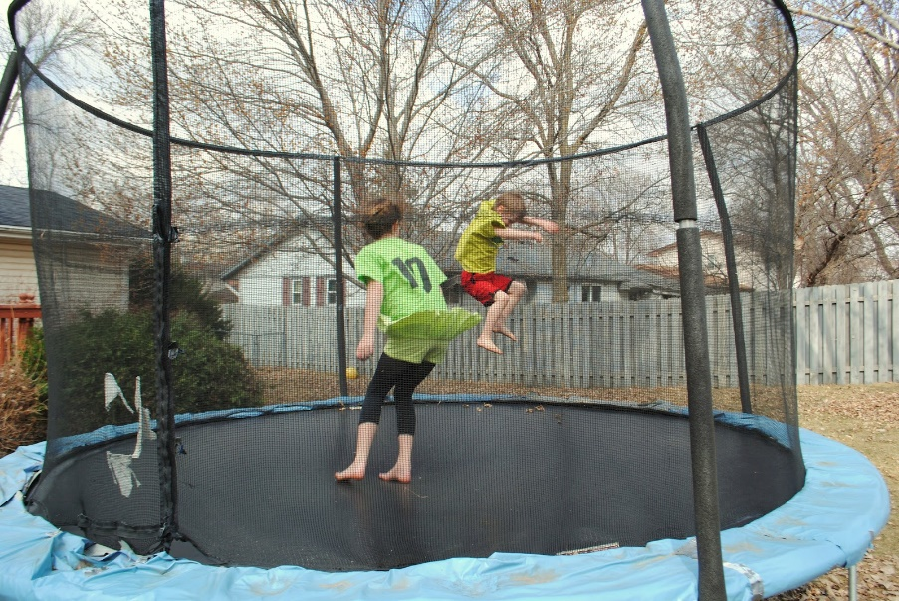
Concept Development
By adding additional information, we can expand sentences to make them more interesting.
Including when, who/what, (did) what, where, why and/or how will make your sentence more informative for the reader:
CFU:
Who jumped?
Where?
When did they jump?
How did they jump?
Why did they jump?
2. What does ‘they’ refer to in the kernel sentence.
On a cloudy day, the two boys jumped excitedly on the trampoline because they were enjoying themselves.
Boring !
They jumped

Slide 8
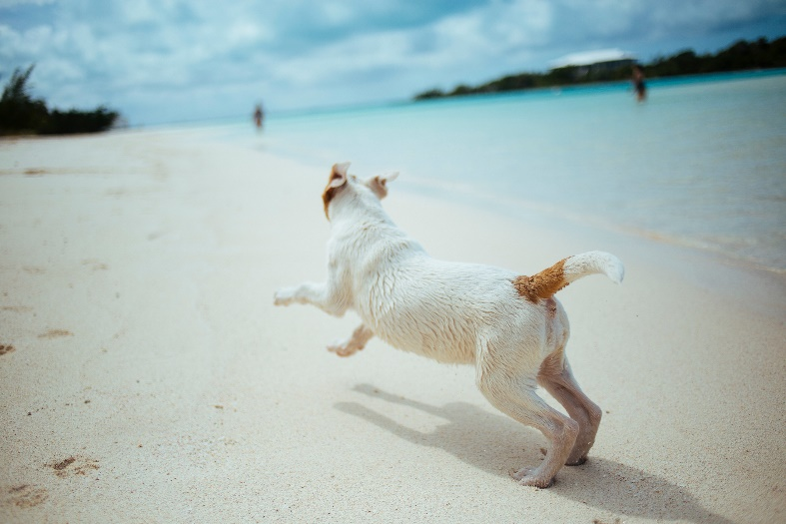
Skill Development: I do
Answer the questions in note form
Use the notes to write the sentence- the order may be different to the order of the notes!
3. Write your sentence using correct punctuation.
4. Read your sentence – does it sound right?
CFU:
What do I need to include if I place the ‘when’ or the ‘how’ at the beginning of the sentence?-
a comma
The little dog ran.
When:
Where:
How:
Why:
early in the morning
beach
enthusiastically
to find his ball
Early in the morning, the little dog ran enthusiastically on the beach to find his ball.
Enthusiastically, the little dog ran on the beach early in the morning to find his ball.

Slide 9
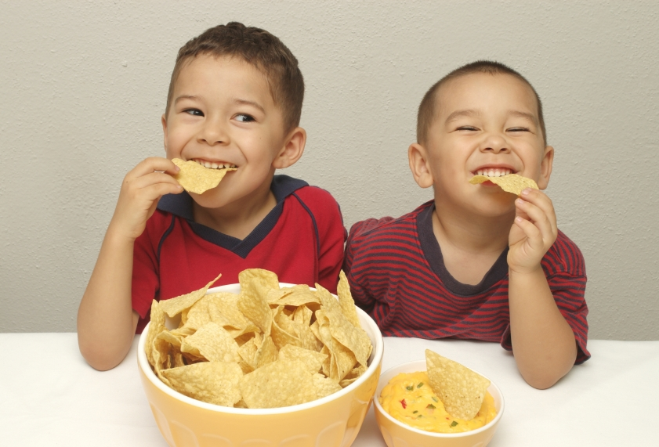
Skill Development: I do
Answer the questions in note form
Use the notes to write the sentence- the order may be different to the order of the notes!
3. Write your sentence using correct punctuation.
4. Read your sentence – does it sound right?
CFU:
What do I need to include if I place the ‘when’ or the ‘how’ at the beginning of the sentence?-
a comma
They ate chips.
When:
Who:
How:
Why:
before dinner
hungry boys
greedily
they couldn’t wait any longer
Before dinner, the hungry boys greedily ate chips because they couldn’t wait any longer.
Greedily, the boys ate chips before dinner because they couldn’t wait any longer.

Slide 10
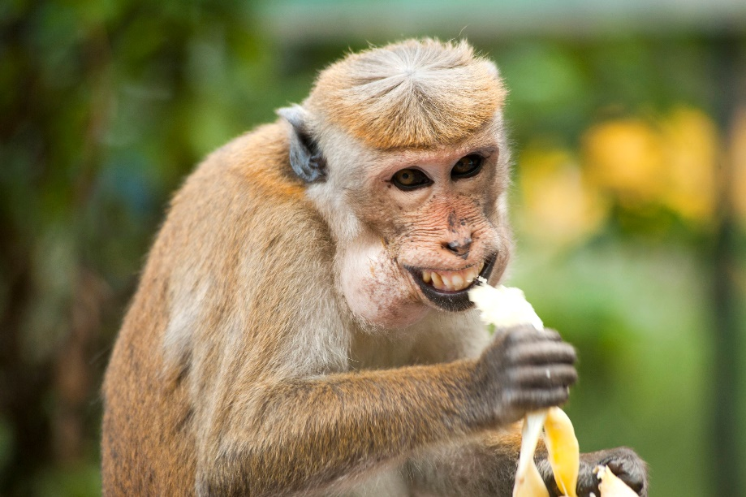
Skill development: I do
Answer the questions in note form
Use the notes to write the sentence- the order may be different to the order of the notes!
3. Write your sentence using correct punctuation.
4. Read your sentence – does it sound right?
CFU:
What sentence sounds better? The first or the second?
It ate a banana.
Who/what:
When:
Where:
How:
the cheeky monkey
on a sunny day
zoo
messily
On a sunny day at the zoo, the cheeky monkey messily ate a banana.
Messily, the cheeky monkey ate a banana at the zoo on a sunny day.

Slide 11
Skill development: We do
Answer the questions in note form
Use the notes to write the sentence- the order may be different to the order of the notes!
3. Write your sentence using correct punctuation.
4. Read your sentence – does it sound right?
CFU:
Did you need a comma in your sentence? Why/ why not?
He swims.
Who/what:
When:
Where:
How:
Why:
the toddler
a warm day
pool
playfully
to cool off

Slide 12
Skill development: We do
Answer the questions in note form
Use the notes to write the sentence- the order may be different to the order of the notes!
3. Write your sentence using correct punctuation.
4. Read your sentence – does it sound right?
CFU:
Who is the subject?
What is the verb?
Where does it happen?
When does it happen?
How does it happen?
Why does it happen?
She stacks blocks.
Who/what:
When:
Where:
How:
Why:
the little girl
after recess
on the desk
carefully
trying to build a tower

Slide 13
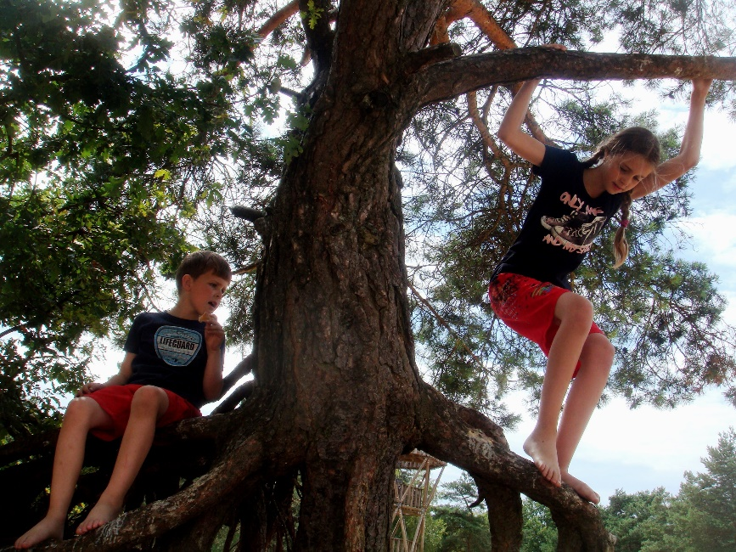
Skill development: You do
Answer the questions in note form
Use the notes to write the sentence- the order may be different to the order of the notes!
3. Write your sentence using correct punctuation.
4. Read your sentence – does it sound right?
CFU:
Who is the subject?
What is the verb?
Where does it happen?
When does it happen?
How does it happen?
Why does it happen?
They climb.
Who/what:
When:
Where:
How:
Why:

Slide 14
Skill development: You do
Answer the questions in note form
Use the notes to say the sentence
Write your sentence using correct punctuation.
4. Read your sentence – does it sound right?
Add kernel here.
Use kernels/pictures from topics/texts/knowledge units in class.
Who/what:
When:
Where:
How:
Why:

