Slide 1
Year: Foundation
Term: 1
Objective: Sentence Expansion – when, who, where
Author: Jasmyn Hall, Rebecca Glasson
ORAL ACTIVITY

Slide 2
Multiple Choice
Pair Share
Track with me
Pick a Stick/Answer (non-volunteer)
Whiteboards
Vote
Read with me
In Your Workbook

Slide 3
Question Words
Who/what?
(did) What?
When?
Where?
Why?
How?
Display this chart in classroom prior to lesson.
Optional: use Colourful Semantics icons in addition to question words. But please note, TWR does not distinguish between the ‘what doing/did what’ (verb) and the ‘what’ (object). If you are using a Colourful Semantics approach, you will need to consider this.

Slide 4
Learning Objective
We are learning to expand our sentences by adding extra information.

Slide 5
Activate Prior Knowledge
A sentence is a complete thought.
It must contain a subject (or who/what) and a verb (a do).
CFU:
What is the subject and the verb in these sentences?
Examples:
Jan hops.
The baby cried.
Tim sprinted.

Slide 6
Concept Development
A sentence is a complete thought.
It must contain a subject (or who/what) and a verb (a do).
CFU:
What is the subject and the verb in these sentences?
Examples:
Jan hops.
The baby cried.
Tim sprinted.
Boring !
These sentences are boring and do not contain any additional information.

Slide 7
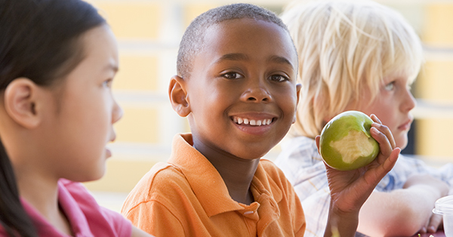
Concept Development
By adding additional information, we can expand sentences to make them more interesting.
Including when, who, what, and where will make your sentence more informative for the reader:
CFU:
Who ate?
Where?
When did they eat?
When?
Where?
Who?
What?
During lunchtime, Pat ate his apple outside.
Boring !
Pat ate.

Slide 8
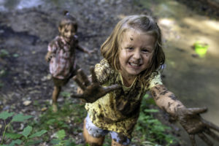
Concept Development
By adding additional information, we can expand sentences to make them more interesting.
Including when, who, what, and where will make your sentence more informative for the reader:
CFU:
Who splashed?
Where?
When did they splash?
2. What does ‘they’ refer to in the kernel sentence.
When?
Where?
Who?
What?
On a rainy day, the two girls splashed in muddy puddles.
Boring !
They splashed.

Slide 9
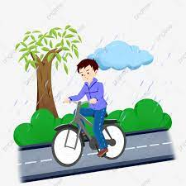
By adding additional information, we can expand sentences to make them more interesting.
Including when, who, what, and where will make your sentence more informative for the reader:
Concept Development
CFU:
Who is the subject?
What is the action?
Where does it occur?
When does it happen?
He rode.
When:
Who:
Where:
one rainy afternoon
Matthew
home from school
Example:
One rainy afternoon, Matthew rode home from school.

Slide 10
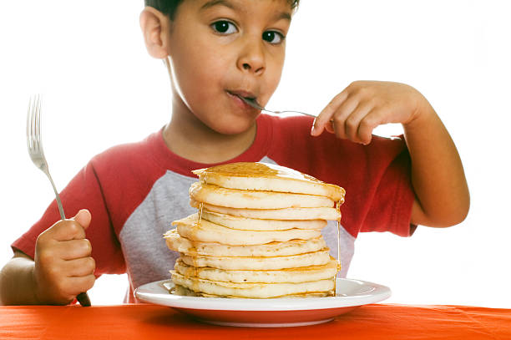
Concept Development
By adding additional information, we can expand sentences to make them more interesting.
Including when, who, what, and where will make your sentence more informative for the reader:
CFU:
Who is the subject?
What is the action?
Where does it occur?
When does it happen?
He ate.
When:
Who:
Where:
At breakfast
Jackson
at the table
At breakfast, Jackson ate at the table.

Slide 11
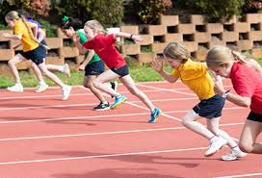
Concept Development
By adding additional information, we can expand sentences to make them more interesting.
Including when, who, what, and where will make your sentence more informative for the reader:
CFU:
Why is this not an example of an expanded sentence?
They raced.
When:
Who:
Where:
on sports carnival day
the children
around the track
Non-Examples:
The children raced around the track.
This sentence does not contain all of the information. It does not have the when.
On sports carnival day, raced.
This sentence does not make sense. It is missing words.

Slide 12
Hinge Point Question
Which sentences contain both a WHERE and a WHEN detail?
They drove to the ocean.
In the morning, Sally jogged around the block.
Yesterday, my teacher ate lunch in the staff room.
The dog fell asleep in his bed.

Slide 13
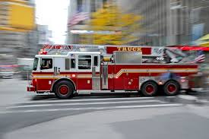
Skill development: I do
Answer the questions in note form
Use the notes to say the sentence, in this order:
When, who what where.
3. Check your sentence – does it sound right?
CFU:
Who is the subject?
What is the action?
Where does it occur?
When does it happen?
It raced.
When:
Who/what:
Where:
On Saturday
the fire engine
to the burning building
On Saturday,
the fire engine
raced
to the burning building.

Slide 14
Skill development: I do
Answer the questions in note form
Use the notes to say the sentence, in this order:
When, who what where.
3. Check your sentence – does it sound right?
CFU:
Who is the subject?
What is the action?
Where does it occur?
When does it happen?
She shops.
When:
Who:
Where:
the weekend
Jessica
at the supermarket
On the weekend,
Jessica
shops
at the supermarket.

Slide 15
Skill development: We do
Answer the questions in note form
Use the notes to say the sentence, in this order:
When, who what where.
3. Check your sentence – does it sound right?
CFU:
Who is the subject?
What is the action?
Where does it occur?
When does it happen?
She read.
When:
Who:
Where:
One sunny day
the little girl
hammock

Slide 16
Skill development: You do
Answer the questions in note form
Use the notes to say the sentence, in this order:
When, who what where.
3. Check your sentence – does it sound right?
CFU:
Who is the subject?
What is the action?
Where does it occur?
When does it happen?
They sang.
When:
Who:
Where:
Notes:
At Christmas, the children sang in the snow.

Slide 17
Skill development: You do
Answer the questions in note form
Use the notes to say the sentence, in this order:
When, who what where.
3. Check your sentence – does it sound right?
CFU:
Who is the subject?
What is the action?
Where does it occur?
When does it happen?
It howled.
When:
Who/what:
Where:

