Slide 1
Year: Foundation
Term: Term 3
Objective: Complete a sentence stem ending with the subordinating conjunction because (to form a complex sentence)
Author: Skye-Anne Cooke

Slide 2
Copy and paste these icons to the appropriate slides to indicate engagement norms/CFU strategies
Multiple Choice
Pair Share
Track with me
Pick a Stick/Answer (non-volunteer)
Whiteboards
Vote
Read with me
In Your Workbook

Slide 3
Learning Objective
We are learning to complete a sentence stem using the conjunction because.

Slide 4
because
Concept Development
CFU:
What is a conjunction?
What does the word because mean?
is a conjunction
Tells us why something has happened
The dog ran away because the gate was left open.
Notes:
Give students sentence-stem activities with but, because, and so to enable them to think critically and to use and understand more complex sentences in their writing and reading

Slide 5
Concept Development
A conjunction is a joining word that joins two sentences together.
Because is a conjunction that tells the reader why.
After using a conjunction you need to give more information to finish the sentence.
CFU:
What is a conjunction?
What does the word because mean?
Examples:
I like her because she is delightful.
We had cake because it was my birthday.
I did not sprint because my leg was sore.

Slide 6
Concept Development
Non-Examples:
CFU:
Why is this not an example of using because as a conjunction?
I was hungry because I went to get food.
Because tells us WHY something has happened. It doesn’t make sense in this sentence. A better word would have been ‘so’.
Because it was raining.
This sentence does not use because to join two sentences together- there is information missing.

Slide 7
Hinge Point Question
Vote
Which of these sentences uses ‘because’ correctly?
CFU:
Why is it/ isn’t it an example of using because ?
Go through each option one-at-a-time and have students vote, and then explain their answer.
I am happy because I won the race.
I love apples because I like bananas.
The flower needed water because it was drooping.
A conjunction is a joining word that joins two sentences together.
Because is a conjunction that tells the reader why.
After using a conjunction you need to give more information to finish the sentence.

Slide 8
Concept Development-
re-explanation
CFU:
Why was I crying?
Why couldn’t the boy play his iPad?
Why did his ice-cream melt?
I was crying because I hurt my knee.
He can’t play on his iPad because it is broken.
My ice-cream melted because it was a hot day.

Slide 9
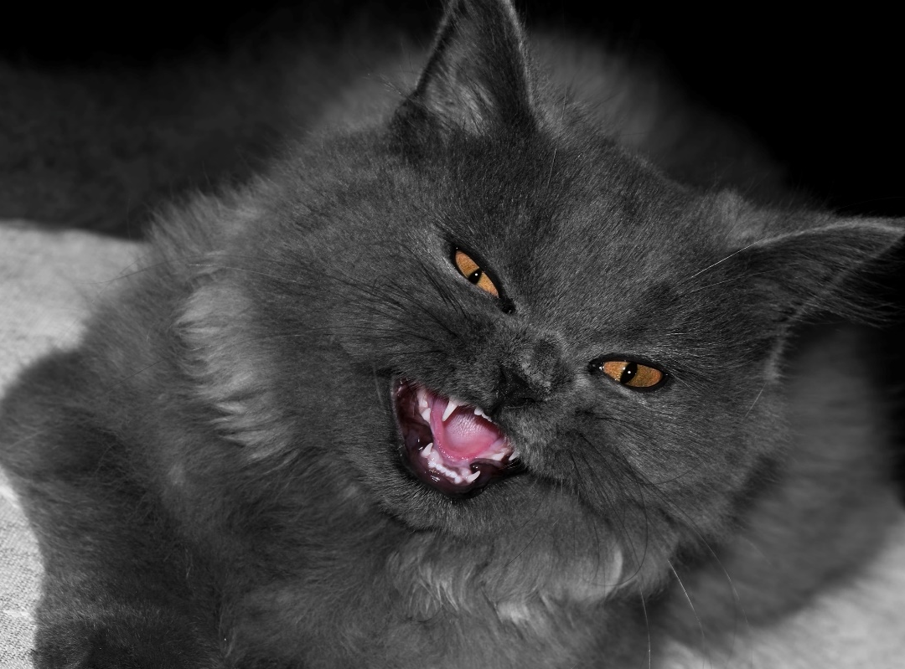
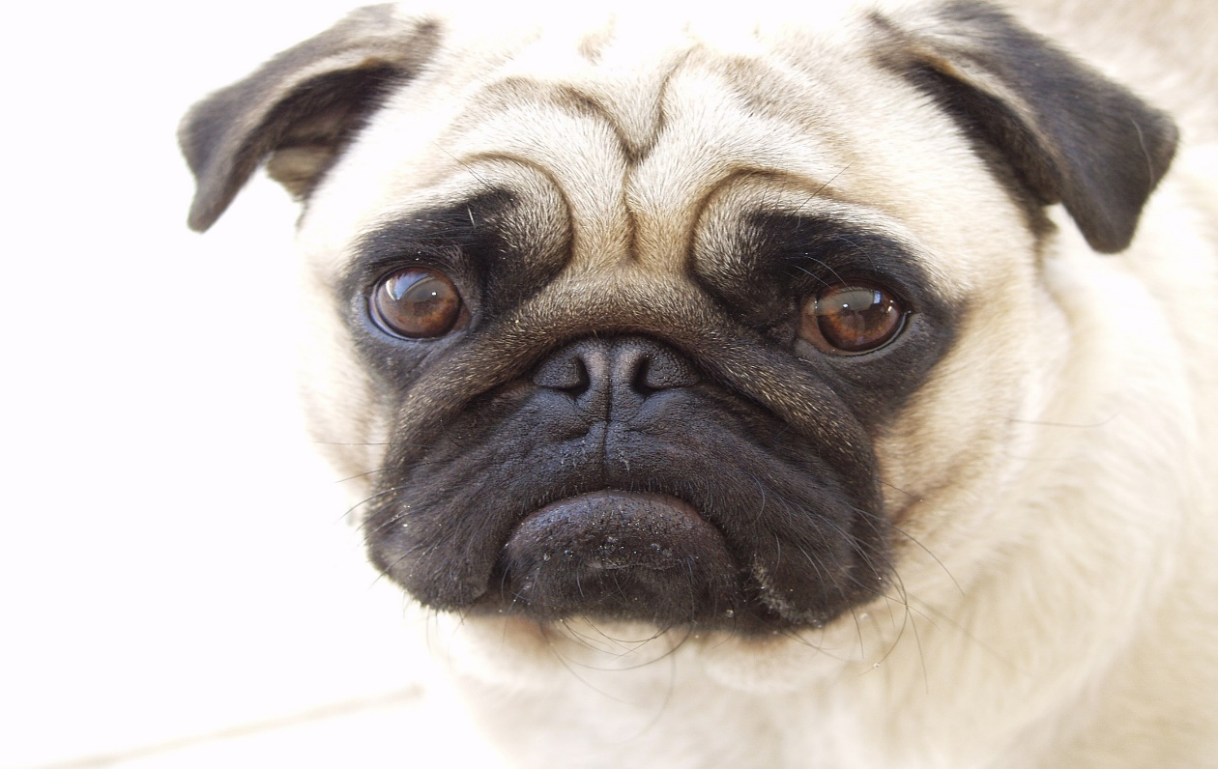
Skill Development: We do (oral)
Finish the sentence stem using the conjunction because by adding the extra information to explain WHY.
Remember to use a full sentence answer.
CFU:
Why is the dog sad?
Why are the clouds grey?
What was making the cat hiss?
The dog is miserable because
The clouds are grey because
My cat hissed because

Slide 10
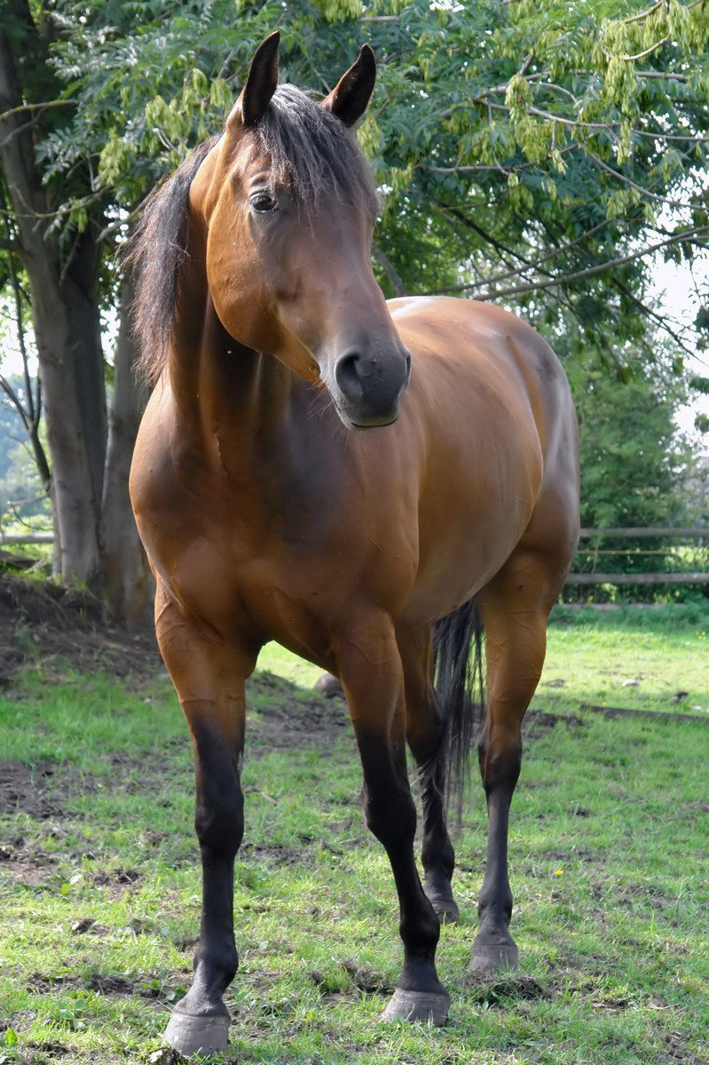
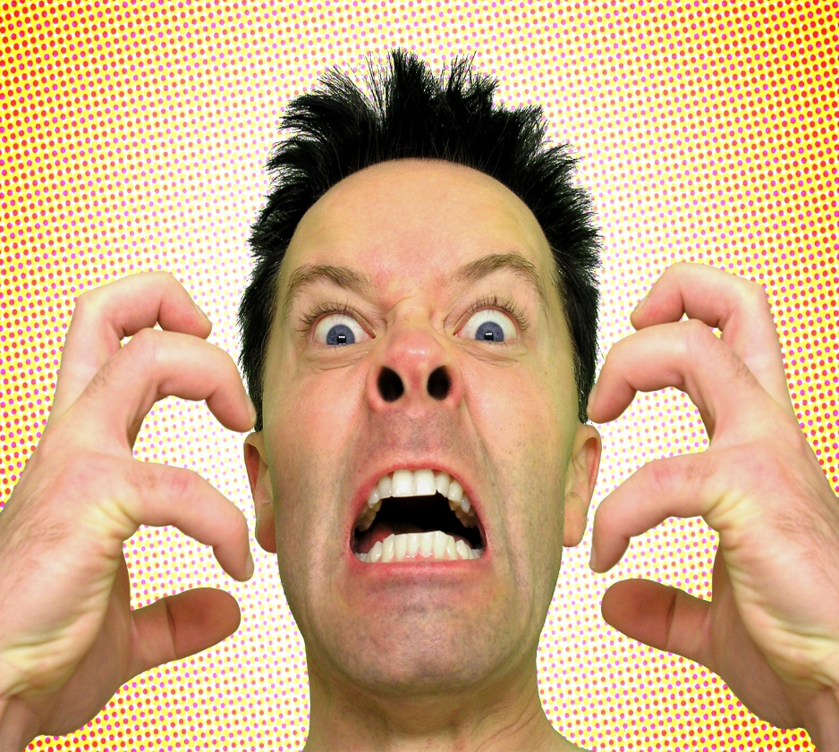
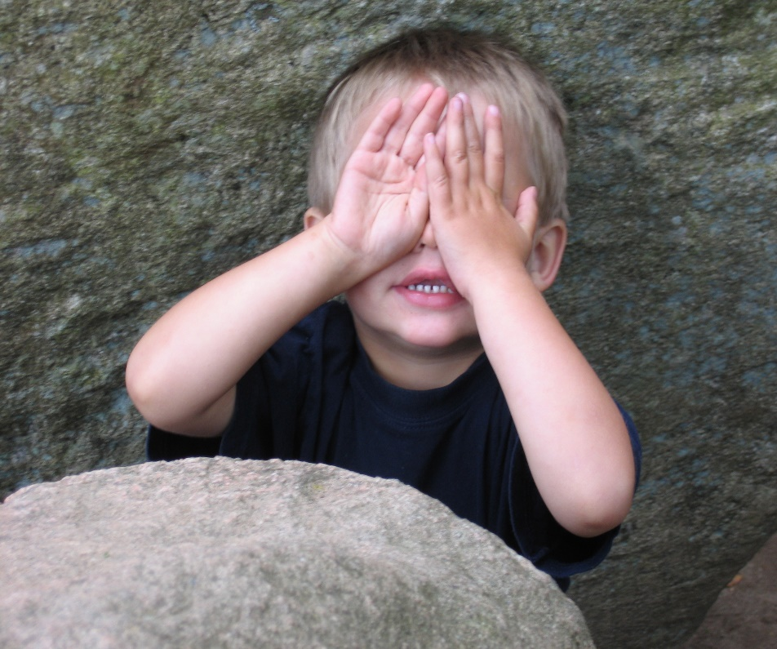
Skill development: I do, We do, You Do (Written)
Write the sentence stem
Finish the sentence- remember that because shows a WHY relationship.
CFU:
Why were you furious?
Why is your horse beautiful?
Why was the child hiding?
I was furious because…
My horse is beautiful because…
The child was hiding because…

Slide 11
Skill development: I do, We do, You Do (Written)
Write the sentence stem
Finish the sentence- remember that because shows a WHY relationship.
CFU:
Why were you furious?
Why is your horse beautiful?
Why was the child hiding?
Insert sentences from class texts/topics/knowledge units

