Slide 1
Year: 4
Term: 2
Objective: Generate compound sentences using coordinating conjunctions FANBOYS (separated by a comma before the conjunction)
Author: Lauren Van Dongen

Slide 2
Copy and paste these icons to the appropriate slides to indicate engagement norms/CFU strategies
Multiple Choice
Pair Share
Track with me
Pick a Stick/Answer (non-volunteer)
Whiteboards
Vote
Read with me
In Your Workbook

Slide 3
Learning Objective
We are learning to generate compound sentences using coordinating conjunctions (FANBOYS)

Slide 4
Concept Development
A compound sentence is made up of 2 independent clauses joined by a comma and coordinating conjunction.
The seven coordinating conjunctions are for, and, nor, but, or, yet, so (FANBOYS)
F | A | N | B | O | Y | S
For | And | Nor | But | Or | Yet | So

Slide 5
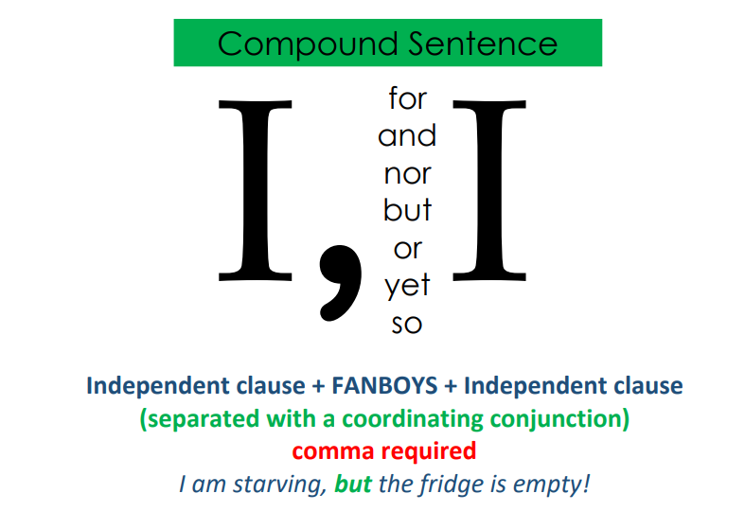
Concept Development
Use a comma immediately after the first independent clause, then a coordinating conjunction, and finally the second independent clause.
CFU:
Where do you place the comma in a compound sentence?

Slide 6
Concept Development
A compound sentence is made up of 2 independent clauses joined by a comma and coordinating conjunction.
The seven coordinating conjunctions are for, and, nor, but, or, yet, so (FANBOYS)
Use a comma immediately after the first independent clause, then a coordinating conjunction, and finally the second independent clause.
CFU:
What is a compound sentence?
What is the first independent clause in this sentence?
What is the second independent clause in this sentence?
What is the coordinating conjunction in this sentence?
Examples:
1. Lily went to the store, but it was closed.
2. Harry was scared by the thunderstorm, and he screamed in fear.
3. We could all go to the skate park, or we could go to the playground.

Slide 7
Concept Development
A compound sentence is made up of 2 independent clauses joined by a comma and coordinating conjunction.
The seven coordinating conjunctions are for, and, nor, but, or, yet, so (FANBOYS)
Use a comma immediately after the first independent clause, then a coordinating conjunction, and finally the second independent clause.
CFU:
Why is this not an example of a compound sentence?
Non-Examples:
1. Emily likes chocolate, lollies and ice-cream.
This sentence is using ‘and’ as part of a list. It is not joining two independent clauses.
2. Zach will be in Sydney for three nights.
‘For’ is being used as a preposition, not a coordinating conjunction.

Slide 8
Concept Development
Underline the first independent clause.
Circle the comma and coordinating conjunction.
Underline the second independent clause.
CFU:
What is the first independent clause?
What is the coordinating conjunction?
What is the second independent clause?
Archie kicked the winning goal, and his team celebrated with him.
The young boy didn’t want to go to the dentist, yet he went anyway.
Everyone was busy, so I went to the movies alone.

Slide 9
Hinge Point Question
What sentences are compound?
It was very hot outside, so the ice-cream melted.
Archie had cereal for breakfast.
I missed the start of school, for the bus had a flat tyre.
Harry loves playing football so much.
Zach missed soccer training, so he wasn’t allowed to play in the game.
CFU:
Why is it/ isn’t it a an example of a compound sentence?
A compound sentence is made up of 2 independent clauses joined by a comma and coordinating conjunction.
The seven coordinating conjunctions are for, and, nor, but, or, yet, so (FANBOYS)
Use a comma immediately after the first independent clause, then a coordinating conjunction, and finally the second independent clause.

Slide 10
Concept Development
Underline the first independent clause.
Circle the comma and coordinating conjunction.
Underline the second independent clause.
CFU:
What is the first independent clause?
What is the coordinating conjunction?
What is the second independent clause?
Lily practised her times tables at home, for she wanted to learn them.
The dog buried her bone, so she could go back to it later.
I do not like cabbage, nor do I like cauliflower.

Slide 11
Skill Progression
1
Select a coordinating conjunction to join two independent clauses to create a compound sentence.
2
Given an independent clause and a coordinating conjunction, generate a second independent clause to complete the compound sentence.
3
Given an independent clause, generate a coordinating conjunction and a second independent clause to complete the compound sentence.

Slide 12
Skill Progression
1
Select a coordinating conjunction to join two independent clauses to create a compound sentence.
FOCUS
2
Given an independent clause and a coordinating conjunction, generate a second independent clause to complete the compound sentence.
3
Given an independent clause, generate a coordinating conjunction and a second independent clause to complete the compound sentence.

Slide 13
Skill development: I do
Select the appropriate coordinating conjunction
Write the first independent clause and the conjunction
Punctuate with a comma
Write the remainder of the sentence
CFU:
Which conjunction is most suitable?
Hayley went to the store,_______ It was closed.
but
or
so
Hayley went to the store, but it was closed.

Slide 14
Skill development: We do
Select the appropriate coordinating conjunction
Write the first independent clause and the conjunction
Punctuate with a comma
Write the remainder of the sentence
Jack was late to class,_________ he got in trouble.
but
so
nor
Jack was late to class, so he got in trouble.

Slide 15
Skill development: We do
Select the appropriate coordinating conjunction
Write the first independent clause and the conjunction
Punctuate with a comma
Write the remainder of the sentence
Molly was rushing, _______ she was running late for school.
or
so
for
Molly was rushing, for she was running late for school.

Slide 16
Skill development: You do
Select the appropriate coordinating conjunction
Write the first independent clause and the conjunction
Punctuate with a comma
Write the remainder of the sentence
1. Lily plays the flute, ______she does not play the piano.
2. We could go to the movies now, ______we could wait for Jen to arrive.
3. It was raining heavily outside, ________we couldn’t go to the park.
4. I missed the bus, _______ I slept in.

Slide 17
Skill Progression
1
Select a coordinating conjunction to join two independent clauses to create a compound sentence.
2
Given an independent clause and a coordinating conjunction, generate a second independent clause to complete the compound sentence.
FOCUS
3
Given an independent clause, generate a coordinating conjunction and a second independent clause to complete the compound sentence.

Slide 18
Skill development: I do
Read the first independent clause and conjunction.
Finish the sentence with a second independent clause that matches with the meaning of the conjunction.
CFU:
Which second independent clause matches best with the conjunction and the first independent clause so the sentence makes complete sense?
Rue didn’t do her homework, so …
the shops shut early.
the electricity went out.
she got into trouble.
Rue didn’t do her homework, so she got into trouble.

Slide 19
Skill development: We do
Read the first independent clause and conjunction.
Finish the sentence with a second independent clause that matches with the meaning of the conjunction.
The team’s supporters were cheering loudly, for …
they won the game.
they lost the game.
it was time for bed.
The team’s supporters were cheering loudly, for they won the game.

Slide 20
Skill development: We do
Read the first independent clause and conjunction.
Finish the sentence with a second independent clause that matches with the meaning of the conjunction.
Josh doesn’t like eggs, nor …
the sun rise was beautiful.
does he like bacon.
he was tired.
Josh doesn’t like eggs, nor does he like bacon.

Slide 21
Skill development: We do
Read the first independent clause and conjunction.
Finish the sentence with a second independent clause that matches with the meaning of the conjunction.
The trick or treaters rang the doorbell, but …
I don’t like eating carrots.
it was a sunny day.
no one answered.
The trick or treaters rang the doorbell, but no one answered.

Slide 22
Skill development: You do
Read the first independent clause and conjunction.
Finish the sentence with a second independent clause that matches with the meaning of the conjunction.
1. Paul jogs 5 kilometres every morning, so
2. The ocean was very rough, but
3. It was raining heavily outside, and
4. You can have spaghetti for dinner, or you can

Slide 23
Skill Progression
1
Select a coordinating conjunction to join two independent clauses to create a compound sentence.
2
Given an independent clause and a coordinating conjunction, generate a second independent clause to complete the compound sentence.
3
Given an independent clause, generate a coordinating conjunction and a second independent clause to complete the compound sentence.
FOCUS

Slide 24
Skill development: I do
Read the first independent clause.
Select a coordinating conjunction and finish the compound sentence.
CFU:
Which second independent clause and conjunction matches best with the first independent clause so the sentence makes complete sense?
Jane had to work on Saturday, __________ …
F | A | N | B | O | Y | S
For | And | Nor | But | Or | Yet | So
Jane had to work on Saturday, so she couldn’t go to the park.

Slide 25
Skill development: We do
Read the first independent clause.
Select a coordinating conjunction and finish the compound sentence.
I tried my best to wash the floor, __________ …
F | A | N | B | O | Y | S
For | And | Nor | But | Or | Yet | So
I tried my best to wash the floor, but it was still dirty.

Slide 26
Skill development: We do
Read the first independent clause.
Select a coordinating conjunction and finish the compound sentence.
Jemma texted her mother, __________ …
F | A | N | B | O | Y | S
For | And | Nor | But | Or | Yet | So
Jemma texted her mother, for she needed to be picked up.

Slide 27
Skill development: We do
Read the first independent clause.
Select a coordinating conjunction and finish the compound sentence.
We could have ice-cream for dessert, __________ …
F | A | N | B | O | Y | S
For | And | Nor | But | Or | Yet | So
We could have ice-cream for dessert, or we could have cheesecake.

Slide 28
Skill development: You do
Read the first independent clause.
Select a coordinating conjunction and finish the compound sentence.
1. The farmer started his tractor
2. Sofia asked Asha to be quiet
3. Dexter kicked the football
4. The whole class were working beautifully

Slide 29
Skill development: You do
Read the first independent clause.
Select a coordinating conjunction and finish the compound sentence.
1. Add in your own sentence stems based on texts/content taught in class
2.
3.
4.

