Slide 1
Year: 5/6
Term: 1
Objective: We are learning to complete a sentence summary of a passage using expansion words (who, what, when, where, why)
Author: Ebony Dowson, Rodney Turnor, Nathan Brown, Stephanie Le Lievre

Slide 2
Multiple Choice
Pair Share
Track with me
Pick a Stick/Answer (non-volunteer)
Whiteboards
Vote
Read with me
In Your Workbook

Slide 3
Concept Development
Sentence Summary: summarise the main idea of the passage in one sentence using expansion words.
Who/what? identifies the subject
Did/will do? contains the main verb
When? time it happened
Where? location it happened
Why? reason it happened
How? the way it happened

Slide 4
Skill Development: I do
As a snake grows, its skin becomes too tight for its body. When this happens, the snake grows a new skin underneath the old one. When the new skin is ready, the snake sheds its old skin. A snake follows several steps to shed its skin. First, the snake rubs against rough objects to rip its skin. Next, it crawls against the ground or through narrow places to strip off the skin. Finally, the outside layer of the scaly skin comes off. This old skin looks like an empty snake.

Slide 5
Skill Development: I do
Answer the questions in note form
2. Write your sentence summary using correct punctuation.
3. Read your sentence – does it sound right?
Who/what:
did/will do:
When:
Where:
How:
Why:
As a snake grows, its skin becomes too tight for its body. When this happens, the snake grows a new skin underneath the old one. When the new skin is ready, the snake sheds its old skin. A snake follows several steps to shed its skin. First, the snake rubs against rough objects to rip its skin. Next, it crawls against the ground or through narrow places to strip off the skin. Finally, the outside layer of the scaly skin comes off. This old skin looks like an empty snake.
snake
shed skin
as it grows
by rubbing and crawling
make way for the new skin
As snake’s skin grows, it sheds its skin by rubbing and crawling to make way for the new skin.

Slide 6
Skill Development: I do
We can change the order of sentence elements.
Who/what:
did/will do:
When:
Where:
How:
Why:
snake
As a snake grows, its skin becomes too tight for its body. When this happens, the snake grows a new skin underneath the old one. When the new skin is ready, the snake sheds its old skin. A snake follows several steps to shed its skin. First, the snake rubs against rough objects to rip its skin. Next, it crawls against the ground or through narrow places to strip off the skin. Finally, the outside layer of the scaly skin comes off. This old skin looks like an empty snake.
shed skin
as it grows
by rubbing and crawling
make way for the new skin
In order to make way for new skin, as a snake grows, it must shed its skin by rubbing and crawling.

Slide 7
Skill Development: We do
Apollo 11 was the first flight to send people to the moon. It was done by NASA, the American space group. It went up to space on 16 July 1969, carrying three astronauts: Neil Armstrong, Buzz Aldrin and Michael Collins. On 20 July 1969, Armstrong and Aldrin became the first humans to land on the moon, while Collins stayed in orbit around the Moon.
The flight was part of the International Space Race. It finished the plan set by John F. Kennedy in 1961 to "land a man on the moon, and return him safely to the Earth", before the 1960s ended.

Slide 8
Skill Development: We do
Answer the questions in note form
2. Write your sentence summary using correct punctuation.
3. Read your sentence – does it sound right?
Who/what:
did/will do:
When:
Where:
How:
Why:
Apollo 11 was the first flight to send people to the moon. It was done by NASA, the American space group. It went up to space on 16 July 1969, carrying three astronauts: Neil Armstrong, Buzz Aldrin and Michael Collins. On 20 July 1969, Armstrong and Aldrin became the first humans to land on the moon, while Collins stayed in orbit around the Moon.
The flight was part of the International Space Race. It finished the plan set by John F. Kennedy in 1961 to "land a man on the moon, and return him safely to the Earth", before the 1960s ended.
Three astronauts
first humans to land
16th July 1969
on the moon
Apollo 11
International Space Race
On the 16th July 1969, three astronauts became the first humans to land on the moon by travelling on Apollo 11 as part of the International Space Race.

Slide 9
Skill Development: We do
The First Fleet, consisting of 11 vessels, was the largest single contingent of ships to sail into the Pacific Ocean. Its purpose was to find a convict settlement on the east coast of Australia, at Botany Bay. The First Fleet sailed from England on 13 May 1787 and arrived at Botany Bay eight months later, on 18 January 1788. Governor Arthur Phillip rejected Botany Bay choosing instead Port Jackson, to the north, as the site for the new colony; they arrived there on 26 January 1788. The number of convicts transported in the First Fleet is unclear; there were between 750-780 convicts and around 550 crew, soldiers and family members.

Slide 10
Skill Development: We do
Answer the questions in note form
2. Write your sentence summary using correct punctuation.
3. Read your sentence – does it sound right?
Who/what:
did/will do:
When:
Where:
How:
Why:
the First Fleet
The First Fleet, consisting of 11 vessels, was the largest single contingent of ships to sail into the Pacific Ocean. Its purpose was to find a convict settlement on the east coast of Australia, at Botany Bay. The First Fleet sailed from England on 13 May 1787 and arrived at Botany Bay eight months later, on 18 January 1788. Governor Arthur Phillip rejected Botany Bay choosing instead Port Jackson, to the north, as the site for the new colony; they arrived there on 26 January 1788. The number of convicts transported in the First Fleet is unclear; there were between 750-780 convicts and around 550 crew, soldiers and family members.
Sailed
1787
England → Botany Bay
to find a convict settlement
In 1787, the First Fleet sailed from England to Botany Bay to find a convict settlement on the east coast of Australia.

Slide 11
Skill Development: We do
The butterfly and moth develop through a process called metamorphosis. This is a Greek word that means transformation or change in shape.
Insects have two common types of metamorphosis. Grasshoppers, crickets, dragonflies, and cockroaches have incomplete metamorphosis. The young (called a nymph) usually look like small adults but without the wings.
Butterflies, moths, beetles, flies and bees have complete metamorphosis. The young (called a larva instead of a nymph) is very different from the adults. It also usually eats different types of food.
There are four stages in the metamorphosis of butterflies and moths: egg, larva, pupa, and adult.

Slide 12
Skill Development: We do
Answer the questions in note form
2. Write your sentence summary using correct punctuation.
3. Read your sentence – does it sound right?
Who/what:
did/will do:
When:
Where:
How:
Why:
The butterfly and moth develop through a process called metamorphosis. This is a Greek word that means transformation or change in shape.
Insects have two common types of metamorphosis. Grasshoppers, crickets, dragonflies, and cockroaches have incomplete metamorphosis. The young (called a nymph) usually look like small adults but without the wings.
Butterflies, moths, beetles, flies and bees have complete metamorphosis. The young (called a larva instead of a nymph) is very different from the adults. It also usually eats different types of food.
There are four stages in the metamorphosis of butterflies and moths: egg, larva, pupa, and adult.
Butterfly & moth
develop/change (metamorphosis)
4 stages
The butterfly and moth develop through a change process called metamorphosis involving 4 stages: egg, larva, pupa, and adult.

Slide 13
Skill Development: You do
Choose text relating to topic in class

Slide 14
Skill Development: You do
Answer the questions in note form
2. Write your sentence summary using correct punctuation.
3. Read your sentence – does it sound right?
Who/what:
did/will do:
When:
Where:
How:
Why:
Passage

Slide 15
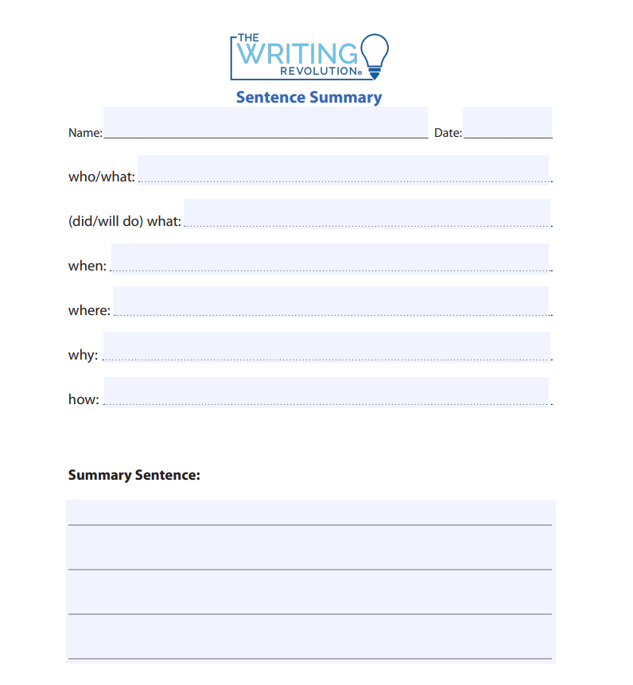
Skill Development: You do
Answer the questions in note form
2. Write your sentence using correct punctuation.
3. Read your sentence – does it sound right? Do you need to change the order?
Download TWR template from the website.

