Slide 1
Year: Foundation
Term: 2
Objective: Construct simple decodable sentences (who/what + what doing)
Author: Stephanie Le Lievre

Slide 2
Multiple Choice
Pair Share
Track with me
Pick a Stick/Answer (non-volunteer)
Whiteboards
Vote
Read with me
In Your Workbook

Slide 3
Question Words
Who/what?
(did) What?
When?
Where?
Why?
How?
Display this chart in classroom prior to lesson.
Optional: use Colourful Semantics icons in addition to question words. But please note, TWR does not distinguish between the ‘what doing/did what’ (verb) and the ‘what’ (object). If you are using a Colourful Semantics approach, you will need to consider this.

Slide 4
Learning Objective
We are learning to write sentences containing a
WHO/WHAT (subject) + WHAT DOING (verb).

Slide 5
Concept Development
A sentence is a complete thought that makes sense.
A sentence must:
make sense
have a WHO/WHAT
and a WHAT DOING

Slide 6
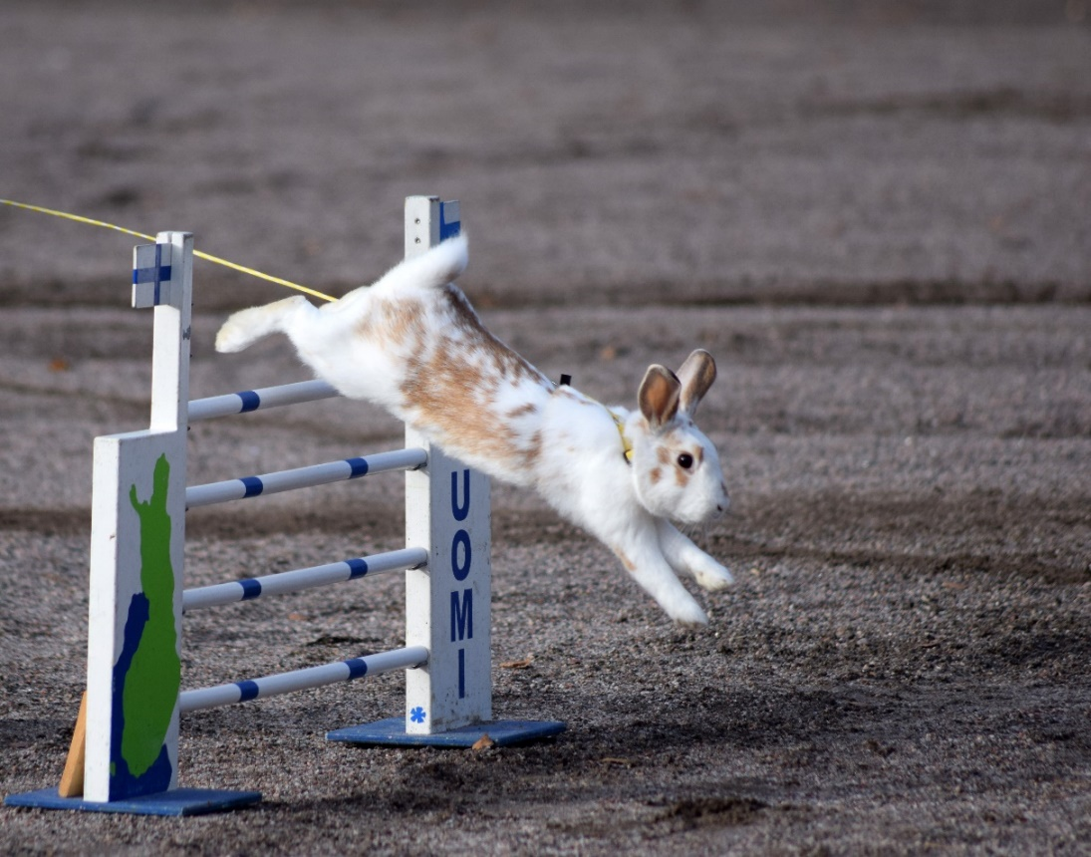
Concept Development
A sentence is a complete thought that makes sense.
A sentence needs a ‘who/what’ and a ‘what doing’ (or a who and a do)
The who/what is the subject.
The ‘what doing’ contains the verb.
CFU:
Say the sentence.
What’s the ‘who’ of the sentence?
What’s the verb of the sentence?
Example:
WHO/WHAT?
WHAT DOING?
The rabbit jumps.

Slide 7
Concept Development
A sentence is a complete thought that makes sense.
A sentence needs a ‘who/what’ and a ‘what doing’ (or a who and a do)
CFU:
What is a sentence?
What does a sentence need?
Example:
WHO?
WHAT DOING?
The boy kicks.

Slide 8
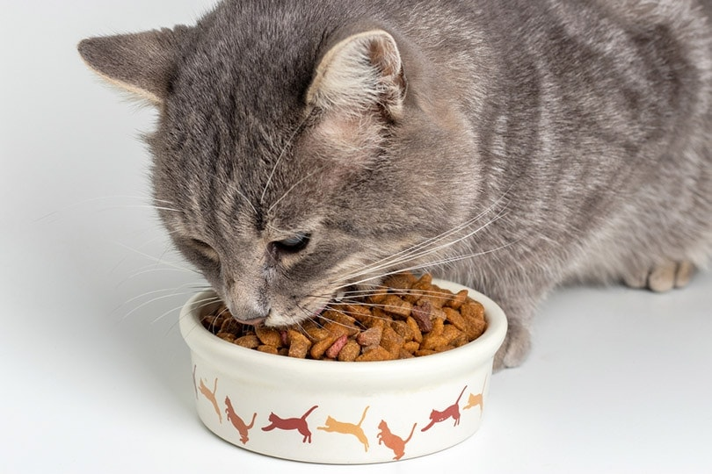
Skill Development: I do
Let’s build some sentences using these pictures.
who/what what doing
CFU:
What’s the sentence? What is the who/what? What is the do?
Model writing: The cat eats

Slide 9
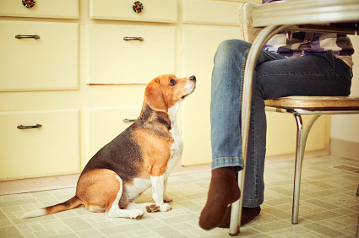
Skill Development: We do
Now let’s write our sentence.
who/what what doing
CFU:
What’s the sentence? What is the who/what? What is the do?
Guided writing
Notes:
The dog sits

Slide 10
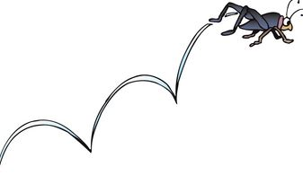
Skill Development: We do
Now let’s write our sentence.
CFU:
What’s the sentence? What is the who/what? What is the do?
who/what what doing
Guided writing
Notes:
The bug jumps

Slide 11
Skill Development: We do
Now let’s write our sentence.
CFU:
What’s the sentence? What is the who/what? What is the do?
who/what what doing
Guided writing
Notes:
The man claps

Slide 12
Skill Development: We do
Now let’s write our sentence.
CFU:
What’s the sentence? What is the who/what? What is the do?
who/what what doing
Guided writing
Notes:
The cat sits

Slide 13
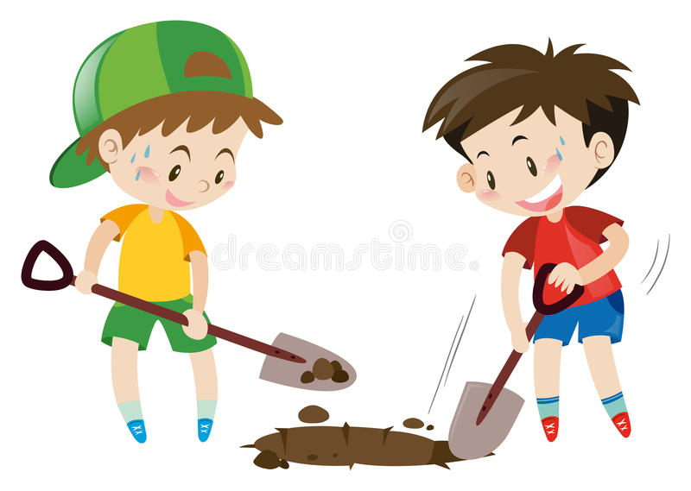
Skill Development: We do
Now let’s write our sentence.
CFU:
What’s the sentence? What is the who/what? What is the do?
who/what what doing
Guided writing
Notes:
The kids dig.

Slide 14
Skill Development: You do
Now let’s write our sentence.
CFU:
What’s the sentence? What is the who/what? What is the do?
who/what what doing
Independent practice
Notes:
The frog jumps

Slide 15
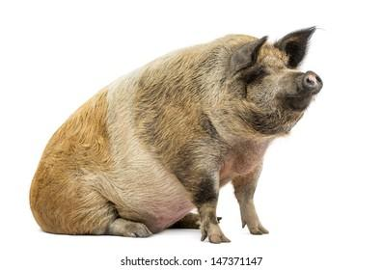
Skill Development: You do
Now let’s write our sentence.
CFU:
What’s the sentence? What is the who/what? What is the do?
who/what what doing
Independent practice
Notes:
The pig sits

Slide 16
Skill Development: You do
Now let’s write our sentence.
CFU:
What’s the sentence? What is the who/what? What is the do?
who/what what doing
Use pictures from the decodable texts used in class.
Independent practice
Notes:
The pig sits

