Slide 1
Year: 2
Term:3
Objective: Use a comma to separate items in a list
Author: Fiona Hart

Slide 2
Multiple Choice
Pair Share
Track with me
Pick a Stick/Answer (non-volunteer)
Whiteboards
Vote
Read with me
In Your Workbook

Slide 3
Learning Objective
We are learning to use commas to separate items in a list.

Slide 4
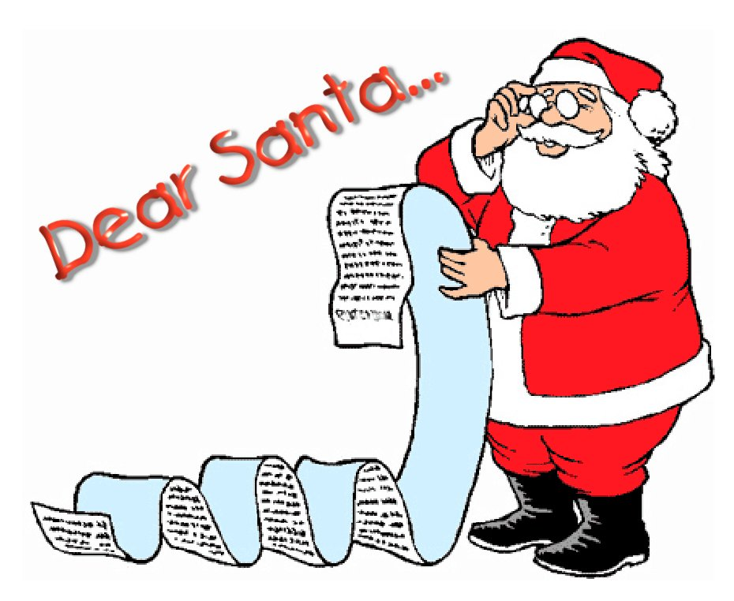
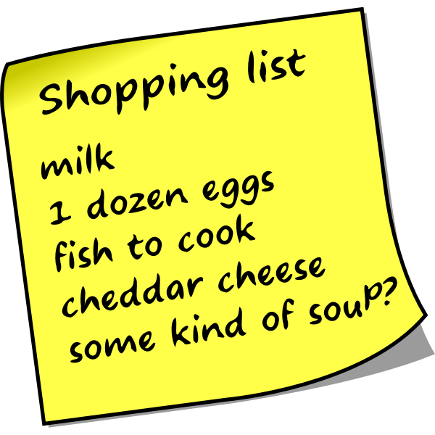
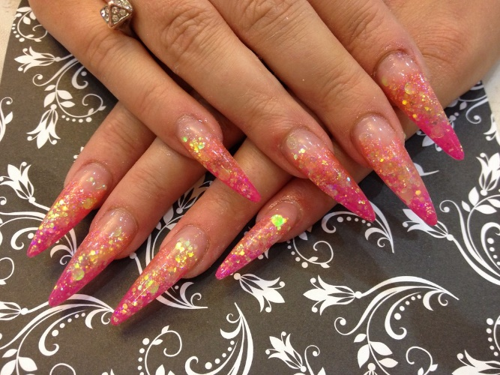
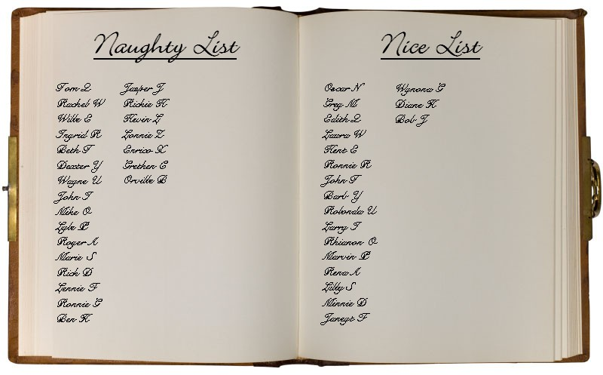
Activate Prior Knowledge
A list is a set of words or thoughts linked to one main idea.
Lists can be nouns, such as items to remember at the shop.
Lists can also be adjectives, such as ways to describe one thing.
A list should have at least three words linked to the main idea.
CFU:
What is the main idea in this list?
What words are linked to the main idea?
Examples:
The nails are sharp, pink and sparkly.
This Photo by Unknown Author is licensed under CC BY-NC-ND
This Photo by Unknown Author is licensed under CC BY

Slide 5
Concept Development
You can write a list by separating items with a comma.
Use a conjunction, usually ‘and’, between your last two items.
Examples:
CFU:
Circle the main idea.
Underline the linked items or describing words.
Point to the commas and conjunction.
Priscilla, Jane, Amanda and John are on Santa’s nice list.
The witch’s nose was long, pointed and red.
The elephant’s ears are large, wrinkly and grey.

Slide 6
Concept Development
You can write a list by separating items with a comma.
Use a conjunction, usually ‘and’, between your last two items.
CFU:
Are there three items linked to the main idea? NO – not a list.
Is there a comma between items and the last item joined with ‘and’? NO – not a correctly punctuated list.
Not a list:
John is on Santa’s naughty list.
The witch has a long pointy nose.
An elephant has large, wrinkly, grey, flat ears.
On library day you should bring your reading book.

Slide 7
Concept Development – Hinge Point
Vote
You can write a list by separating items with a comma.
Use a conjunction, usually ‘and’, between your last two items.
CFU:
Are there three or more items linked to the main idea?
Is there a comma between items and the last item joined with ‘and’?
Is this a correct example of a list?
We saw a dog, cat, sheep and horse on the farm.
The birthday cake had chocolate icing marshmallows and cream.
A hippo has big teeth.
During swimming lessons, make sure you bring a towel, bathers, goggles and sunscreen.

Slide 8
Skill development: I do
Write a sentence beginning.
Write the first item, then a comma.
Write the next item, then a comma. Repeat for other items until the last.
Before the last item, write <and>.
CFU:
What is the main idea?
Are there more than three items?
How do I separate the items?
Why do I use ‘and’ here?
Shopping List
apples
bread
cheese
milk
At the shops, we will buy

Slide 9
Skill development: We do / You Do
Write a sentence beginning.
Write the first item, then a comma.
Write the next item, then a comma.
Before the last item, write <and>.
CFU:
What is the main idea?
Are there more than three items?
How do I separate the items?
Why do I use ‘and’ here?
Kmart
toaster
dog toy
book
At Kmart, we will buy

Slide 10
Skill development: I do
Write a sentence beginning.
Write the first item, then a comma.
Write the next item, then a comma.
Before the last item, write <and>.
CFU:
What is the main idea?
Are there more than three items?
How do I separate the items?
Why do I use ‘and’ here?
Birthday Wish List
puppy
book
fidget toy
For my birthday, I would like

Slide 11
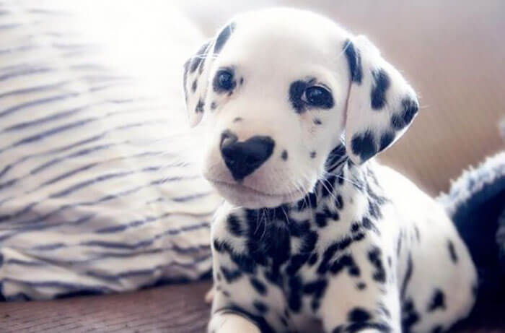
Skill development: We do/You Do
Write your sentence beginning.
Write the first item, then a comma.
Write the next item, then a comma.
Before the last item, write <and>.
CFU:
What is the main idea?
Are there more than three items?
How do I separate the items?
Why do I use ‘and’ here?
adorable
spotty
small
This puppy is

Slide 12
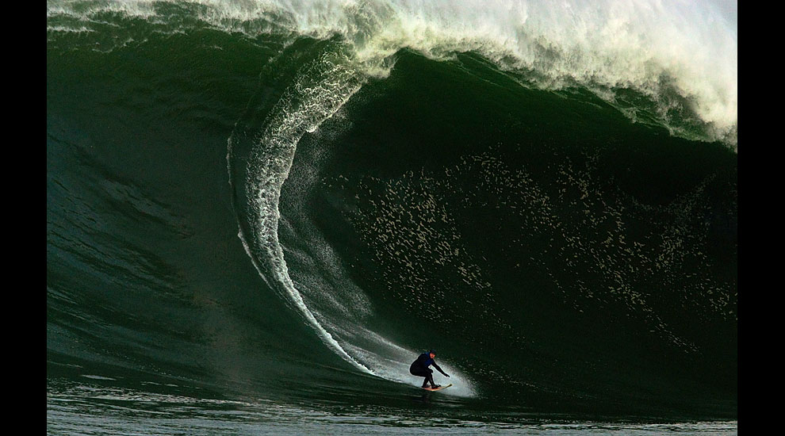
Skill development: You do
Write your sentence beginning.
Write the first item, then a comma.
Write the next item, then a comma.
Before the last item, write <and>.
CFU:
What is the main idea?
Are there more than three items?
How do I separate the items?
Why do I use ‘and’ here?
strong
daring
brave
This big wave surfer is

Slide 13
Skill Development Extra – writing adjectives in a list: I do
Write your sentence beginning.
Write the first item, then a comma.
Write the next item, then a comma.
When you end the sentence with the main idea, write <and> between the last two adjectives.
CFU:
What is the main idea?
Are there more than three items?
How do I separate the items?
Why do I use ‘and’ here?
old
haunted
gloomy
Use ‘and’ between the last two adjectives.
The boy saw an old, haunted and gloomy castle.
The boy saw an old, haunted, gloomy and castle.
The boy saw an old, haunted and gloomy, castle.

Slide 14
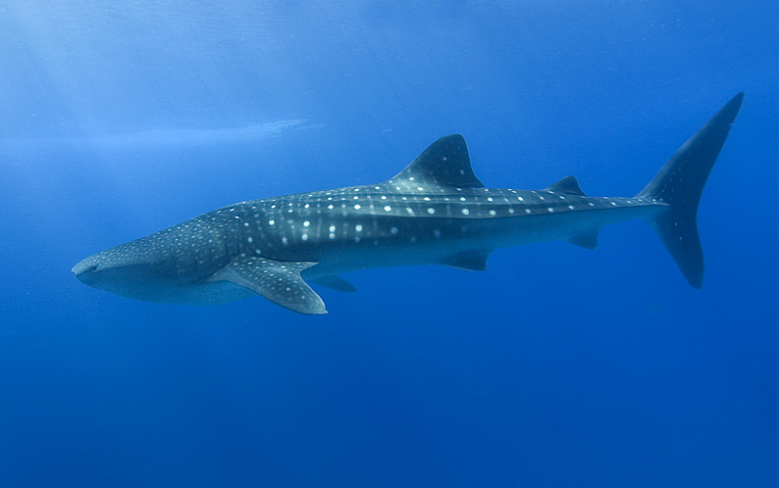
Skill Development Extra – writing adjectives in a list: We do
Write your sentence beginning.
Write the first item, then a comma.
Write the next item, then a comma.
When you end the sentence with the main idea, write <and> between the last two adjectives.
CFU:
What is the main idea?
Are there more than three items?
How do I separate the items?
Why do I use ‘and’ here?
whale shark
Use ‘and’ between the last two adjectives.
huge
graceful
spotted
The girl swam with a

Slide 15
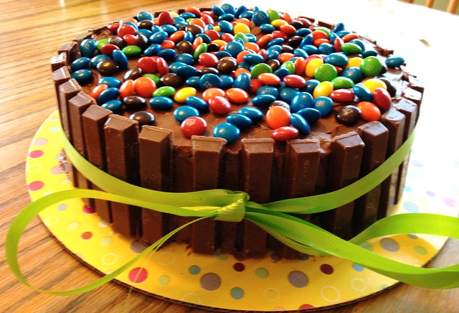
Skill Development Extra – writing adjectives in a list: You do
Skill development: You do
Write your sentence beginning.
Write the first item, then a comma.
Write the next item, then a comma.
When you end the sentence with the main idea, write <and> between the last two adjectives.
CFU:
What is the main idea?
Are there more than three items?
How do I separate the items?
Why do I use ‘and’ here?
round
colourful
chocolate
Use ‘and’ between the last two adjectives.
This is a

Slide 16
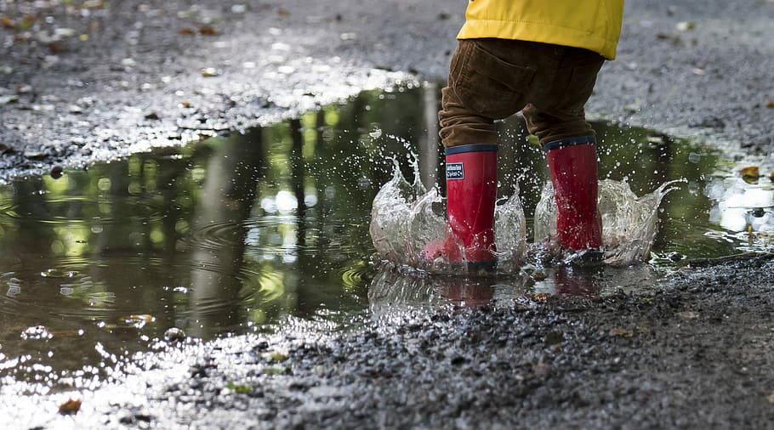
Skill Development Extra – writing adjectives in a list: I do
Write your sentence beginning.
Write the first item, then a comma.
Write the next item, then a comma.
When you end the sentence with the main idea, write <and> between the last two adjectives.
CFU:
What is the main idea?
Are there more than three items?
How do I separate the items?
Why do I use ‘and’ here?
cold
wet
muddy
Use ‘and’ between the last two adjectives.
This is a cold wet and muddy puddle.
This is a cold, wet and muddy puddle.
This is a cold, wet muddy and puddle.

Slide 17
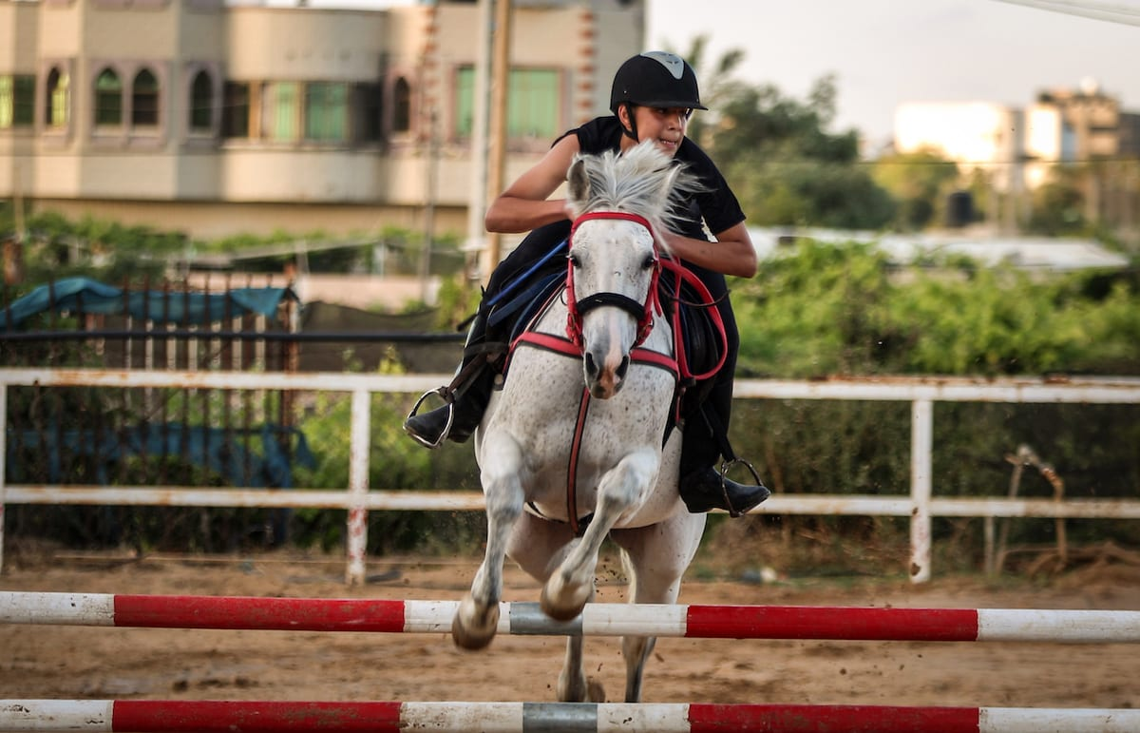
Skill Development Extra – writing adjectives in a list: We do
Write your sentence beginning.
Write the first item, then a comma.
Write the next item, then a comma.
When you end the sentence with the main idea, write <and> between the last two adjectives.
CFU:
What is the main idea?
Are there more than three items?
How do I separate the items?
Why do I use ‘and’ here?
horse
Use ‘and’ between the last two adjectives.
strong
swift
agile
She rode a

Slide 18
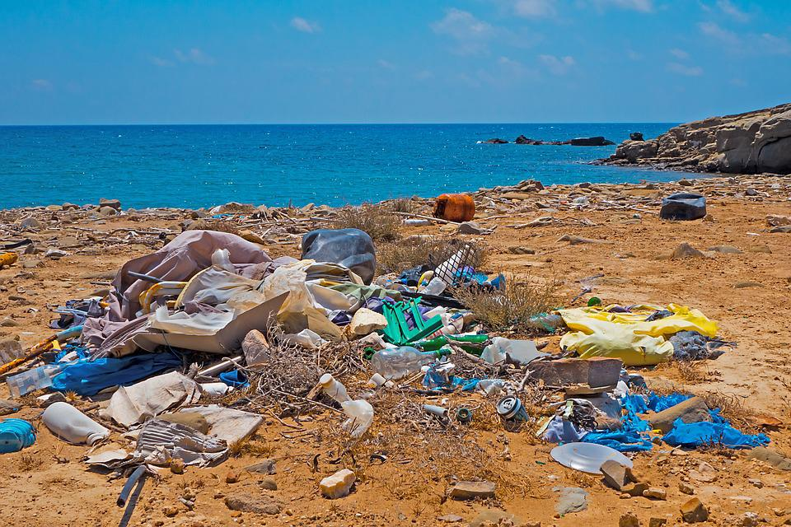
Skill Development Extra – writing adjectives in a list: You do
Skill development: You do
Write your sentence beginning.
Write the first item, then a comma.
Write the next item, then a comma.
When you end the sentence with the main idea, write <and> between the last two adjectives.
CFU:
What is the main idea?
Are there more than three items?
How do I separate the items?
Why do I use ‘and’ here?
litter
messy
yucky
dangerous
Use ‘and’ between the last two adjectives.
This is

