Slide 1
Year: 1
Term: 2
Objective: Develop questions given a picture of text material- who, what, where, when
Author: Tara Noble

Slide 2
Copy and paste these icons to the appropriate slides to indicate engagement norms/CFU strategies
Multiple Choice
Pair Share
Track with me
Pick a Stick/Answer (non-volunteer)
Whiteboards
Vote
Read with me
In Your Workbook

Slide 3
Learning Objective
We are learning to make who, what, where and when questions from a picture.

Slide 4
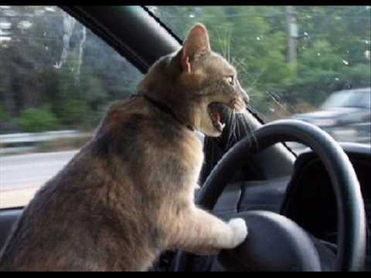
Concept Development
A question sentence asks something
A question sentence ends with a question mark.
Question sentences often ask – who, what, when, where
CFU:
What is a question sentence?
Why is this an example of a question sentence?
What punctuation mark is at the end?
Examples:
Who questions ask about a person or animal.
Who is in the car?
Notes:
https://1.bp.blogspot.com/-ca0nC3LEys4/WZQNovoG7WI/AAAAAAAAOAY/0kXV_YxaSHsOw73AjhjeM2ablK1Ws2BTQCLcBGAs/s1600/driving%2Bcat.jpg

Slide 5
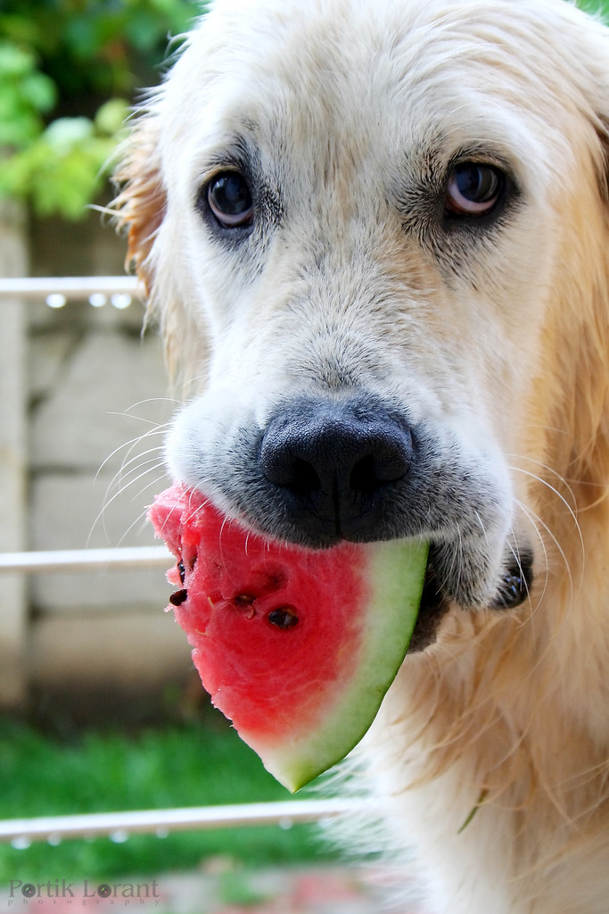
Concept Development
A question sentence asks something
A question sentence ends with a question mark.
Question sentences often ask – who, what, when, where
CFU:
What is a question sentence?
Why is this an example of a question sentence?
What punctuation mark is at the end?
Examples:
What questions ask about details or actions.
What is the dog doing?
Notes:
https://c2.staticflickr.com/6/5253/5489476583_36e48985b0_b.jpg

Slide 6
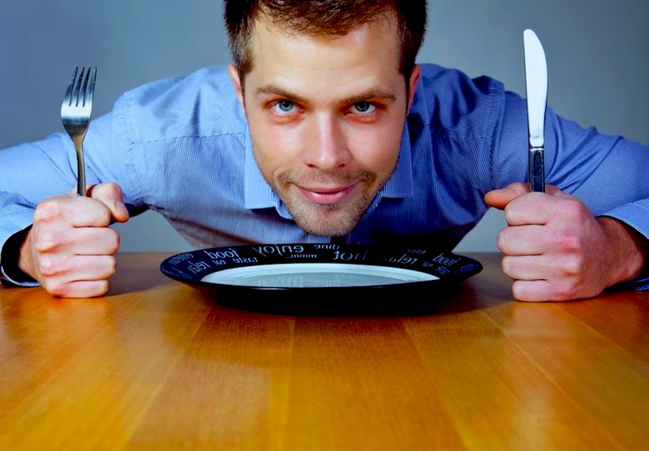
Concept Development
A question sentence asks something
A question sentence ends with a question mark.
Question sentences often ask – who, what, when, where
CFU:
What is a question sentence?
Why is this an example of a question sentence?
What punctuation mark is at the end?
Examples:
When questions ask about time.
When is the dinner ready?
Notes:
https://rxthewod.com/wp-content/uploads/2013/07/tngre.jpg

Slide 7
Concept Development
A question sentence asks something
A question sentence ends with a question mark.
Question sentences often ask – who, what, when, where
CFU:
What is a question sentence?
Why is this an example of a question sentence?
What punctuation mark is at the end?
Examples:
Where questions ask about the place or positions.
Where are they going?
Notes:
https://images.pexels.com/photos/1170184/pexels-photo-1170184.jpeg?cs=srgb&dl=backpack-commute-commuters-locomotive-1170184.jpg&fm=jpg

Slide 8
Concept Development
A question sentence asks something
A question sentence ends with a question mark.
Question sentences often ask – who, what, when, where
CFU:
Why is this not an example of a question sentence?
Non-Examples:
I like ice-cream.
It is a statement, not a question. It tells you something, it doesn’t ask you something.
When the bell goes, stand up quietly.
Even though this sentence starts with a when, It is a command, not a question. It tells you to do something, it doesn’t ask you something.
What a wonderful class!
Even though this sentence starts with a what, It is a statement, not a question. It tells you something, it doesn’t ask you something.
Notes:
Question or Interrogative

Slide 9
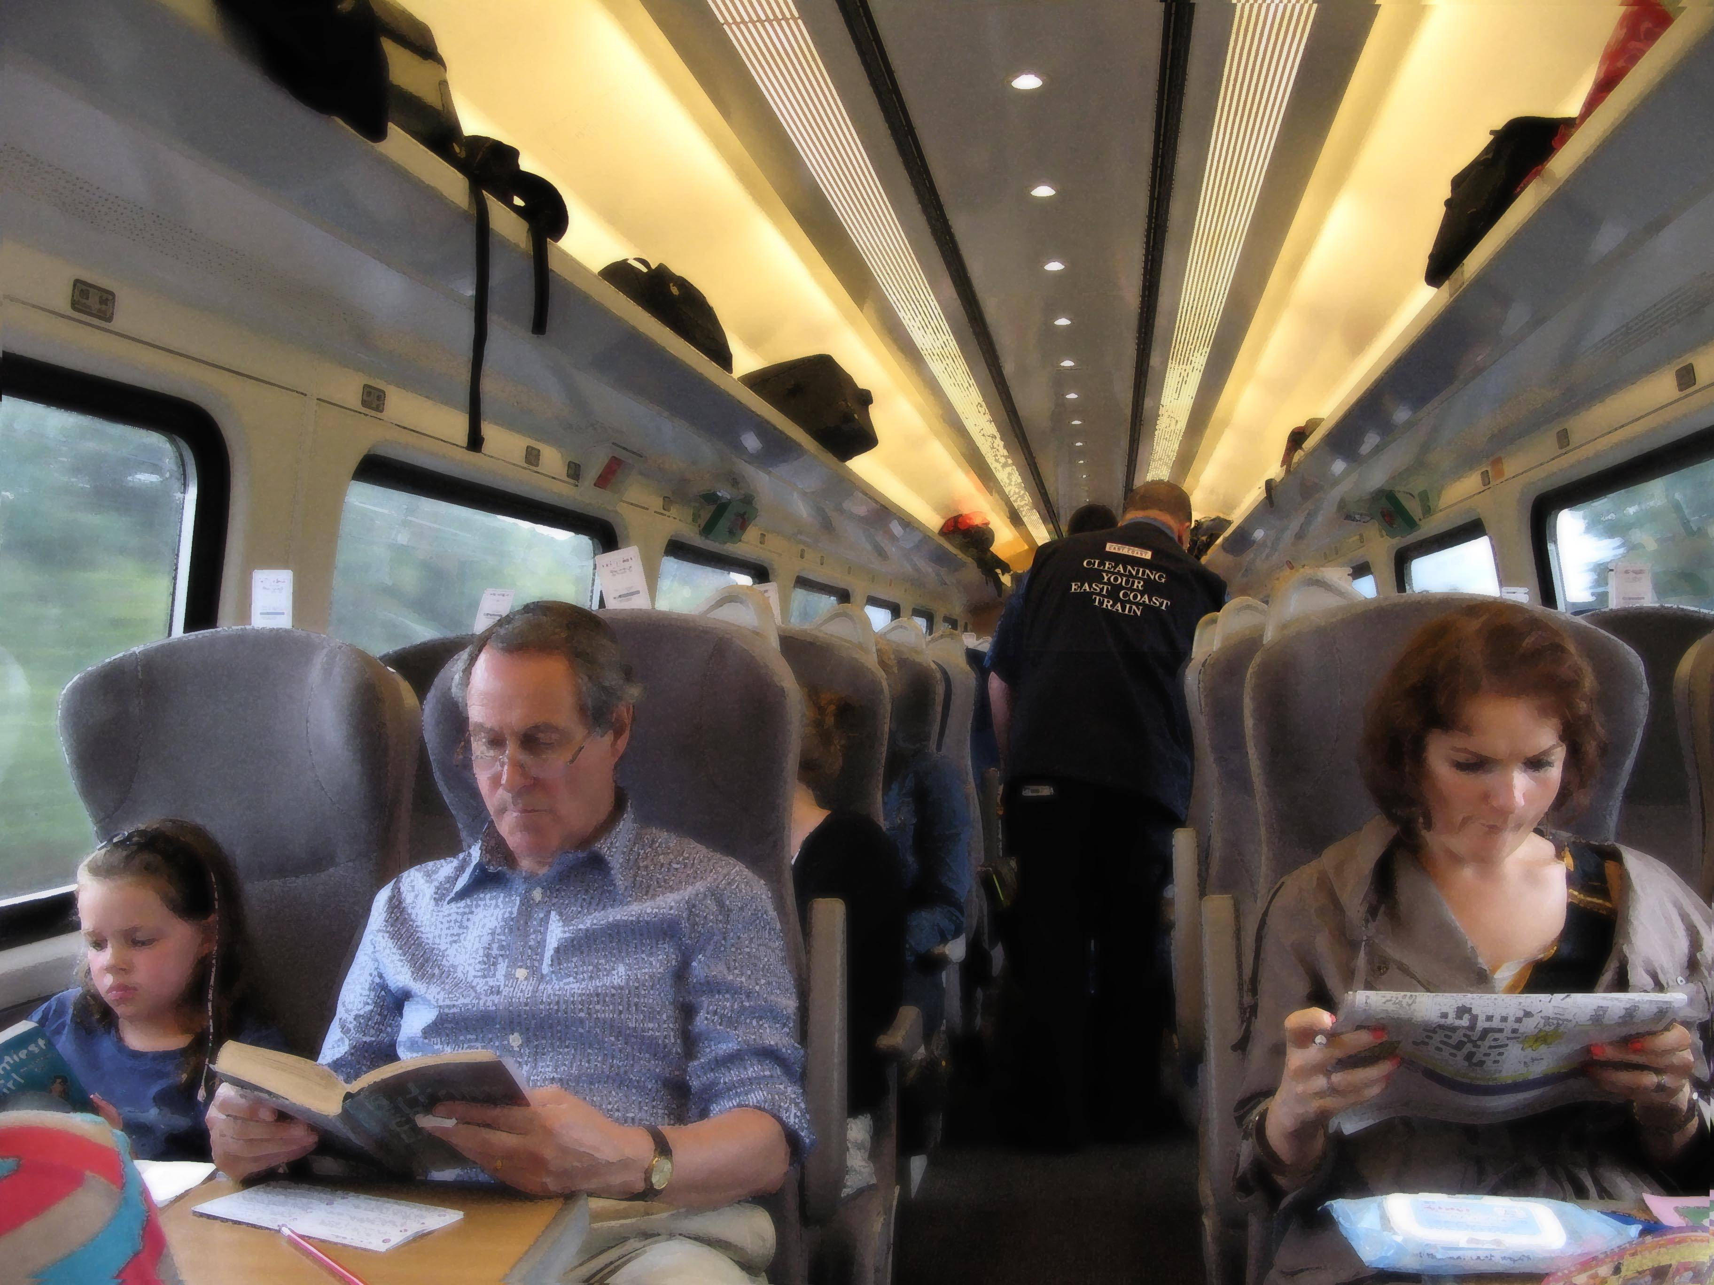
Concept Development
A question sentence asks something
A question sentence ends with a question mark.
Question sentences often ask – who, what, when, where
CFU:
What is the purpose of a who question?
What is the purpose of a what question?
What is the purpose of a when question?
What is the purpose of a where question?
We can make questions based on pictures.
Who…is on the train?
What…are the passengers doing?
When… will the people get off?
Where… are they going?
Notes:
https://i.stack.imgur.com/uYutg.jpg

Slide 10
Hinge Point Question
What sentences are questions?
When will they arrive ?
When I finish my dinner, I will get ice-cream.
What is the girl wearing?
What a clever boy!
CFU:
Why is it/ isn’t it a an example of a question sentence?
A question sentence asks something
A question sentence ends with a question mark.
Question sentences often ask – who, what, when, where
Notes:
Hinge-point question:
Hinge-point questions are usually multiple choice questions that you ask your students when you reach the point in a lesson when you need to check if students are ready to move on, and if yes, in which direction. You can make it so there are multiple correct answers- this ensures there’s less chance of a ‘lucky guess’.
Go through each option one-at-a-time once students have answered on their whiteboards

Slide 11
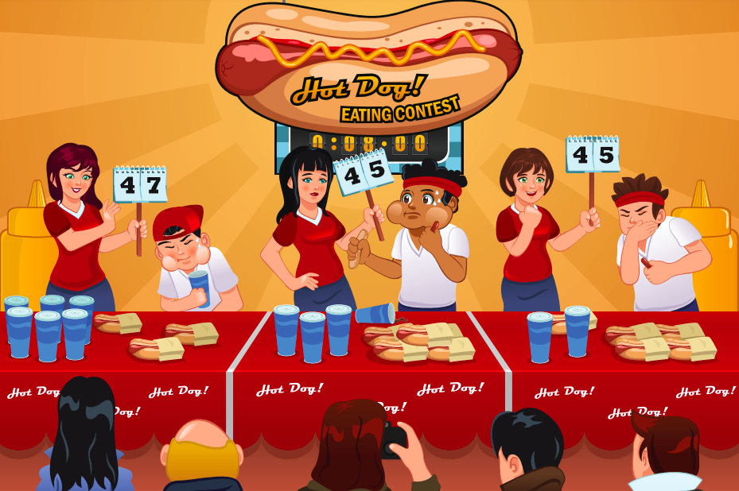
Concept Development-
re-explanation
A question sentence asks something
A question sentence ends with a question mark.
Question sentences often ask – who, what, when, where
CFU:
What type of sentence is it?
How do you know?
What punctuation would you add?
We can make questions based on pictures.
Who…
What…
When…
Where…
has eaten the most hotdogs?
is happening?
will the time be up?
is this contest happening?
Notes:
The purpose of this slide is further practice at the concept development stage, prior to moving on with the lesson. This is only required if there were some misconceptions identified in the Hinge Point.

Slide 12
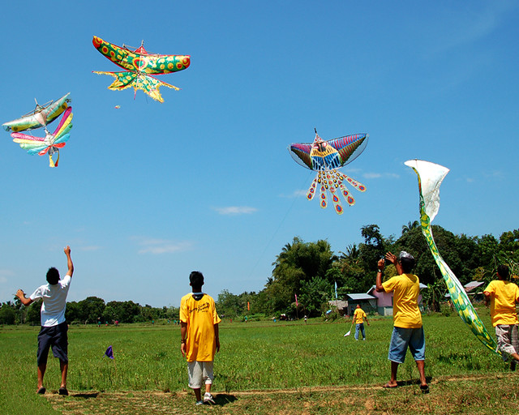
Skill development: I do
Think about the purpose of who, what, when, where questions,
Write a question based on the picture.
End each sentence with a question mark.
CFU:
How do you know it’s a statement /question/command/exclamation?
Who… (people or animals)
Who is in this picture?
What… (details or actions)
What has happened?
When… (time)
When would it be a good day to fly a kite?
Where… (place)
Where are they?
Notes:
https://c1.staticflickr.com/3/2631/3848384444_d8014b1b53_z.jpg?zz=1

Slide 13
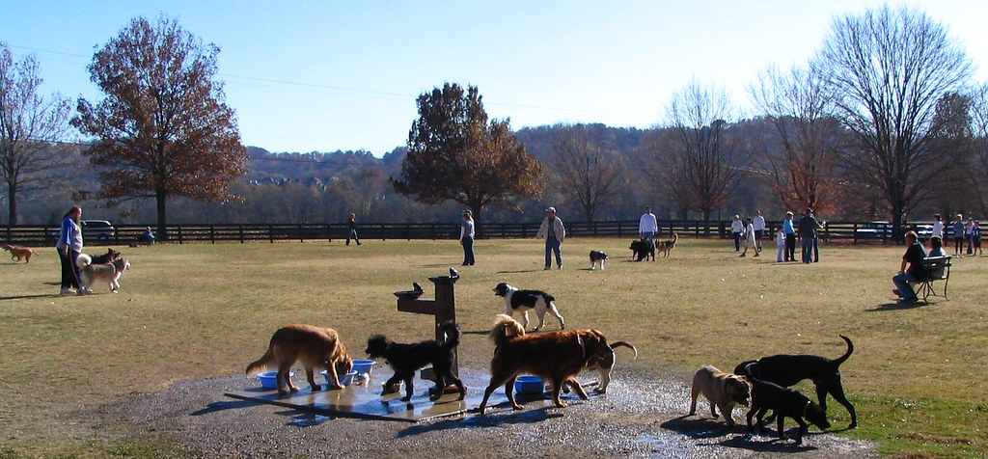
Skill development: We do
Think about the purpose of who, what, when, where questions,
Write a question based on the picture.
End each sentence with a question mark.
CFU:
How do you know it’s a question?
Who
A who question has answers about people or animals.
Notes:
https://c1.staticflickr.com/1/11/95240809_be6b739054_b.jpg

Slide 14
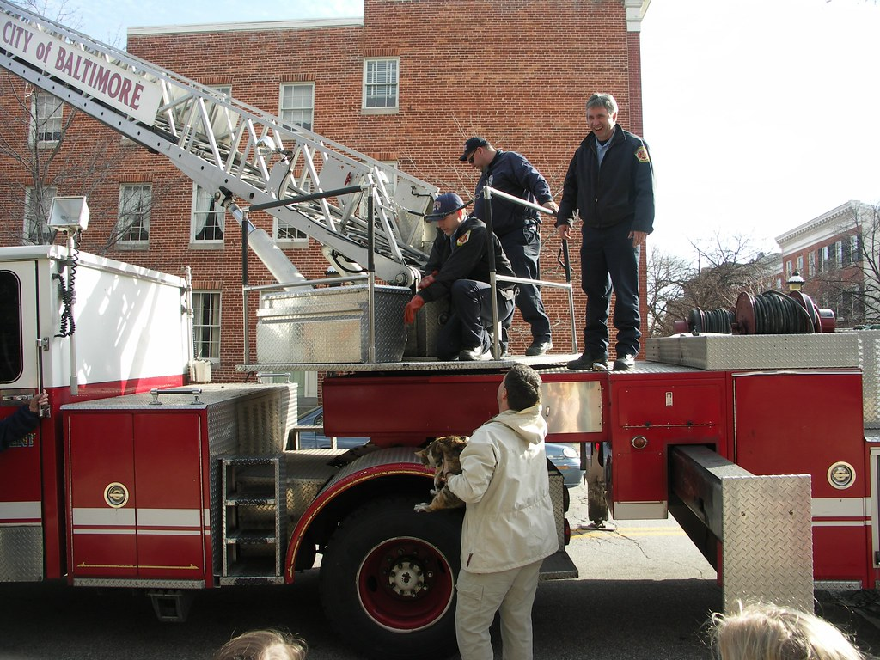
Skill development: We do
Think about the purpose of who, what, when, where questions,
Write a question based on the picture.
End each sentence with a question mark.
CFU:
How do you know it’s a question?
What
A what question has answers about details or actions.
Notes:
https://live.staticflickr.com/2241/2454178185_2cf00952e1_b.jpg

Slide 15
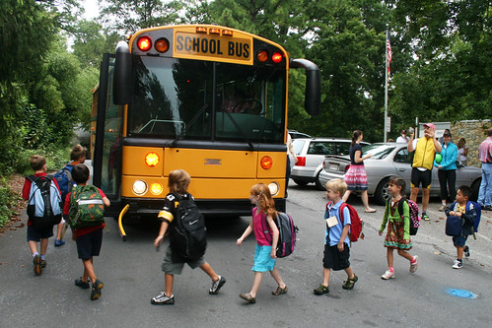
Skill development: We do
Think about the purpose of who, what, when, where questions,
Write a question based on the picture.
End each sentence with a question mark.
CFU:
How do you know it’s a question?
When
A when question has answers about time.
Notes:
http://c1.staticflickr.com/3/2627/3876284625_87290edf7d.jpg

Slide 16
Skill development: We do
Think about the purpose of who, what, when, where questions,
Write a question based on the picture.
End each sentence with a question mark.
CFU:
How do you know it’s a question?
Where
A where question has answers about a place.
Notes:
https://c2.staticflickr.com/8/7016/6573154235_64c84a9ba1_b.jpg

Slide 17
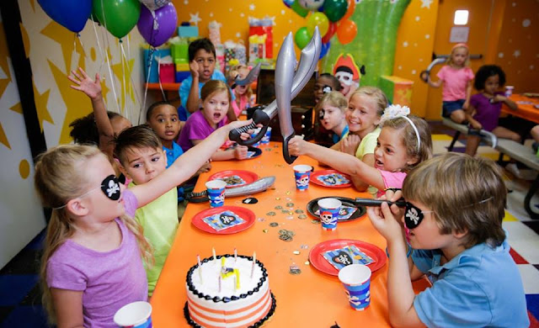
Skill development: You do
Think about the purpose of who, what, when, where questions,
Write a question based on the picture.
End each sentence with a question mark.
Write a who, what, when, where question for this picture in your book.
Who
What
When
Where
Notes:
https://2.bp.blogspot.com/-cKUiWp9Smqw/VxzzCNEfS4I/AAAAAAAABAc/vEem9mGRWuIi_N4xQ7lG3j1DVsdJosQ-ACLcB/s640/12687894_10153241631497175_8475971760114583674_n.jpg

Slide 18
Skill development: You do
Think about the purpose of who, what, when, where questions,
Write a question based on the picture.
End each sentence with a question mark.
Write a who, what, when, where question for this picture in your book.
Who
What
When
Where
Insert picture based on content/topic taught in class
Notes:
https://2.bp.blogspot.com/-cKUiWp9Smqw/VxzzCNEfS4I/AAAAAAAABAc/vEem9mGRWuIi_N4xQ7lG3j1DVsdJosQ-ACLcB/s640/12687894_10153241631497175_8475971760114583674_n.jpg

