Slide 1
Year: 1
Term: 4
Objective: Unscramble sentences: statements
Author: Judith Davison

Slide 2
Copy and paste these icons to the appropriate slides to indicate engagement norms/CFU strategies
Multiple Choice
Pair Share
Track with me
Pick a Stick/Answer (non-volunteer)
Whiteboards
Vote
Read with me
In Your Workbook

Slide 3
Learning Objective
We are learning to unscramble sentences.

Slide 4
Concept Development
A sentence states a complete thought. It must make sense.
A statement always begins with a capital letter and ends with a full stop.
A complete statement has two parts.
(Who or What the sentence is about + what doing/ being
CFU:
What is a sentence?
What must a sentence have?
Why is this an example of a sentence?
Who or What | Doing/being
Amy | carefully lifted the baby.
I | think Lizzie knew I didn’t want to hurt her.
Examples:
1. My dog made a mess.
2. The car stopped at the last driveway on the street.
3. Mary is a smart girl.

Slide 5
Concept Development
A sentence always begins with a capital letter.
A sentence often ends with a full stop.
A sentence states a complete thought. It must make sense.
A complete sentence has two parts.
(Who or What the sentence is about + Action (doing, thinking or feeling)
CFU:
Why is this not an example of a sentence?
Who or What | Action
Amy | carefully lifted the baby.
I | think Lizzie knew I didn’t want to hurt her.
Non-Examples:
1. Mary drove her car to the shop
This sentence does not end with a full stop.
2. My is blue.
The who or what is missing. It does not make sense. This is a fragment.
3. i like my red bike.
This sentence does not begin with a capital letter.
4. jumped over the fence The big dog.
The words are in the wrong order. Who or what comes before the action. It does not make sense.

Slide 6
Hinge Point Question
Which sentences are correct?
CFU:
Why is it/isn’t it an example of a sentence?
Going ben is to a party
The dog chased the cat.
I like going to the beach.
Got a new hat Sam.

Slide 7
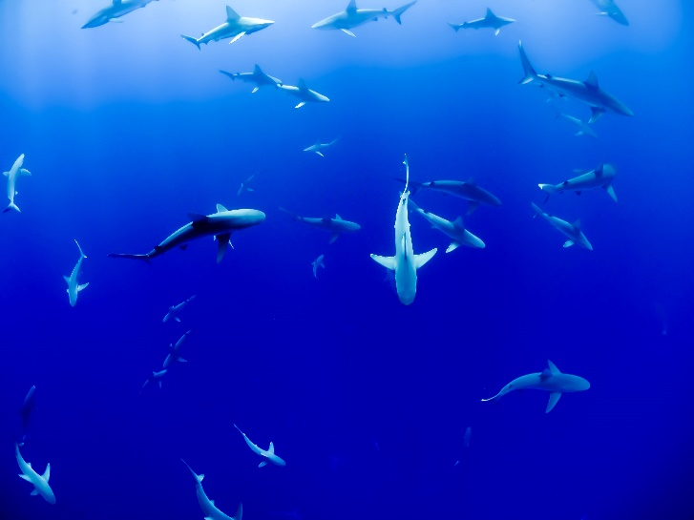
Skill development: I do
Identify the first word and place it at the start of the sentence
Change the first letter in the first word into a capital letter
Arrange the words in the correct order so the sentence makes sense (who/what + action)
Insert a full stop at the end of the sentence
CFU:
Who or what is in the sentence?
What are they doing (action)?
What must go at the start of a sentence?
What must go at the end of a statement?
live | in | the | ocean | sharks
Sharks
sharks
live in the ocean
.

Slide 8
Skill development: We do
Identify the first word and place it at the start of the sentence
Change the first letter in the first word into a capital letter
Arrange the words in the correct order so the sentence makes sense (who/what + action)
Insert a full stop at the end of the sentence
CFU:
Who or what is in the sentence?
What are they doing (action)?
What must go at the start of a sentence?
What must go at the end of a sentence?
the | jane | dishes | washed | dirty
Jane
jane
washed the dirty dishes
.

Slide 9
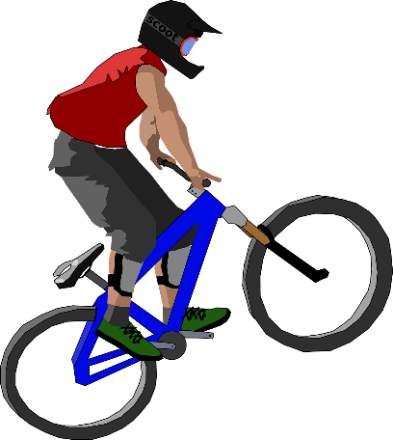
Skill development: We do
Identify the first word and place it at the start of the sentence
Change the first letter in the first word into a capital letter
Arrange the words in the correct order so the sentence makes sense (who/what + action)
Insert a full stop at the end of the sentence
CFU:
Who or what is in the sentence?
What are they doing (action)?
What must go at the start of a sentence?
What must go at the end of a sentence?
rode | street | the | down | bike | his | henry
Henry
henry
rode his bike down the street
.

Slide 10
Skill development: I do
Identify the first word and place it at the start of the sentence
Change the first letter in the first word into a capital letter
Arrange the words in the correct order so the sentence makes sense (who/what + action)
Insert a full stop at the end of the sentence
CFU:
Who or what is in the sentence?
What are they doing (action)?
What must go at the start of a sentence?
What must go at the end of a sentence?
pond | jumped | the | frog | in | the
The
the
frog jumped in the pond
.

Slide 11
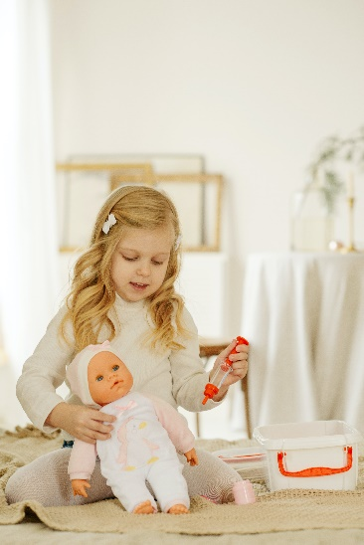
Skill development: We do
Identify the first and place it at the start of the sentence
Change the first letter in the first word into a capital letter
Arrange the words in the correct order so the sentence makes sense (who/what + action)
Insert a full stop at the end of the sentence
CFU:
Who or what is in the sentence?
What are they doing (action)?
What must go at the start of a sentence?
What must go at the end of a sentence?
with | played | the | girl | her | dolls
the
girl played with her dolls
The
.

Slide 12
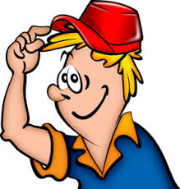
Skill development: We do
Identify the first word and place it at the start of the sentence
Change the first letter in the first word into a capital letter
Arrange the words in the correct order so the sentence makes sense (who/what + action)
Insert a full stop at the end of the sentence
CFU:
Who or what is in the sentence?
What are they doing (action)?
What must go at the start of a sentence?
What must go at the end of a sentence?
his | the | hat | man | put | on
the
man put his on his hat
The
.

Slide 13
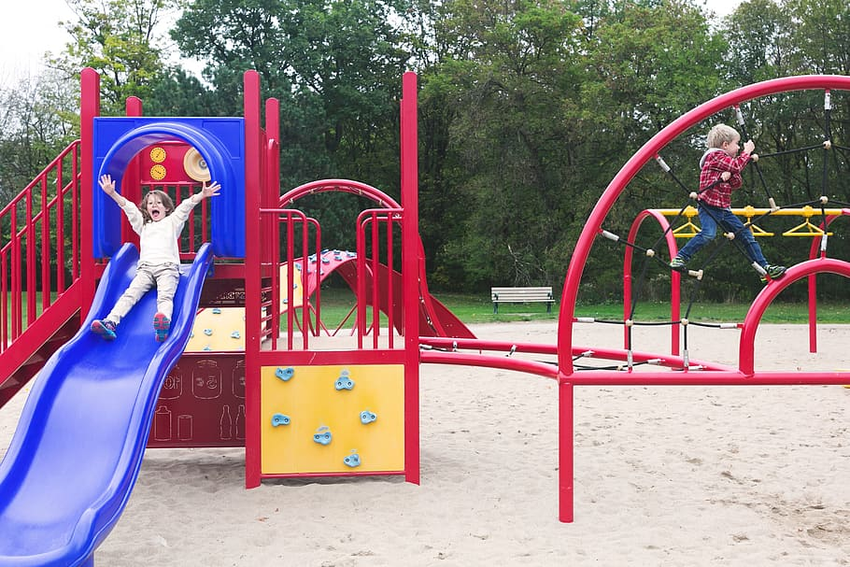
Skill development: You do
Unjumble the sentences. Put the words in the correct order.
Add the correct capitalisation and punctuation.
Complete these in your workbook:
for | the | outside | students | went | recess
__________________________________________________________________________________________________

Slide 14
Skill development: You do
Unjumble the sentences. Put the words in the correct order.
Add the correct capitalisation and punctuation.
Complete these in your workbook:
This Photo by Unknown Author is licensed under CC BY-SA
a | my | barks | brother’s | lot | dog
__________________________________________________________________________________________________

