Slide 1
Year: 4
Term: 1
Objective: Use apostrophes to indicate possession (singular)
.
Author: Wiehann Nel & Stephanie Le Lievre

Slide 2
Copy and paste these icons to the appropriate slides to indicate engagement norms/CFU strategies
Multiple Choice
Pair Share
Track with me
Pick a Stick/Answer (non-volunteer)
Whiteboards
Vote
Read with me
In Your Workbook

Slide 3
Learning Objective
We are learning to use apostrophes to signal possession/ownership.

Slide 4
Concept Development
Apostrophes are used for two purposes:
To signal the omission of letters or numbers
E.g.
are + not = aren’t
2022 = ’22
2. to show ownership
E.g.
Tom’s house
Today, we are focusing on apostrophes to show ownership/possession.
CFU:
What is an apostrophe used for?

Slide 5
Concept Development
Possession means that you have, own or control something.
CFU:
What does possession mean?
If you want to show that someone has, owns or controls something when you are writing, you can use an apostrophe and often the letter ‘s’.

Slide 6
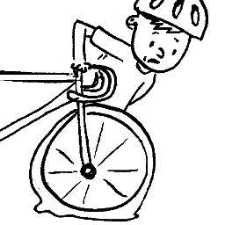
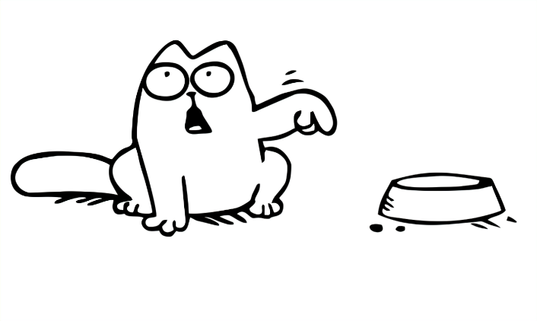
Concept Development
If you want to show that someone has, owns or controls something when you are writing, you can use an apostrophe and often the letter ‘s’.
CFU:
Who does the bike belong to?
Who does the bowl belong to?
Who does the phone number belong to?
Why do we use the apostrophe followed by an ‘s’? What is it showing?
Examples:
The little boy’s bike has a flat tyre.
The cat’s bowl was empty.
The school's phone number was disconnected.

Slide 7
Concept Development
CFU:
Why don’t we need an apostrophe in these sentences?
Non-examples:
The kid’s were playing.
An apostrophe is not needed here. The ‘s’ marks a plural (more than one) and there is no ownership/possession.
The kids were playing.
The cat’s ran away when they saw the dog.
An apostrophe is not needed here. The ‘s’ marks a plural (more than one) and there is no ownership/possession.
The cats ran away when they saw the dog.

Slide 8
Hinge Point Question
Which sentence(s) show the correct use of an apostrophe to show possession/ownership?
CFU:
Why is it/ isn’t it a an example?
The girl’s mother was late to pick her up from school.
The tree’s leaves fell off in autumn.
All of the teacher’s were at the assembly.
There were three dog’s on the farm.
Ron’s shoes were dirty from the mud.

Slide 9
Concept Development- re-explanation
If you want to show that someone has, owns or controls something when you are writing, you can use an apostrophe and often the letter ‘s’.
CFU:
Who does the sandwich belong to?
Who does the class belong to?
Who done the phone number belong to?
Why do we use the apostrophe followed by an ‘s’? What is it showing?
Examples:
Fred’s sandwich was in his lunchbox.
Mrs. Smith’s class was in the library.

Slide 10
Concept Development- re-explanation
CFU:
Why don’t we need an apostrophe in these sentences?
Non-examples:
The flower’s were blooming in the spring.
An apostrophe is not needed here. The ‘s’ marks a plural (more than one) and there is no ownership/possession.
The flowers were blooming.
There was a bowl of apple’s on the table.
An apostrophe is not needed here. The ‘s’ marks a plural (more than one) and there is no ownership/possession.
There was a bowl of apples on the table.

Slide 11
Skill development: I do
Identify if there is ownership/possession within the sentence (POSSESSION OR PLURAL?).
Does the word need an apostrophe before the ‘s’? If so, rewrite the sentence with the apostrophe added to indicate possession.
CFU:
Why do I/ don’t I need an apostrophe?
Brads bike has a flat tyre.
Brad’s bike has a flat tyre.
Brad owns the bike. This is an example of possession, so an apostrophe is needed.

Slide 12
Skill development: We do
Identify if there is ownership/possession within the sentence (POSSESSION OR PLURAL?).
Does the word need an apostrophe before the ‘s’? If so, rewrite the sentence with the apostrophe added to indicate possession.
CFU:
Why do I/ don’t I need an apostrophe?
My brothers cat climbed a tree.
My brother’s cat climbed a tree.
His brother owns the cat. This is an example of possession, so an apostrophe is needed.

Slide 13
Skill development: We do
Identify if there is ownership/possession within the sentence (POSSESSION OR PLURAL?).
Does the word need an apostrophe before the ‘s’? If so, rewrite the sentence with the apostrophe added to indicate possession.
CFU:
Why do I/ don’t I need an apostrophe?
The kids were eating ice-cream.
The kids were eating ice-cream.
This is an example of plural (more than one kid), so an apostrophe is not needed.

Slide 14
Skill development: We do
Identify if there is ownership/possession within the sentence (POSSESSION OR PLURAL?).
Does the word need an apostrophe before the ‘s’? If so, rewrite the sentence with the apostrophe added to indicate possession.
CFU:
Why do I/ don’t I need an apostrophe?
Billy spilled ink on Lisas dress.
Billy spilled ink on Lisa’s dress.
Lisa owns the dress. This is an example of possession, so an apostrophe is needed.

Slide 15
Skill development: You do
Identify if there is ownership/possession within the sentence (POSSESSION OR PLURAL?).
Does the word need an apostrophe before the ‘s’? If so, rewrite the sentence with the apostrophe added to indicate possession.
CFU:
Why do I/ don’t I need an apostrophe?
The placemats were on the table.
Troys mother was not impressed with the state of his room.
Mias t-shirt was red.
There were so many chocolates left over from Easter.

Slide 16
Skill development: You do
Identify if there is ownership/possession within the sentence (POSSESSION OR PLURAL?).
Does the word need an apostrophe before the ‘s’? If so, rewrite the sentence with the apostrophe added to indicate possession.
CFU:
Why do I/ don’t I need an apostrophe?
Add in sentences based on texts/topics/knowledge units covered in class.

