Slide 1
Year: 3
Term: 1
Objective: Expand sentences using adverbs of time, place and manner
Author: Stephanie Le Lievre

Slide 2
Copy and paste these icons to the appropriate slides to indicate engagement norms/CFU strategies
Multiple Choice
Pair Share
Track with me
Pick a Stick/Answer (non-volunteer)
Whiteboards
Vote
Read with me
In Your Workbook

Slide 3
Learning Objective
We are learning to expand sentences using adverbs of time, place and manner

Slide 4
Concept Development
CFU:
What does an adverb modify or describe?
An adverb is a word that modifies or describes a verb.
NOUN / PRONOUN
VERB
ADJECTIVE
ADVERB

Slide 5
Concept Development
An adverb is a word that modifies or describes a verb.
3 categories of adverbs are:
CFU:
What is an action verb?
Adverbs of manner (how) | Adverbs of place (where) | Adverbs of time (when)
eagerly softly quickly | here outside inside | yesterday today soon

Slide 6
Concept Development
An adverb modifies or describes a verb.
Adverbs of manner answer the question how?
CFU:
Is ‘elegantly’ an adverb of manner? Explain why/why not.
Examples:
1. loudly
I yelled loudly to get my neighbour’s attention.
Clark mixed the ingredients thoroughly before baking the pie.
2. thoroughly
Nina ran quickly to escape the vicious dog.
3. quickly

Slide 7
Concept Development
An adverb modifies or describes a verb.
Adverbs of manner answer the question how?
CFU:
Is ‘tomorrow’ an adverb of manner? Explain why/why not.
Non-Examples:
1. soon
Soon is an adverb, but does not answer the question how?
2. inside
Inside is an adverb, but does not answer the question how?

Slide 8
Concept Development
An adverb modifies or describes a verb.
Adverbs of time answer the question when?
CFU:
Is ‘afterwards’ an adverb of time? Explain why/why not.
Examples:
Soon, you will have to get a new car.
1. soon
Murdoch found that cat yesterday before I got home from work.
2. yesterday
The children will go to school tomorrow.
3. tomorrow

Slide 9
Concept Development
An adverb modifies or describes a verb.
Adverbs of time answer the question when?
CFU:
Is ‘carefully’ an adverb of time? Explain why/why not.
Non-Examples:
Quietly describes how something can be done, making it an adverb of manner.
1. quietly
Gently describes how something can be done, making it an adverb of manner.
2. gently

Slide 10
Concept Development: I do
Underline the adverb
Draw an arrow to the verb they modify/describe.
CFU:
What type of adverb is underlined? How do you know? How is it modifying or describing the verb?
She eagerly waited for her guests to arrive.

Slide 11
Concept Development: We do
Underline the adverb
Draw an arrow to the verb they modify/describe.
CFU:
What type of adverb is underlined? How do you know? How is it modifying or describing the verb?
The doctor yelled loudly for his patient to stop smoking.

Slide 12
Concept Development: We do
Underline the adverb
Draw an arrow to the verb they modify/describe.
CFU:
What type of adverb is underlined? How do you know? How is it modifying or describing the verb?
Yesterday, I saw a movie.

Slide 13
Concept Development: We do
Underline the adverb
Draw an arrow to the verb they modify/describe.
CFU:
What type of adverb is underlined? How do you know? How is it modifying or describing the verb?
My uncle laughed hysterically at the joke.

Slide 14
Concept Development: We do
Underline the adverb
Draw an arrow to the verb they modify/describe.
CFU:
What type of adverb is underlined? How do you know? How is it modifying or describing the verb?
I can’t find it anywhere.

Slide 15
Concept Development: You do
Underline the adverb
Draw an arrow to the verb they modify/describe.
CFU:
What type of adverb is underlined? How do you know? How is it modifying or describing the verb?
The man walked backwards.

Slide 16
Concept Development: You do
Underline the adverb
Draw an arrow to the verb they modify/describe.
CFU:
What type of adverb is underlined? How do you know? How is it modifying or describing the verb?
Nearby, a dog barked loudly.

Slide 17
Hinge-Point Question
What sentence/s contain an adverb?
She patiently waited for the book shop to open.
patiently
They raced to the shops to buy a new skateboard.
Swiftly, they ran behind the garden shed.
swiftly
Sally went to the doctors yesterday for a check-up.
yesterday

Slide 18
Concept Development: Re-clarification
Underline the adverb
Draw an arrow to the verb they modify/describe.
CFU:
What type of adverb is underlined? How do you know? How is it modifying or describing the verb?
Yesterday, we rode our bikes.
We rode our bikes quickly to school.
We rode our bikes there.

Slide 19
Skill Development: I do, We do
Choose an appropriate adverb to modify the verb
CFU:
How is it modifying or describing the verb?
Adverb of manner (how)
sleep: _______________________
run: _______________________
burp: _______________________
argue: _______________________
fight: _______________________
read: _______________________
Suggestions:
quickly
amusingly
soothingly
joyously
loudly
curiously

Slide 20
Skill Development: I do, We do
Choose an appropriate adverb to modify the verb
CFU:
How is it modifying or describing the verb?
Adverb of place (where)
toss: _______________________
walk: _______________________
shovel: _______________________
discuss: _______________________
Suggestions:
nowhere
anywhere
somewhere
here
there

Slide 21
Skill Development: I do, We do
Choose an appropriate adverb to modify the verb
CFU:
How is it modifying or describing the verb?
Adverb of time (when)
exercise: _______________________
arrive: _______________________
wake-up: _______________________
Suggestions:
soon
later
now
first
next

Slide 22
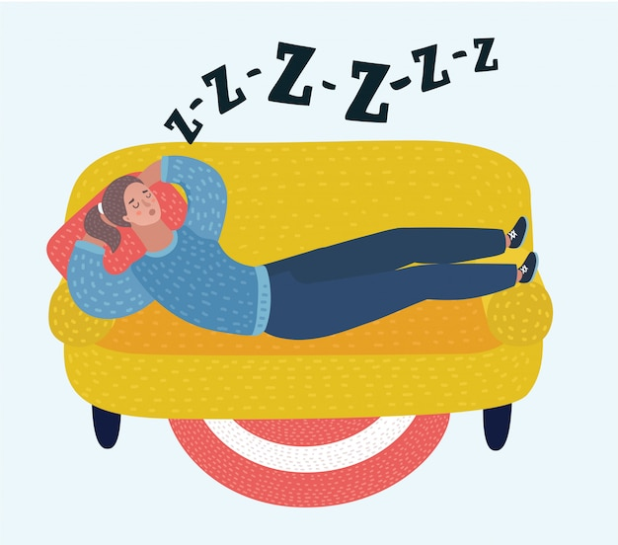
Skill Development: We do
Expand the sentence with an appropriate adverb
CFU:
How is it modifying or describing the verb?
My aunt sat ________________ snoring.
Suggestions:
obnoxiously
irritably
loudly
violently
Provide students with a list of adverbs from Writing Matters (page 293-294 reproducible)

Slide 23
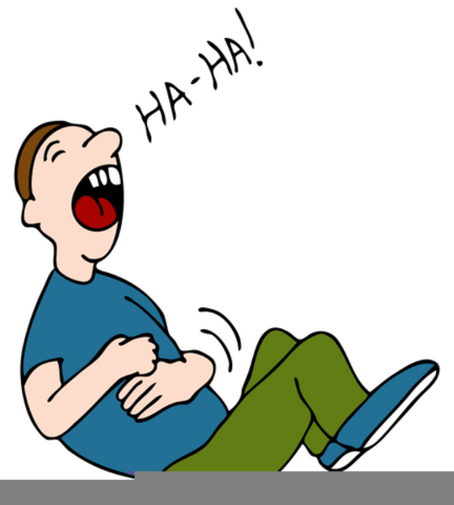
Skill Development: We do
Expand the sentence with an appropriate adverb
CFU:
How is it modifying or describing the verb?
My brother laughed ___________ at the TV.
Suggestions:
obnoxiously
irritably
loudly
violently
Provide students with a list of adverbs from Writing Matters (page 293-294 reproducible)

Slide 24
Skill Development: You
Expand the sentence with an appropriate adverb
CFU:
How is it modifying or describing the verb?
__________, we rode to the ice-cream shop.
Suggestions:
Yesterday
Excitedly
Swiftly
Eagerly
Provide students with a list of adverbs from Writing Matters (page 293-294 reproducible)

Slide 25
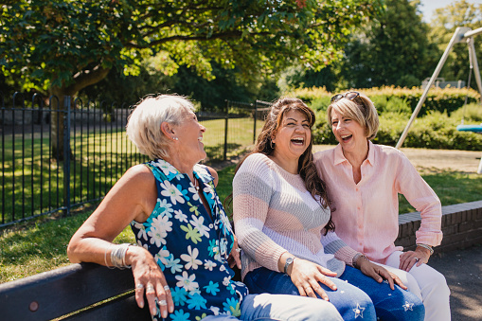
Skill development: I do
Answer the questions in note form
Construct a sentence using expanded notes
3. Read your sentence – does it sound right?
CFU:
What adverbs did we use in this sentence?
The women laughed.
When:
Where:
How:
Yesterday
in the park
uncontrollably
Yesterday, the women laughed uncontrollably in the park.

Slide 26
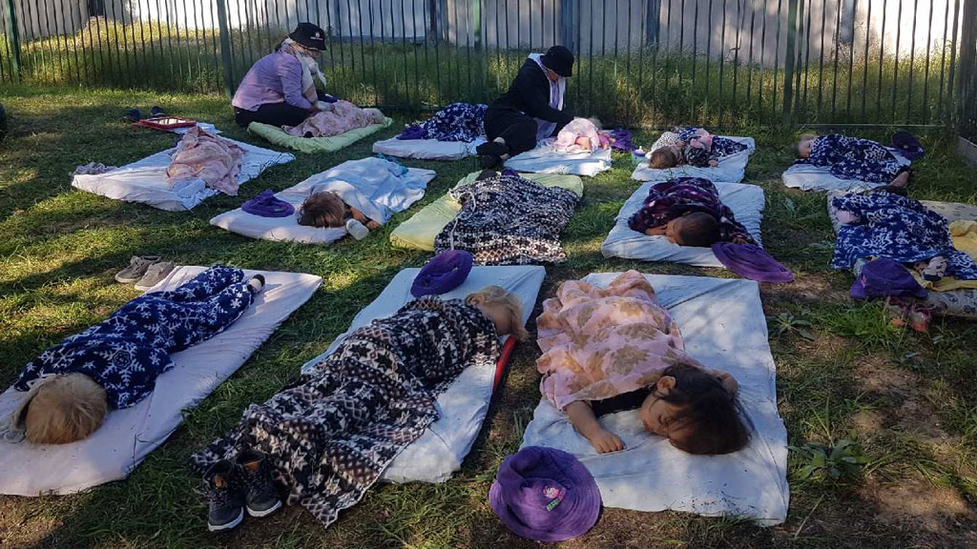
Skill development: We do
Answer the questions in note form
Construct a sentence using expanded notes
3. Read your sentence – does it sound right?
CFU:
What adverbs did we use in this sentence?
The children slept.
When:
Where:
How:
Yesterday
outside
soundly
Yesterday, the children slept soundly outside.

Slide 27
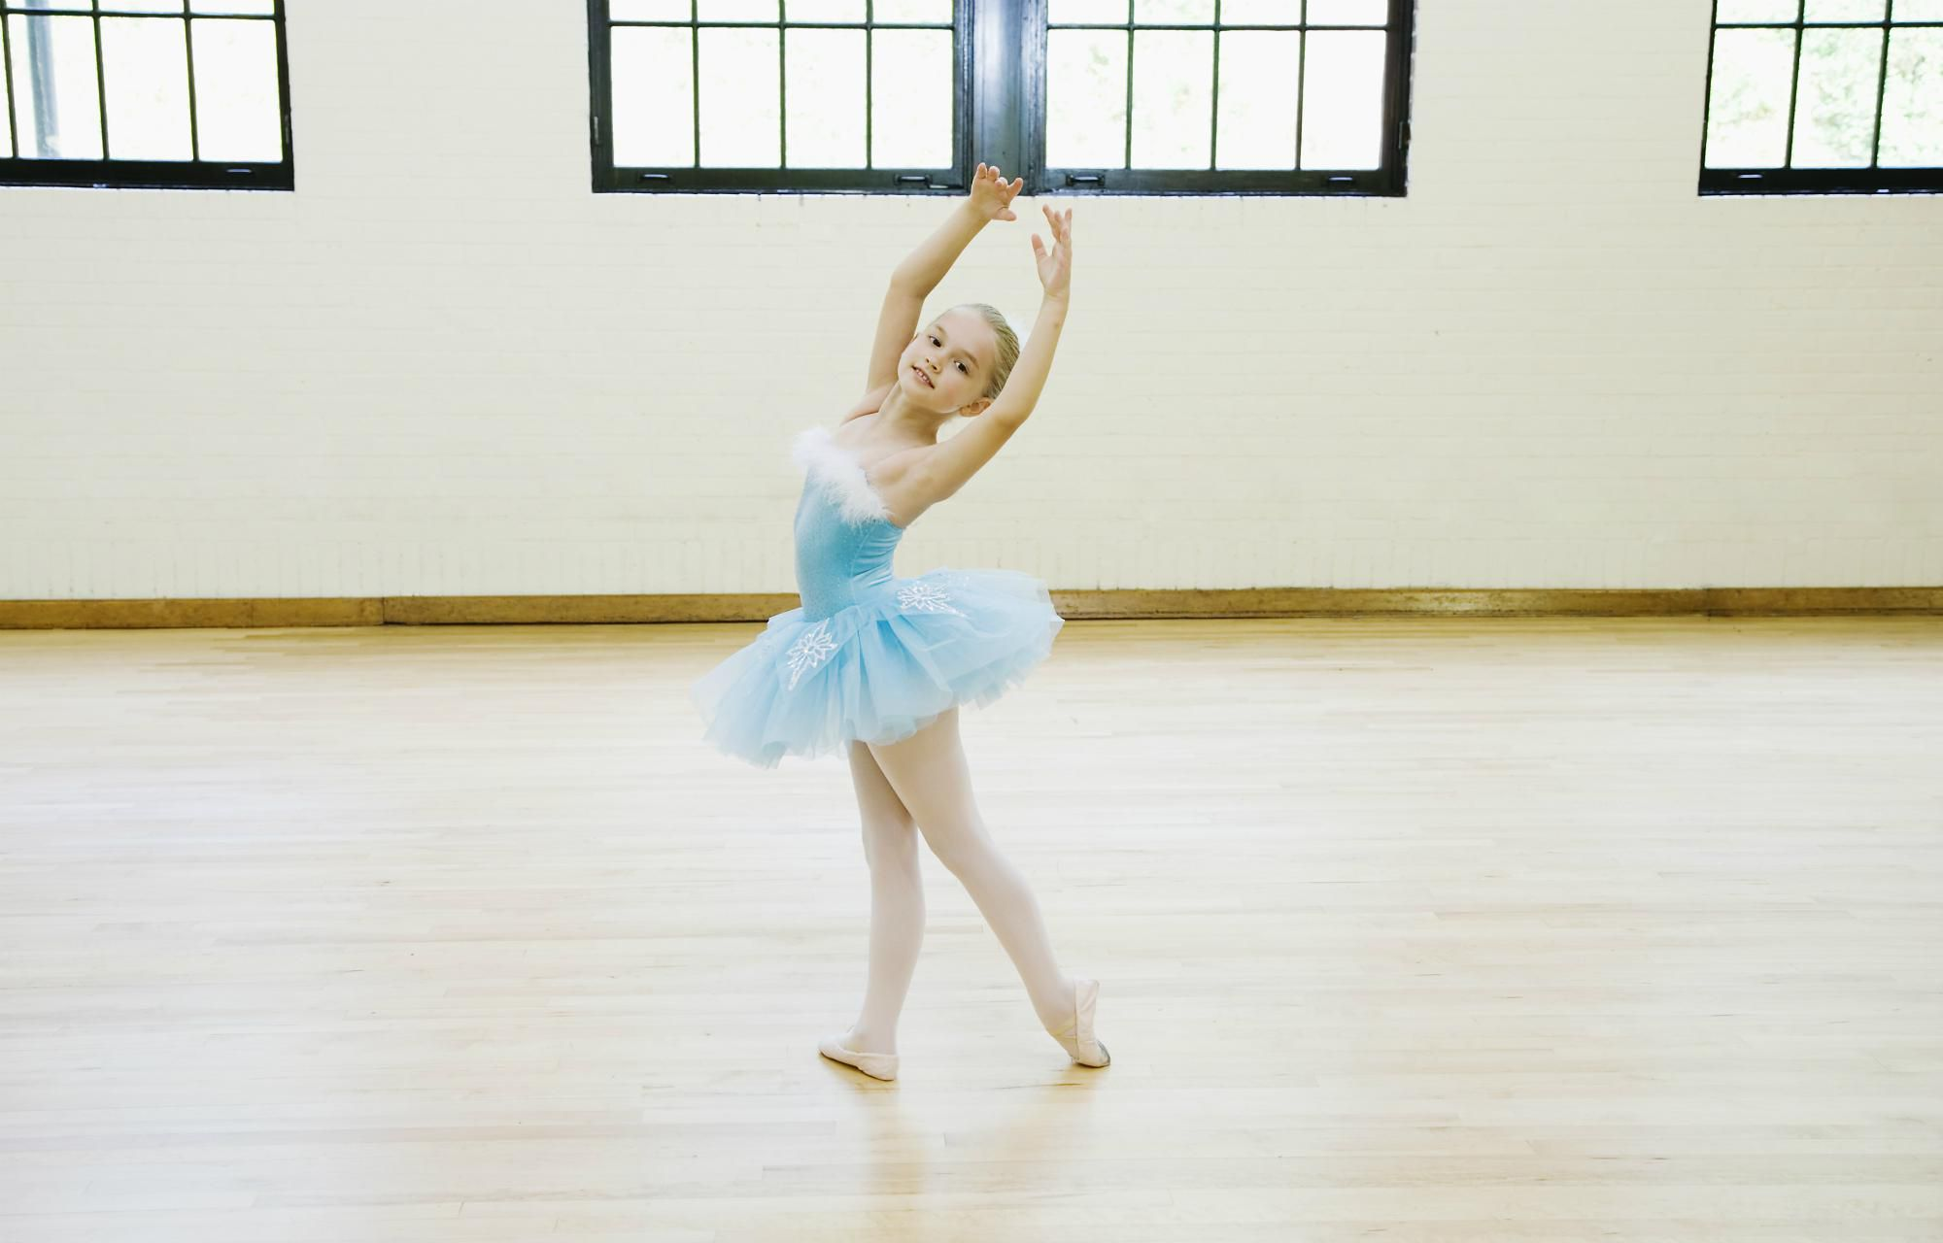
Skill development: You do
Answer the questions in note form
Construct a sentence using expanded notes
3. Read your sentence – does it sound right?
CFU:
What adverbs did we use in this sentence?
The ballerina danced.
When:
Where:
How:

Slide 28
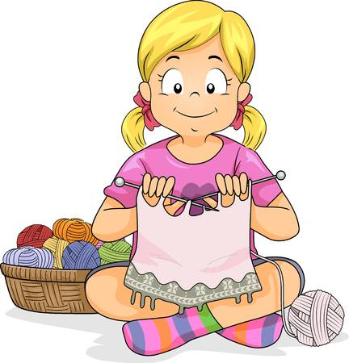
Skill development: You do
Answer the questions in note form
Construct a sentence using expanded notes
3. Read your sentence – does it sound right?
CFU:
What adverbs did we use in this sentence?
The girl knitted.
When:
Where:
How:

Slide 29
Skill development: You do
Answer the questions in note form
Construct a sentence using expanded notes
3. Read your sentence – does it sound right?
CFU:
What adverbs did we use in this sentence?
The boy jumped.
When:
Where:
How:

