Slide 1
Year: Foundation
Term: Term 3
Objective: Complete a sentence stem ending with the coordinating conjunction but (to form a compound sentence)
Author: Skye-Anne Cooke

Slide 2
Copy and paste these icons to the appropriate slides to indicate engagement norms/CFU strategies
Multiple Choice
Pair Share
Track with me
Pick a Stick/Answer (non-volunteer)
Whiteboards
Vote
Read with me
In Your Workbook

Slide 3
Learning Objective
We are learning to complete a sentence stem using the conjunction ‘but’.

Slide 4
but
Concept Development
CFU:
What is a conjunction?
What does the word but mean?
Is a conjunction
Indicates a change of direction.
I am hungry, but there is no food in the fridge.
Notes:
Hint:
For young students, explain how the conjunction ‘but’ can indicate a problem. This isn’t always the case but it helps young children develop a basic understanding they can use straight away in their sentences.

Slide 5
Concept Development
Examples:
A conjunction is a joining word that joins two sentences together.
But is a conjunction that shows a change of direction.
After using a conjunction you need to give more information to finish the sentence.
CFU:
What is a conjunction?
What does the conjunction ‘but’ tell the reader?
I love dark chocolate, but too much makes me sick.
The playground was beautiful, but we did not get time to play on it.
Notes:
A conjunction is a joining word that joins two sentences together.
‘But’ is a conjunction that usually tells the reader that something is opposite or different to what was mentioned.

Slide 6
Concept Development
Examples:
CFU:
What is a conjunction?
What does the conjunction ‘but’ tell the reader?
The horse was beautiful, but he was dangerous to ride.
I like peas and corn, but I don’t like broccoli.
Notes:
A conjunction is a joining word that joins two sentences together.
‘But’ is a conjunction that usually tells the reader that something is opposite or different to what was mentioned.

Slide 7
Concept Development
Non-Examples:
CFU:
Why is this not an example of using a conjunction?
I like cats, but I like dogs too.
But shows a change in direction or thinking. The person likes cats AND dogs, so a better conjunction would be ‘and’
I wanted a turn but!
This sentence does use the word but, however, there it is not joining two sentences together.
Notes:
After using a conjunction you need to join on your second sentence.
A full stop is only used once at the end of the sentence, even when conjunction is used.

Slide 8
Hinge Point Question
Vote
Which of these sentences uses ‘but’ correctly?
CFU:
Why is it/ isn’t it an example of using but ?
Go through each option one-at-a-time and have students vote, and then explain their answer.
I am happy, but I won the dance contest.
I want the doll, but I also want the car.
The cat was meowing but it was hungry.
Notes:
A conjunction is a joining word that joins two sentences together.
‘But’ is a conjunction.
After using a conjunction you need to use another sentence.

Slide 9
Concept Development-
re-explanation
CFU:
What does the conjunction ‘but’ tell the reader?
I wanted the balloon, but it popped before I could get it.
Notes:
A conjunction is a joining word that joins 2 ideas together.
After using a conjunction you need to use another sentence.

Slide 10
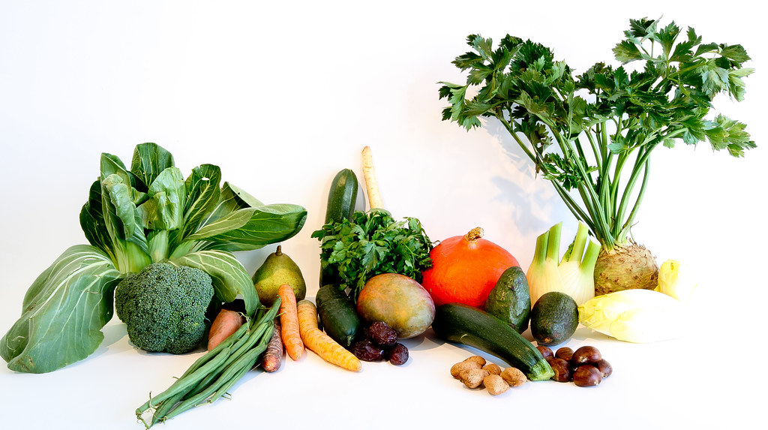
Skill Development: We do (oral)
Finish the sentence stem using the conjunction but by adding the extra information to show a change of direction.
Remember to use a full sentence answer.
CFU:
What conjunction is used in this sentence?
How could we finish this sentence?
I don’t like vegetables, but…
Notes:
A conjunction is a joining word that joins two sentences together.
After using a conjunction you need to give more information to finish the sentence.
‘But’ is a conjunction that usually tells the reader that something is opposite or different to what was mentioned.

Slide 11
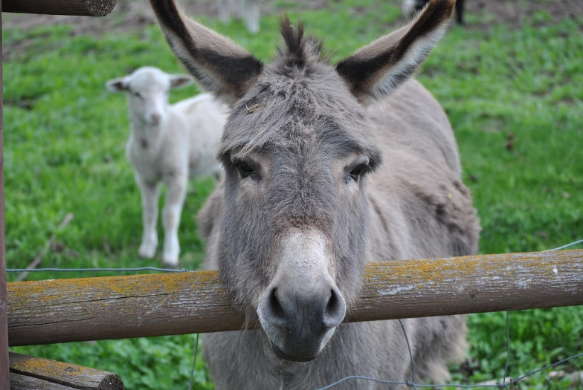
Skill Development: We do (oral)
Finish the sentence stem using the conjunction but.
Remember to use a full sentence answer.
CFU:
What conjunction is used in this sentence?
How could we finish this sentence?
I wanted a donkey for my birthday, but…
Notes:
A conjunction is a joining word that joins two sentences together.
After using a conjunction you need to give more information to finish the sentence.

Slide 12
Skill Development: You do (oral)
Finish the sentence stem using the conjunction but.
Remember to use a full sentence answer.
CFU:
Does that fit with the conjunction ‘but’? How do you know?
I said I would go to the party, but…
Notes:
A conjunction is a joining word that joins two sentences together.
‘But’ is an example of a conjunction.
After using a conjunction you need to give more information to finish the sentence.

Slide 13
Skill development: I do (Written)
Write the sentence stem
Finish the sentence- remember that but shows a change of direction.
CFU:
Does that fit with the conjunction ‘but’? How do you know?
The boy on the ride was terrified, but…

Slide 14
Skill development: We do (Written)
Write the sentence stem
Finish the sentence- remember that but shows a change of direction.
CFU:
Does that fit with the conjunction ‘but’? How do you know?
I felt sick, but…

Slide 15
Skill development: You do (Written)
Write the sentence stem
Finish the sentence- remember that but shows a change of direction.
CFU:
Does that fit with the conjunction ‘but’? How do you know?
I love jumping in puddles, but …

Slide 16
Skill development: You do (Written)
Write the sentence stem
Finish the sentence- remember that but shows a change of direction.
CFU:
Does that fit with the conjunction ‘but’? How do you know?
Insert sentences from class texts/topics/knowledge units

