Slide 1
Year: Foundation
Term: Term 3
Objective: Complete sentences when provided with but & because sentence stems (compound and complex sentences)
Author: Skye-Anne Cooke

Slide 2
Copy and paste these icons to the appropriate slides to indicate engagement norms/CFU strategies
Multiple Choice
Pair Share
Track with me
Pick a Stick/Answer (non-volunteer)
Whiteboards
Vote
Read with me
In Your Workbook

Slide 3
Learning Objective
We are learning to complete a sentence stem using the conjunctions ‘but’ and ‘because’.

Slide 4
but
Concept Development
CFU:
What is a conjunction?
What does the word but show?
Is a conjunction
Indicates a change of direction.
I am hungry, but there is no food in the fridge.
Notes:
Hint:
For young students, explain how the conjunction ‘but’ can indicate a problem. This isn’t always the case but it helps young children develop a basic understanding they can use straight away in their sentences.

Slide 5
because
Concept Development
CFU:
What is a conjunction?
What does the word because show?
is a conjunction
Tells us why something has happened
The dog ran away because the gate was left open.
Notes:
Give students sentence-stem activities with but, because, and so to enable them to think critically and to use and understand more complex sentences in their writing and reading

Slide 6
Concept Development
A conjunction is a joining word that joins two sentences together.
‘But’ is a conjunction that shows a change in direction.
CFU:
What is a conjunction?
What does the conjunction ‘but’ tell the reader?
Examples:
I like pizza but only with a thick crust.
The playground was beautiful but we did not get time to play on it.

Slide 7
Concept Development
A conjunction is a joining word that joins two sentences together.
‘Because’ is a conjunction that tells the reader why.
CFU:
What does the conjunction ‘because’ tell the reader?
Why was he wailing?
Why did they have to stay inside?
Examples:
He was wailing because he hurt his leg.
We had to stay inside today because the weather was horrible.

Slide 8
Concept Development
‘Because’ and ‘but’ are both examples of conjunctions.
CFU:
What does a conjunction do?
What are 2 examples of a conjunction?
What conjunction is being used to join this sentence together?
Examples:
I ran fast, but I couldn’t catch my dog.
I really needed a tissue because my nose was dripping with snot.

Slide 9
Concept Development
After using a conjunction you need to give more information to complete the sentence.
CFU:
Why is this not an example of using a conjunction to join two sentence together?
Non-Examples:
I am starving!
This sentence does not use a conjunction and only has one idea.
I said it because.
This sentence uses the word because but there is no more additional information.

Slide 10
Hinge Point Question
Vote
Which of these sentences uses ‘but’ or ‘because’ to join 2 sentences together?
CFU:
Why is it/ isn’t it an example of using because and but to join 2 sentences together.
Go through each option one-at-a-time and have students vote, and then explain their answer.
I am happy because I won the race.
My tummy felt awful because.
The red flower needed water, but it was still growing.
A conjunction is a joining word that joins two sentences together.
‘But’ and ‘because’ are conjunctions.
After using a conjunction you need to give more information to finish the sentence.

Slide 11
Concept Development: re-explanation
A conjunction is a joining word that joins 2 ideas together.
After using a conjunction you need to give more information or your sentence is not finished.
CFU:
What does the conjunction show in each sentence? Why or change of direction?
I was tired, but I had to keep running to win the race.
I was tired because I went to bed late last night.

Slide 12
Skill Development: I do
Write the sentence stem
Finish the sentence that fits the conjunction
CFU:
What conjunction is used in this sentence?
How could we finish this sentence?
The dog is miserable, but…
The dog is miserable because…

Slide 13
Skill Development: We do (written)
Write the sentence stem
Finish the sentence that fits the conjunction
CFU:
What conjunction is used in this sentence?
How could we finish this sentence?
I like soccer, but…
I like soccer because…

Slide 14
Skill Development: We do (written)
Write the sentence stem
Finish the sentence that fits the conjunction
CFU:
What conjunction is used in this sentence?
How could we finish this sentence?
The clouds are grey, but…
The clouds are grey because…

Slide 15
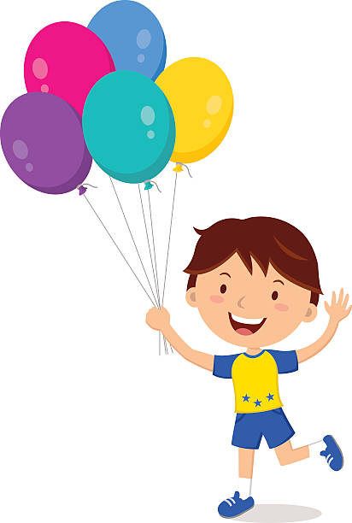
Skill Development: You do (written)
Write the sentence stem
Finish the sentence that fits the conjunction
CFU:
What conjunction is used in this sentence?
How could we finish this sentence?
He was happy, but…
He was happy because…

Slide 16
Skill Development: You do (written)
Write the sentence stem
Finish the sentence that fits the conjunction
CFU:
What conjunction is used in this sentence?
How could we finish this sentence?
Insert sentences from class texts/topics/knowledge units

