Slide 1
Year: 2
Term: 3
Objective: Identify and use subject and object pronouns within a sentence
Author: Stephanie Le Lievre

Slide 2
Multiple Choice
Pair Share
Track with me
Pick a Stick/Answer (non-volunteer)
Whiteboards
Vote
Read with me
In Your Workbook

Slide 3
Learning Objective
We are learning to identify and use subject and object pronouns within a sentence

Slide 4
Concept Development
A noun names a person, place, thing or idea
Subject are the doer of a sentence (the one who does the action)
Objects are the receiver of the action
CFU:
Identify the nouns in the sentence.
In each sentence:
Which is the subject?
Which is the object?
How do you know (link to the doer and the receiver).
Mary laughed at John.
Sam kicked the ball.
Henry picked up the paper.
Mel gave the dogs a pat.

Slide 5
Concept Development
A noun names a person, place, thing or idea
Pronouns replace nouns
Pronouns can replace a subject or an object noun
CFU:
Can you tell me one subject pronoun?
Object pronouns?
Pronouns (subject- the doer)
I
he
she
they
it
we
you
Pronouns (object- the receiver)
me
him
her
them
it
us
you
Mary laughed at John.
She laughed at him.

Slide 6
Concept Development
A noun names a person, place, thing or idea
Pronouns replace nouns
Pronouns can replace a subject or an object noun
CFU:
What is a pronoun?
What is the noun that the pronoun is replacing?
Examples:
He
Tim went to school today.
He went to school today.

Slide 7
Concept Development
A noun names a person, place, thing or idea
Pronouns replace nouns
Pronouns can replace a subject or an object noun
CFU:
What is a pronoun?
What is the noun that the pronoun is replacing?
Examples:
them
Sally hugged her friends.
Sally hugged them.

Slide 8
Concept Development
A noun names a person, place, thing or idea
Pronouns replace nouns
CFU:
What is a pronoun?
What is the noun that the pronoun is replacing?
Examples:
them
I gave the keys to the kids.
I gave the keys to them.

Slide 9
Hinge Point Question
What sentences contain pronouns?
CFU:
Why is it/ isn’t it a an example of a pronoun?
What type of pronoun- subject or object?
She went for a run.
Sanna likes eating chips.
Chase threw the ball to her.
Macy found a dog.

Slide 10
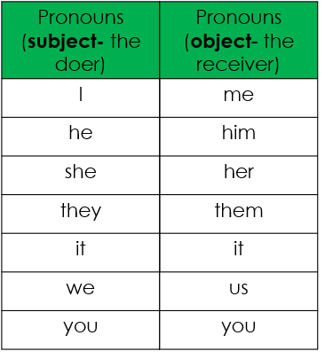
Skill development: I do
Select a pronoun to replace the underlined noun.
Write the sentence using the pronoun you have chosen.
CFU:
What does a pronoun take the place of?
Why did you choose that pronoun?
Mila loves to eat fish.
She loves to eat fish.

Slide 11
Skill development: We do
Select a pronoun to replace the underlined noun.
Write the sentence using the pronoun you have chosen.
CFU:
What does a pronoun take the place of?
Why did you choose that pronoun?
Jake and Lily walked to the shops.
They walked to the shops.

Slide 12
Skill development: We do
Select a pronoun to replace the underlined noun.
Write the sentence using the pronoun you have chosen.
CFU:
What does a pronoun take the place of?
Why did you choose that pronoun?
They invited my family to dinner.
They invited us to dinner.

Slide 13
Skill development: We do
Select a pronoun to replace the underlined noun.
Write the sentence using the pronoun you have chosen.
CFU:
What does a pronoun take the place of?
Why did you choose that pronoun?
Brent cooked dinner for________.
Brent cooked dinner for them/us/me…

Slide 14
Skill development: You do
Select a pronoun to replace the underlined noun.
Write the sentence using the pronoun you have chosen.
CFU:
What does a pronoun take the place of?
Why did you choose that pronoun?
Insert sentences based on topics/books/units.

