Slide 1
Year: 3
Term: 1
Objective: upgrade action and speaking verbs within a sentence.
Author: Wiehann Nel & Stephanie Le Lievre

Slide 2
Copy and paste these icons to the appropriate slides to indicate engagement norms/CFU strategies
Multiple Choice
Pair Share
Track with me
Pick a Stick/Answer (non-volunteer)
Whiteboards
Vote
Read with me
In Your Workbook

Slide 3
Learning Objective
We are learning to upgrade action and speaking verbs within a sentence.
This lesson is best taught in the context of a narrative unit. Adapt the slides to fit the model texts as needed.
Use specific upgraded verbs to teach as tier 2 vocabulary.

Slide 4
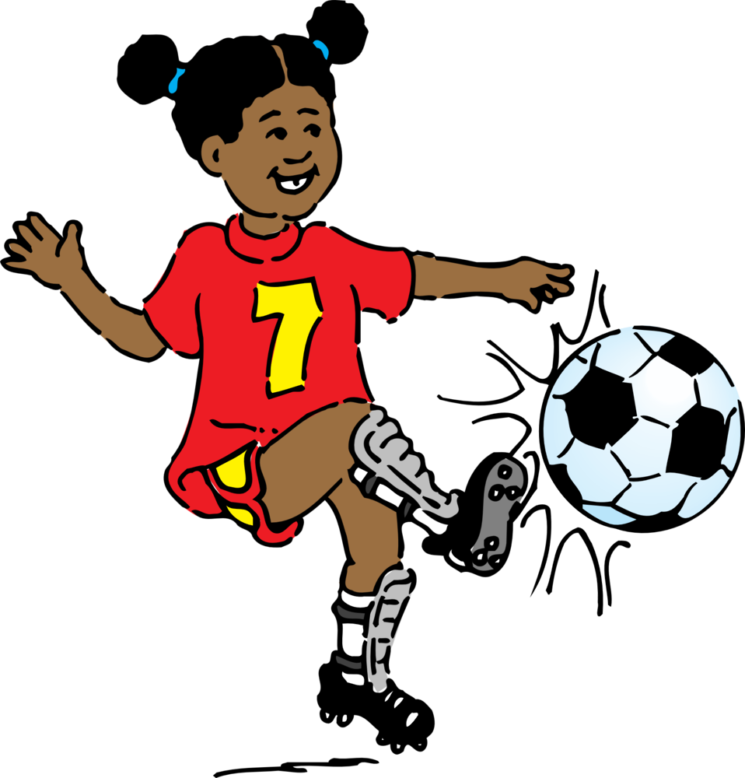
Concept Development
A verb is a word which describes an action, state, or occurrence.
It forms the main part of the predicate of a sentence
CFU:
What are the three main types of verbs?
A physical or mental action:
She walked.
They thought about the answers.
A state - form of being:
We are cold.
He was happy.
An occurrence -something happening:
The sun shone.
She became a teacher.

Slide 5
Concept Development
Action verb
An action verb is a verb that describes a physical or mental action, like run, jump, kick, eat, break, cry, smile, or think.
Speaking verb:
Speaking verbs are a type of action verb that relate to character speech.
CFU:
What is an action verb?
When we upgrade a verb- we are making it more specific!

Slide 6
Concept Development
Upgraded verb:
An upgraded verb adds more specificity to writing. Some verbs are more powerful than others. Upgrading verbs makes your writing more interesting and engaging to the reader.
CFU:
What’s an upgraded verb for went?
For saw?
For said?
went: ran, jogged, scurried, dashed, meandered,
saw: spied, observed, spotted, witnessed
said: yelled, whispered, bellowed, muttered

Slide 7
Concept Development
Upgraded verb:
An upgraded verb adds more specificity to writing. Some verbs are more powerful than others. Upgrading verbs makes your writing more interesting and engaging to the reader.
The teacher asked them to return to class.
Upgraded speaking verb
The teacher yelled at them to return to class.
The student ran across the field to reach the canteen before it closed.
Upgraded action verb
The student bolted across the field to reach the canteen before it closed.

Slide 8
Concept Development: I do, We do
Read the sentence.
Re-write the sentence with an upgraded verb to replace the verb + adverb. You can use a suggested one or choose your own.
CFU:
What effect do these different verbs have on our understanding of the subject (character)?
The girl went quickly out the door.
dashed
bolted
Action verb
scurried
shot
went

Slide 9
Concept Development: I do, We do
Read the sentence.
Re-write the sentence with an upgraded verb to replace the verb + adverb. You can use a suggested one or choose your own.
CFU:
What effect do these different verbs have on our understanding of the subject (character)?
The girl went slowly out the door.
meandered
drifted
Action verb
ambled
crept
went

Slide 10
Concept Development: We do
Read the sentence.
Re-write the sentence with an upgraded verb. You can use a suggested one or choose your own.
CFU:
What effect do these different verbs have on our understanding of the subject (character)?
He saw the keys from across the room.
glimpsed
spied
Action verb
noticed
located
saw

Slide 11
Concept Development: We do
Read the sentence.
Re-write the sentence with an upgraded verb. You can use a suggested one or choose your own.
CFU:
What effect do these different verbs have on our understanding of the subject (character)?
They looked around the room.
studied
examined
Action verb
inspected
surveyed
looked (around)

Slide 12
Concept Development: We do
Read the sentence.
Re-write the sentence with an upgraded verb to replace the adverb + verb. You can use a suggested one or choose your own.
CFU:
What effect do these different verbs have on our understanding of the subject (character)?
He quickly ate the chocolate cake.
devoured
inhaled
Action verb
scoffed
gobbled up
ate

Slide 13
Concept Development: We do
Read the sentence.
Re-write the sentence with an upgraded verb to replace the adverb + verb. You can use a suggested one or choose your own.
CFU:
What effect do these different verbs have on our understanding of the subject (character)?
He slowly ate the chocolate cake.
grazed
Action verb
pecked (at)
consumed
ate

Slide 14
Concept Development: We do
Read the sentence.
Re-write the sentence with an upgraded verb to replace the verb + adverb. You can use a suggested one or choose your own.
CFU:
What effect do these different verbs have on our understanding of the subject (character)?
“Who’s there?” asked Lucy loudly when she heard a knock at the door.
bellowed
yelled
Speaking verb
demanded
questioned
asked

Slide 15
Concept Development: We do
Read the sentence.
Re-write the sentence with an upgraded verb to replace the verb + adverb. You can use a suggested one or choose your own.
CFU:
What effect do these different verbs have on our understanding of the subject (character)?
“Who’s there?” asked Lucy softly when she heard a knock at the door.
squeaked
whimpered
Speaking verb
whispered
questioned
asked

Slide 16
Concept Development: We do
Read the sentence.
Re-write the sentence with an upgraded verb. You can use a suggested one or choose your own.
CFU:
What effect do these different verbs have on our understanding of the subject (character)?
“I want an ice-cream!” said the small child.
begged
demanded
Speaking verb
pleaded
snapped
said

Slide 17
Concept Development: We do
Read the sentence.
Re-write the sentence with an upgraded verb. You can use a suggested one or choose your own.
CFU:
What effect do these different verbs have on our understanding of the subject (character)?
He thought about his options.
ruminated (over)
deliberated (over)
Speaking verb
mulled (over)
considered
thought

Slide 18
Concept Development: We do
Read the sentence.
Re-write the sentence with an upgraded verb. You can use a suggested one or choose your own.
CFU:
What effect do these different verbs have on our understanding of the subject (character)?
Add in own words

Slide 19
Skill Development: I do, We do
Read the sentence.
Re-write the sentence with an upgraded verb. You can use a suggested one or choose your own.
The man sat (plopped/relaxed) on the couch after having a snack.
The boy ran (dashed/sprinted) across the finish line.
Anthony threw (hurled/lobbed) the football to his teammate.
She asked (quizzed/queried) the student about his recent behaviour.

